Slide 1

Keyboarding Programs
A Way to Get Better at Keyboarding and Writing for the 21st Century

Slide 2
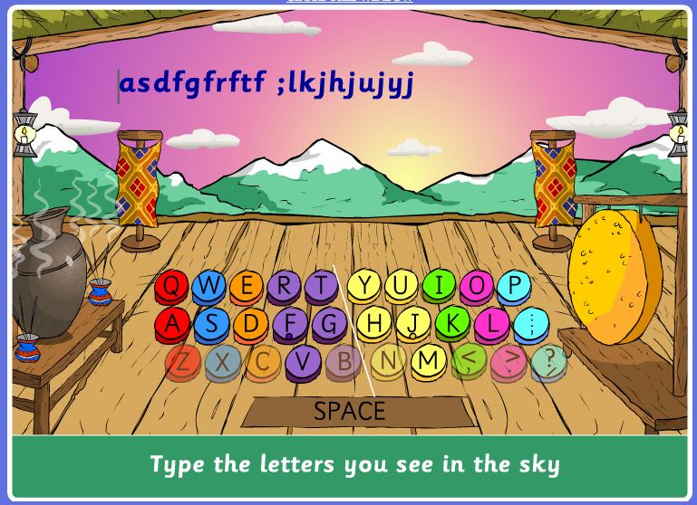
Dance Mat Typing
http://www.bbc.co.uk/schools/typing/
Sequential lessons
Animal guides
Reward Screens
10-minute lessons
20 small typing tasks.
About a dozen lessons in the sequence.

Slide 3
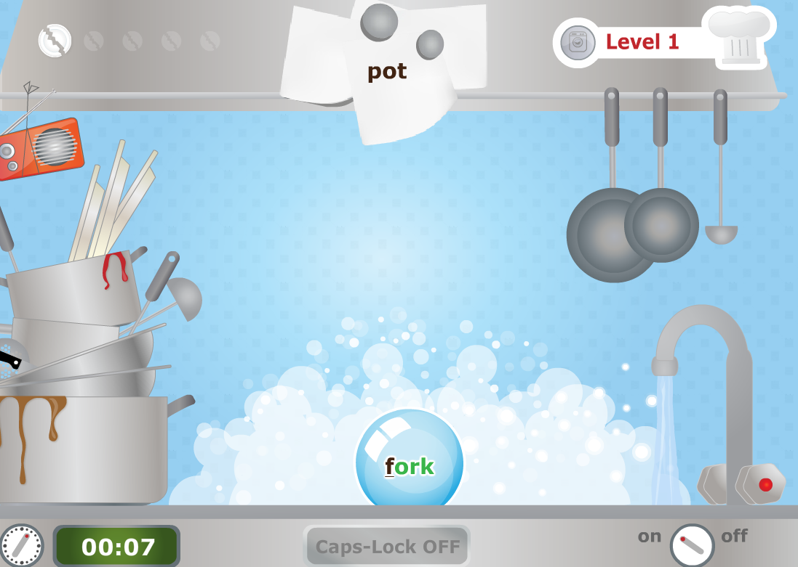
Typing Chef
http://www.sense-lang.org/typing/games/typingchef.php
Type the word in the bubble before it pops.
In later, more challenging screens other food falls into the pan.
Game works on speed of typing target words that get increasingly complex.

Slide 4
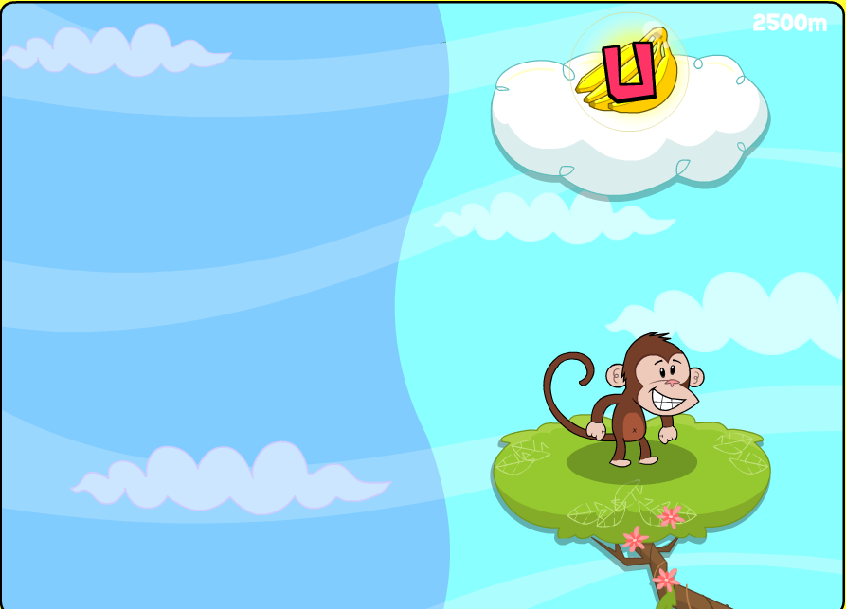
Keyboard Climber Game
http://www.tvokids.com/games/keyboardclimber
Help the monkey to climb ever higher by correctly typing the letter above him.
Clue to which hand to use based on left or right of screen.
Monkey falls to bottom of current level with each mistake.

Slide 5
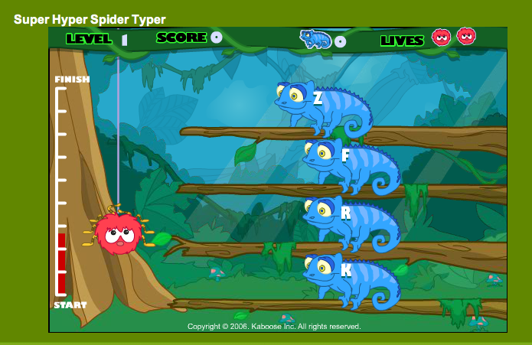
Super Hyper Spider Typer
http://funschool.kaboose.com/fun-blaster/games/game_super_hyper_spider_typer.html
Three levels of difficulty.
Each progressively difficult within level.
Type the letters or words on the chameleons’ backs to protect the spider.
Different colored chameleons have different numbers of lives.

Slide 6
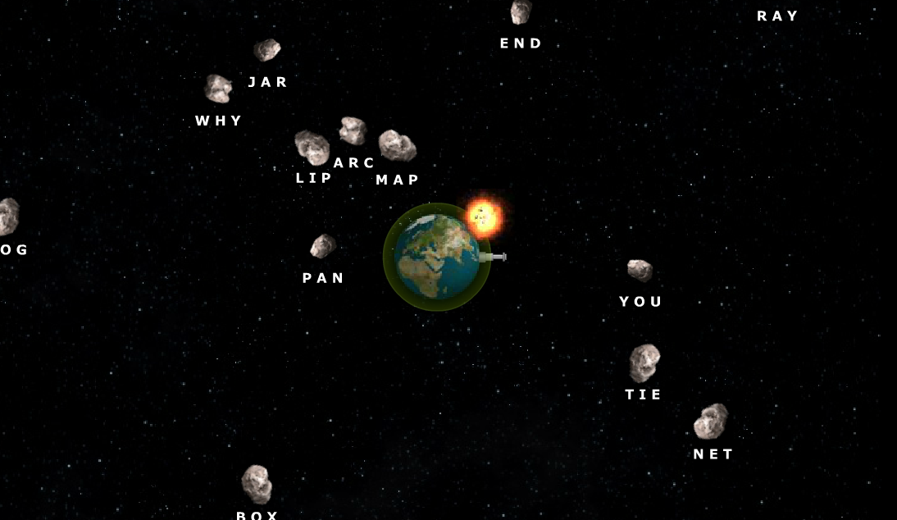
Typing Defense
http://games.wordgames.com/media/typing-defense.swf
Type the word associated with each asteroid before it collides with the earth.
Planetary defense ray destroys correctly spelled asteroids.
Additional key words are earned like “slow, ice, and strike” as you increase in levels.

