Slide 1
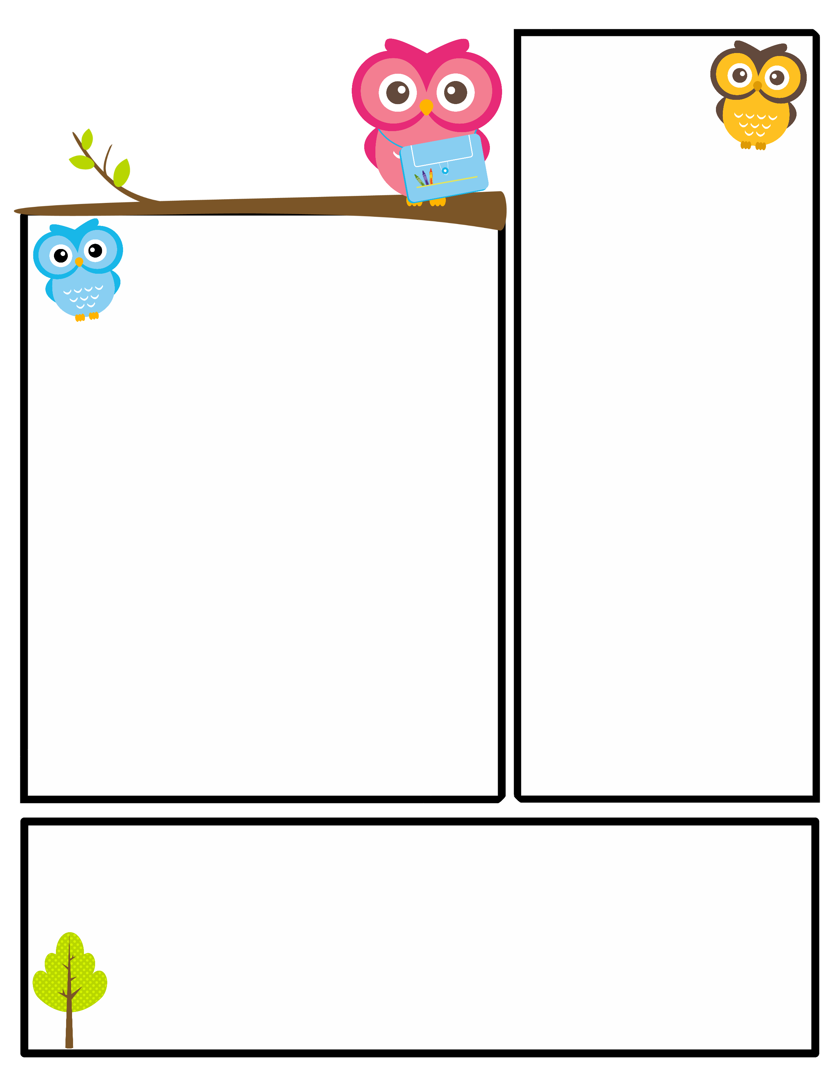
News from 3T
Upcoming Events
October
Author Visit! Rob Buyea
PTA sponsored
October 29th
Alvin Ailey Field Trip
PTA sponsored
October 30th 11:45-2:00: Bring a packed lunch!
Halloween Celebration
October 31st 2:30-3:25
All parents are invited! Please review the letter sent home from Mr. Bluestein regarding Halloween at Burr.
Election Day
November 5th
No school for students
Check the BURR BUZZ for more updates and information!
What We’re Learning!
In reading, we continued our study of comprehension strategies by making connections to our reading, such as connections to ourselves or to other text.
In writing, we are finalizing our true story that we have been working on by using our narrative checklist and our editing checklist to guide our work. We will be publishing next week and celebrating our amazing writing!
In math, we continued our work with computation and estimation. We have been working on rounding and estimating through word problems. We also started talking about overestimates and underestimates.
We are finishing our work on Native Americans by creating a Voice Thread presentation to accompany our artifacts. More information to come about our parent presentation!
We learned about a river basin system and its different parts. We were able to visit the Mill River and see an authentic river system along with numerous habitats. When we returned from our trip, we spent more time discussing habitats and adaptations. THANK YOU to all of the parents who volunteered to help guide us.
Thank you!
Thank you for helping to make Burr a community. Our first Pep Rally showed how much we appreciate all of you and how much school spirit we really have! Go Burr!
Thank you for taking the time to meet with me to discuss your child’s learning at our fall conferences. Open communication between home and school is important to your child’s success. As always, feel free to contact me if you have any questions or concerns throughout the year.

