Slide 1
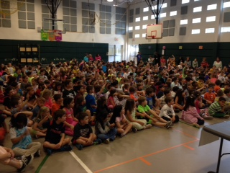
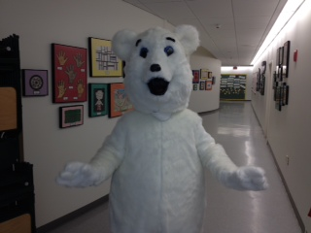
Welcome to Burr Elementary School!
Home of the Polar Bears!

Slide 2
Please welcome…
Sharon Jacobs
PTA President
http://www.burrpta.org

Slide 3
Ten Things To Know Before the School Year Begins
Infinite Campus (IC)
A lot of school communication is through IC.
You need an activation code to set up an account. You can get this through the main office.
On the Fairfield Public Schools website there is a link under Parent Resources for Infinite Campus.
Include e-mail and text as contact preferences.

Slide 4
School Hours
School hours are 8:55-3:30.
The doors open to students at 8:45.
Dismissal begins at 3:25.
After 8:55 is considered tardy.
Shortened days end at 1:40. Lunch is served on these days. Check the district calendar for shortened days. We typically send out reminders as well.
A-E schedule for specials (not Monday-Friday). See calendar.

Slide 5
Arrival
The building is open to students at 8:45.
Students can be driven to school or take the bus.
Parent drop off is in the front of the school.
Bus drop off is in the back of the school.
If dropping your children at school, please pull up to the drop off area and follow the directions of the staff members in charge.
If you are visiting Burr, please enter the building after 9:00.

Slide 6
Dismissal
Students can be picked up or take the bus home.
Pick ups occur in the cafeteria beginning at 3:25. Park your car in the back of the building and enter the cafeteria beginning at that time.
If you (or your designee) are picking up your child, please write a note to the classroom teacher. We discourage e-mails or call to teachers during the school day. If you have a last minute change of plans, call the main office.
If you (or your designee) will be picking up your child on a regular basis, please put that in a note to your child’s classroom teacher, and we can issue your child a permanent pick up pass.
There are adult staff members in the cafeteria checking notes and monitoring dismissal. If you need to enter the building for any reason at dismissal, the school secretary will be there issuing guest badges.
If you need to pick up your child early, please do so before 3:00.

Slide 7
Safety
Burr School is locked between 9:00 and 3:25.
There is an electronic buzzer system in the front of the building. Please buzz in before entering the building. Office secretaries will ask you why you are visiting Burr.
Once you enter the building, please report directly to the front office. You will need to sign in and will be issued a visitor badge.
There is an Oops Cart in the front of the building for any items that your child might have forgotten.
We practice lockdowns 3 times per year. They are announced, so you can talk to your child before each lockdown.
Despite all of these safety measures, we welcome your presence in our school, and there are different opportunities to volunteer.

Slide 8
Cafeteria / Food
Students have the option of buying lunch everyday or bringing a lunch.
Lunch is served on early dismissal days.
If your child is buying lunch, we recommend you set up an electronic account through food services.
The link is located on the Fairfield Public Schools website under Parent Resources.
https://www.mypaymentsplus.com/default.aspx

Slide 9
Aftercare Program / ATB
The Easton Community Center (ECC) runs Burr’s aftercare program. The aftercare program runs until 6:00.
The handbook and forms are located on the Burr PTA’s website. Please call the ECC with any questions / special requests.
http://www.burrpta.org/Child_Care_at_Burr.html
Burr’s After the Bell (ATB) program offers afterschool enrichment classes multiple times during the year. Look for flyers, notices, etc.

Slide 10
Bus Transportation
Will be accessed through IC.
Burr uses IC to communicate with parents when a bus is delayed or there is an issue.

Slide 11
Communication
Burr Basics – the 2014-2015 family handbook will be attached to the school website and sent through IC – most likely next week.
Burr Buzz – PTA
Burr Website http://fairfieldschools.org/schools/burr/ - Includes teacher pages.
Burr PTA Website
Infinite Campus – District, school and class portals
Monthly school newsletters
E-mail jbluestein@fairfieldschools.org

Slide 12
Important Upcoming Dates
Wednesday, August 27 – Kindergarten Warm Up
Thursday, August 28 – First Day of School
Thursday, August 28 – 9:15 – Tears and Cheers in Cafeteria
Monday, September 8 (Raindate September 15) – 4:00 - Ice Cream Social
Wednesday, September 17 – Picture Day
Wednesday, September 17 – Open House 7:00 PM

Slide 13
Questions???
And Now Let’s Take a Tour…

