Slide 1
KV Polar Bears

Slide 8
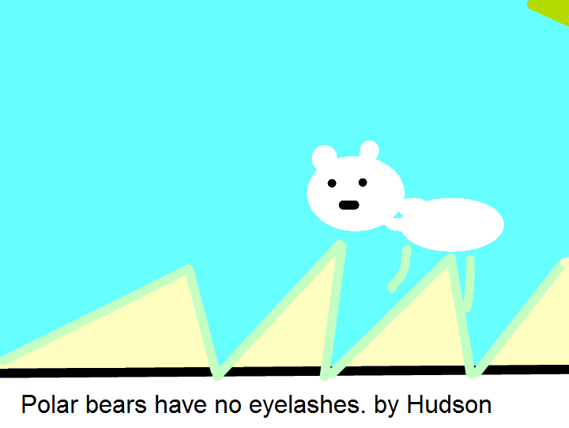

Slide 11
