Slide 1
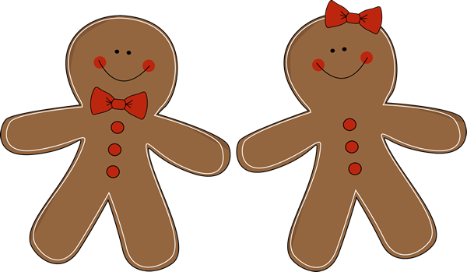
Kindergarten News
DECEMBER
klahiff@fairfieldschools.org
http://fairfieldschools.org/schools/dwt/welcome-to-kl-2/
Upcoming Events
Reminders
12/7 | FIELD TRIP to Cabaret Theater
12/26-1/2 | Holiday Vacation
Please pack your child’s lunch in a disposable bag for our field trip! We will be eating there.
a a a
December VIPs:
Eloise 12/5
Caitlin 12/12
Cece 12/19
a a a
Happy Birthday Charlotte!
October 31st | Halloween Party
October 27th | Conferences
Our Week of Learning
Reader’s Workshop: Story Elements
Writer’s Workshop: Re-reading our writing
Math: 2D Shapes
Letter of the week: Ee
Words of the week: of, and

