Slide 1
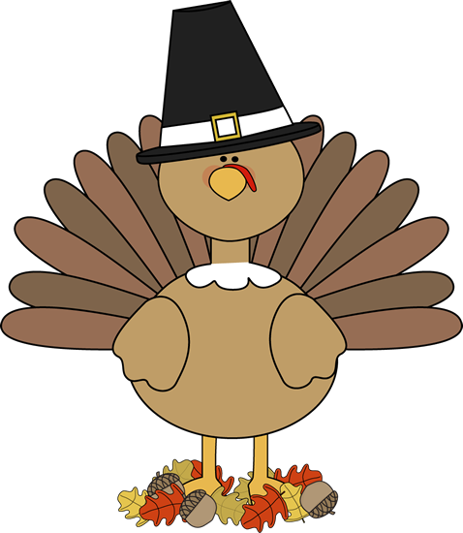
Kindergarten News
NOVEMBER
klahiff@fairfieldschools.org
http://fairfieldschools.org/schools/dwt/welcome-to-kl-2/
STEM Night | Wednesday, Nov. 16th
Thanksgiving Celebration | Wednesday, Nov. 23
Upcoming Events
Reminders
The Book Fair comes this month!
11/15 & 11/16
a a a
No School 11/8 & 11/11
a a a
Happy Birthday Nora!
October 31st | Halloween Party
October 27th | Conferences
Our Week of Learning
Reader’s Workshop: Book Handling
Writer’s Workshop: Writing stories with a beginning, middle and an end
Math: 2D and 3D shapes
Letters of the Month: Oo, Cc, Ee, Ff
Words of the Month: a, is, this, my, look, at

