Slide 2
Directional Terms

Slide 3
Body Planes and Sections

Slide 4
Body Movements

Slide 5
Directional Terms (Pics)

Slide 6
Body Planes and Sections (Pics)

Slide 7
Body Movements (Pics)

Slide 8
Directional Terms
Body Planes
Body Movements
Directional Terms
(Pics)
Body Planes
(Pics)
Body Movements
(Pics)
$100
$100
$100
$100
$100
$100
$200
$200
$200
$200
$200
$200
$300
$300
$300
$300
$300
$300
$400
$400
$400
$400
$400
$400
$500
$500
$500
$500
$500
$500

Slide 9
Toward the head or upper part of a structure or the body

Slide 10
What is superior?

Slide 11
Closer to the point of attachment of a limb to the body trunk

Slide 12
What is proximal?

Slide 13
Away from the midline of the body; on the outer side of

Slide 14
What is lateral?

Slide 15
Toward or at the body surface

Slide 16
What is superficial?

Slide 17
Toward or at the backside of the body; behind.

Slide 18
What is posterior?

Slide 19
A plane that divides the body or organ into superior and inferior parts.

Slide 20
What is the transverse plane?

Slide 21
A lengthwise plane that divides the body or organ into anterior and posterior parts.

Slide 22
What is the frontal plane?

Slide 23
A lengthwise plane that divides the body or organ into right and left parts.

Slide 24
What is the sagittal plane?

Slide 25
A plane right down the middle of a body or organ that divides it into equal left and right halves.

Slide 26
What is a midsagittal section?

Slide 27
A section dividing the body or structure into left and right parts that is off the mid-line.

Slide 28
What is a para-sagittal section?

Slide 29
A movement that decreases the angle at a joint.

Slide 30
What is flexion?

Slide 31
An increase in the angle at a joint or a return to anatomical position.

Slide 32
What is extension?

Slide 33
Pointing the toes up.

Slide 34
What is dorsiflexion?

Slide 35
Daily
Double!!

Slide 36
To move away from the midline in the frontal plane.

Slide 37
What is abduction?

Slide 38
To bend the neck or trunk to the left or right in the frontal plane.

Slide 39
What is lateral flexion?

Slide 40
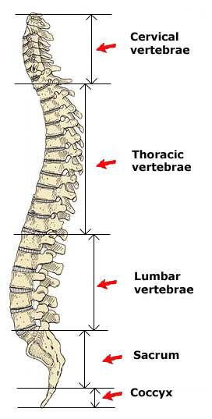
Position of thoracic vertebrae relative to cervical vertebrae.

Slide 41
What is inferior?

Slide 42
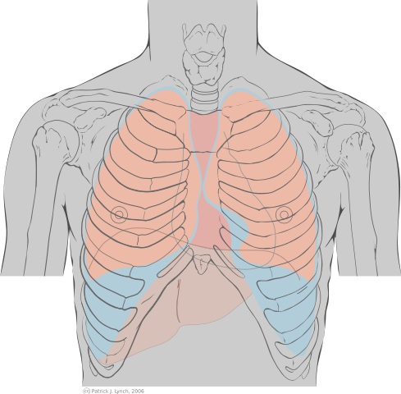
The sternum’s position relative to the heart.

Slide 43
What is anterior?

Slide 44
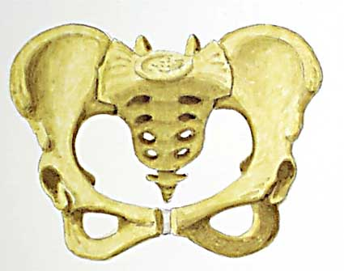
Position of the sacrum relative to the pelvic bones.

Slide 45
What is medial (or posterior)?

Slide 46
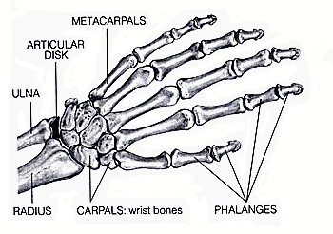
Position of the metacarpals relative to the carpals.

Slide 47
What is distal?

Slide 48
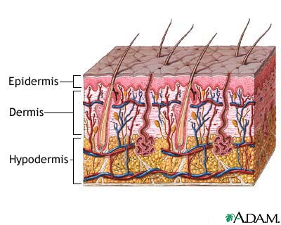
Position of the dermis relative to the epidermis.

Slide 49
What is deep?

Slide 50
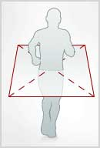
The plane shown here.

Slide 51
What is the transverse plane?

Slide 52
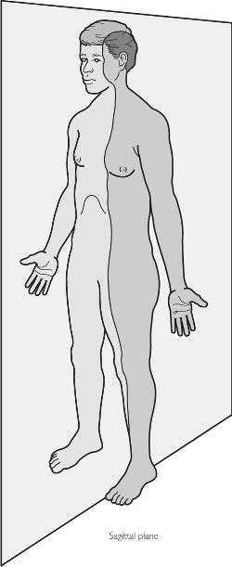
The plane shown here.

Slide 53
What is the sagittal plane?

Slide 54
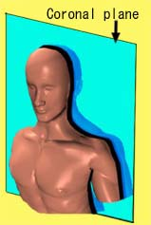
The plane shown here.

Slide 55
What is the frontal plane?

Slide 56
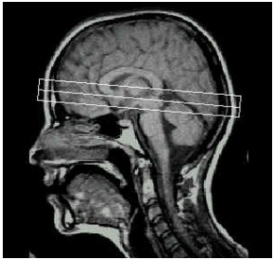
The plane of this MRI.

Slide 57
What is the sagittal plane?

Slide 58
Daily
Double!!

Slide 59
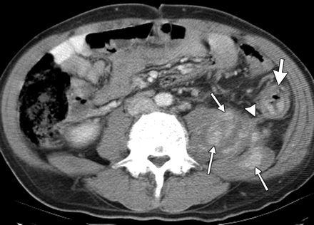
The plane of this CT scan.

Slide 60
What is the transverse or horizontal plane?

Slide 61
The movement shown here.

Slide 62
What is neck hyperextension?

Slide 63
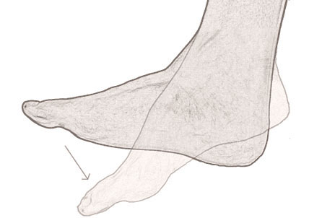
Movement shown here.

Slide 64
What is plantar flexion?

Slide 65
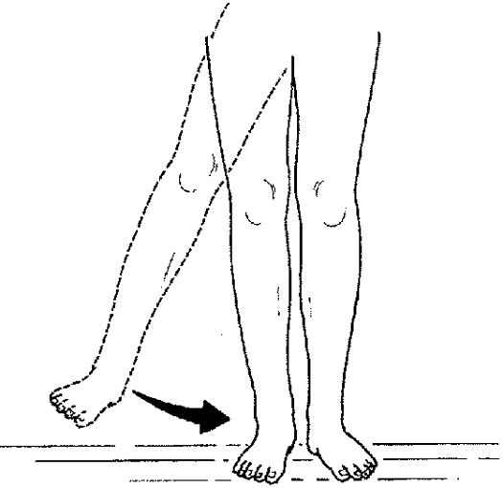
Movement shown here.

Slide 66
What is adduction?

Slide 67
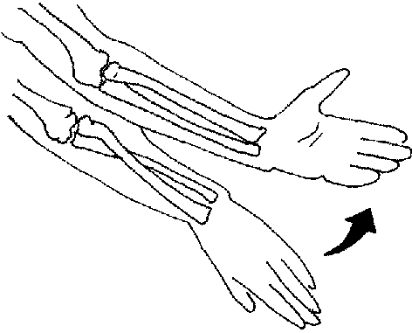
Movement shown here.

Slide 68
What is supination?

Slide 69
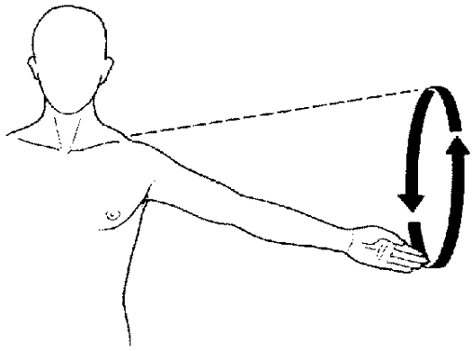
Movement shown here.

Slide 70
What is circumduction?

Slide 71
Double
Jeopardy!!

Slide 73
Type Subject One Here

Slide 74
Type Subject Two Here

Slide 75
Type Subject Three Here

Slide 76
Type Subject Four Here

Slide 77
Type Subject Five Here

Slide 78
Type Subject Six Here

Slide 79
Type
Subject #1
Here
Type
Subject #2
Here
Type
Subject #3
Here
Type
Subject #4
Here
Type
Subject #5
Here
Type
Subject #6
Here
$200
$200
$200
$200
$200
$200
$400
$400
$400
$400
$400
$400
$600
$600
$600
$600
$600
$600
$800
$800
$800
$800
$800
$800
$1000
$1000
$1000
$1000
$1000
$1000

Slide 80
Type Subject 1 $200 Answer Here

Slide 81
Type Subject 1 $200 Question Here

Slide 82
Type Subject 1 $400 Answer Here

Slide 83
Type Subject 1 $400 Question Here

Slide 84
Type Subject 1 $600 Answer Here

Slide 85
Type Subject 1 $600 Question Here

Slide 86
Type Subject 1 $800 Answer Here

Slide 87
Type Subject 1 $800 Question Here

Slide 88
Type Subject 1 $1000 Answer Here

Slide 89
Type Subject 1 $1000 Question Here

Slide 90
Type Subject 2 $200 Answer Here

Slide 91
Type Subject 2 $200 Question Here

Slide 92
Type Subject 2 $400 Answer Here

Slide 93
Type Subject 2 $400 Question Here

Slide 94
Type Subject 2 $600 Answer Here

Slide 95
Type Subject 2 $600 Question Here

Slide 96
Type Subject 2 $800 Answer Here

Slide 97
Type Subject 2 $800 Question Here

Slide 98
Type Subject 2 $1000 Answer Here

Slide 99
Type Subject 2 $1000 Question Here

Slide 100
Type Subject 3 $200 Answer Here

Slide 101
Type Subject 3 $200 Question Here

Slide 102
Type Subject 3 $400 Answer Here

Slide 103
Type Subject 3 $400 Question Here

Slide 104
Type Subject 3 $600 Answer Here

Slide 105
Type Subject 3 $600 Question Here

Slide 106
Type Subject 3 $800 Answer Here

Slide 107
Type Subject 3 $800 Question Here

Slide 108
Type Subject 3 $1000 Answer Here

Slide 109
Type Subject 3 $1000 Question Here

Slide 110
Type Subject 4 $200 Answer Here

Slide 111
Type Subject 4 $200 Question Here

Slide 112
Type Subject 4 $400 Answer Here

Slide 113
Type Subject 4 $400 Question Here

Slide 114
Type Subject 4 $600 Answer Here

Slide 115
Type Subject 4 $600 Question Here

Slide 116
Type Subject 4 $800 Answer Here

Slide 117
Type Subject 4 $800 Question Here

Slide 118
Type Subject 4 $1000 Answer Here

Slide 119
Type Subject 4 $1000 Question Here

Slide 120
Type Subject 5 $200 Answer Here

Slide 121
Type Subject 5 $200 Question Here

Slide 122
Daily
Double!!

Slide 123
Type Subject 5 $400 Answer Here

Slide 124
Type Subject 5 $400 Question Here

Slide 125
Type Subject 5 $600 Answer Here

Slide 126
Type Subject 5 $600 Question Here

Slide 127
Type Subject 5 $800 Answer Here

Slide 128
Type Subject 5 $800 Question Here

Slide 129
Daily
Double!!

Slide 130
Type Subject 5 $1000 Answer Here

Slide 131
Type Subject 5 $1000 Question Here

Slide 132
Type Subject 6 $200 Answer Here

Slide 133
Type Subject 6 $200 Question Here

Slide 134
Type Subject 6 $400 Answer Here

Slide 135
Type Subject 6 $400 Question Here

Slide 136
Type Subject 6 $600 Answer Here

Slide 137
Type Subject 6 $600 Question Here

Slide 138
Type Subject 6 $800 Answer Here

Slide 139
Type Subject 6 $800 Question Here

Slide 140
Type Subject 6 $1000 Answer Here

Slide 141
Type Subject 6 $1000 Question Here

Slide 142
Final
Jeopardy
Write the Final Question Here

Slide 143
Write
the Final
Answer
Here

