Slide 1
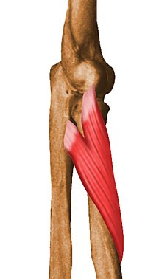
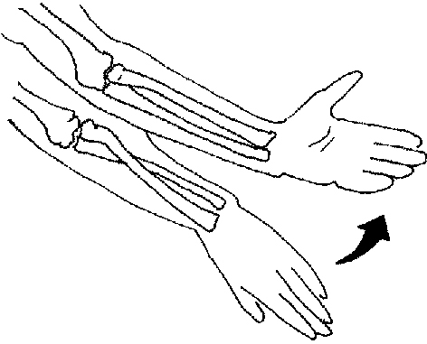
Name:
Supinator
Muscle
Lateral R Arm
Action:
Supination

Slide 2
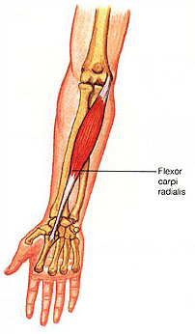
Name:
Wrist Flexor (flexor carpi radialis)
Anterior R Arm
Muscle
Action:
Wrist flexion

Slide 3
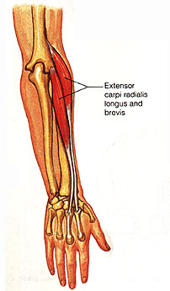
Name:
Wrist Extensor (extensor carpi radialis longus)
Muscle
Posterior R Arm
Action:
Wrist extension

Slide 4
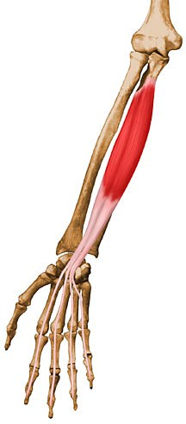
Name:
Finger Flexor (flexor digitorum profundus)
Muscle
Anterior R Arm
Action:
Finger flexion

Slide 5
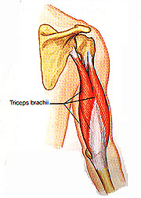
Name:
Triceps
Posterior R Arm
Muscle
Action:
Elbow extension

Slide 6
Name:
Finger Extensor (extensor digitorum)
Muscle
Posterior R Arm
Action:
Finger extension

Slide 7
Name:
Wrist Extensor (extensor carpi ulnaris)
Muscle
Posterior R Arm
Action:
Wrist extension

Slide 8
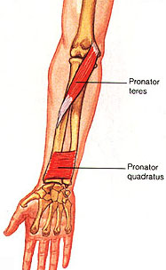
Name:
Pronator teres
Muscle
Anterior R Arm
Action:
Pronation

Slide 9
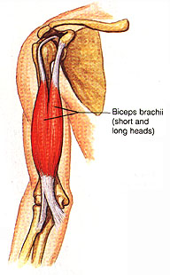
Name:
Biceps
Anterior R Arm
Muscle
Action:
Elbow flexion

Slide 10
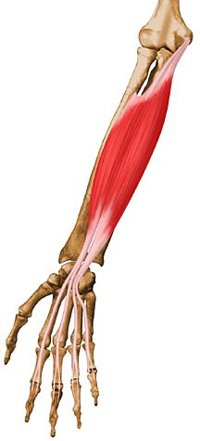
Name:
Finger Flexor (flexor digitorum superficialis)
Muscle
Anterior R Arm
Action:
Finger flexion

