Slide 1
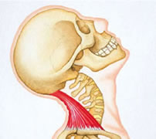
Neck
Hyperextension

Slide 2
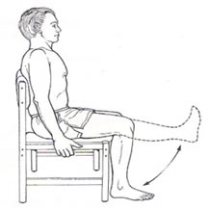
Knee
Extension

Slide 3
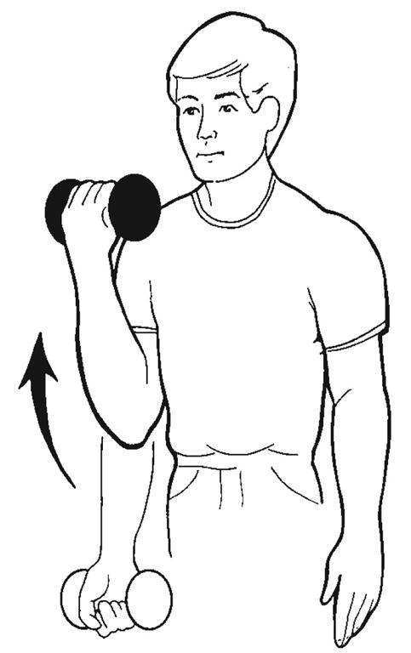
Elbow
Flexion

Slide 4
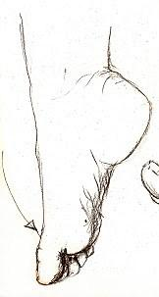
Plantarflexion

Slide 5
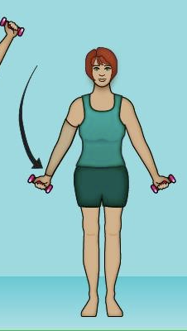
Shoulder
Adduction

Slide 6
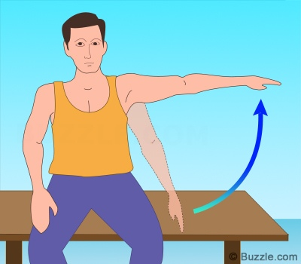
Shoulder
Abduction

Slide 7
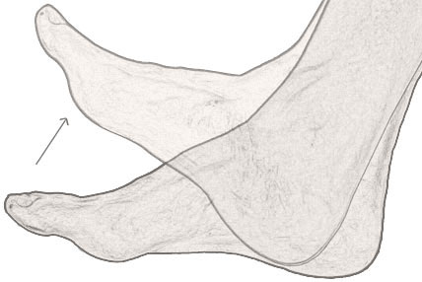
Dorsiflexion

Slide 8
Ankle Eversion

Slide 9
Shoulder
Depression

Slide 10
Shoulder
Elevation

Slide 11
Radial Deviation

Slide 12
Ankle Inversion

Slide 13
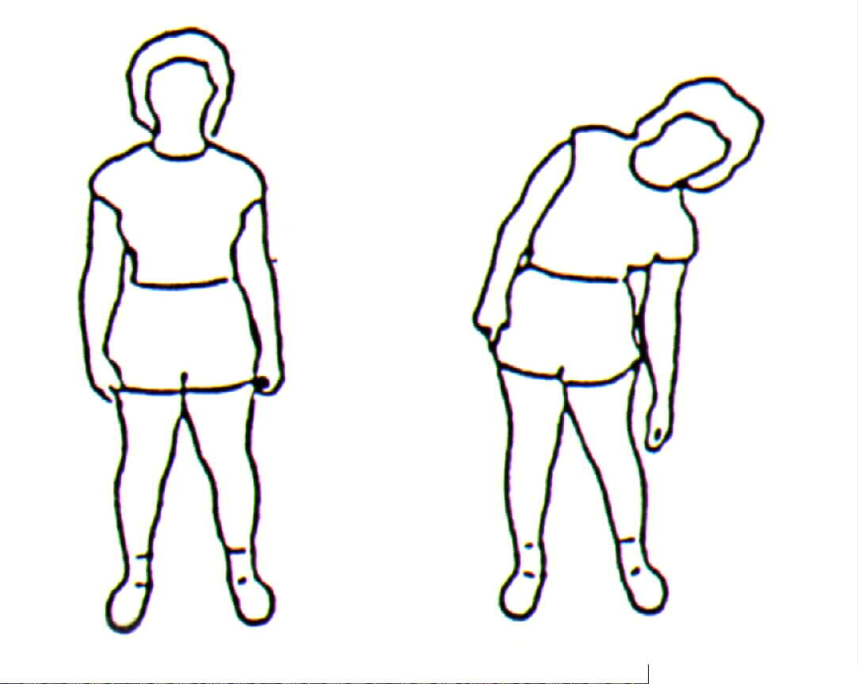
Lateral trunk flexion

Slide 14
Ulnar Deviaton

Slide 15
Hip
Medial Rotation

Slide 16
Supination

Slide 17
Hip
Lateral Rotation

Slide 18
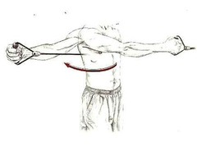
Shoulder
Horizontal Abduction

Slide 19
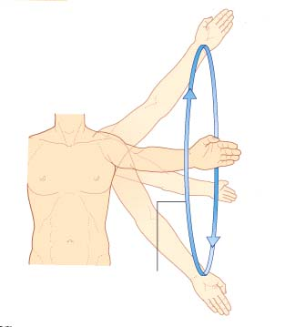
Circumduction

Slide 20
Pronation

Slide 21
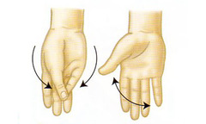
Opposition
Reposition

Slide 22
Jaw protrusion

Slide 23
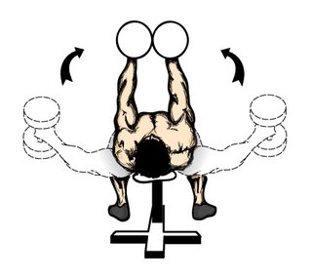
Shoulder
Horizontal Adduction

Slide 24
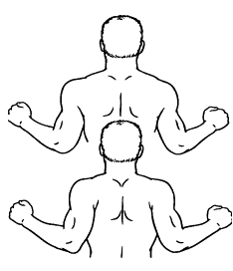
Shoulder retraction

