Slide 1
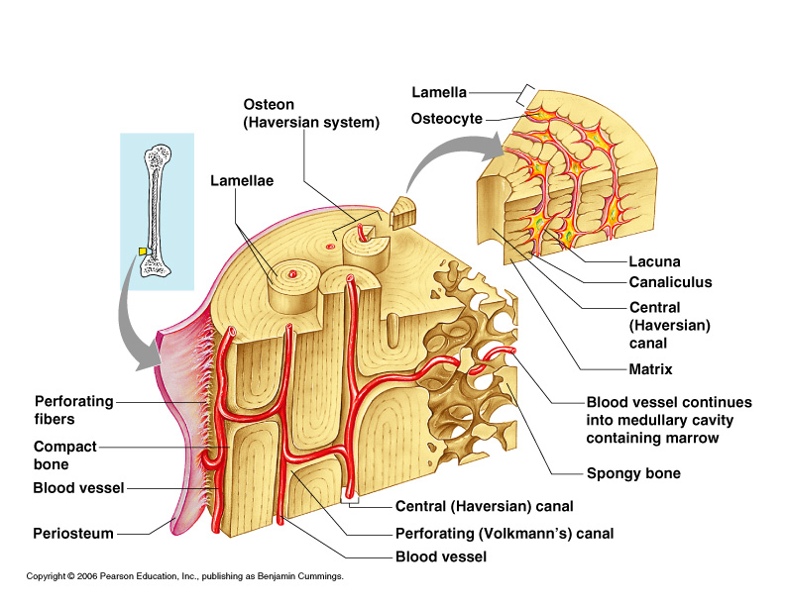

Slide 2
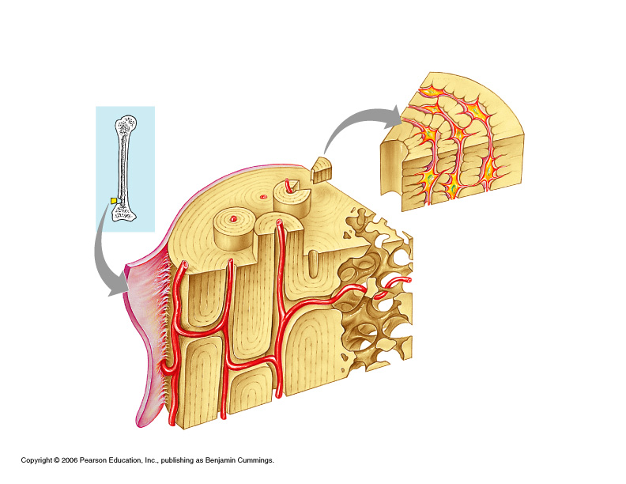
Name:
Period:
Dr. Kelly
D
C
B
E
A
F
G

Slide 3
Bone matrix
(Calcium Phosphate)
Osteon
Compact bone
Osteocytes
(Encased osteoblasts)
Periosteum
Spongy bone
Blood vessels

Slide 4
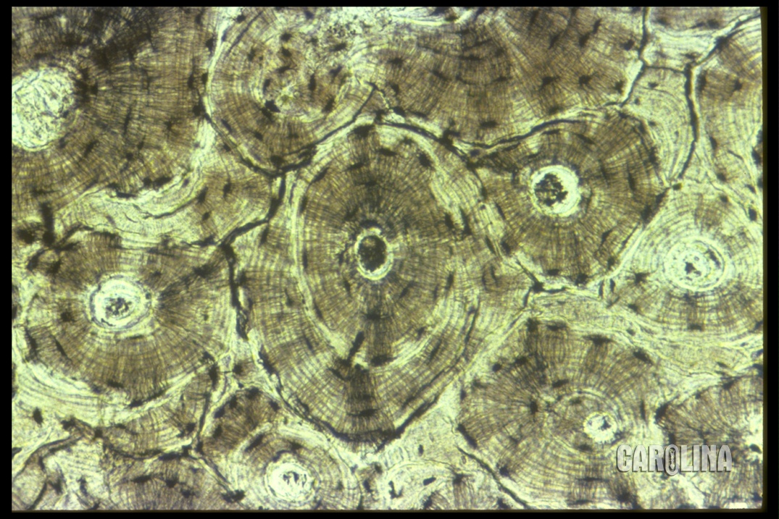

Slide 5
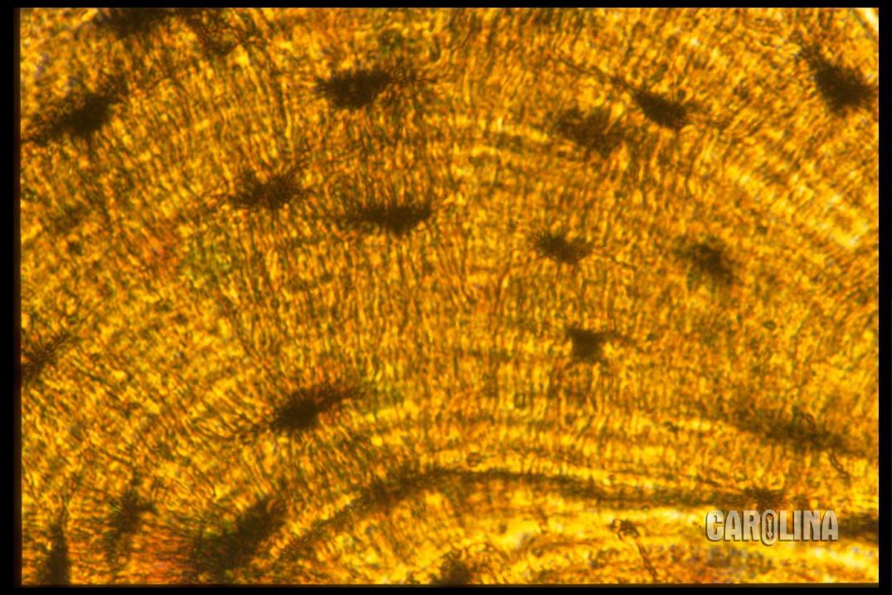

Slide 6
Compact Bone
Compact bone consists of repeating units called osteons. Each osteon has concentric layers of the mineralized matrix deposited around a central canal. The canal contains blood vessels and nerves that serve the bone cells. Bone-forming cells, called osteoblasts, deposit the matrix around the central canal and ultimately surround themselves with the mineralized material, forming a pocket called a lacuna. Once osteoblasts are surrounded by matrix, the cells are called osteocytes. Narrow connections called canaliculi extend from lacunae and connect osteocytes to each other and to the central canal.

Slide 7
Compact Bone
cc
Compact bone is made up of concentric layers of bone matrix surrounding central canals (CC). A canal and its associated layers make up an osteon. Osteocytes are located within cavities called lacunae.

Slide 8
Osteocytes
oc
Osteocytes (OC) are connected by cellular extensions called canaliculi. These extensions allow nutrients to pass from cell to cell.

