Slide 1
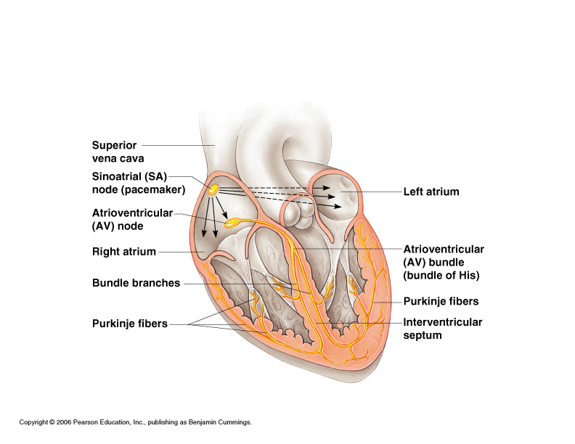
The Heart’s Conduction System

Slide 2
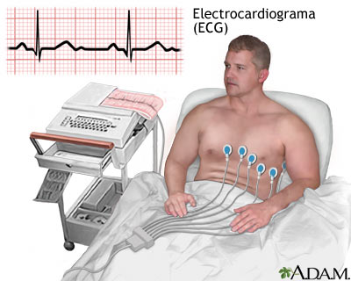
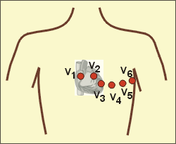
ECG Lead Placement

Slide 4
Heart Sounds
“Lub”
“Dub”
Closing of the AV valves
Closing of aortic and pulmonic valves
Systole
Early Diastole
Mid to Late Diastole

Slide 6
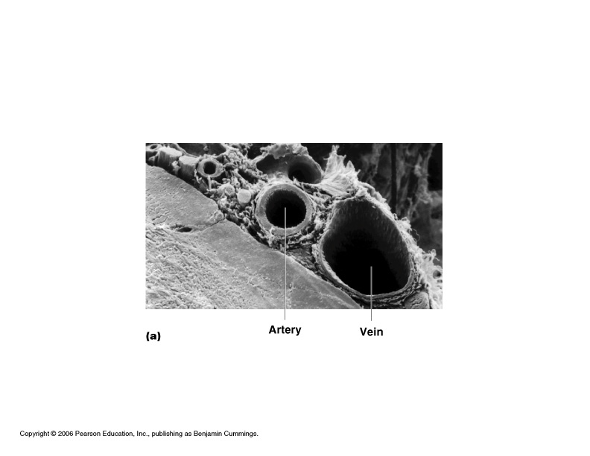

Slide 7
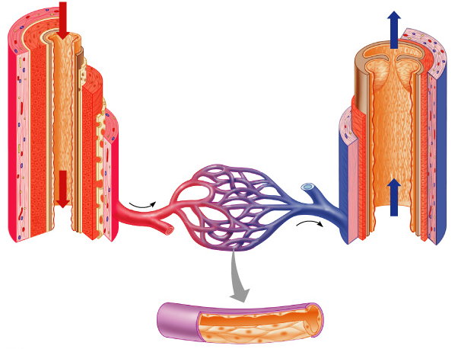
Blood Vessel Anatomy
Artery
Vein
Narrow diameter
Internal elastic layer
Wider diameter
Thick smooth muscle layer
One-way valves
External elastic layer
(No elastic layers)
Capillaries
Thinner smooth muscle layer
Smallest blood vessels
Only one cell layer thick

Slide 8
“Muscular Pump”
Helps low pressure
blood in veins return
to the heart.
Especially in the legs.

