Slide 1
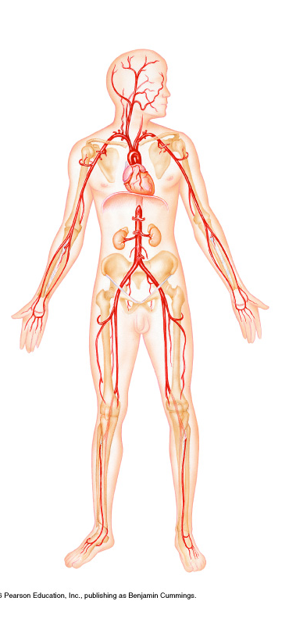
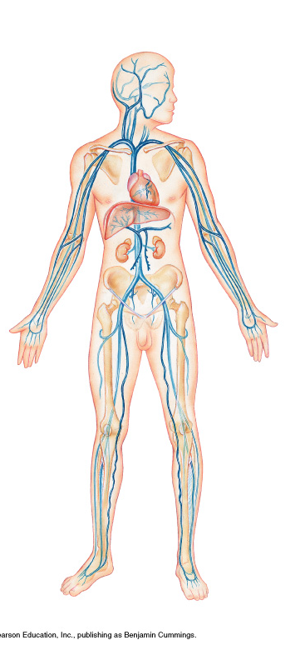
Blood Vessels
Veins
Arteries

Slide 2
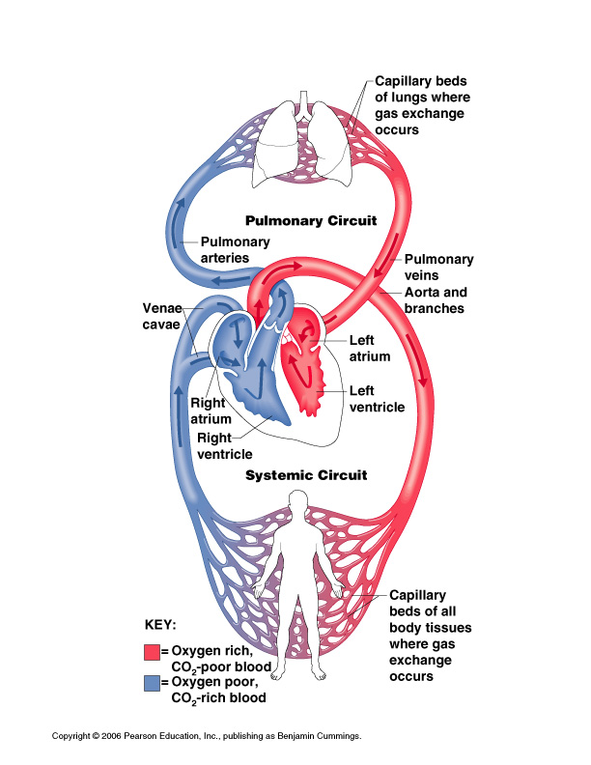
8
1
7
9
12
10
5
3
6
4
2
11

Slide 3
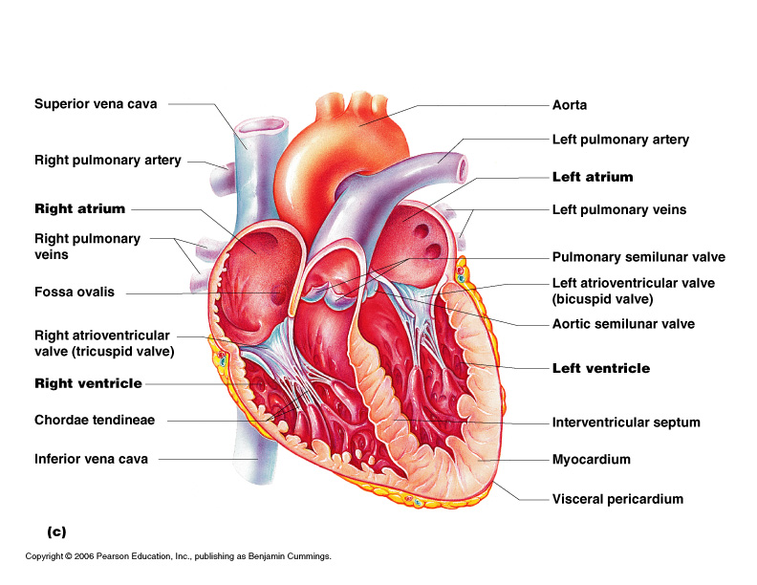
1
9
10
2
11
3
12
4
13
Pulmonary valve
14
Aortic valve
5
15
16
6
7
17
8
18
Cardiac muscle

Slide 4
Pulmonary valve
Aortic valve
Cardiac muscle

Slide 5
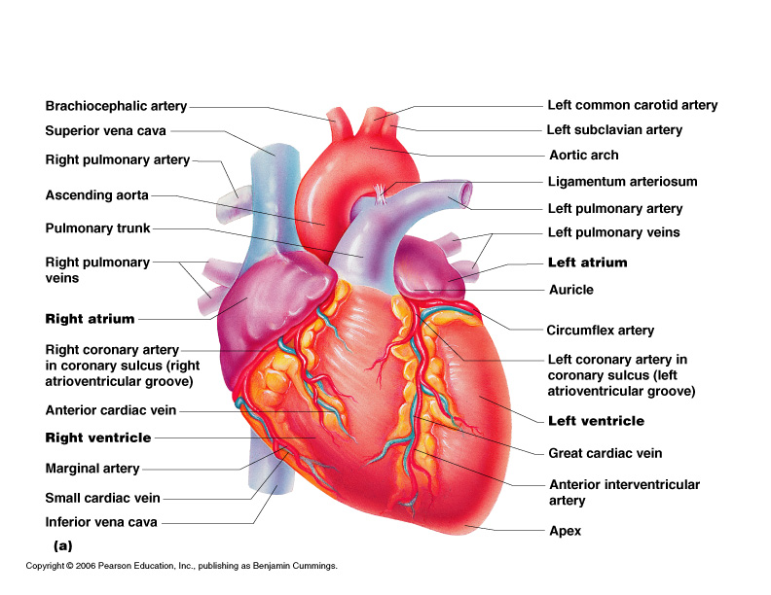
1
2
10
3
11
Pulmonary artery
4
12
5
13
6
7
14
15
8
9

Slide 6
Pulmonary artery

