Slide 1
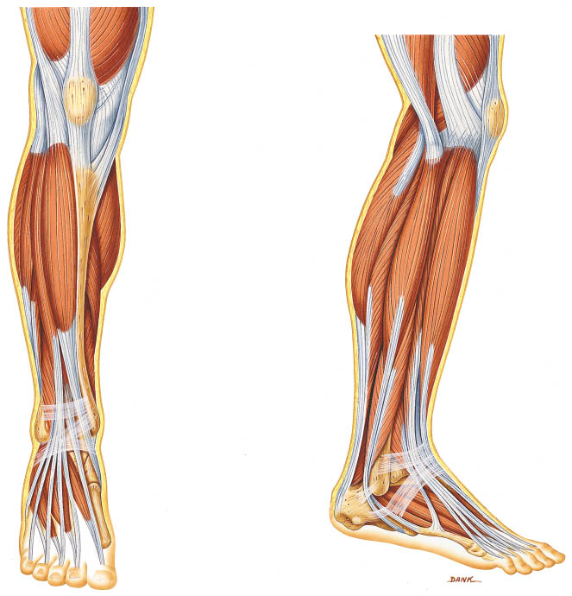

Slide 2
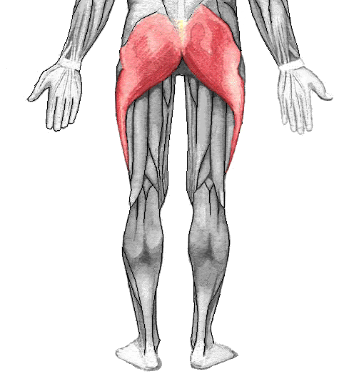
Name:
Gluteus maximus
Muscle
Action:
Hip extension

Slide 3
Name:
Soleus
Posterior R Leg
Muscle
Action:
Plantarflexion

Slide 4
Name:
Rectus femoris
Muscle
Anterior R Leg
Action:
Knee extension

Slide 5
Name:
Vastus lateralis
Muscle
Anterior R Leg
Action:
Knee extension

Slide 6
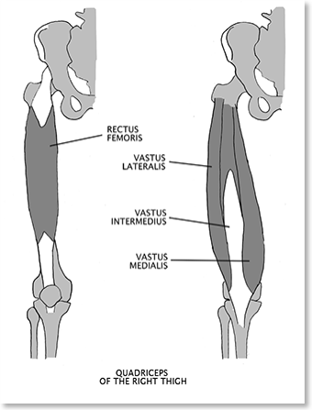
Name:
Vastus intermedius
Muscle
Anterior R Leg
Action:
Knee extension

Slide 7
Name:
Biceps femoris
Posterior R Leg
Muscle
Action:
Knee flexion

Slide 8
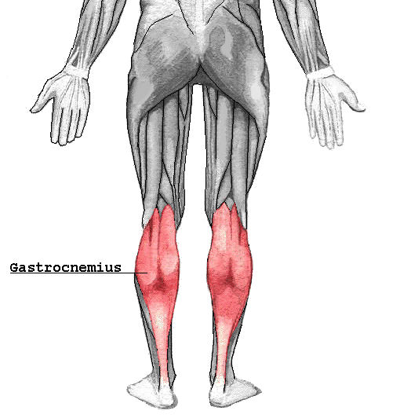
Name:
Gastrocnemius
Anterior R Arm
Muscle
Action:
Plantarflexion

Slide 9
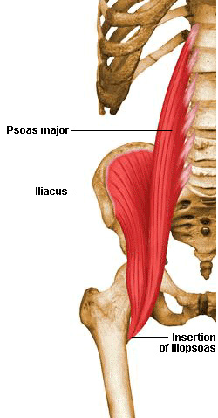
Name:
Iliopsoas
Anterior R Leg
Muscle
Action:
Hip flexion

Slide 10
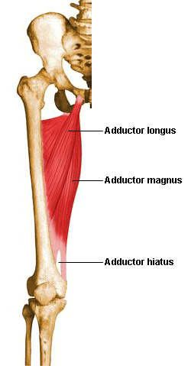
Name:
Hip adductors
Anterior R Leg
Muscles
Action:
Hip adduction

Slide 11
Name:
Semimembranosus
Posterior R Leg
Muscle
Action:
Knee flexion

Slide 12
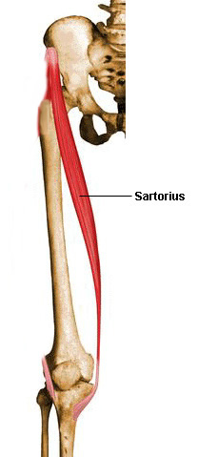
Name:
Sartorius
Muscle
Anterior R Leg
Action:
Weak hip flexor and lateral rotator

Slide 13
Name:
Vastus medialis
Anterior R Leg
Muscle
Action:
Knee extension

Slide 14
Name:
Tibialis anterior
Anterior R Leg
Muscle
Action:
Dorsiflexion

Slide 15
Name:
Semitendinosus
Posterior R Leg
Muscle
Action:
Knee Flexion

