Slide 2
Muscles

Slide 3
Gross Anatomy

Slide 4
Microscopic Anatomy

Slide 5
Muscle Pics

Slide 6
Energy

Slide 7
Exercise

Slide 8
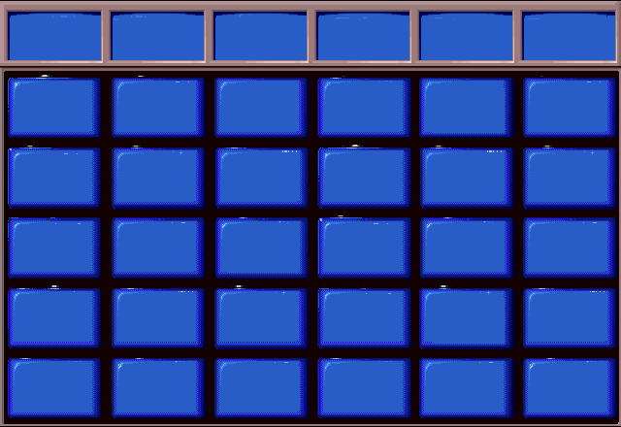
Muscles
Gross Anatomy
Microscopic Anatomy
Muscle Pics
Energy
Exercise
$100
$100
$100
$100
$100
$100
$200
$200
$200
$200
$200
$200
$300
$300
$300
$300
$300
$300
$400
$400
$400
$400
$400
$400
$500
$500
$500
$500
$500
$500

Slide 9
This muscle does elbow flexion.

Slide 10
What is the bicep?

Slide 11
This muscle does trunk flexion.

Slide 12
What is the rectus abdominis?

Slide 13
Weak hip flexor and lateral rotator.

Slide 14
What is the sartorius muscle?

Slide 15
Neck flexion (together); Neck rotation (alone).

Slide 16
What are the sternocleidomastoid muscles?

Slide 17
Name the quadriceps muscles and their action.

Slide 18
What are rectus femoris, vastus lateralis, vastus medialis, vastus intermedius? What is knee extension?

Slide 19
Structures that bring nutrients like glucose and oxygen to muscles and carry waste products like carbon dioxide and lactic acid away.

Slide 20
What are blood vessels?

Slide 21
Connective tissue structure that attaches a muscle to the bone.

Slide 22
What is a tendon?

Slide 23
Another name given to a single muscle cell.

Slide 24
What is a muscle fiber?

Slide 25
A bundle of muscle fibers wrapped together.

Slide 26
What is a fascicle?

Slide 27
The approximate number of skeletal muscles in the human body.

Slide 28
What is 600-850?

Slide 29
Contractile protein that makes the thick filaments.

Slide 30
What is myosin protein?

Slide 31
Contractile protein that makes the thin filaments.

Slide 32
What is actin protein?

Slide 33
Name given to one contractile unit (the proteins between two z-lines).

Slide 34
What is a sarcomere?

Slide 35
Daily
Double!!

Slide 36
Muscles get bigger and stronger by A. Making more muscle cells. B. Adding more protein to existing cells.

Slide 37
What is B? Adding more protein to existing muscle cells.

Slide 38
Bundles of thick and thin contractile protein filaments form these structures within a muscle cell.

Slide 39
What are myofibrils?

Slide 40
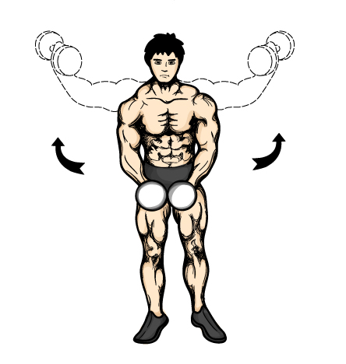
Muscle that does this.

Slide 41
What is the deltoid?

Slide 42
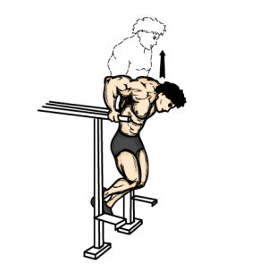
Muscle that enables you to do this.

Slide 43
What are your triceps?

Slide 44
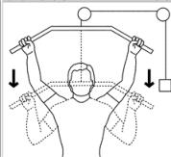
Muscle that does this.

Slide 45
What is latissimus dorsi?

Slide 46
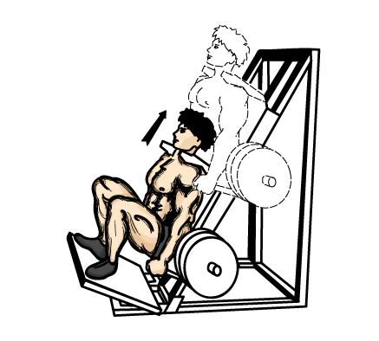
Muscle group that does this.

Slide 47
What are your quadriceps?

Slide 48
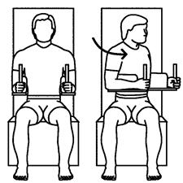
Muscles that rotate the upper body like this.

Slide 49
What are the internal and external obliques?

Slide 50
Energy pathway that requires oxygen.

Slide 51
What is aerobic energy pathway?

Slide 52
Energy pathway that does not require oxygen.

Slide 53
What is anaerobic energy pathway?

Slide 54
Cell organelle where aerobic energy production takes place.

Slide 55
What is the mitochondria?

Slide 56
Acidic byproduct of anaerobic energy production.

Slide 57
What is lactic acid?

Slide 58
Daily
Double!!

Slide 59
Number of ATP generated per glucose using aerobic pathway vs. number of ATP generated per glucose using anaerobic pathway.

Slide 60
What is 36 ATP vs. 2 ATP?

Slide 61
Thick filaments use this energetic molecule to pull thin filaments together and cause contraction.

Slide 62
What is ATP?

Slide 63
Aerobic exercise leads to an increase in these structures responsible for delivering oxygen and nutrients to working muscles.

Slide 64
What are blood vessels?

Slide 65
This organ increases in size and strength to better deliver oxygen-rich blood to working muscles.

Slide 66
What is the heart?

Slide 67
Anaerobic exercise leads to an increase in these within a muscle cell, which causes your muscle cells to increase in size and strength.

Slide 68
What are contractile proteins or contractile filaments or myofibrils?

Slide 69
Protein in muscle cells that binds oxygen. Its concentration increases in response to aerobic exercise.

Slide 70
What is myoglobin?

