Slide 1
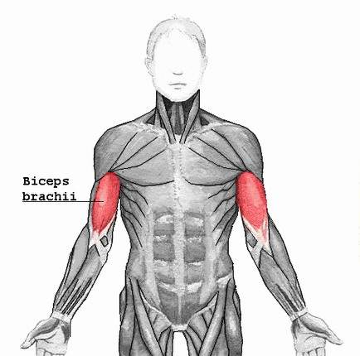
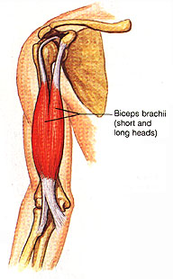

Slide 2
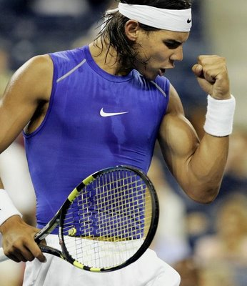

Slide 3
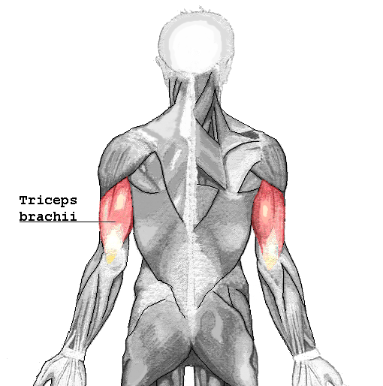
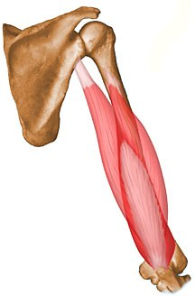

Slide 4
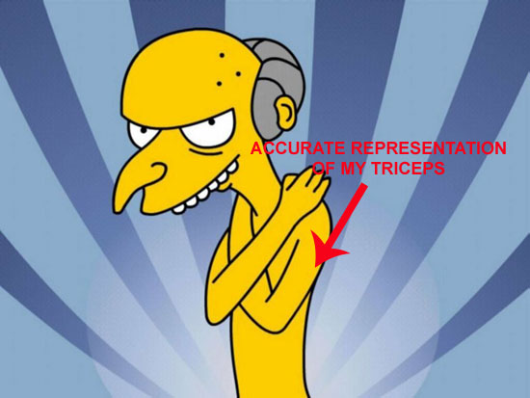

Slide 6
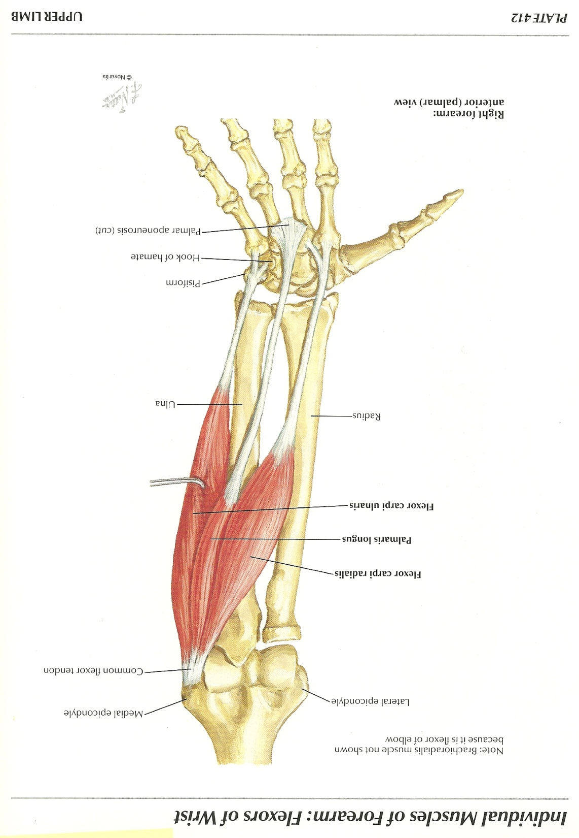
Wrist Flexors
Anterior Forearm muscles.
Tendons attach to the wrist bones or proximal metacarpals.

Slide 7
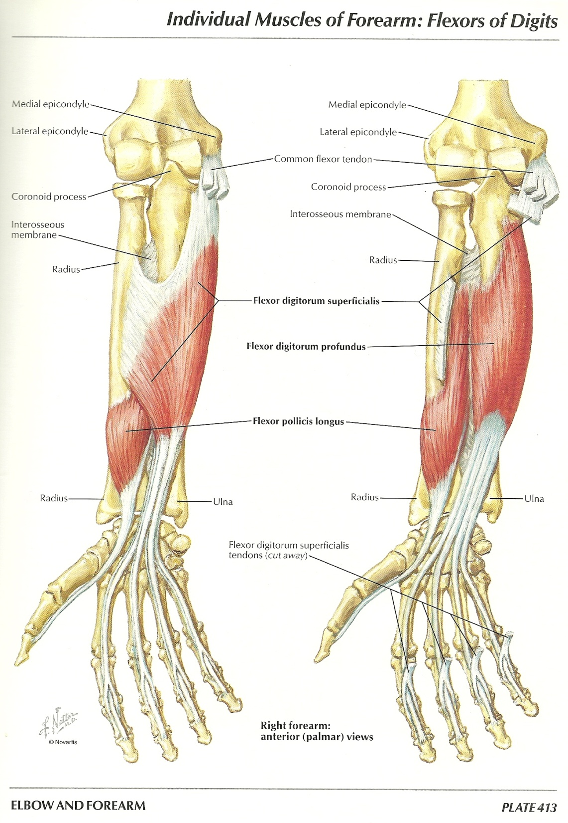
Finger Flexors
Anterior Forearm muscles.
Tendons attach to the finger bones

Slide 8
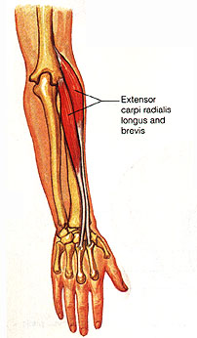
Wrist Extensors
Posterior Forearm muscles.
Tendons attach to the wrist bones or proximal metacarpals.

Slide 9
Finger Extensors
Posterior forearm muscles.
Tendons attach to the finger bones

Slide 10
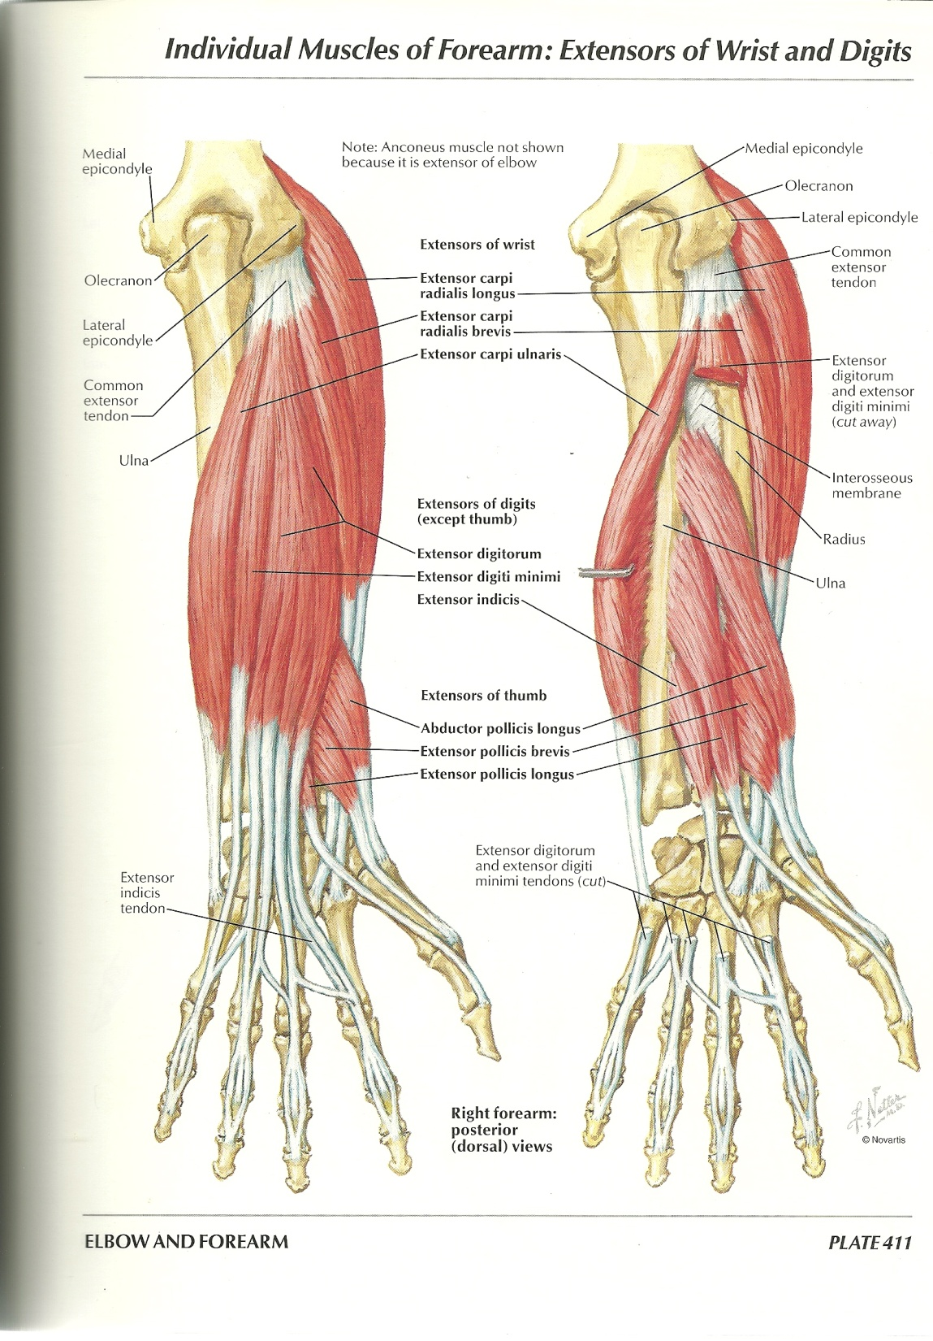

Slide 11
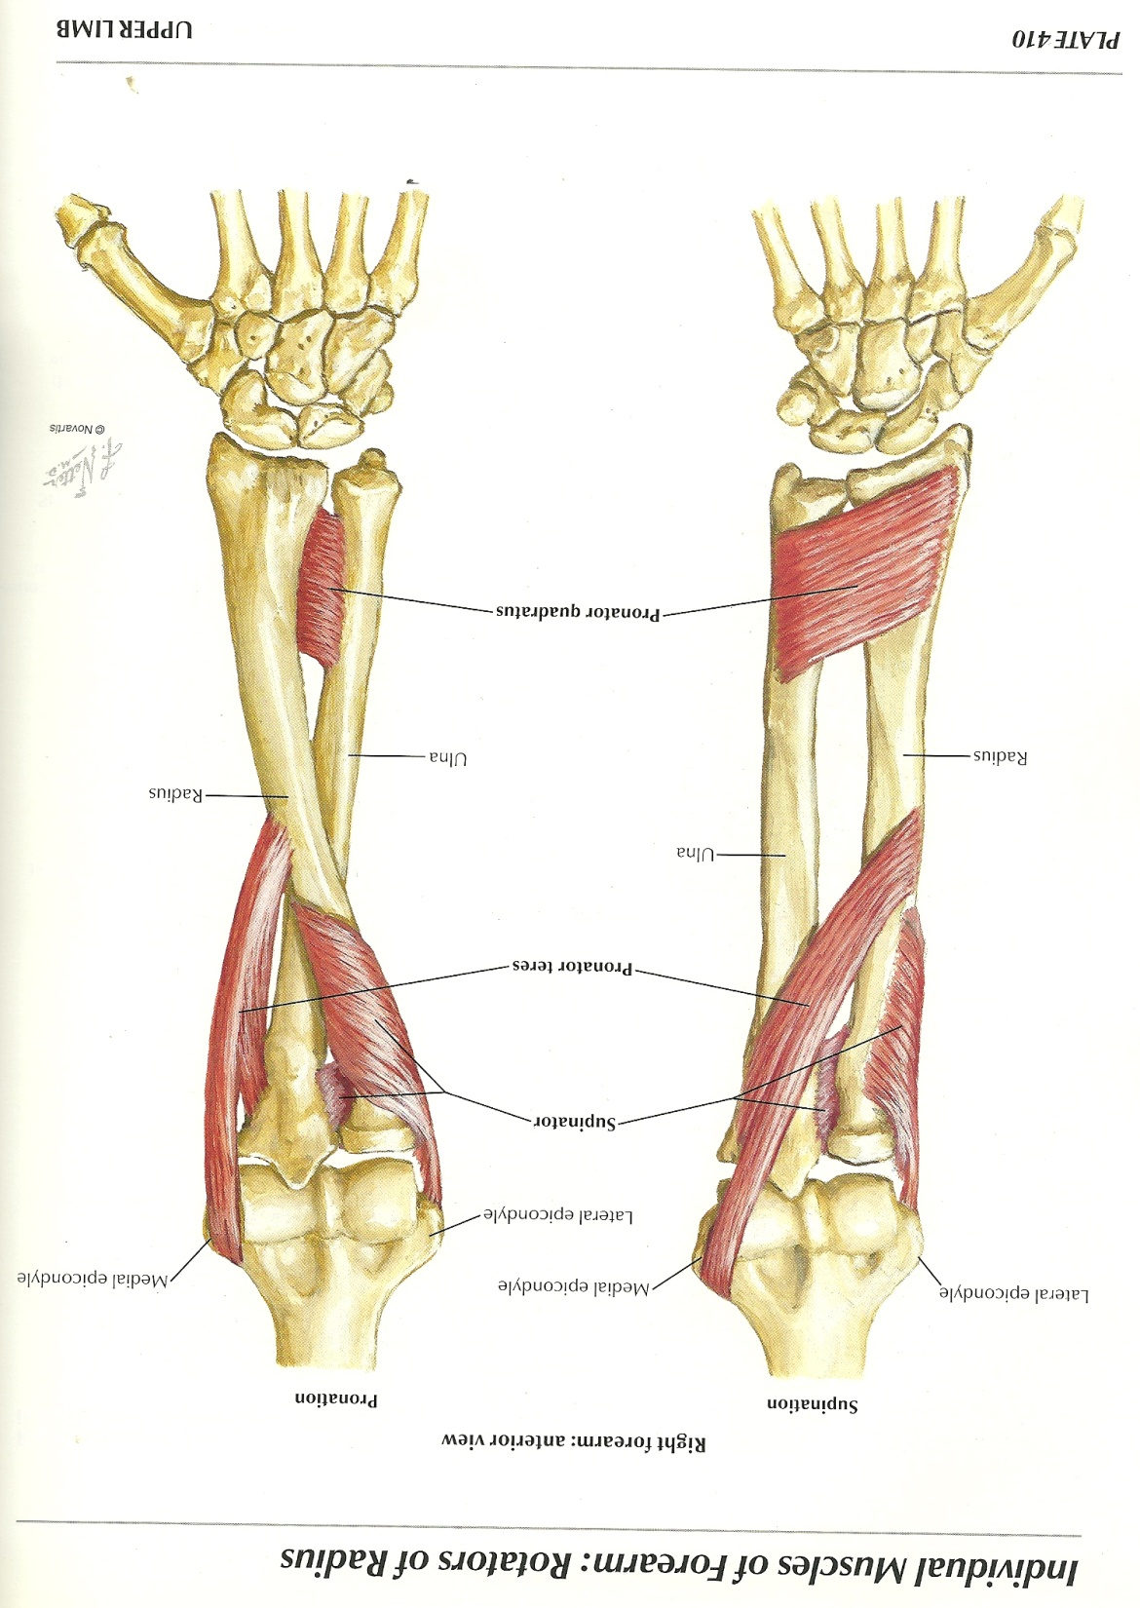

Slide 12
