Slide 1
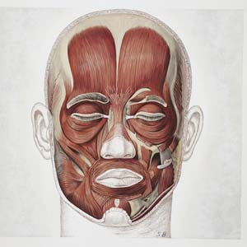
Muscle
Frontalis
Action
Raises eyebrows

Slide 2
A
Muscle=
Zygomaticus
B
Demonstrate the
action.
C
D
E

Slide 3
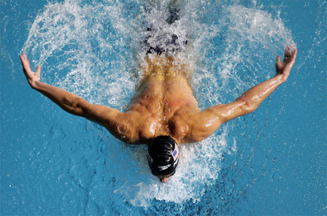
Muscle
Latissimus dorsi
Action 1
1. Shoulder adduction
Action 2
2. Shoulder extension

Slide 4
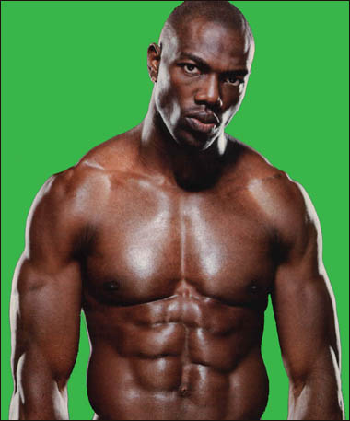
Muscle
Rectus abdominis
Action
Flexes trunk

Slide 5
Muscle
Orbicularis oculi
Action
Closes eye

Slide 6
Muscle
Sternocleidomastoid
Action 1
1. Rotates head (alone)
Action 2
2. Flexes neck (together)

Slide 7
A
Muscle=
Platysma
B
Action
Frown
C
D
E

Slide 8
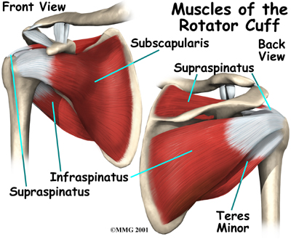
Action
Shoulder
Lateral rotation
Muscle

Slide 9
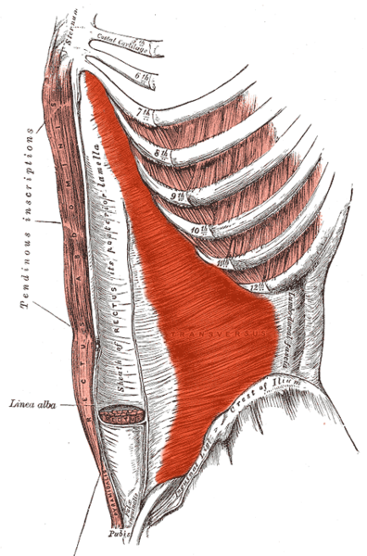
The deepest layer of the abdominal wall.
Muscle
Transversus abdominis
Action
Compresses abdomen
and rotates trunk

Slide 10
A
Muscle=
Buccinator
B
Action
Keeps cheeks
against teeth.
C
D
E

Slide 11
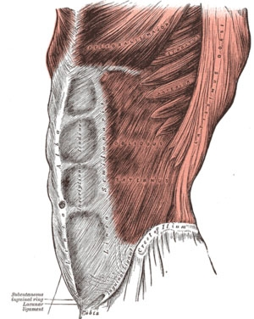
Most superficial layer of abdominal wall.
Muscle
External oblique
Action
Rotates trunk

Slide 12
A
Muscle=
Temporalis
B
Action
Closes jaw.
C
D
E

Slide 13
Action
Shoulder
Lateral rotation
Muscle

Slide 14
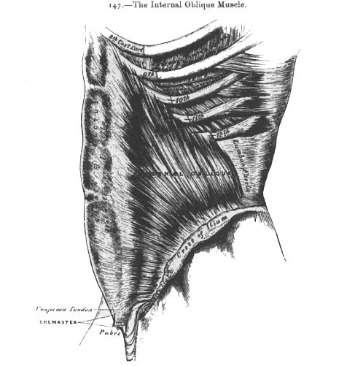
The 2nd (middle) layer of the abdominal wall.
Muscle
Internal obliques
Action
Rotates trunk

Slide 15
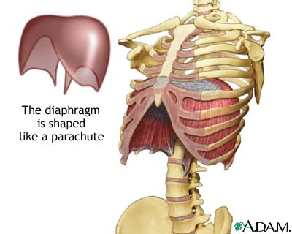
Muscle
Diaphragm
Action
Breathing

Slide 16
Muscle
Deltoid
Demonstrate the action.

Slide 17
Muscle
Action
Shoulder
Medial rotation

Slide 18
Muscle
Pectoralis major
Action
Shoulder horizontal
adduction

Slide 19
Muscle
Mentalis
Demonstrate the action.

Slide 20
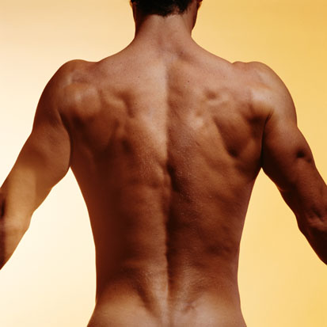
Column of 3 muscles
Muscle
Erector spinae
Action 1
1. Extends trunk (together)
Action 2
2. Lateral flexion (alone)

Slide 21
A
Muscle=
Masseter
B
Action
Closes jaw.
C
D
E

Slide 22
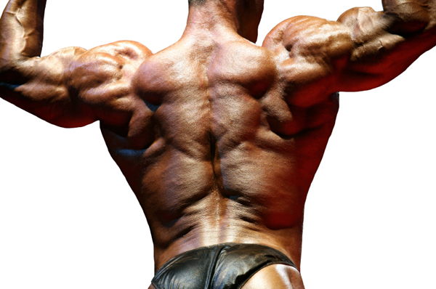
Muscle
Trapezius
Action 1
1. Neck extension
Action 2
2. Shoulder elevation
Action 3
3. Shoulder retraction

Slide 23
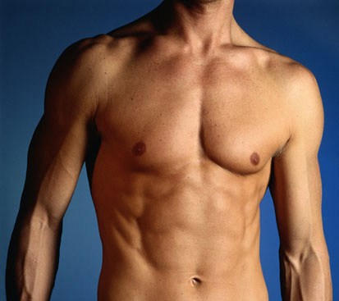
Muscle
External oblique
Action
Rotates trunk

Slide 24
Muscle
Orbicularis oris
Action
-Compresses and
protrudes lips, the kissing muscle.

Slide 25
Muscle
Action
Shoulder
Abduction

Slide 26
Muscle
Nasalis
Action
Scrunches nose
Crinkles nose

