Slide 1
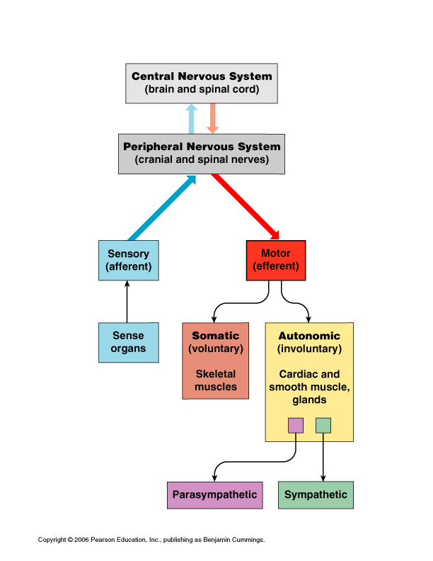

Slide 2
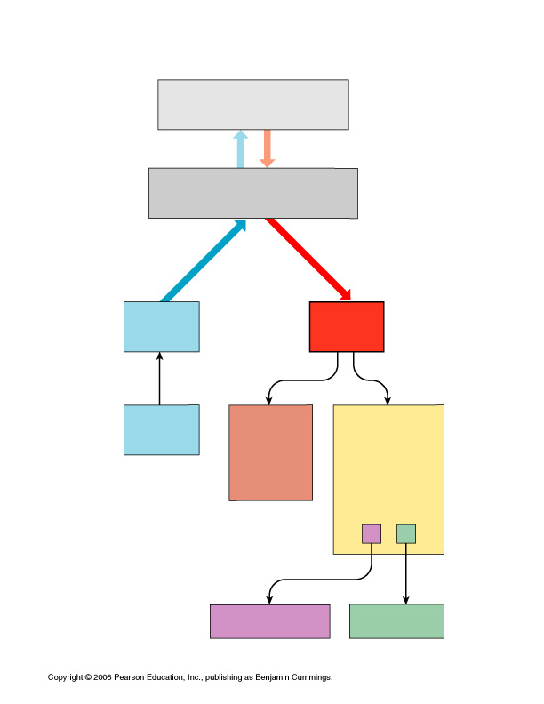

Slide 3
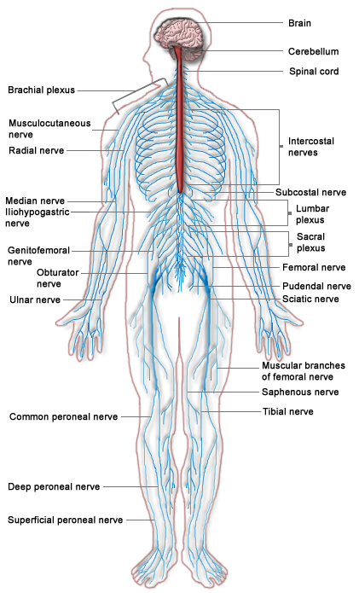
The Nervous System

Slide 4
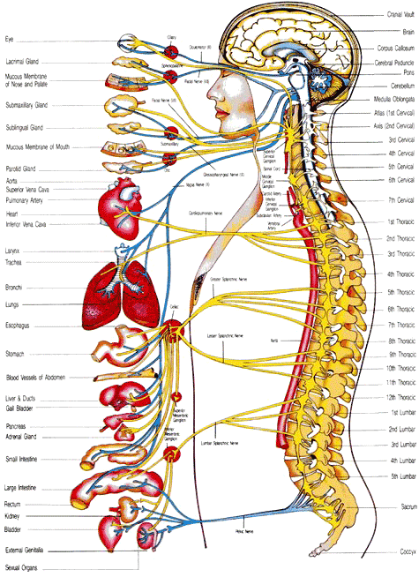

Slide 5
Thalamus and Hypothalamus
Midbrain
Pons
Medulla

Slide 6
1
2
Thalamus and Hypothalamus
3
4
Midbrain
Pons
Medulla

Slide 7
Thalamus and Hypothalamus
Midbrain
Pons
Medulla

Slide 10
8
5
9
1
2
6
7
3
4
10
11
14
12
13
15

Slide 11
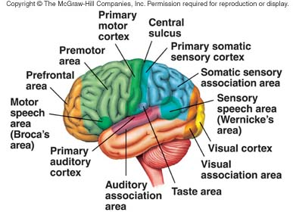

Slide 12
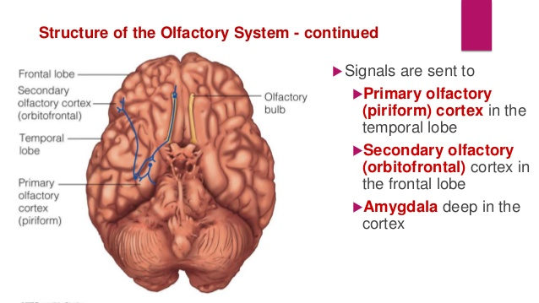

Slide 14
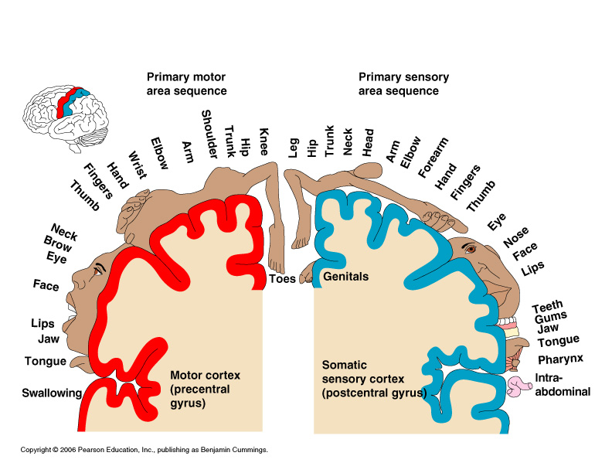

Slide 15
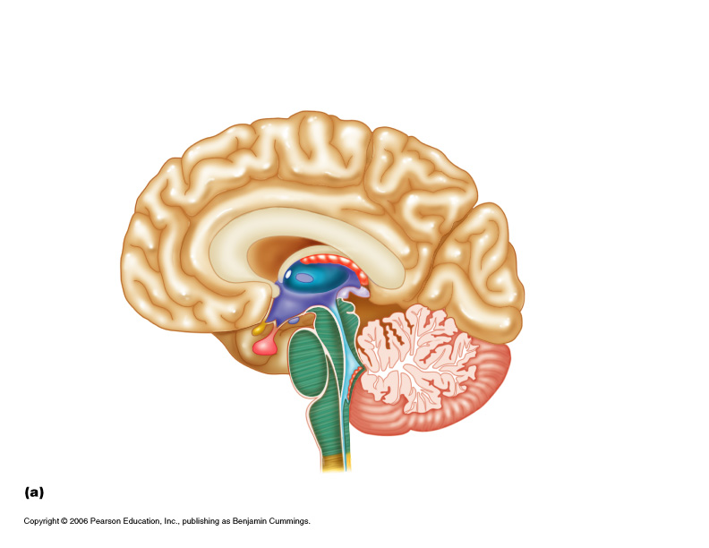
Corpus Callosum
Frontal Lobe
Parietal Lobe
Pineal body
Thalamus
Hypothalamus
Occipital Lobe
Optic chiasm
Midbrain
Pituitary gland
Cerebellum
Pons
Medulla
Spinal cord

Slide 16
8
Corpus Callosum
7
9
Frontal Lobe
Parietal Lobe
Pineal body
6
10
Thalamus
11
5
Occipital Lobe
Hypothalamus
12
4
Midbrain
Optic chiasm
Pituitary gland
3
13
Cerebellum
2
Pons
1
Medulla
14
Spinal cord

Slide 17
Corpus Callosum
Frontal Lobe
Parietal Lobe
Pineal body
Thalamus
Hypothalamus
Occipital Lobe
Optic chiasm
Midbrain
Pituitary gland
Cerebellum
Pons
Medulla
Spinal cord

Slide 18
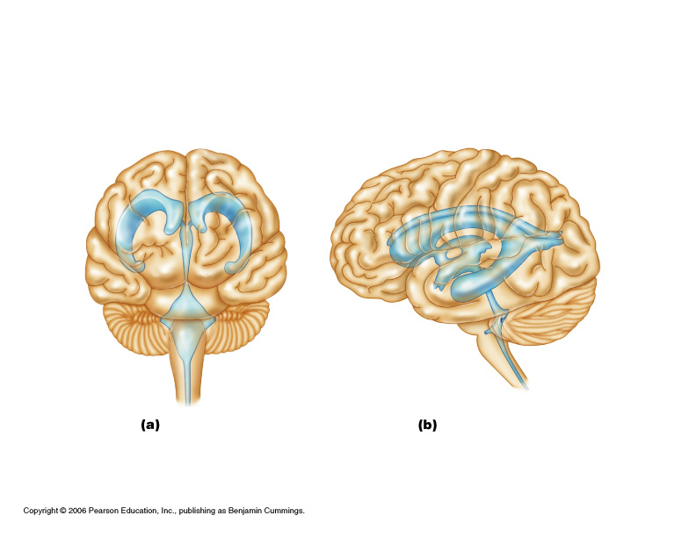

Slide 19
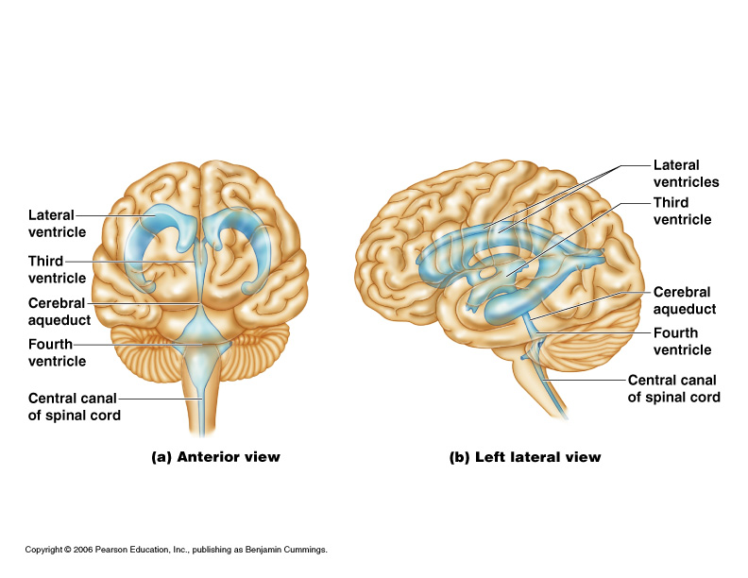

Slide 20
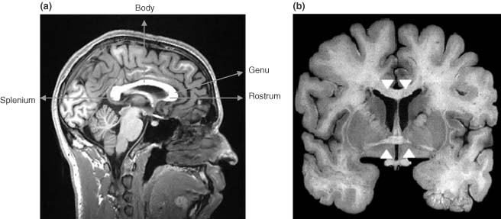
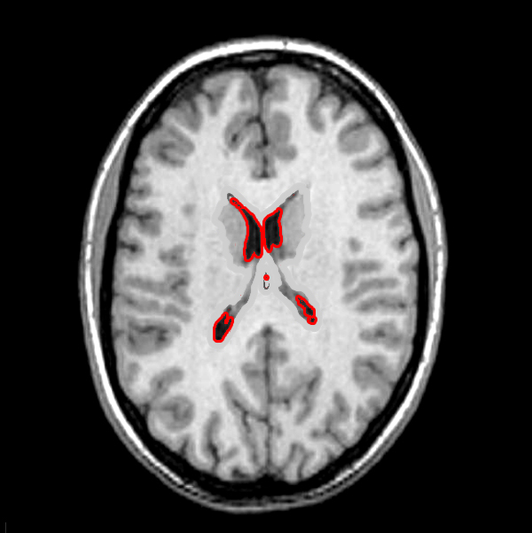

Slide 21
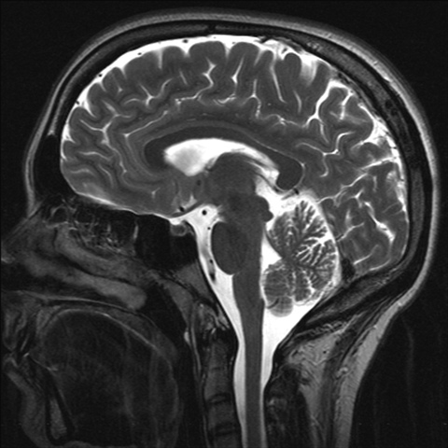

Slide 22
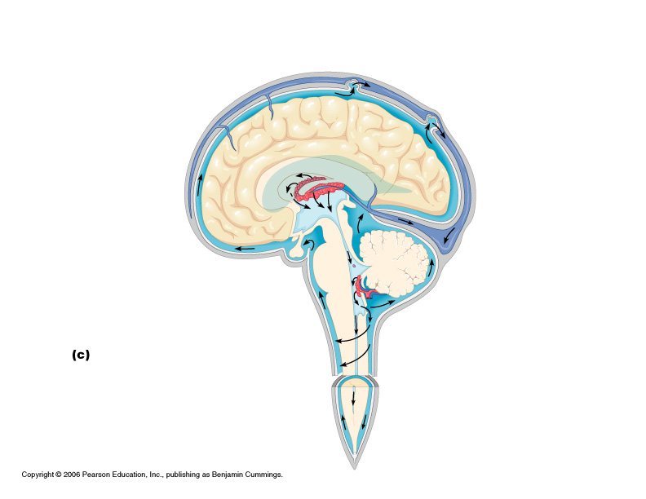

Slide 23
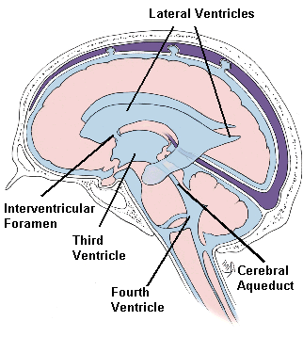

Slide 24
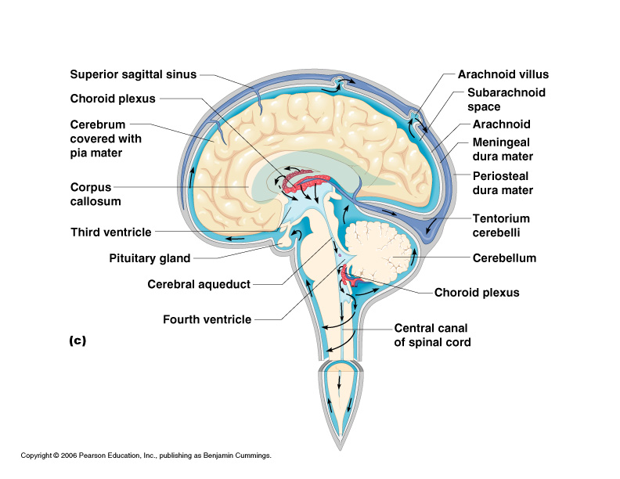

Slide 25
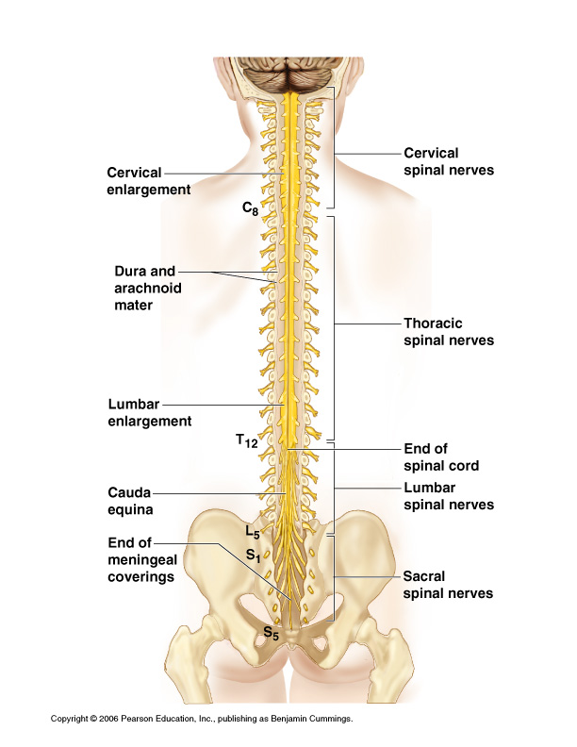

Slide 26
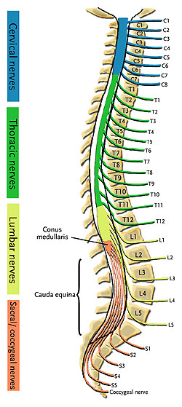
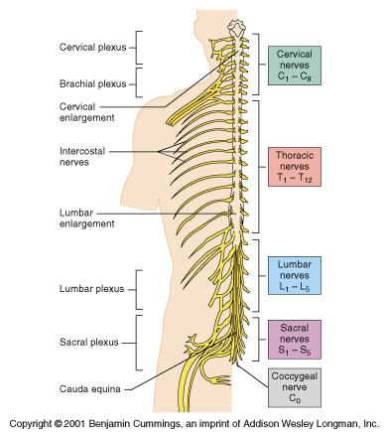

Slide 27
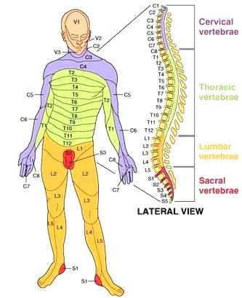

Slide 28
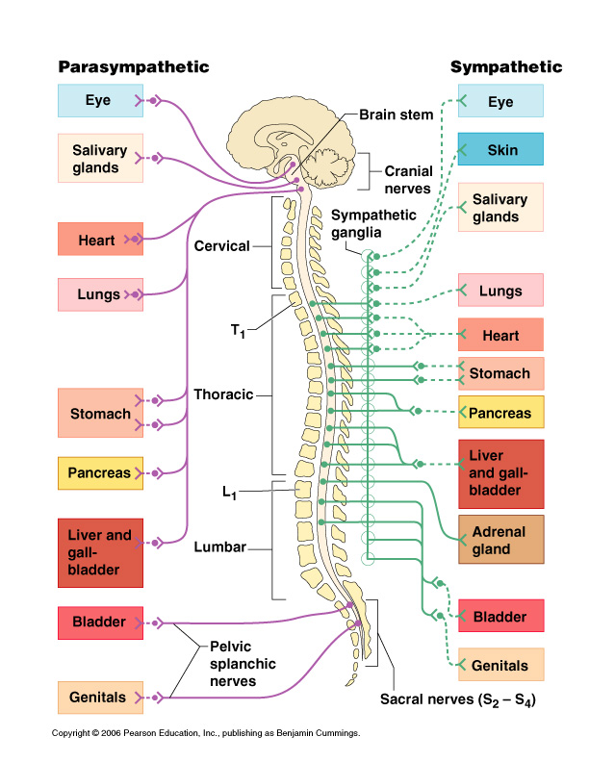

Slide 29
