Slide 1
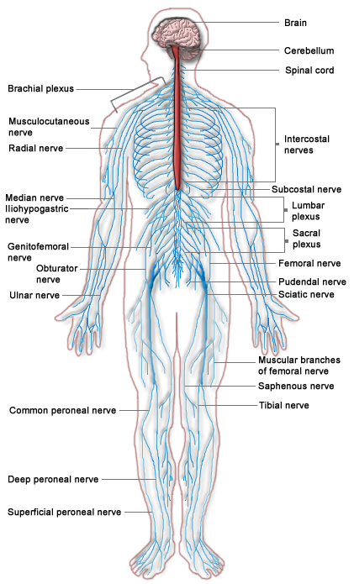
The Nervous System

Slide 2
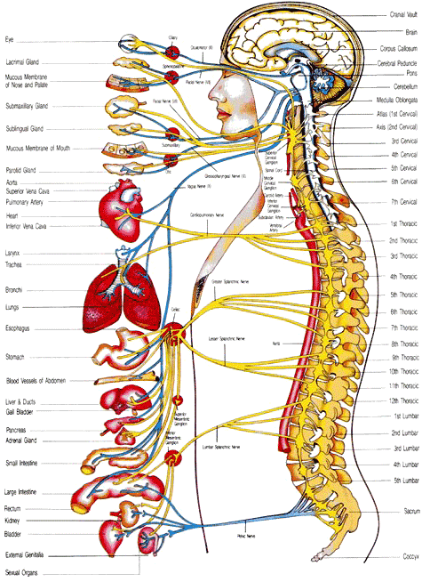

Slide 3
Thalamus and Hypothalamus
Midbrain
Pons
Medulla

Slide 4
1
2
Thalamus and Hypothalamus
3
4
Midbrain
Pons
Medulla

Slide 5
Thalamus and Hypothalamus
Midbrain
Pons
Medulla

Slide 8
8
5
9
1
2
6
7
3
4
10
11
14
12
13
15

Slide 9
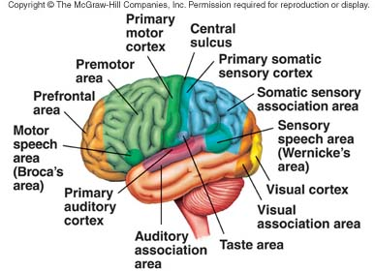

Slide 11
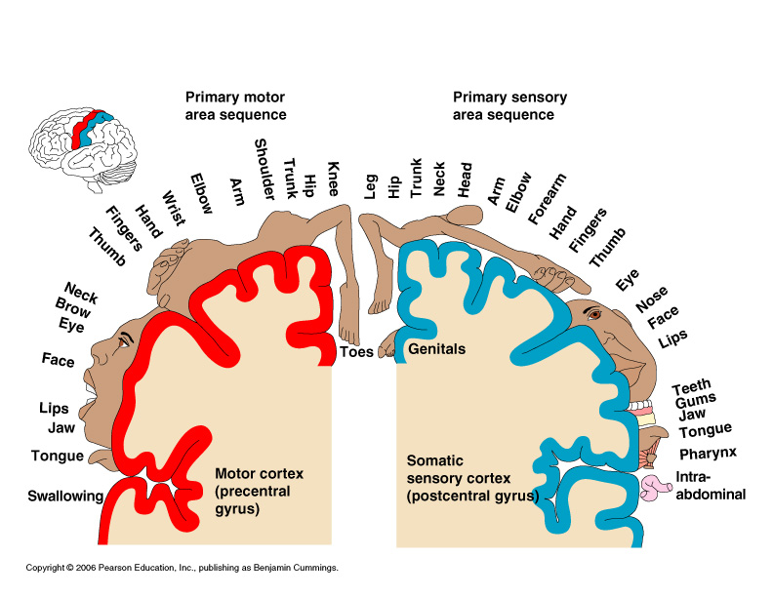

Slide 12
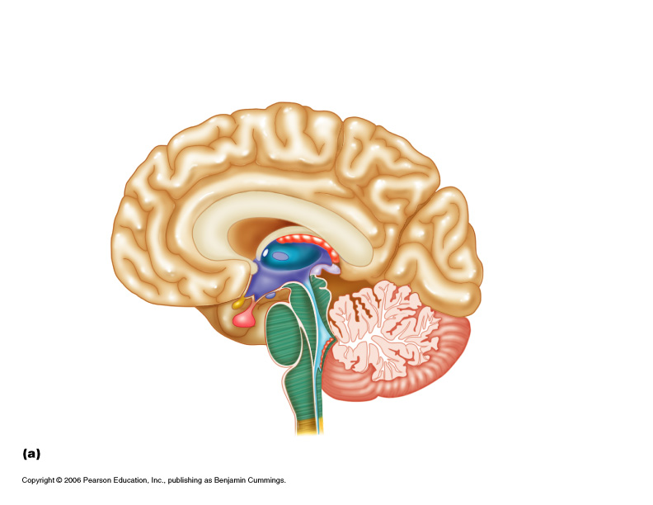
Corpus Callosum
Frontal Lobe
Parietal Lobe
Pineal body
Thalamus
Hypothalamus
Occipital Lobe
Optic chiasm
Midbrain
Pituitary gland
Cerebellum
Pons
Medulla
Spinal cord

Slide 13
8
Corpus Callosum
7
9
Frontal Lobe
Parietal Lobe
Pineal body
6
10
Thalamus
11
5
Occipital Lobe
Hypothalamus
12
4
Midbrain
Optic chiasm
Pituitary gland
3
13
Cerebellum
2
Pons
1
Medulla
14
Spinal cord

Slide 14
Corpus Callosum
Frontal Lobe
Parietal Lobe
Pineal body
Thalamus
Hypothalamus
Occipital Lobe
Optic chiasm
Midbrain
Pituitary gland
Cerebellum
Pons
Medulla
Spinal cord

Slide 15
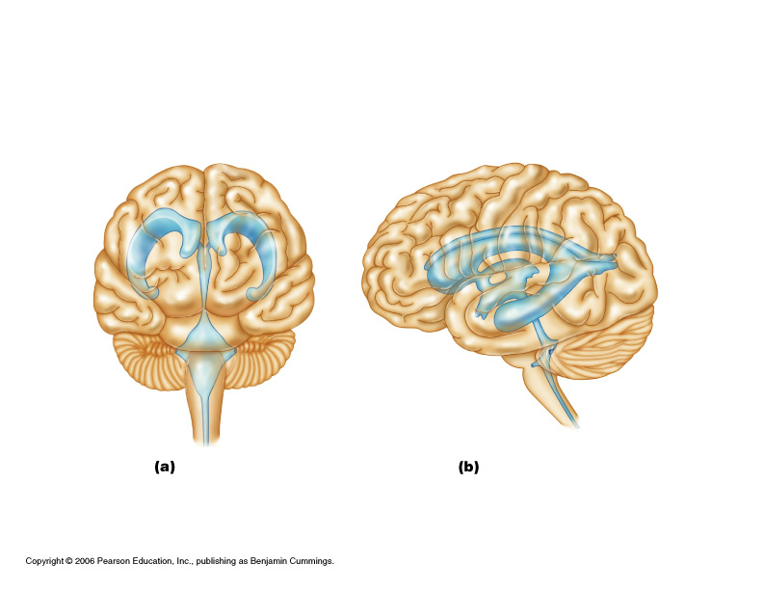

Slide 16
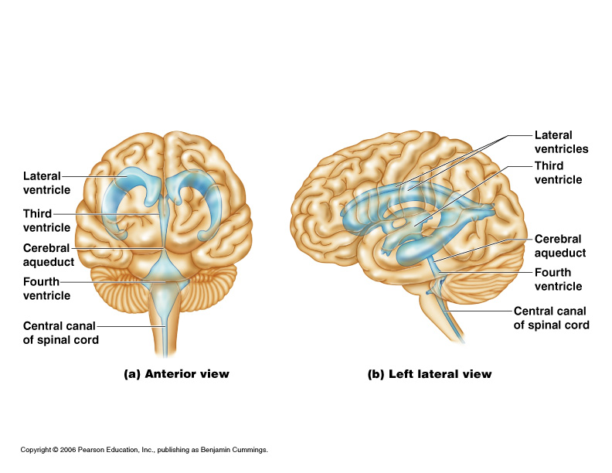

Slide 17
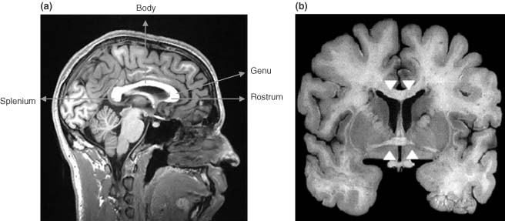
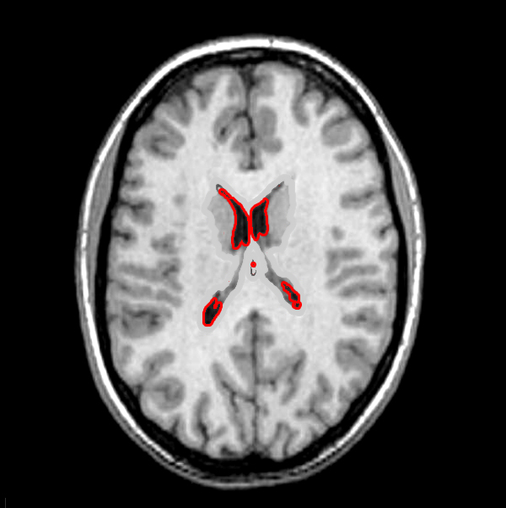

Slide 18
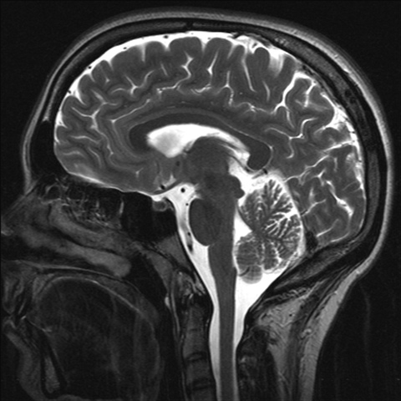

Slide 19
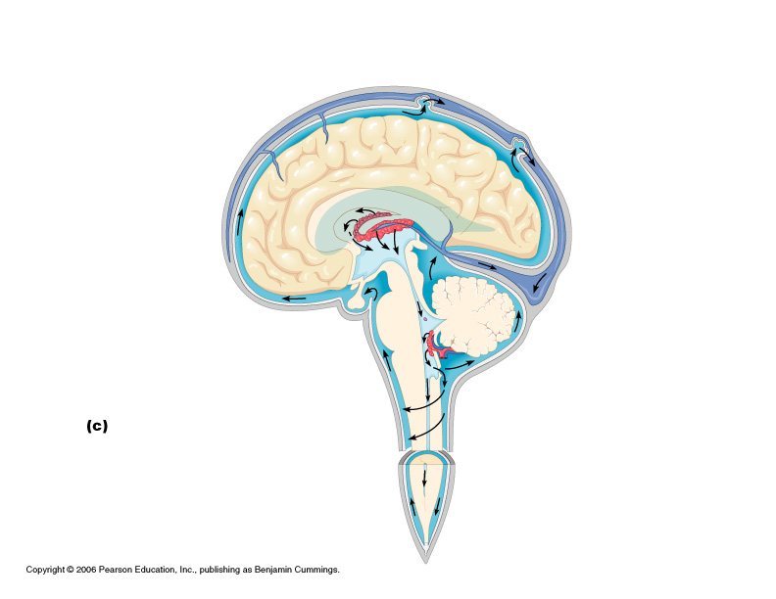

Slide 20
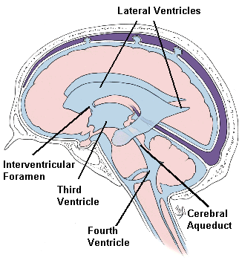

Slide 21
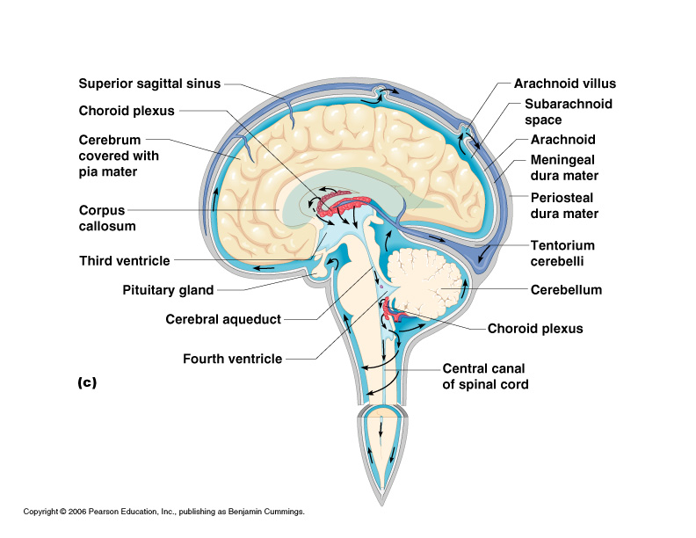

Slide 22
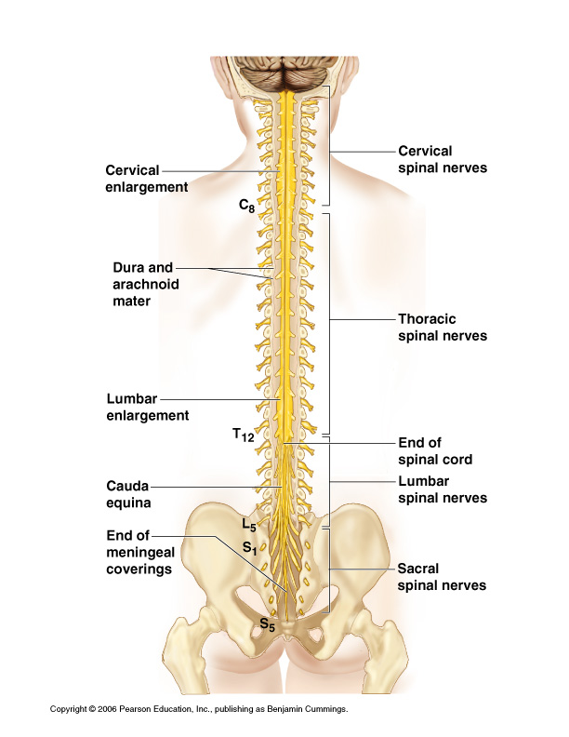

Slide 23
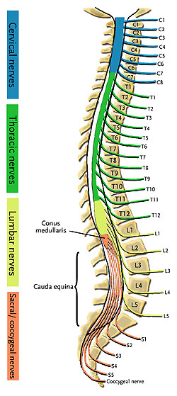
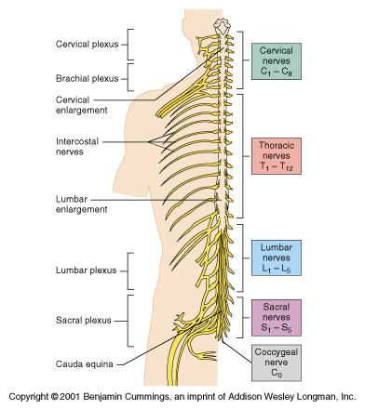

Slide 24
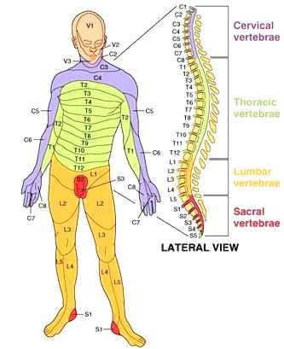

Slide 25
