Slide 1
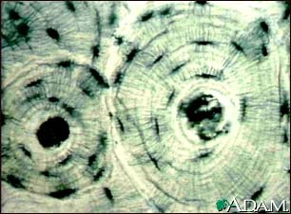
Compact Bone tissue

Slide 2
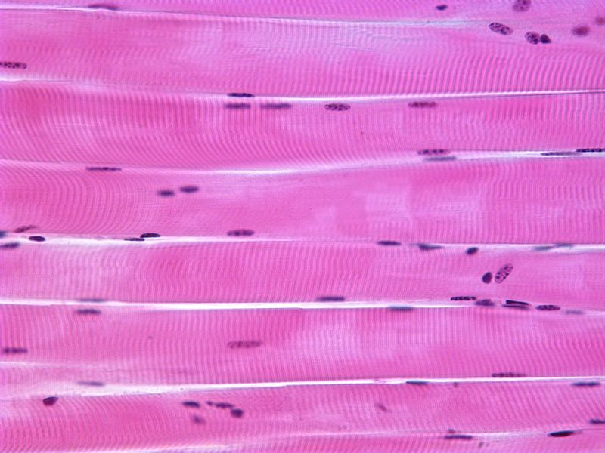
Skeletal muscle tissue

Slide 3
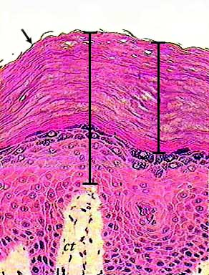
Skin

Slide 4
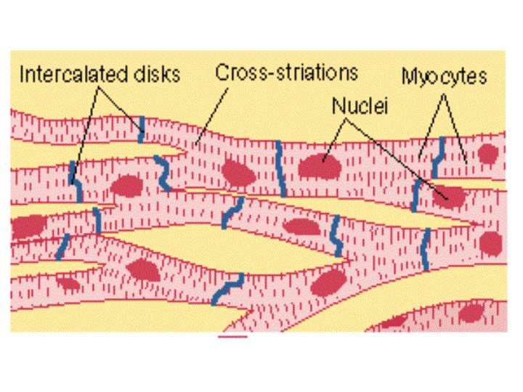
Heart/cardiac muscle tissue

Slide 5
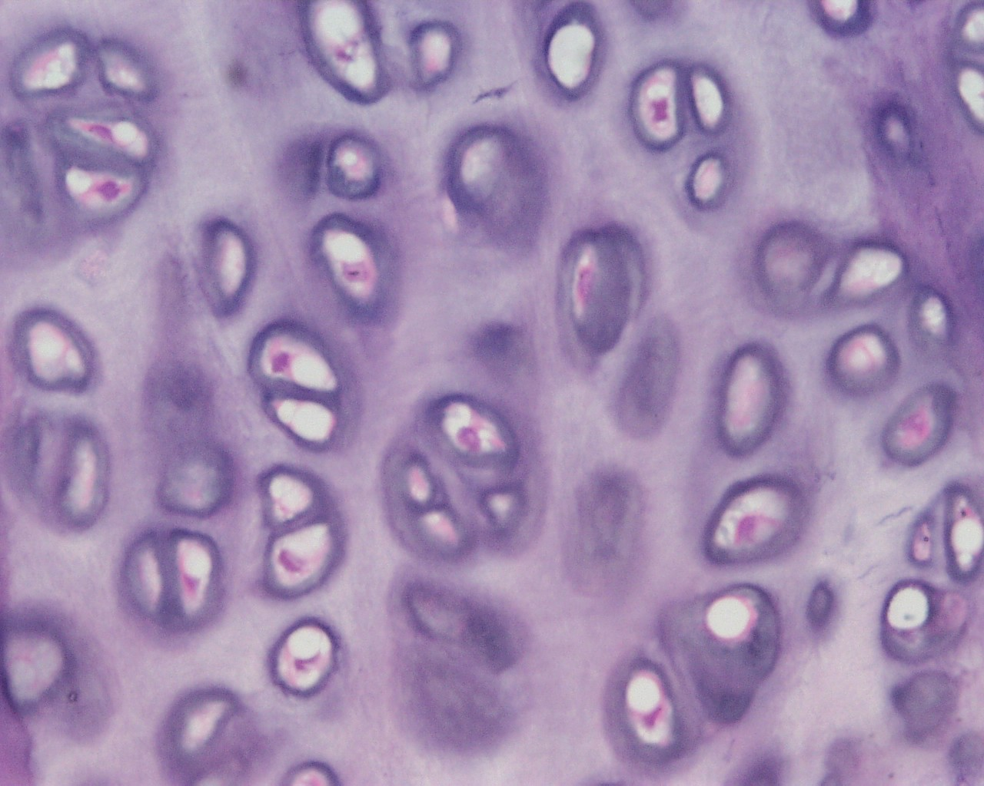
Cartilage tissue made by chondrocytes

Slide 6
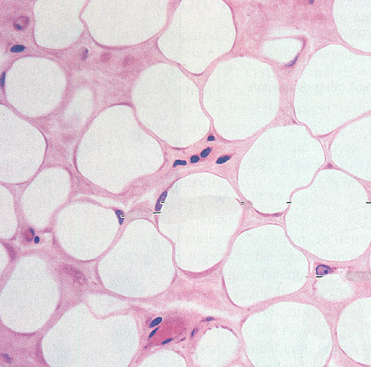
Adipose tissue/Fat tissue

Slide 7
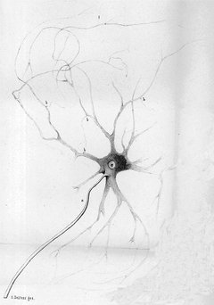
Nerve cell

