Slide 1
The Course Selection Process
Fairfield Ludlowe High School

Slide 2
Resources for Students/Parents
Program of Studies – the most thorough resource you have
Student assemblies
Conversations with teachers, counselors, curriculum leaders, administrators
Course Selection Night, January 28– all materials posted online
Informational website:
www.fairfieldschools.org/highschoolcourse_selection.html
(Includes: Course descriptions, AP syllabi, AP sample tasks and exemplary student work samples, table of time commitment expectations for each class)

Slide 3
Goals for All Students
Develop and enhance critical thinking skills
Solve problems of increasing complexity
Analyze and synthesize information
Apply knowledge/skills to new and different situations
Become more independent learners and self-advocates

Slide 4
Expectations for each Level
Level 2: (College Preparatory)
  Reading material at grade level
  Complexity of the material and work expectation at grade level
Level 1 (Honors)
  Reading material above grade level
  Complexity of the material and work expectation above grade level
  Accelerated pace
Advanced Placement
  Equivalent to a freshman college course in a major
  Reading material at the college/university level
  Significant volume of independent work
  Level of synthesis, critical thinking and problem solving significantly above that of a high school course
  Very rapid pace

Slide 5
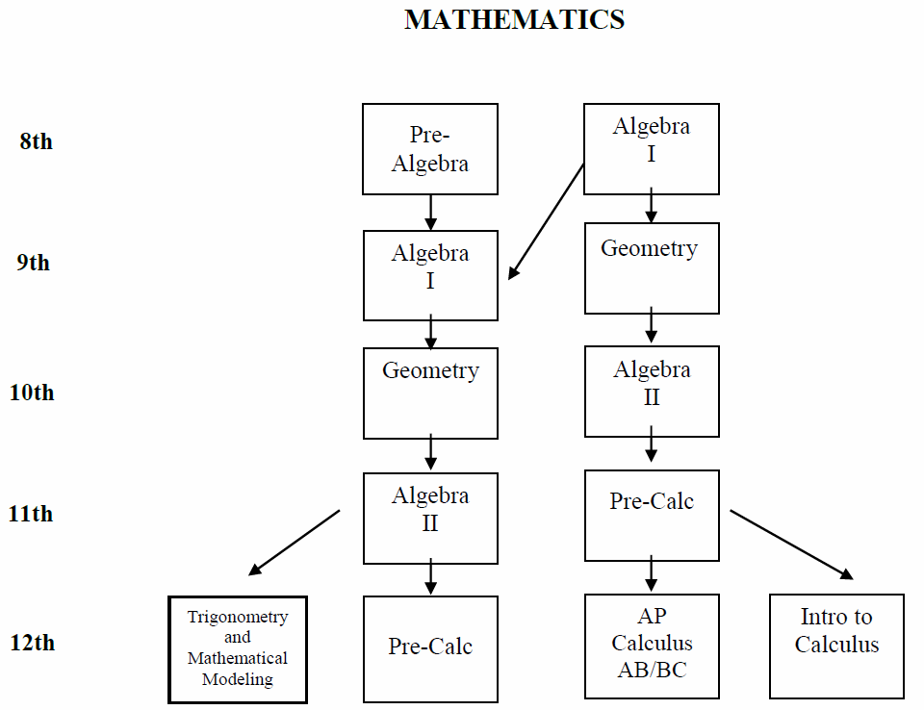

Slide 6
Comparison Among Levels of Mathematics
AP Calculus AB and BC
  5-6 hrs per week (average) outside of class time
AP Statistics
  4-6 hrs per week (average) outside of class time
Level 1 courses
  3-6 hrs per week (average) outside of class time
Level 2 courses
  1.5-2 hrs per week (average) outside of class time
Level O courses
  1.5-3 hrs per week (average) outside of class time

Slide 7
SCIENCE
SUGGESTED COURSE SEQUENCE

Slide 8
Comparison Among Levels of Science
AP Environmental Science, Biology, Chemistry, Physics
  7-10 hrs per week (average) outside of class time
  Most courses have summer assignments
Level 1 courses
  3-4 hrs per week (average) outside of class time
Level 2 courses
  1.5-2 hrs per week (average) outside of class time
Level O courses
  1.5-2 hrs per week (average) outside of class time

Slide 9
ENGLISH
 | AP Level |  | Level 1 | Level 2
Grade 9 |  |  | English 11 | English 12
Grade 10 |  |  | English 21 | English 22
Grade 11 | AP American Studies | AP Language and Composition | English 31 | English 32
Grade 12 | AP Literature |  | English 41 | English 42
 | Senior English Elective Semester Courses *
*Available to all seniors as the required English courses or in addition to other English courses. If taken as the required English courses, must take one writing and one literature course. All Senior English electives are Level O. Also available to juniors in addition to their required full-year course.

Slide 10
Comparison Among Levels of English
AP Literature and Composition
  7-10 hrs per week (average) outside of class time
  Summer assignment
AP Language and Composition and AP American Studies
  6-9 hrs per week (average) outside of class time
  Summer assignment
Level 1 courses
  4-6 hrs per week (average) outside of class time
Level 2 courses
  2.5-4 hrs per week (average) outside of class time
Level O courses
  3-5 hrs per week (average) outside of class time

Slide 11
SOCIAL STUDIES
Three and one-half years of Social Studies is required. The course sequence is described below: (7 Credit Requirement)
Global Studies 10
9th
Modern Global Studies
22 or 21
10th
US History 32, 31, or AP
AP American Studies
11th
11th or 12th *
Civics*
Civics & Contemporary Issues
Civics & International Relations
Civics & Youth and the Law
12th
Elective Courses
AP Modern European History Humanities
AP American Gov’t & Politics Psychology
AP Psychology Economics
Modern European History
*1 semester of civics may be taken in either 11th or 12th grade
(AP American Gov’t and Politics will also fulfill the Civics Requirement)

Slide 12
Comparison Among Levels of
Social Studies
AP Government and Politics
  5-7 hrs per week (average) outside of class time
  Summer assignment
AP Modern European History
  4-7 hrs per week (average) outside of class time
  Summer assignment
AP Psychology
  4-7 hrs per week (average) outside of class time
  Summer assignment
AP American Studies
  6-9 hrs per week (average) outside of class time
  Summer assignment
AP United States History
  6-8 hrs per week (average) outside of class time
  Summer assignment
Level 1 courses
  3-4 hrs per week (average) outside of class time
Level 2 courses
  2-3 hrs per week (average) outside of class time
Level O courses
  1.5-3 hrs per week (average) outside of class time

Slide 13
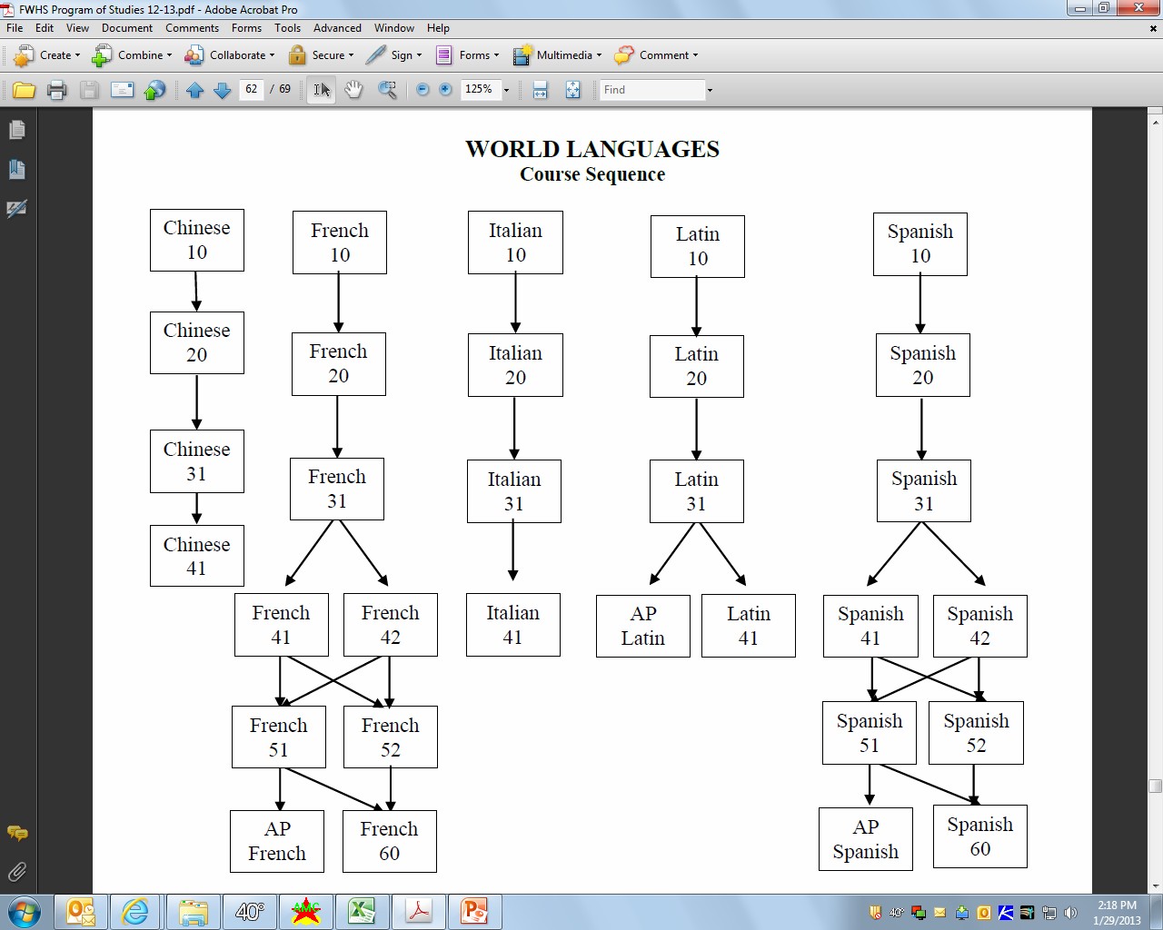

Slide 14
Comparison Among Levels of
World Languages
AP French, Spanish, Latin
  5-8 hrs per week (average) outside of class time
  Most courses have summer assignments
Level 1 courses
  3-6 hrs per week (average) outside of class time
Level 2 courses
  2-4 hrs per week (average) outside of class time
Level O courses
  2-4 hrs per week (average) outside of class time

Slide 15
The Process
1. Get Informed
Read the Program Of Studies and course information posted online, speak with your teachers
Course Selection night
Class meetings - Monday, February 2nd
2. Complete the Course Selection Worksheet with your requests
Be sure all information is accurate and complete
Week of February 2-6: Teachers will spend class time discussing department courses and their recommendations, and signing Course Selection Worksheet
Sign your form when completed
Obtain your parent’s signature
Enter your Requests into Infinite Campus
Turn your completed, signed Course Selection Worksheet into your school counselor on or before February 10, 2015

Slide 16
The Process
3. Review your requests with your school counselor
Schedule an appointment between February 10 and 27th
Enter your final selections into Infinite Campus (with counselor’s assistance)
Print out Final Course Request Form from Infinite Campus
4. Final Step
Sign and obtain your parent’s signature on the Final Course Request Form
Return the Final Course Request Form to your school counselor on or before MARCH 2, 2015

Slide 17
Changing/Dropping Courses
Once schedules are finalized, counselors will make changes for the following reasons only:
An incomplete schedule or insufficient credits
A course scheduled in error by the school
Changes needed as the result of courses failed
Changes needed as the result of summer school work
As always, students with concerns regarding their academic progress should speak to their teacher and school counselor.

Slide 18
Calendar for
Changing/Dropping Courses
Course changes will not be approved during the first two weeks of any course (except for reasons posted on previous slide).
After the first quarter of any course, any changes will result in a grade of “W” (withdrawn) which will appear on your transcript—this applies even to level changes. This will not impact GPA. After the 1st semester, any student dropping a full year course which they are failing will receive a grade of WF.

Slide 19
Rationale for Change/Drop Policy
Our goal is to provide students and teachers with balanced classes.
Multiple changes to a schedule causes students to miss critical information shared in the initial days the course meets.
Even a single change can affect enrollment in multiple courses, increasing disruption.
We build the master schedule from student course requests, so it is important to have accurate counts.
Our process is providing students with more opportunity and responsibility to build their schedule – and we are looking to foster commitment to original requests.

Slide 20
The Schedule
 | DAY 1 | DAY 2
7:30—8:55 | Period 1 | Period 1
9:00—10:25 | Period 2 | Period 2
10:30—10:37 | Homeroom | Homeroom
 | Period 3 | Period 3
12:45—2:10 | Period 4 | Period 4
Lunch 10:39 – 11:09 | Class 10:42 – 11:25 | Class 10:42 – 12:08
Class 11:14 – 12:40 | Lunch 11:25 – 11:55
 | Class 11:58 – 12:40 | Lunch 12:10 – 12:40

Slide 21
The Guiding Principles are:
Increase instructional time
Lunch time for all students
Improved pace of the day
Longer instructional periods
More access to electives
Opportunities for increased graduation requirements
Opportunities for collaboration by teachers

Slide 22
Sample Weekly Schedule
Times |  | Mon DAY 1 | Tue Day 2 | Wed Day 1 | Thurs Day 2 | Fri Day 1
7:30 8:55 | Period 1 | Science | Science/ PE or Health | Science | Science/ PE or Health | Science
9:00 10:25 | Period 2 | English | Elective II | English | Elective II | English
10:30 10:37 | HR | Homeroom | Homeroom | Homeroom | Homeroom | Homeroom
 | Period 3 | Elective I | World Lang | Elective I | World Lang | Elective I
12:45 2:10 | Period 4 | Social Studies | Math | Social Studies | Math | Social Studies
Lunch 10:39 11:09 | Class 10:42 11:25 | Class 10:42 12:08
Class 11:14 12:40 | Lunch 11:25 11:55
 | Class 11:58 12:40 | Lunch 12:10 12:40

Slide 23



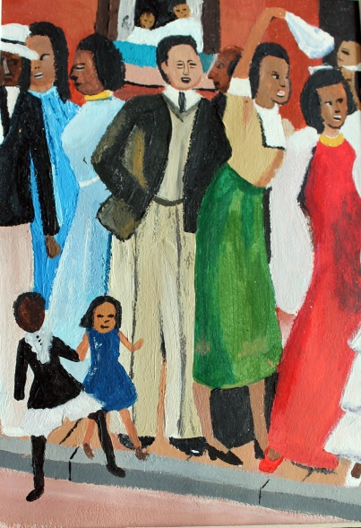
Art Course Selections

Slide 24
Art Course Sequence Options
All Electives are 1 Semester Courses
Foundations 2-D Foundations 3-D
Drawing & Painting I
Drawing & Painting II
Intro to Studio
Graphic Design & Illustration
Digital Photo
Interm./Advan.Photo
Darkroom Photo
*AP Studio (2D) – 2 periods full year
*Intro to Pottery
*Sculpture 1
Sculpture II
*Advanced Pottery/
3-Dimensional Design
*AP Studio (3D) – 2 periods full year

Slide 25
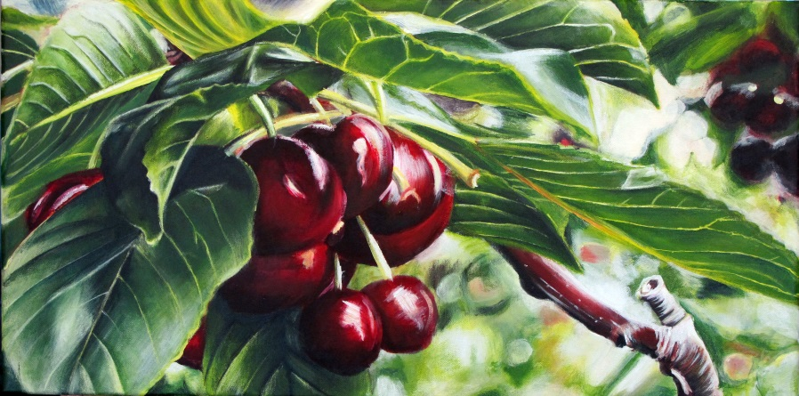
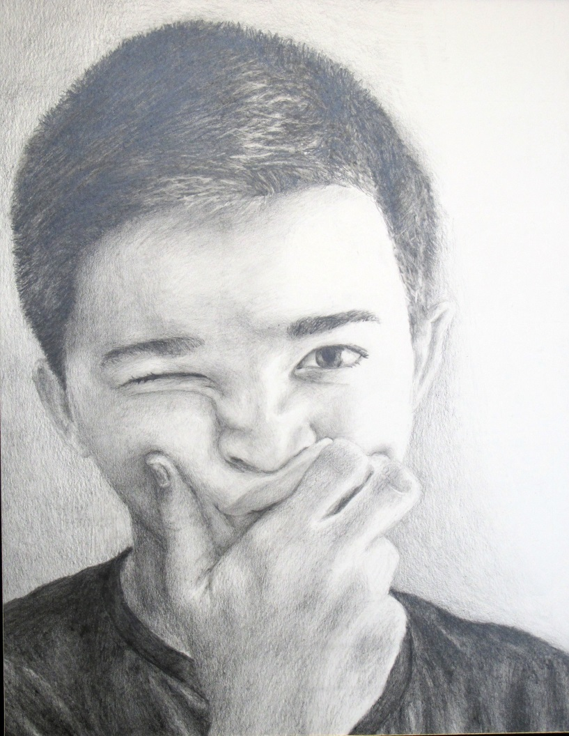
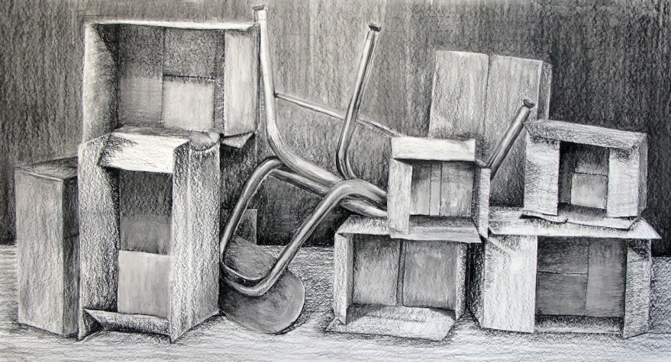
“The Arts are among the ‘six basic academic subjects’. Art is valuable in all areas of study because it engages the imagination, fosters flexible ways of thinking, develops disciplined effort & builds self-confidence.” – The College Board

Slide 26
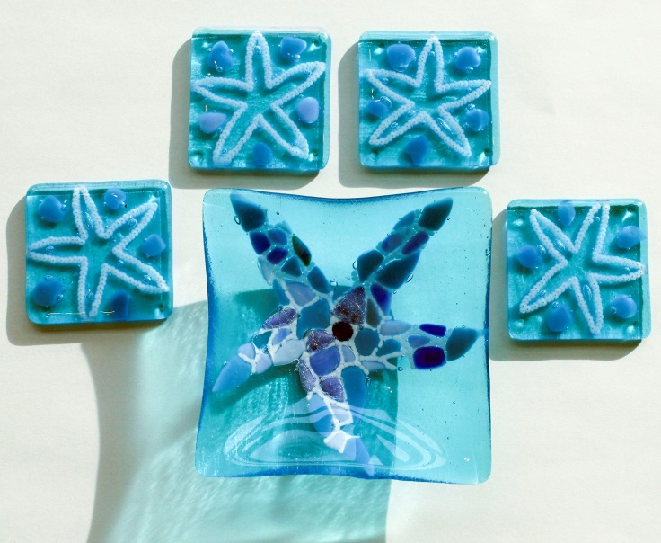


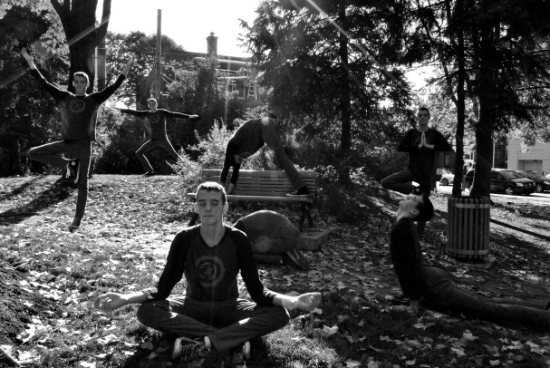
ART MATTERS

Slide 27
Business Courses
COURSE OFFERINGS | Grade 9 | Grade 10 | Grade 11 | Grade 12
Introduction to Business | X | X
Marketing |  | X | X | X
Financial Literacy |  | X | X | X
Accounting |  | X | X | X
Business Law |  | X | X | X
Business Management |  | X | X | X
The Business of Sports & Entertainment |  | X | X | X
AP Economics |  | X | X | X
Advanced Advertising & Design |  |  | X | X
Entrepreneurship |  |  | X | X
Internship & Career |  |  | X | X
Introduction to Investing |  |  | X | X

Slide 28
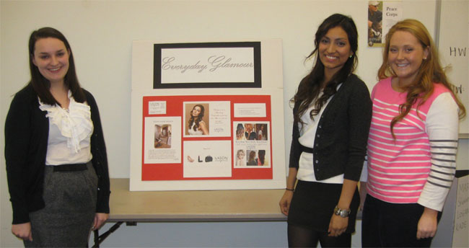
Business Courses Continued…
COURSE OFFERINGS | Grade 9 | Grade 10 | Grade 11 | Grade 12
Computer Information Systems | X | X | X | X
Computer Game Design & Programming | X | X | X | X
Robotic Programming | X | X | X | X
Web Design | X | X | X | X
AP Computer Science |  |  | X | X

Slide 29
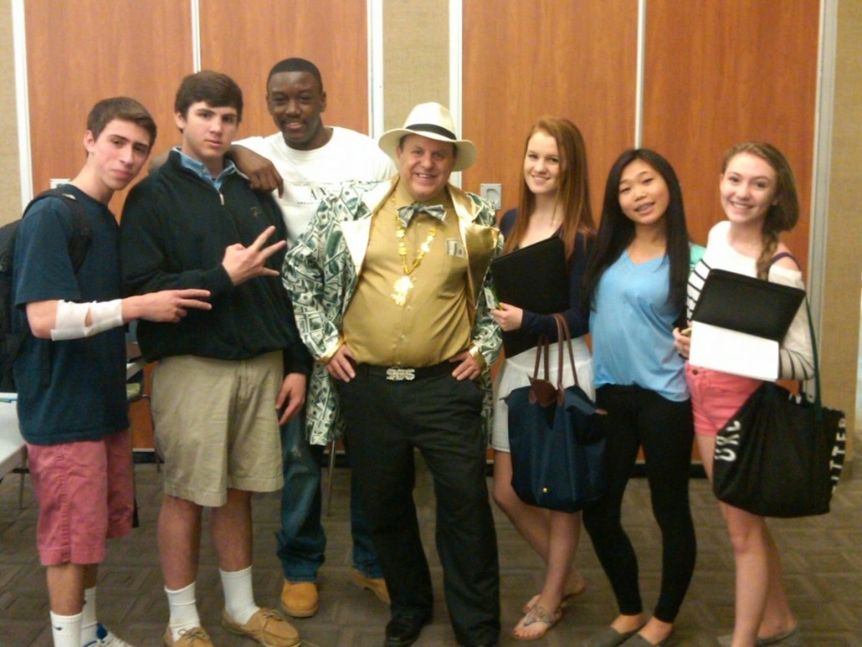
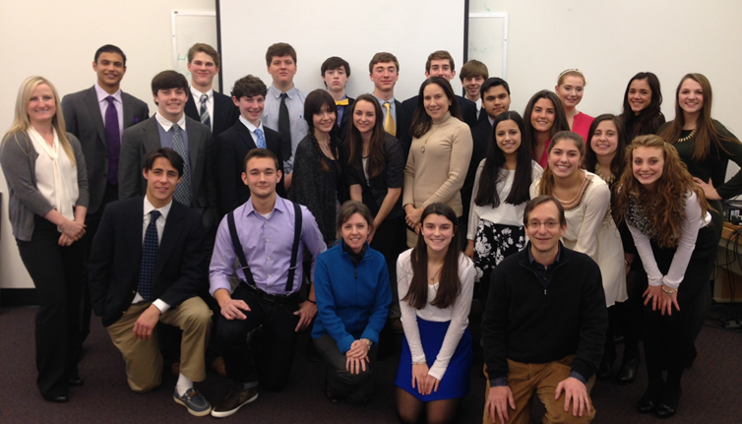
Our Business Students
Consistently demonstrate 21st century skill sets such as creativity, innovation, problem-solving, collaboration and perseverance.

Slide 30
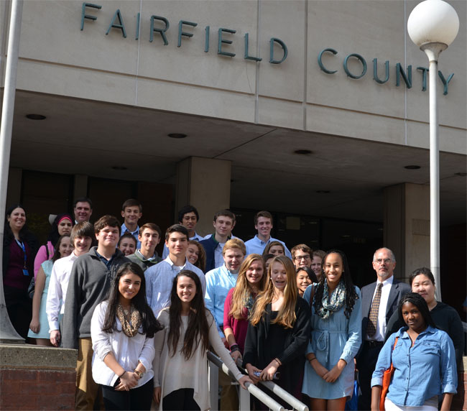
Are provided with a platform to find their niche.
Are constantly challenged to become more effective communicators.

Slide 31
Family & Consumer Sciences
Culinary Arts | Fashion Design, Merchandising & Interior Design | Child Development
Introduction to Culinary Arts 10 | Fashion & Design 10 | Child Development 30
Global Foods 20 | Fashion & Design 20 | Early Childhood Education 40
Baking & Pastry 20 | Fashion & Design 30/40 | Individual and Family Development UCONN College Course
Food Services 20, 30 & 40 | Fashion Merchandising & Design 10 & 20 | Option for 3 College Credits
 | Interior Design 10 & 20

Slide 32
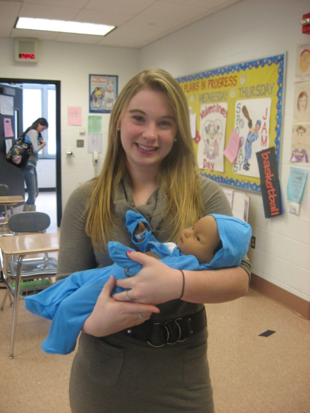
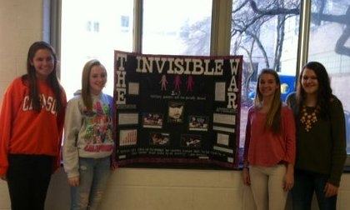
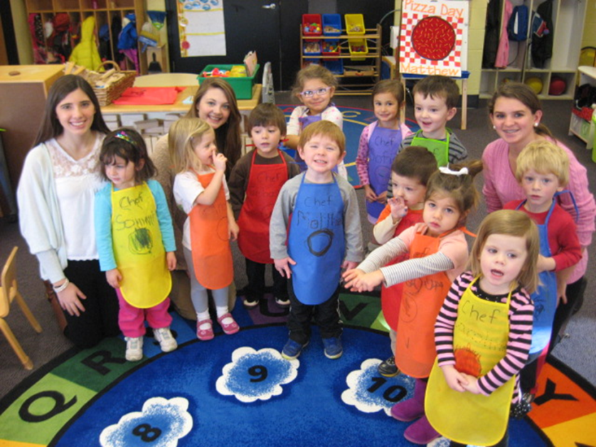
Child Development/Early Childhood Education
Individual and Family Development
3 College Credits
Child Development 30
Early Childhood Education 40
Possible Career Pathways:
Pediatrician
Psychologist
Teacher
Speech Pathologist

Slide 33
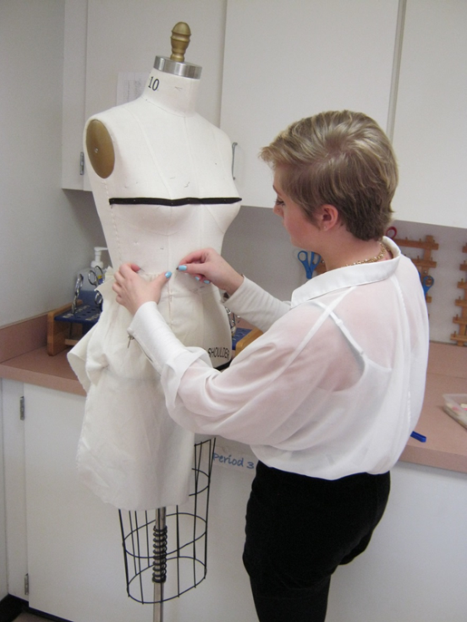
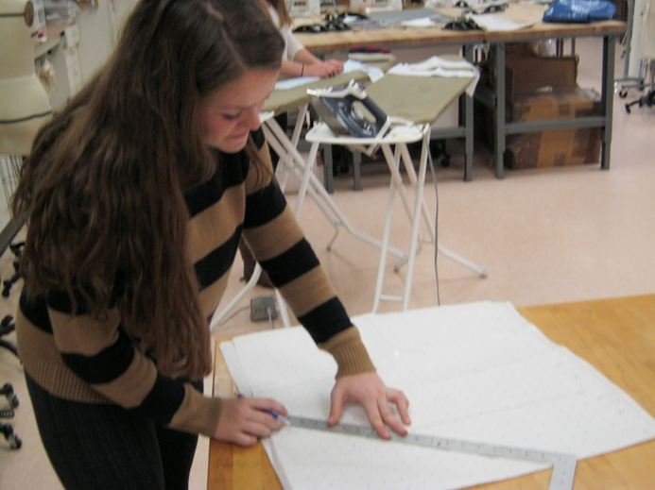
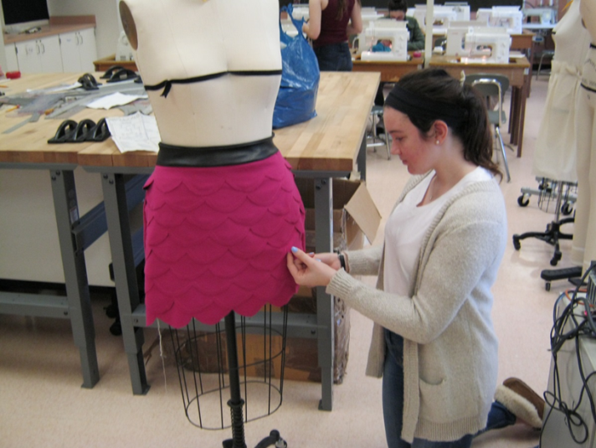
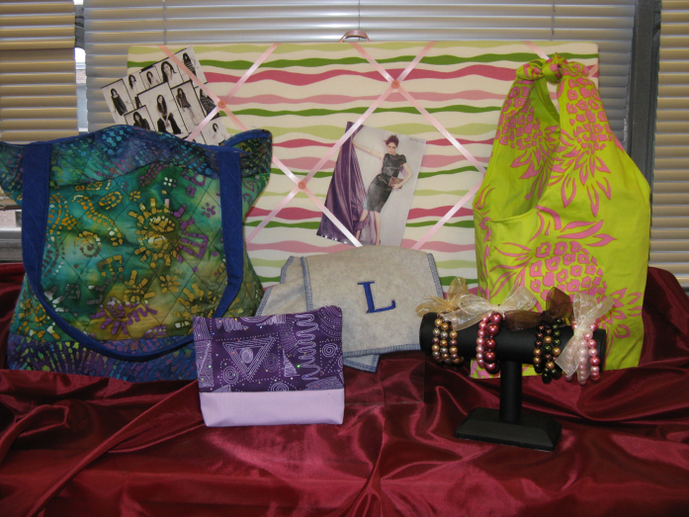
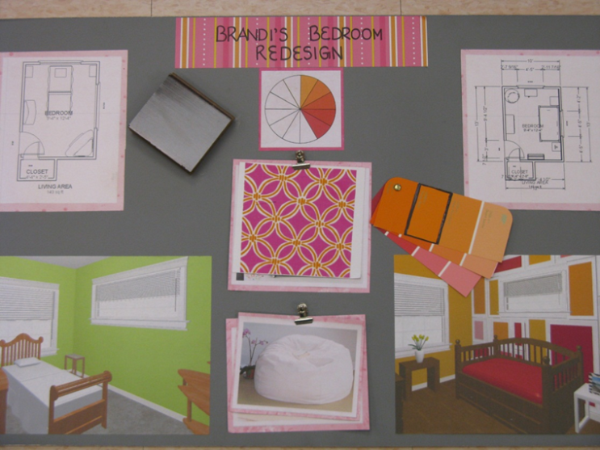
Fashion and Design
Fashion and Design
10, 20, 30, 40
Possible Career Pathways:
Retail Buyer or Merchandiser
Showroom Sales
Visual Merchandiser
Store Planning Designer
Fabric or Clothing Designer
Trend Forecaster
Interior Designer
Fashion Merchandising and Interior Design

Slide 34
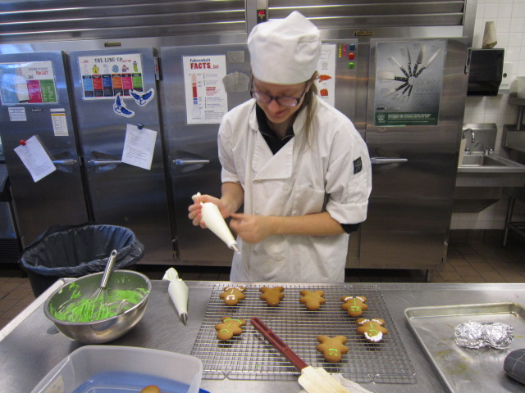
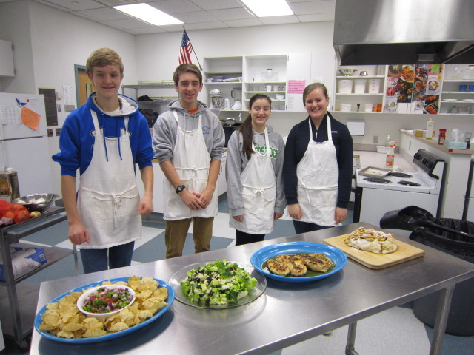
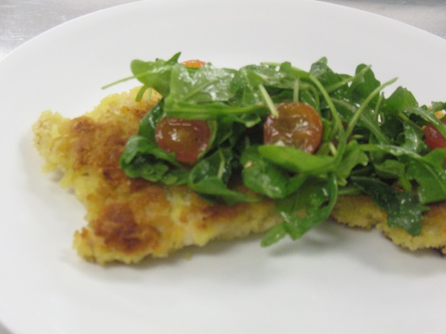
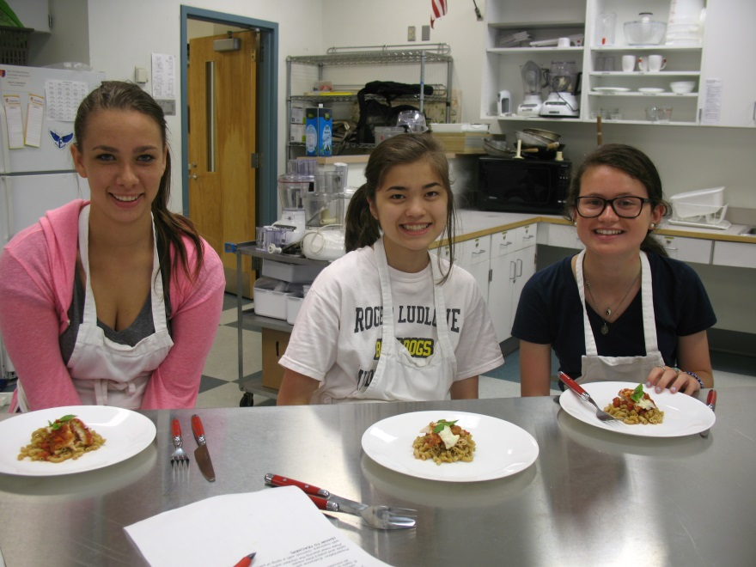
Culinary Arts & Food Service
Possible Career Pathways:
Professional Chef
Nutritionist
Food Photographer or Stylist
Hotel Management
Food Science & Research

Slide 35
Media Production:
Telling Real and Imagined Visual Stories
Library Media Department
Broadcast Journalism
Documentary Production
Movie Production
Video Production

Slide 36
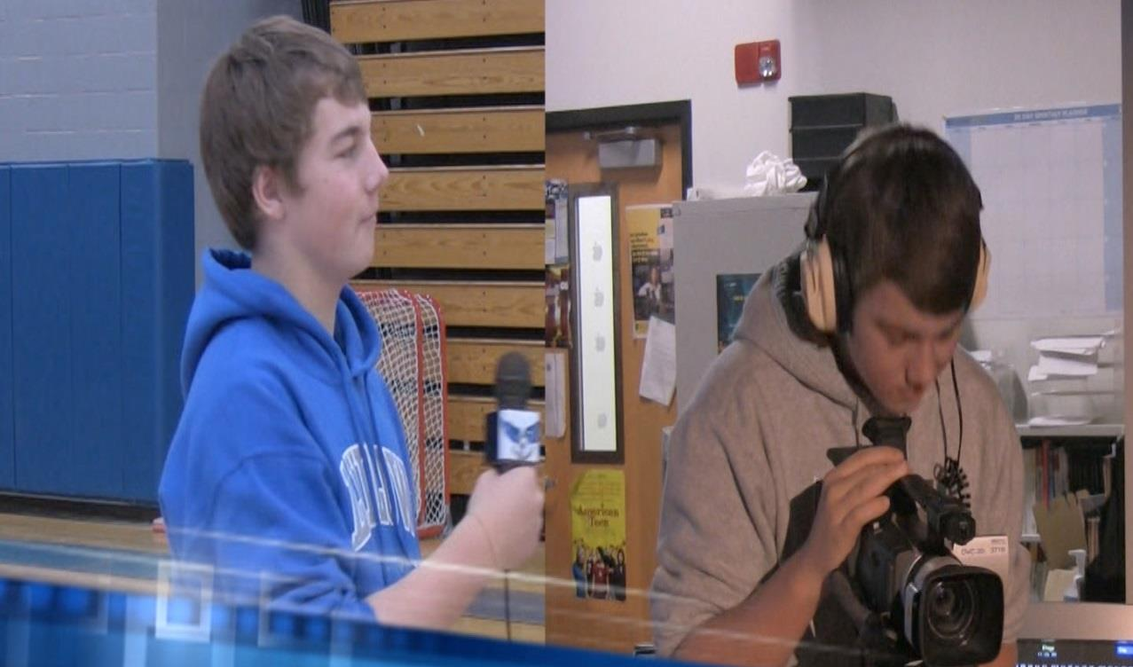
Broadcast Journalism
Producing informative stories of interest and importance to the school and local community.

Slide 37
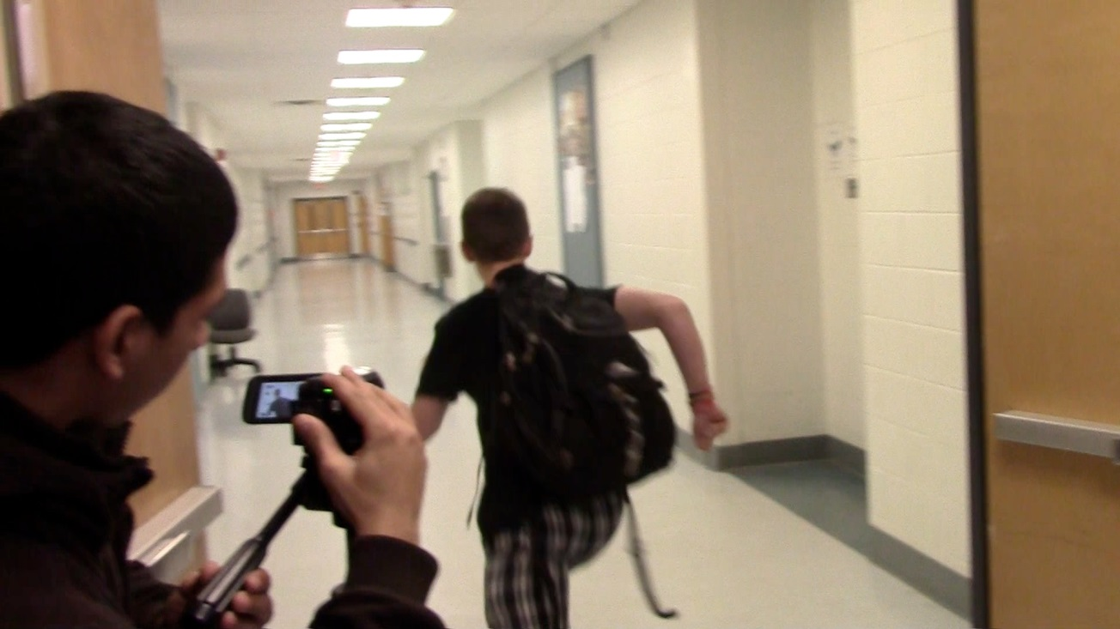
Documentary Production
Researching and producing stories about real people and events .
Creating and producing imagined visual stories.
Movie Production

Slide 38
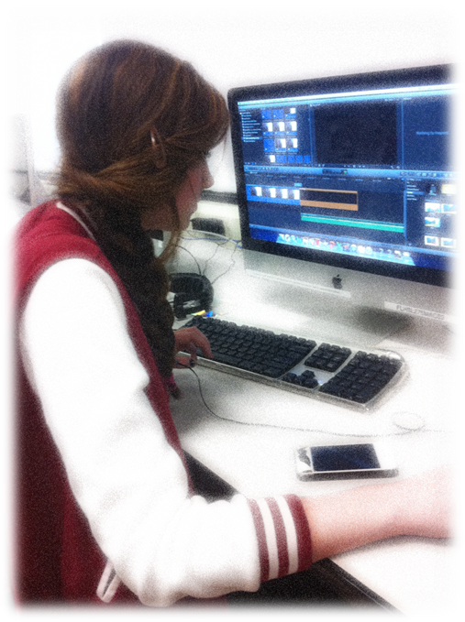
Video Production
Exploring the technical side of media production with a focus on camera work, sound and editing.

Slide 39
Technology
Education
.
CAD: Computer Aided Design
Computer Technology
Graphic Communications
Robotics
Transportation/Auto Technology
Wood Manufacturing

Slide 40
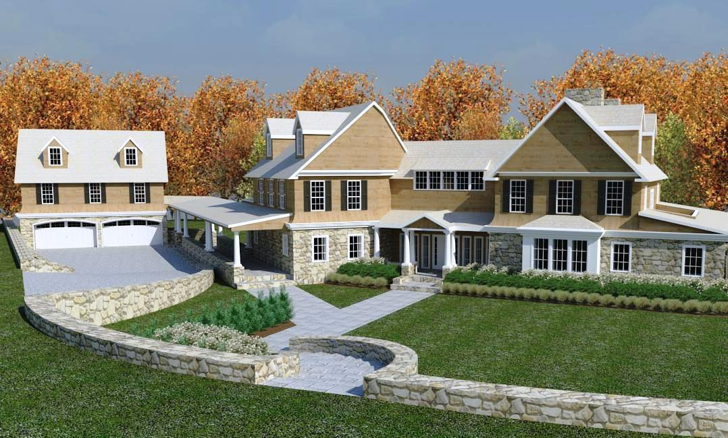
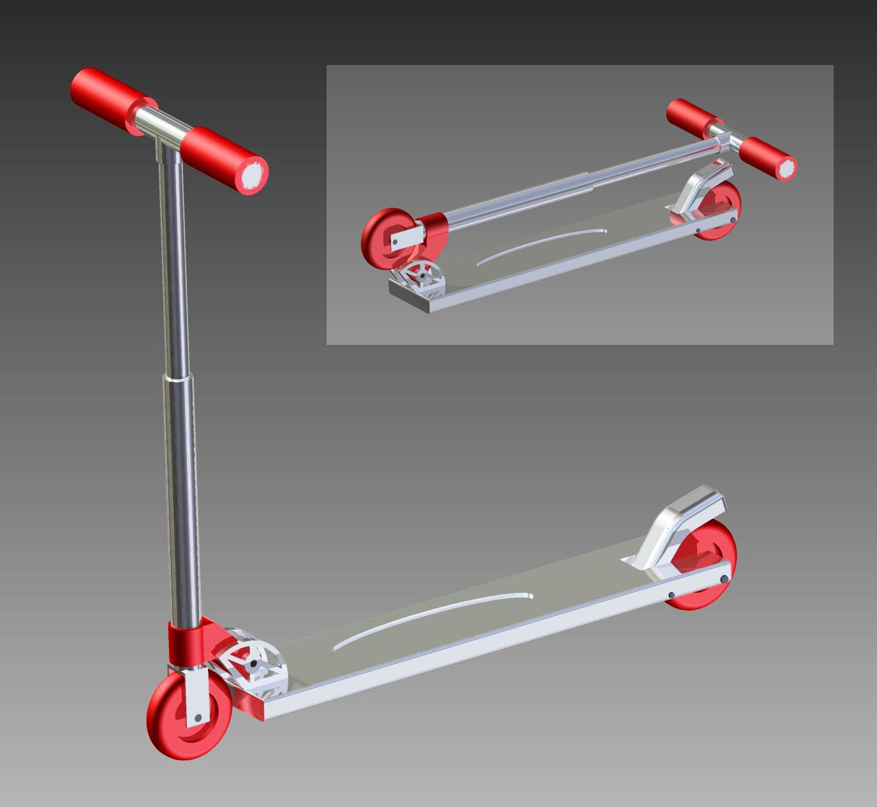

Architecture
Computer
Aided design
Engineering
Animation

Slide 41

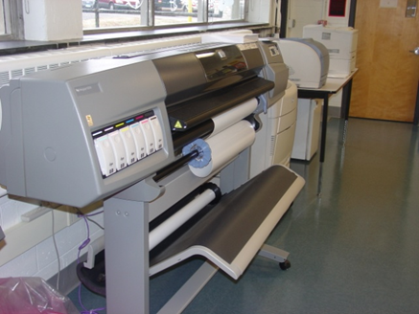
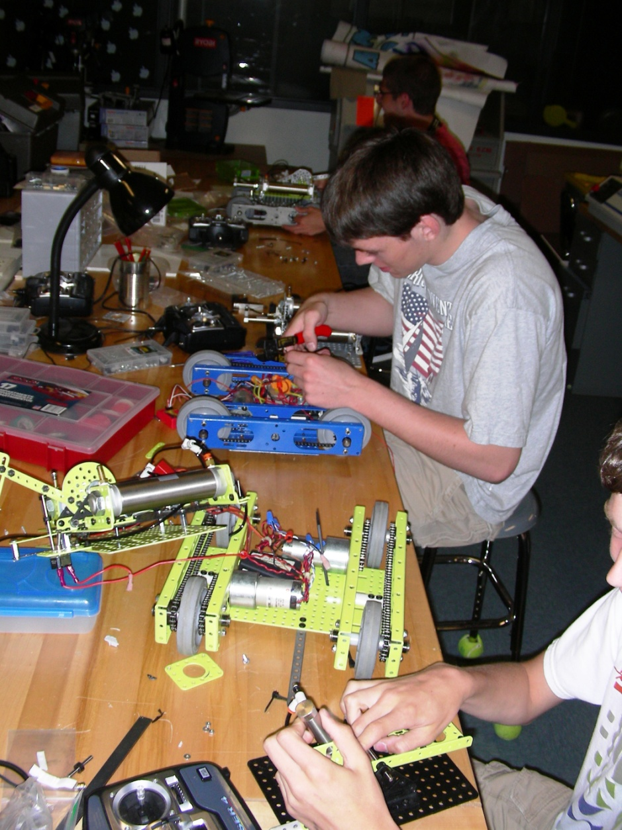
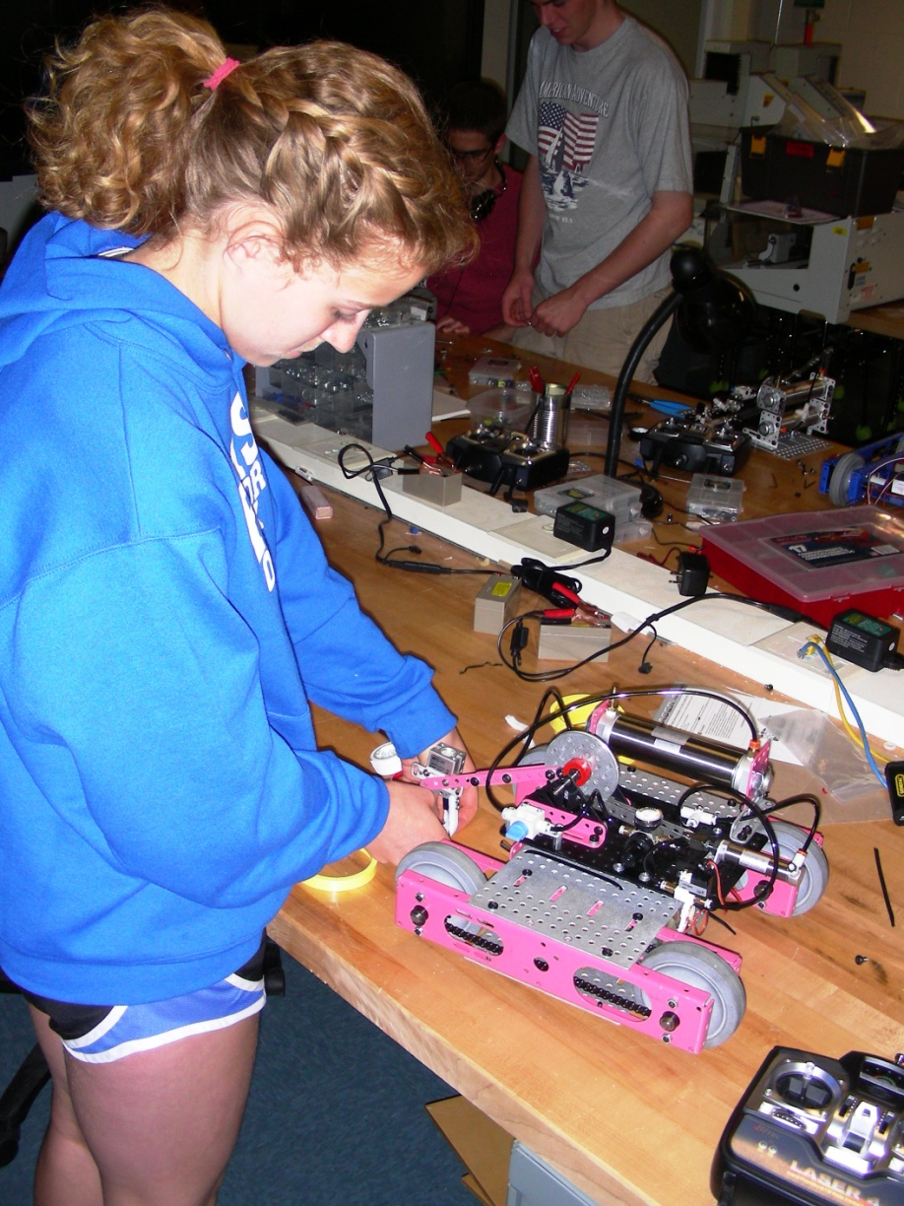
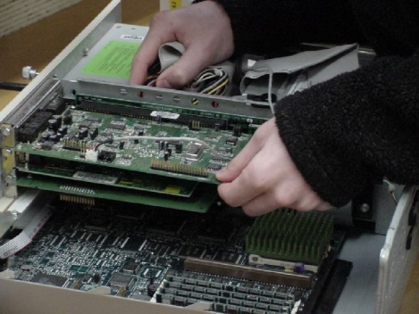
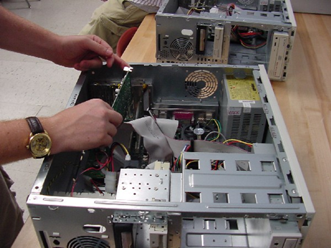



Computer Technology
Robotics Engineering
Graphic Communications
Hardware
Software
Networking
Diagnostics
Repair

Slide 42
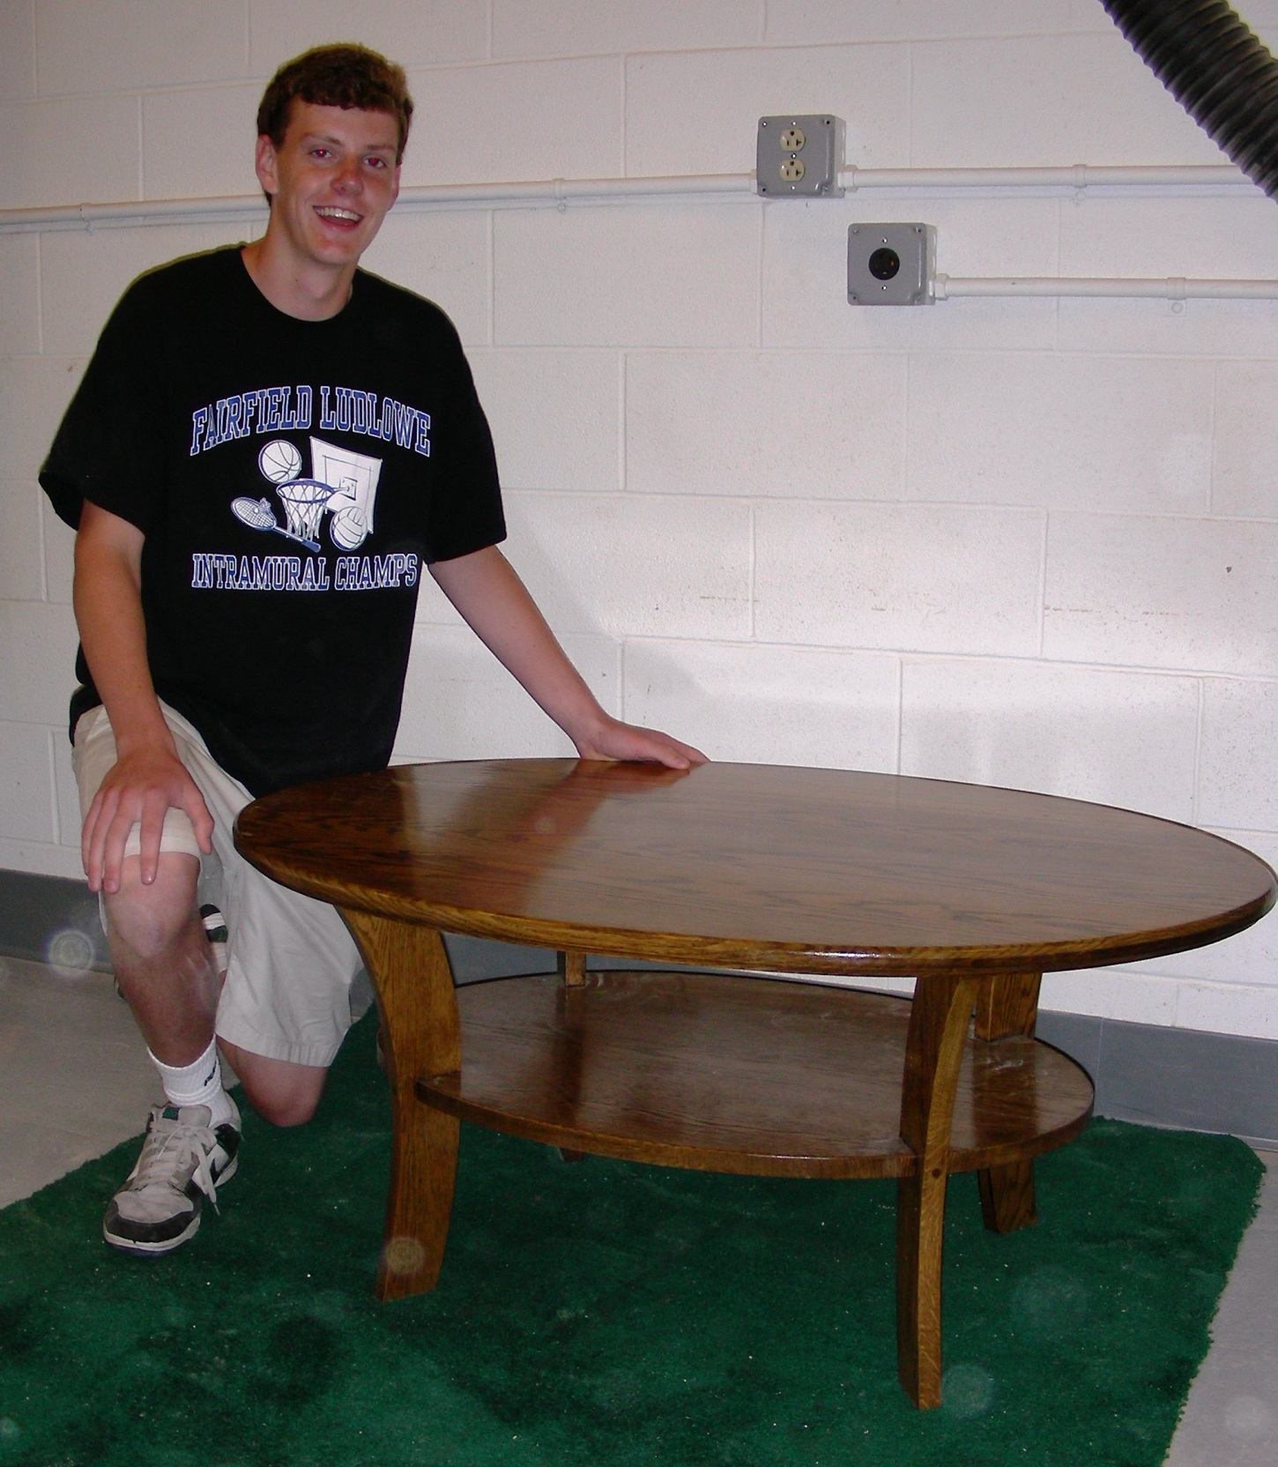
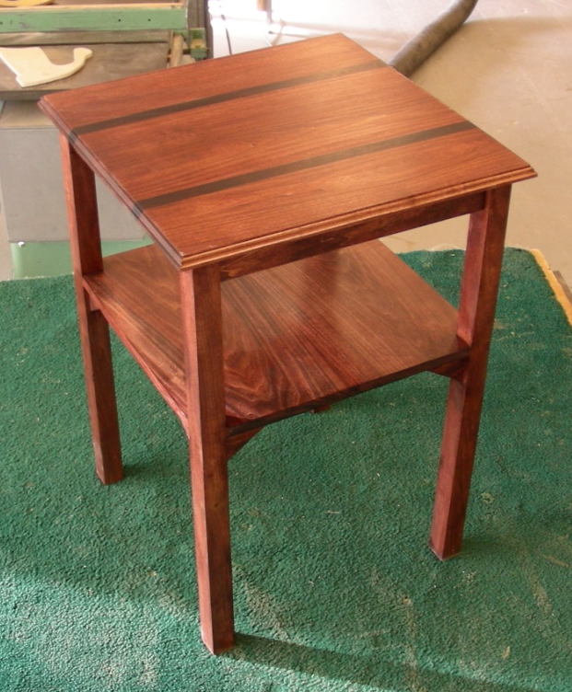
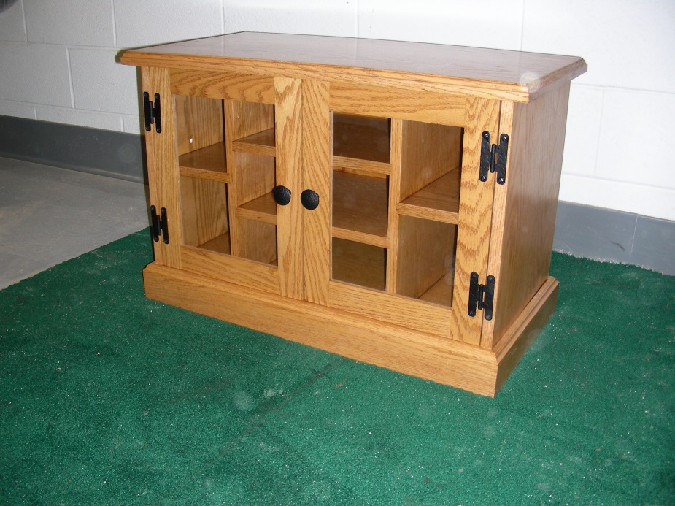
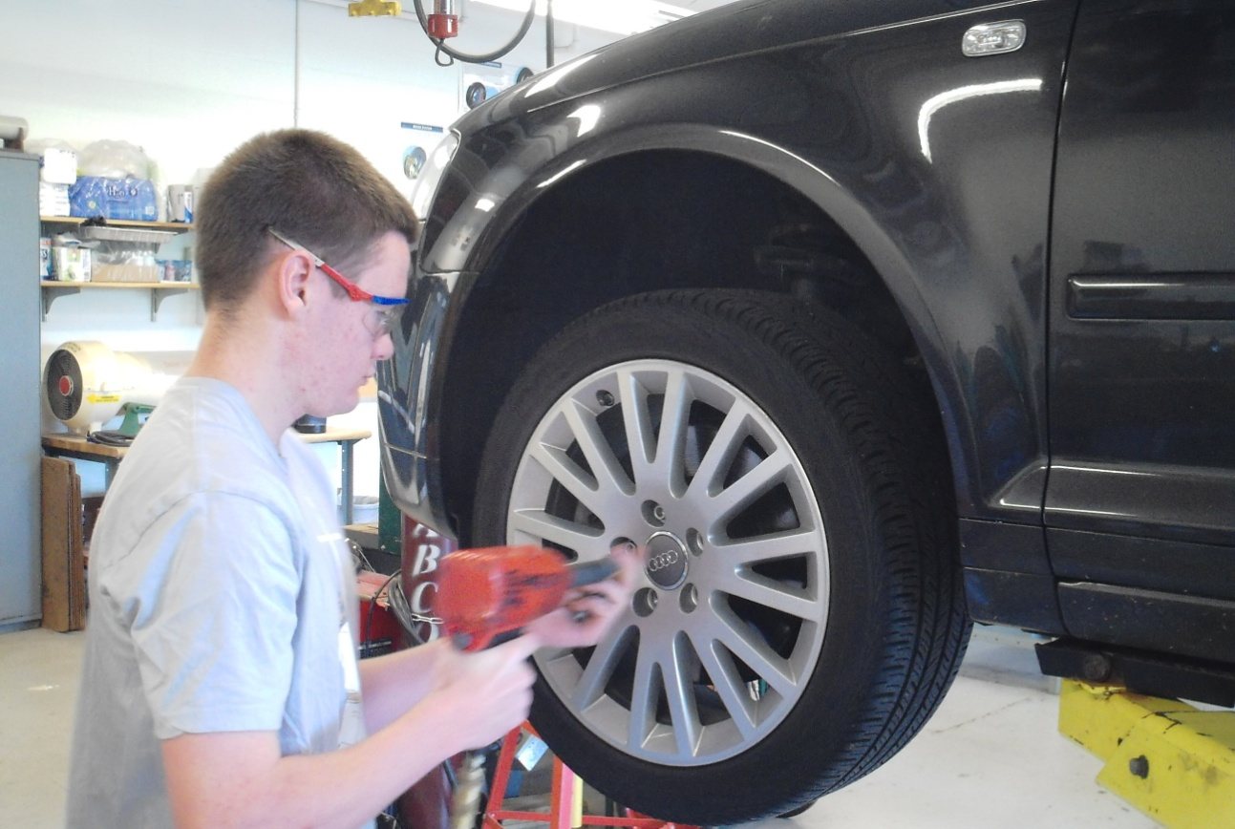
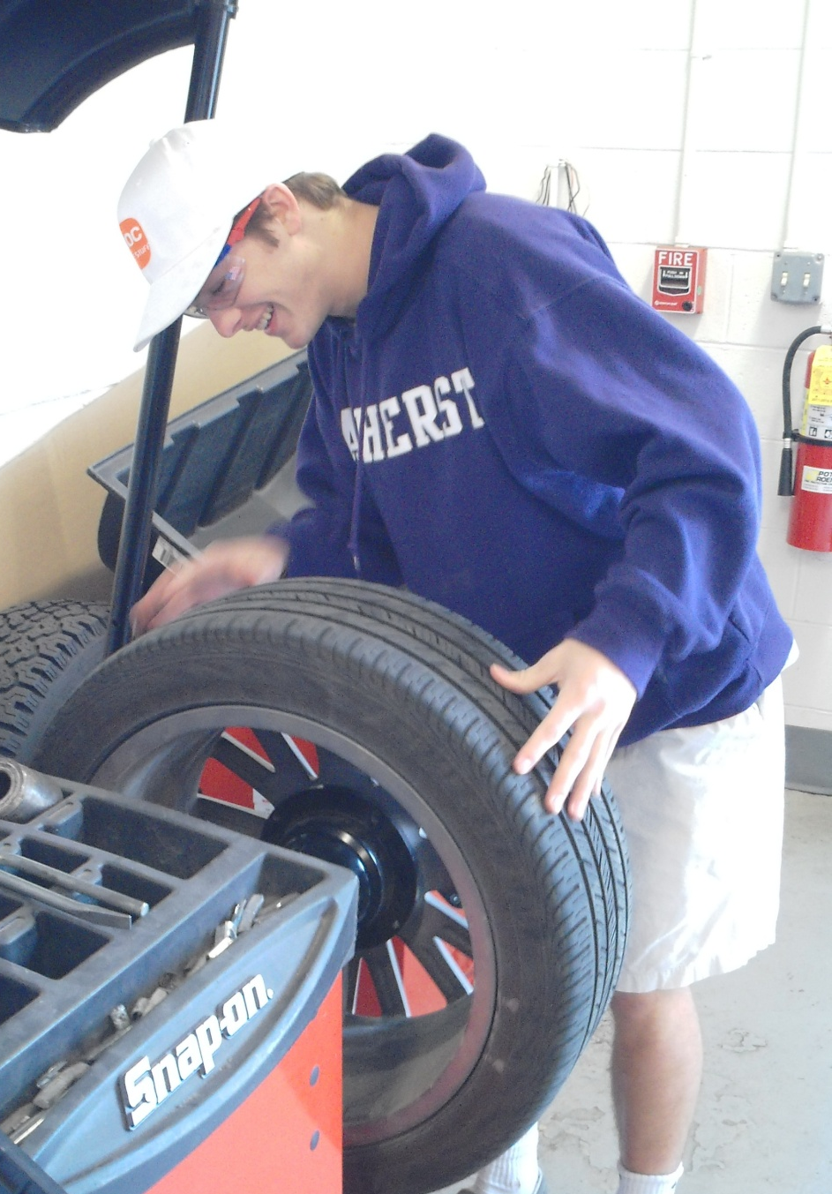
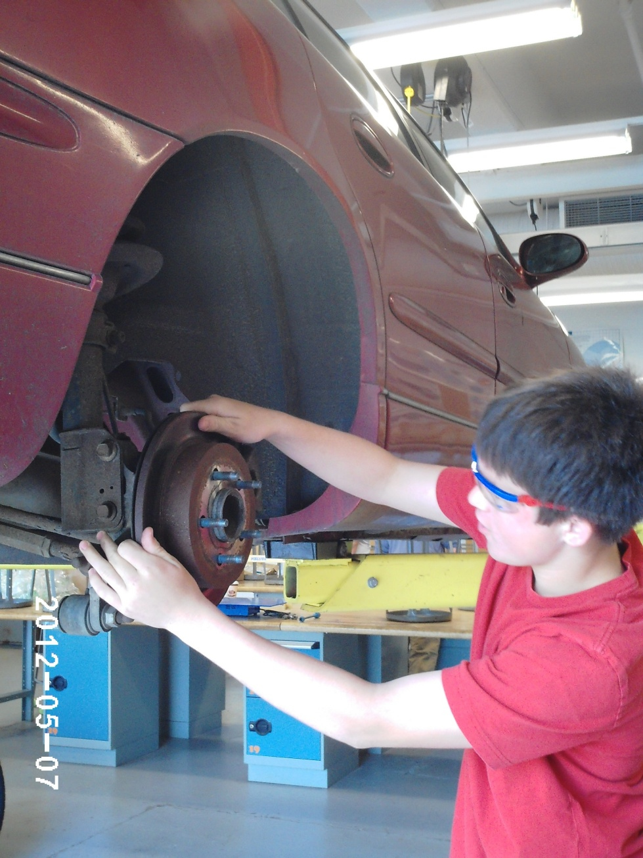
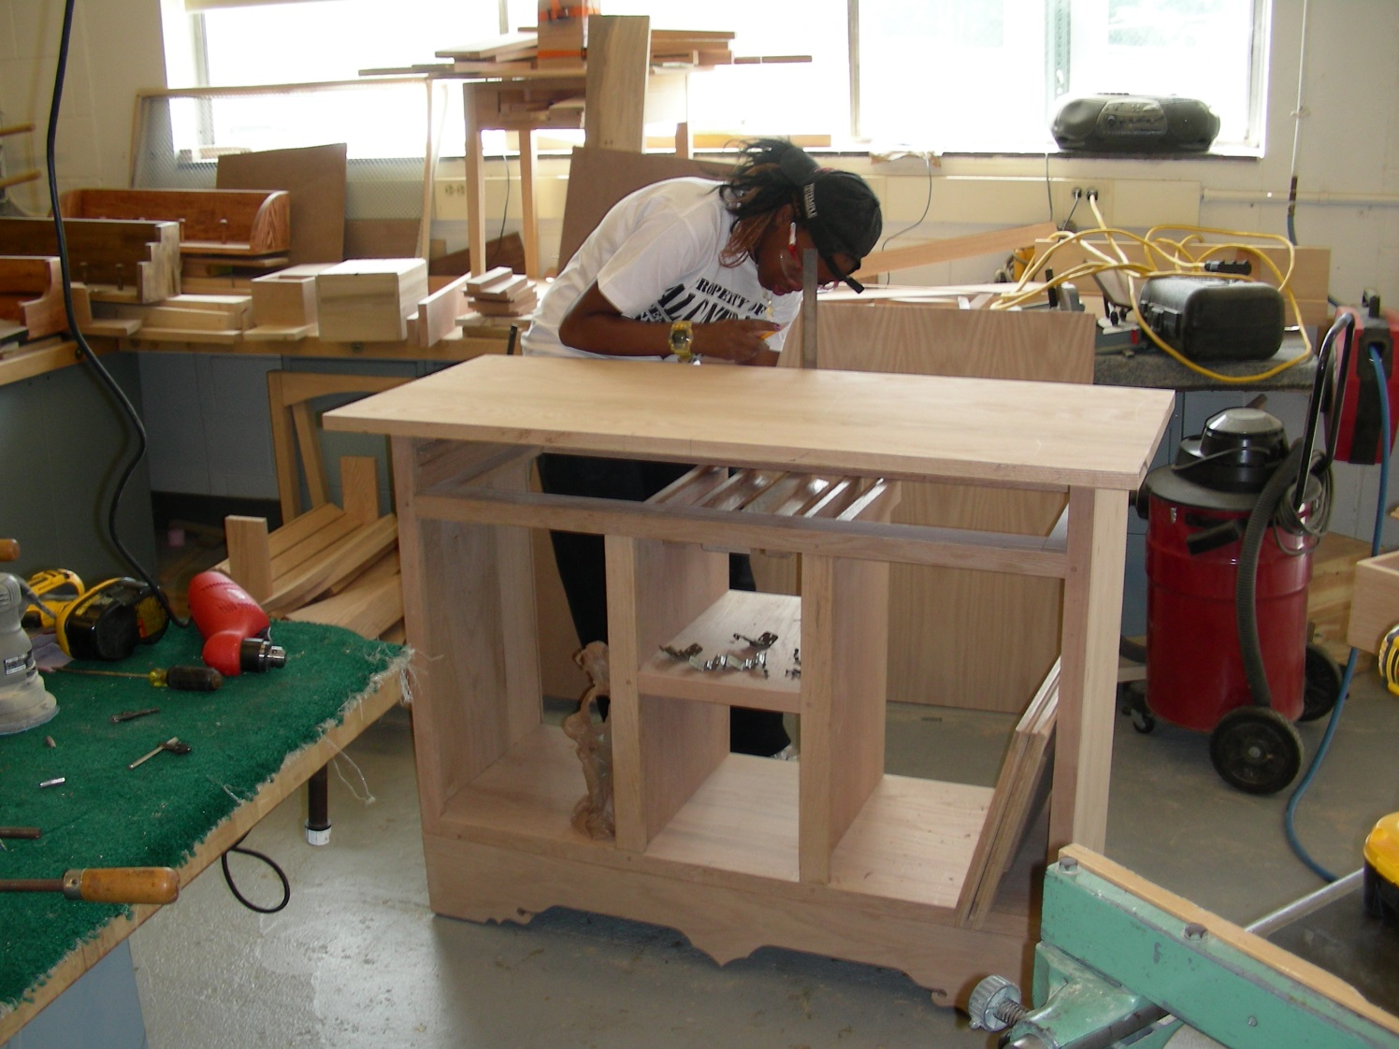
Transportation/Auto Technology
Wood Manufacturing
.

