Slide 1
Understanding The College Financial Aid Process
Kelly E. Jambo
Director of Financial Assistance
Sacred Heart University

Slide 2
“I am so overwhelmed. Where do I begin?”
Research the necessary forms and deadlines for each college the student applies to.
      Although you may believe you do NOT qualify for aid please fill out the paperwork anyway.
      Colleges utilize various forms to make determinations on aid eligibility.
      Make sure you know which forms pertain to which college:
      If a deadline passes your student may forfeit aid eligibility.
      Each and every college has a different deadline…you MUST be organized!
      If deadline is March 1st commit to getting applications done two weeks prior.
      DO NOT WAIT FOR STUDENT TO BE ACCEPTED!!!!
      Although it is nice to listen to others who have gone through this process…speak to the colleges directly.

Slide 3
Where can I access financial aid forms?
If the college has their own forms it may be on their website.
FAFSA= Free Application for Federal Student Aid
      www.fafsa.ed.gov
      All colleges administering federal aid must require students to complete the FAFSA
CSS Profile: www.collegeboard.org
          Cost to register and to list one college is $25.00 each additional school listed is $16.00. Fee waivers are determined by the college board only based on income levels.
NCP Profile: Non custodial Parent Profile www.collegeboard.org
To see whether the colleges you apply to require this form please visit: www.collegeboard.org

Slide 4
What is the CSS Profile Application
CSS Profile = University $$$$.
Application is On-Line Only
You will need:
    Parent/Step-parent and Student previous years tax return…2013 W2’s and federal tax return (1040/1040A/1040 EZ)
    You may estimate off of your 2012 federal tax return and W2’s
    Asset and investment info
    Correct Social Security numbers
    Correct DOB years…
    To answer ALL questions even if the answer is zero
    Changes and updates can be made however you must print out a copy of the form, make the corrections manually and then fax the updates to the colleges.
Once the CSS Profile is submitted it will provide the college with a
family contribution=EFC

Slide 5
Non-Custodial Parent Profile
The Non-Custodial Parent Profile (NCP) is requested by some colleges in addition to the CSS Profile.
      You can see who asks for this by visiting www.collegeboard.org
Application is on-line only!
Cost is the same as CSS Profile
This forms is requested of families who are divorced or separated.
It will require the NCP to input their previous years income/asset info based on their federal tax return.
Some colleges, not all, may have waiver process with proper documentation.
Once the NCP is submitted the college(s) will come up with a
Family Contribution=EFC

Slide 6
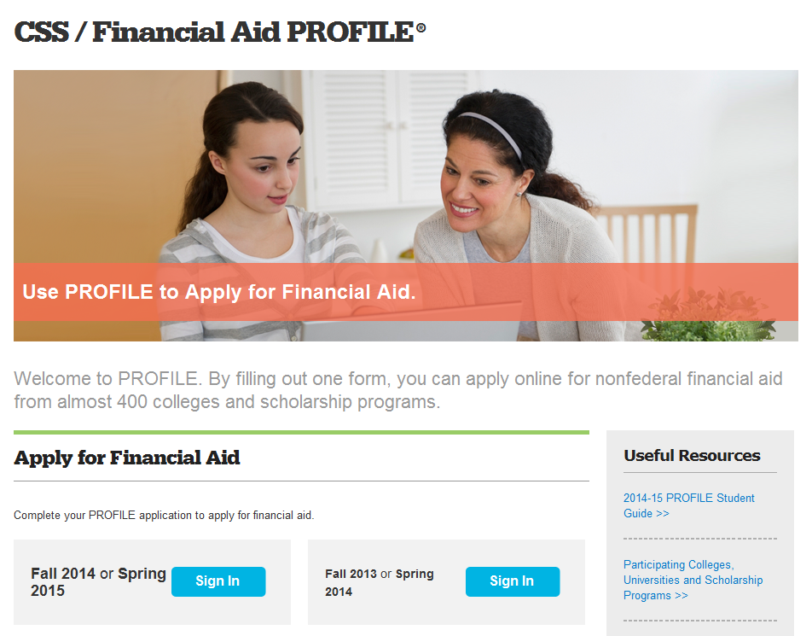
This is where you apply…

Slide 7
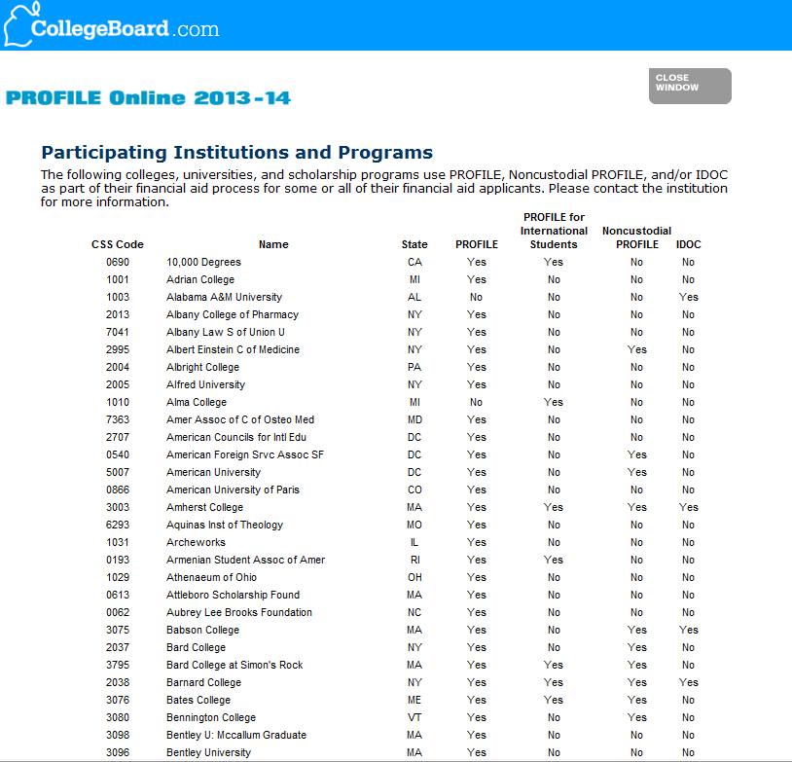
Here is the list of institutions who require the CSS Profile/Non-Custodial Profile… if the college is not listed do not complete the form…

Slide 8
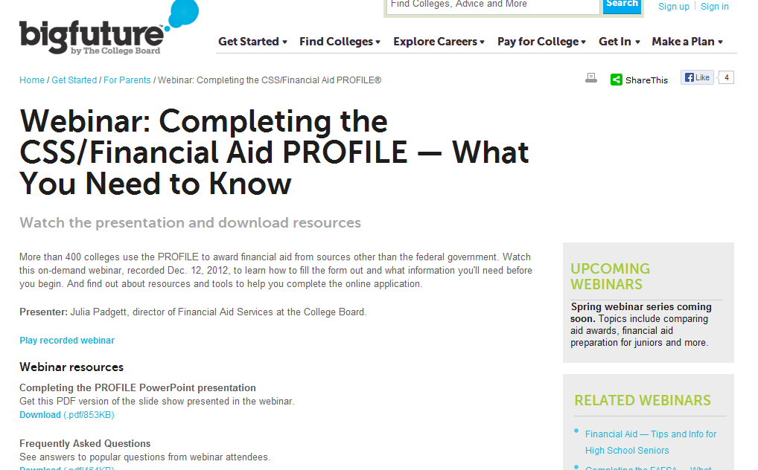
CSS Profile Webinar…

Slide 9
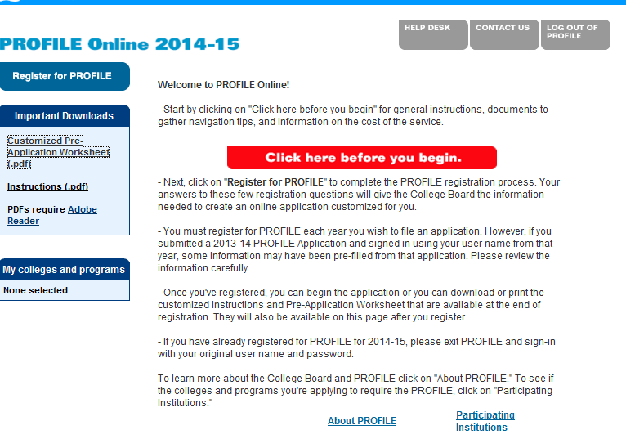
CSS Profile cont

Slide 10
The MOST Common Financial Aid application is…
Free Application for Federal Student Aid
FAFSA= Federal $$$
This is a FREE Application….DO NOT GO TO www.FAFSA.com
Application is on-line only and available January 1 2014
Apply for a federal PIN number now!
      www.pin.ed.gov
      Parent and Student MUST have a PIN Number in order to authenticate the application.
Only custodial parents file FAFSA
If remarried….SORRY!!!
You may ESTIMATE however eventually you will need student and parent(s) previous tax year 1040 and W2’s (2013) to input OR depending on timing you may be able to import that IRS data directly into the FAFSA application.
DRT: Data Retrieval Tool
College may request copy of 2013 Tax Transcript/W2s
Examples of federal aid include: Pell Grant/Supplemental Grant/Federal Direct Stafford Loan/Work Study/State Grant (CICSG) if student attends CT College.
Every question MUST be answered…if left blank the FAFSA will be rejected…
            Ex: Gender question
Once your tax return is filed you may go back into www.fafsa.gov to update your estimated or erroneous data.
Once the FAFSA is submitted it will provide the college with a family contribution.

Slide 11
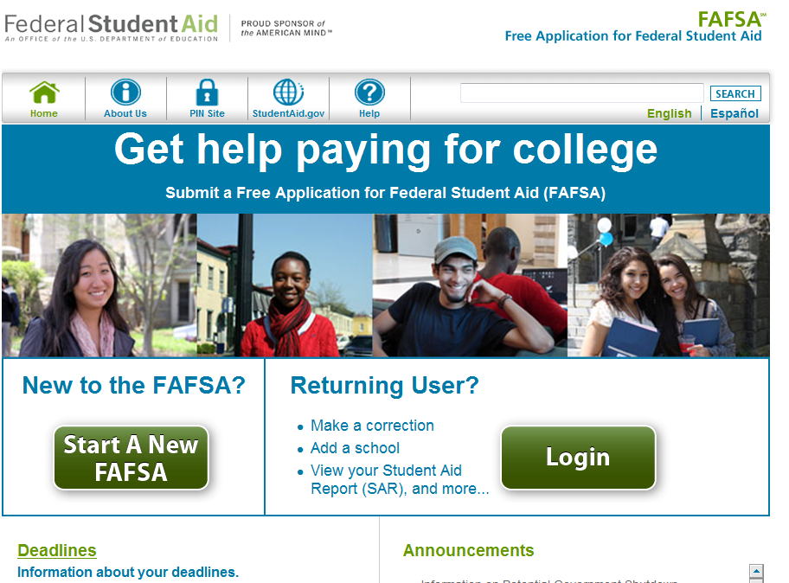
FAFSA: www.fafsa.gov

Slide 12

FAFSA on Youtube

Slide 13
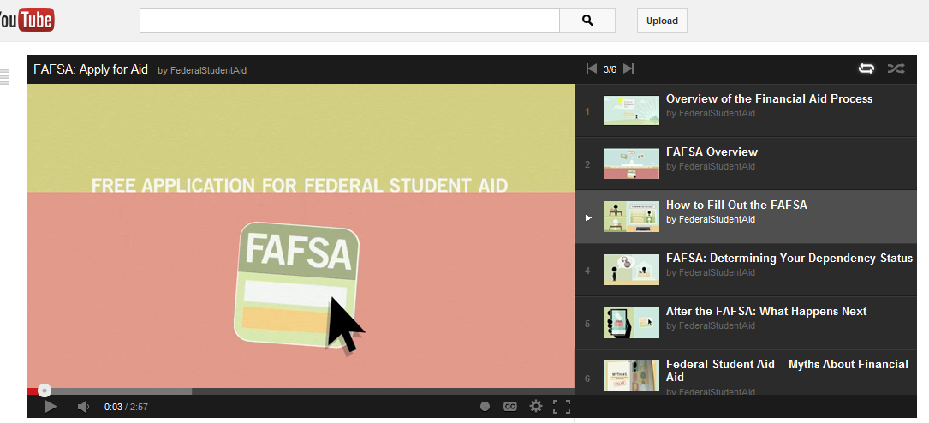
How to Fill out the FAFSA- Youtube

Slide 14
All of my forms are submitted…now what?
Colleges will then put together aid packages to discount your overall family share.
Kelly University | Elizabeth College | Jambo Community College
Cost: $50,000 | Cost $40,000 | Cost: $3,000
EFC: $20,000 | EFC: $20,000 | EFC: $20,000
Need: $30,000 | Need: $20,000 | Need: $0
Aid Package: ??? | Aid Package:??? | Aid Package: ???

Slide 15
Types of Financial Assistance
Scholarships/Merit awards
Institutional Grants
Work Study
Federal/Private Loans
Outside Scholarship
State Grant
Federal Grants

Slide 16
Wyatt University
Cost of Attendance: $50,000
Breakdown of Award:
Trustee Award $10,000
Performing Arts Award: $5,000
Wyatt U need based grant: $2,000
Work Study Award: $1,000
Federal Direct Subsidized Stafford Loan: $3,500
Federal Direct Unsubsidized Stafford Loan $2,000
Total Awards: $23,500

Slide 17
Family Share
Cost of Attendance – Financial Aid = Family Share
$50,000 - $23,500 = $26,500

Slide 18
What are my options if I feel the gap is too large…
Families and students can meet or contact the financial aid office directly to discuss the awards.
Appealing the award may be an option.
        Professional judgment with the collection of proper documentation
Loans: www.studentloans.gov
      www.chesla.org
Payment Plans
Outside scholarships…
      www.fastweb.com
      www.scholarships.com
      www.collegeboard.com

Slide 19

Net-Price Calculator (NPC)…

Slide 20

Result page based on info…

Slide 21
Final Notes…
If possible it is important to visit all colleges your student is interested in.
Deadlines
Forms
Understanding costs and award letters
Speaking with the aid office
Family Share
Importance of Outside Scholarships

Slide 22
Questions

