Slide 1
FAIRFIELD LUDLOWE HIGH SCHOOL
High School 101
For Parents of Freshmen
Class of 2019

Slide 2
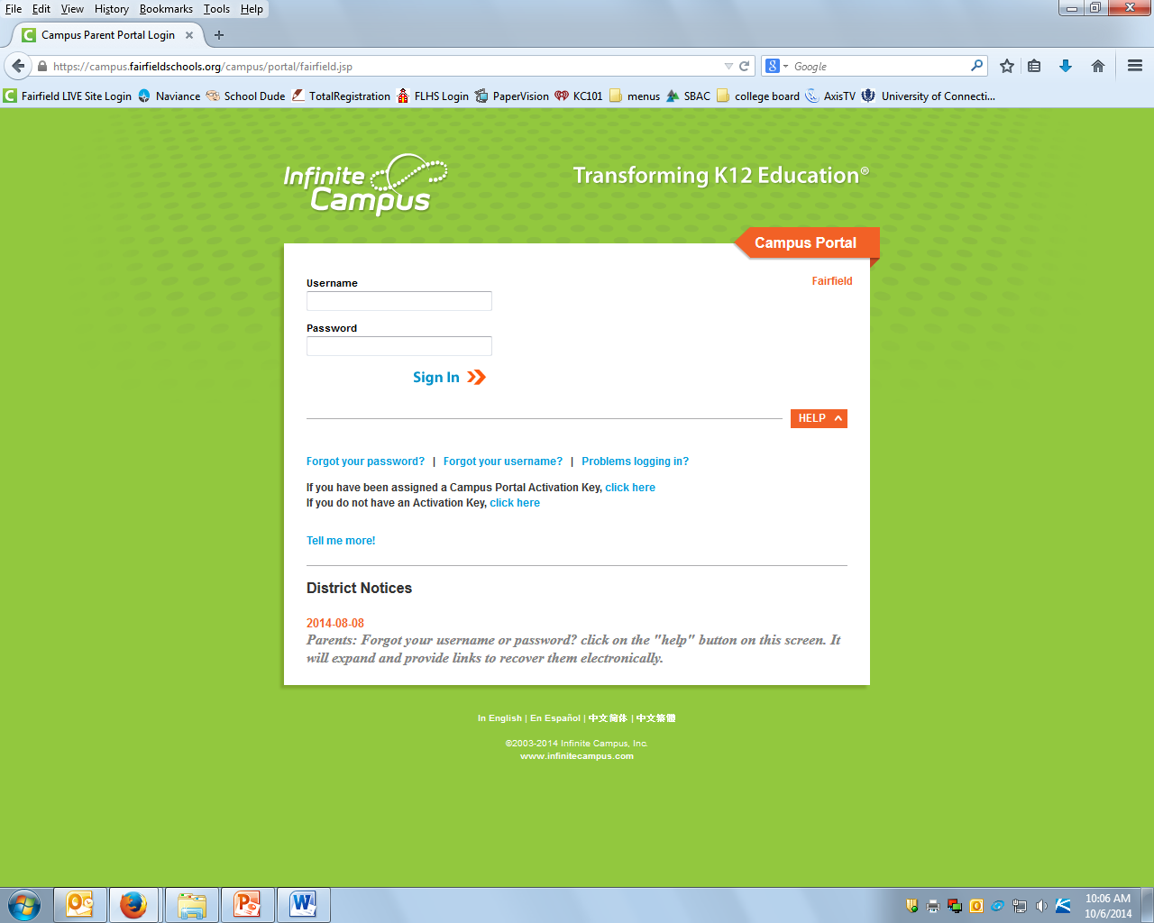

Slide 3
Freshman Forum
On Underage Drinking
Save the Date
Thursday, November 12, 2015
7:00- 8:30 PM
Fairfield Ludlowe High School Auditorium
All Freshman Students and Parents
must attend together
Freshman Forum on Underage Drinking
Soar Above the Influence….

Slide 4
FAIRFIELD LUDLOWE HIGH SCHOOL
ATTENDANCE POLICY
Reporting Absences from School
Parents are expected to call or otherwise communicate with their child’s house administrative office within two school days of each day their child is absent from school, tardy to school, or dismissed early from school. For your convenience, each house office has voice mail during non-school hours:
Warner House : 255-7223 Webster House: 255-7236 Wright House: 255-7240
Purpose of the Attendance Policy
The purpose of the Fairfield Ludlowe High School Attendance Policy reflects our desire to have each student attend all classes and arrive on time.
The maximum number of absences permitted before credit is lost:
Full-year course (five class periods per week): 12
Semester course (five class periods per week): 6
All health & PE courses: 3
Courses that deviate from the above: Prorate absences

Slide 5
FAIRFIELD LUDLOWE HIGH SCHOOL
REQUIREMENTS FOR GRADUATION
Board of Education Policy 5225
To graduate from the Fairfield Public Schools a student must earn a minimum of 43 credits and meet the credit distribution requirement. A student must also demonstrate the designated computer applications proficiency.
Credit Requirements for Graduation
To meet the minimum requirements for a high school diploma, a student must earn 43 credits and achieve the following credit distribution:
English 8 credits
Math 6 credits
Science 6 credits
Social Studies 7 credits
Physical Education & Health 4 years (8 units)
Arts/Vocational 2 credits

Slide 6
FAIRFIELD LUDLOWE HIGH SCHOOL
EARLY COMPLETION OF HIGH SCHOOL GRADUATION REQUIREMENTS
It is possible for students who are willing and able to plan ahead to complete high school in less than 4 years. Those who want to finish in 3-1/2 years must complete their plans by June of their 11th grade year.
All plans for early completion of high school must be carefully reviewed to be sure all situations have been thoroughly explored and understood by the student and his parents. A parent letter indicating the plan must be filed with the Director of Pupil Services and Counseling. The Headmaster must approve all requests. Students approved for the early completion of high school are expected to complete the program as planned.

Slide 7
FAIRFIELD WARDE/ LUDLOWE HIGH SCHOOLS
MARKING PERIOD/REPORT CARD SCHEDULE
2015—2016
SEMESTER ONE
Marking Period 1
September 3—November 10, 2015 (45 days—D1=23, D2=22)
Tuesday November 10, 2015 2:00 p.m. Portal closed to parents & students
Wednesday, November, 18, 2015 2:00 p.m. Portal reopens to parents & students to access report cards
Marking Period 2
November 11—January 27, 2016 (45 days—D1=22, D2=23)
Wednesday, January 27, 2016 2:00 p.m. Portal closed to parents & students
Thursday February 4, 2016 2:00 p.m. Portal reopens to parents & students to access report cards
**** MID YEAR EXAMS – January 21, 22, 25, 26****
REVIEW DAY – Wednesday January 27, 2016
**** All dates are tentative and flexible

Slide 8
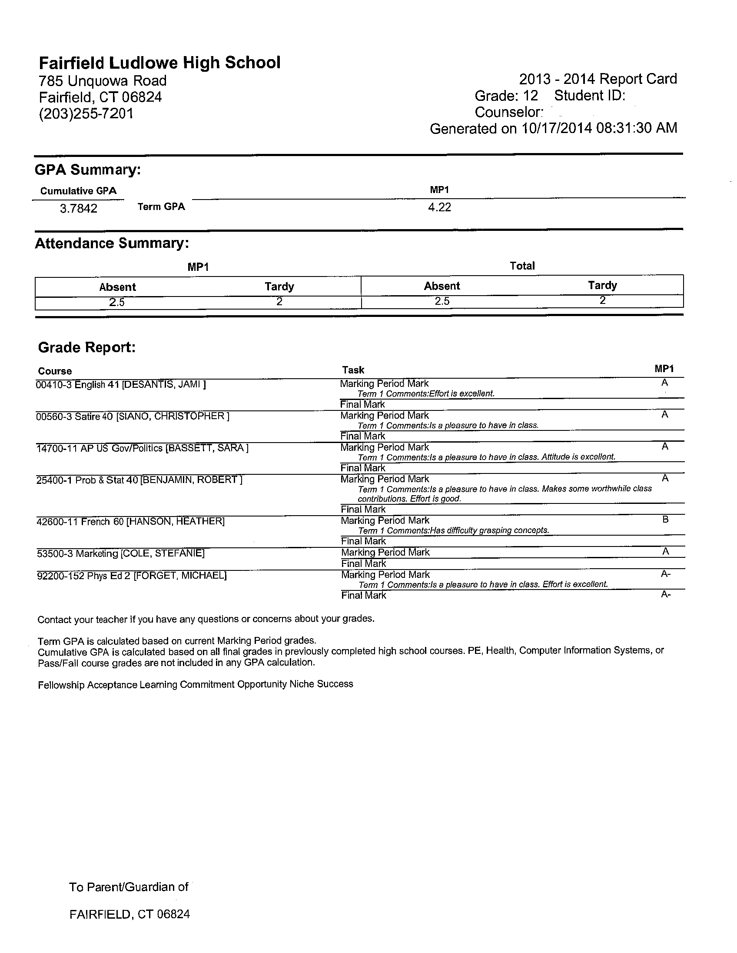

Slide 9
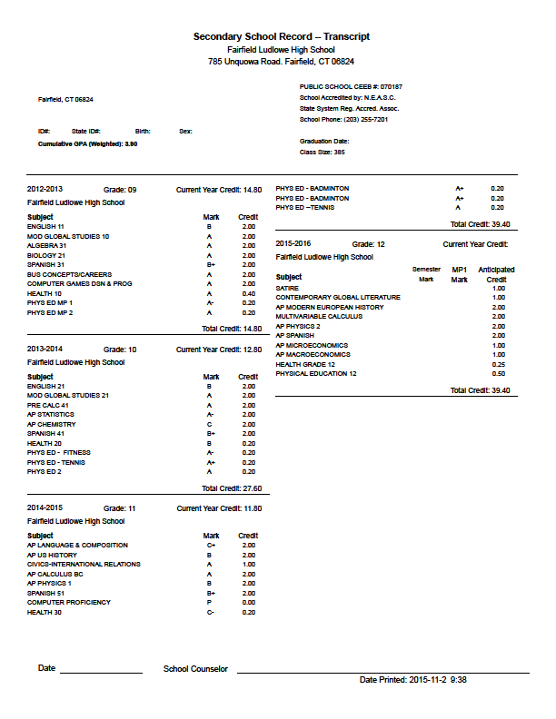

Slide 10
FAIRFIELD LUDLOWE HIGH SCHOOL
Naviance – Family Connection

