Slide 1
The Course Selection Process
Fairfield Ludlowe High School

Slide 2
Resources for Students/Parents
Program of Studies – the most thorough resource you have
Student assemblies
Conversations with teachers, counselors, curriculum leaders, administrators
Course Selection Night, January 29– all materials posted online
Informational website:
www.fairfieldschools.org/highschoolcourse_selection.html
(Includes: Course descriptions, AP syllabi, AP sample tasks and exemplary student work samples, table of time commitment expectations for each class)

Slide 3
Goals for All Students
Develop and enhance critical thinking skills
Solve problems of increasing complexity
Analyze and synthesize information
Apply knowledge/skills to new and different situations
Become more independent learners and self-advocates

Slide 4
Expectations for each Level
Level 2: (College Preparatory)
  Reading material at grade level
  Complexity of the material and work expectation at grade level
Level 1 (Honors)
  Reading material above grade level
  Complexity of the material and work expectation above grade level
  Accelerated pace
Advanced Placement
  Equivalent to a freshman college course in a major
  Reading material at the college/university level
  Significant volume of independent work
  Level of synthesis, critical thinking and problem solving significantly above that of a high school course
  Very rapid pace

Slide 5
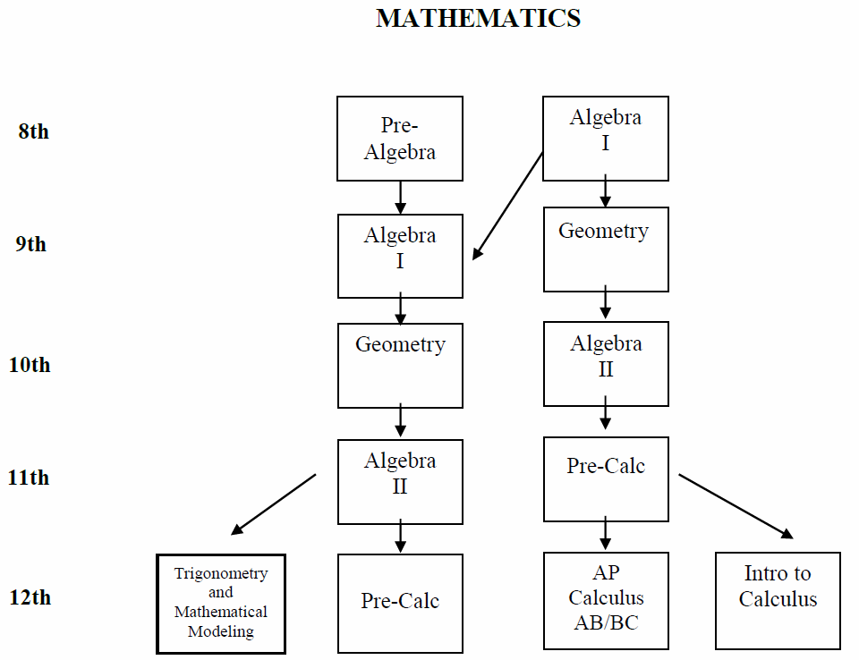

Slide 6
Comparison Among Levels of Mathematics
AP Calculus AB and BC
  5-6 hrs per week (average) outside of class time
AP Statistics
  4-6 hrs per week (average) outside of class time
Level 1 courses
  3-6 hrs per week (average) outside of class time
Level 2 courses
  1.5-2 hrs per week (average) outside of class time
Level O courses
  1.5-3 hrs per week (average) outside of class time

Slide 7
ENGLISH
 | AP Level |  | Level 1 | Level 2
Grade 9 |  |  | English 11 | English 12
Grade 10 |  |  | English 21 | English 22
Grade 11 | AP American Studies | AP Language and Composition | American Cultural Studies 31 | American Cultural Studies 32
Grade 12 | AP Literature |  | English 41 | English 42
 | Senior English Elective Semester Courses *
*Available to all seniors as the required English courses or in addition to other English courses. If taken as the required English courses, must take one writing and one literature course. All Senior English electives are Level O. Also available to juniors in addition to their required full-year course.

Slide 8
Comparison Among Levels of English
AP Literature and Composition
  7-10 hrs per week (average) outside of class time
  Summer assignment
AP Language and Composition and AP American Studies
  6-9 hrs per week (average) outside of class time
  Summer assignment
Level 1 courses
  4-6 hrs per week (average) outside of class time
Level 2 courses
  2.5-4 hrs per week (average) outside of class time
Level O courses
  3-5 hrs per week (average) outside of class time

Slide 9
SOCIAL STUDIES
Three and one-half years of Social Studies is required. The course sequence is described below: (7 Credit Requirement)
Global Studies 10
9th
Modern Global Studies
22 or 21
10th
US History 32, 31, or AP
AP American Studies
11th
11th or 12th *
Civics*
Civics & Contemporary Issues
Civics & International Relations
Civics & Youth and the Law
12th
Elective Courses
AP Modern European History Humanities
AP American Gov’t & Politics Psychology
AP Psychology Economics
Modern European History
*1 semester of civics may be taken in either 11th or 12th grade
(AP American Gov’t and Politics will also fulfill the Civics Requirement)

Slide 10
Comparison Among Levels of
Social Studies
AP Government and Politics
  5-7 hrs per week (average) outside of class time
  Summer assignment
AP Modern European History
  4-7 hrs per week (average) outside of class time
  Summer assignment
AP Psychology
  4-7 hrs per week (average) outside of class time
  Summer assignment
AP American Studies
  6-9 hrs per week (average) outside of class time
  Summer assignment
AP United States History
  6-8 hrs per week (average) outside of class time
  Summer assignment
Level 1 courses
  3-4 hrs per week (average) outside of class time
Level 2 courses
  2-3 hrs per week (average) outside of class time
Level O courses
  1.5-3 hrs per week (average) outside of class time

Slide 11
SCIENCE
SUGGESTED COURSE SEQUENCE

Slide 12
Comparison Among Levels of Science
AP Environmental Science, Biology, Chemistry, Physics
  7-10 hrs per week (average) outside of class time
  Most courses have summer assignments
Level 1 courses
  3-4 hrs per week (average) outside of class time
Level 2 courses
  1.5-2 hrs per week (average) outside of class time
Level O courses
  1.5-2 hrs per week (average) outside of class time

Slide 13
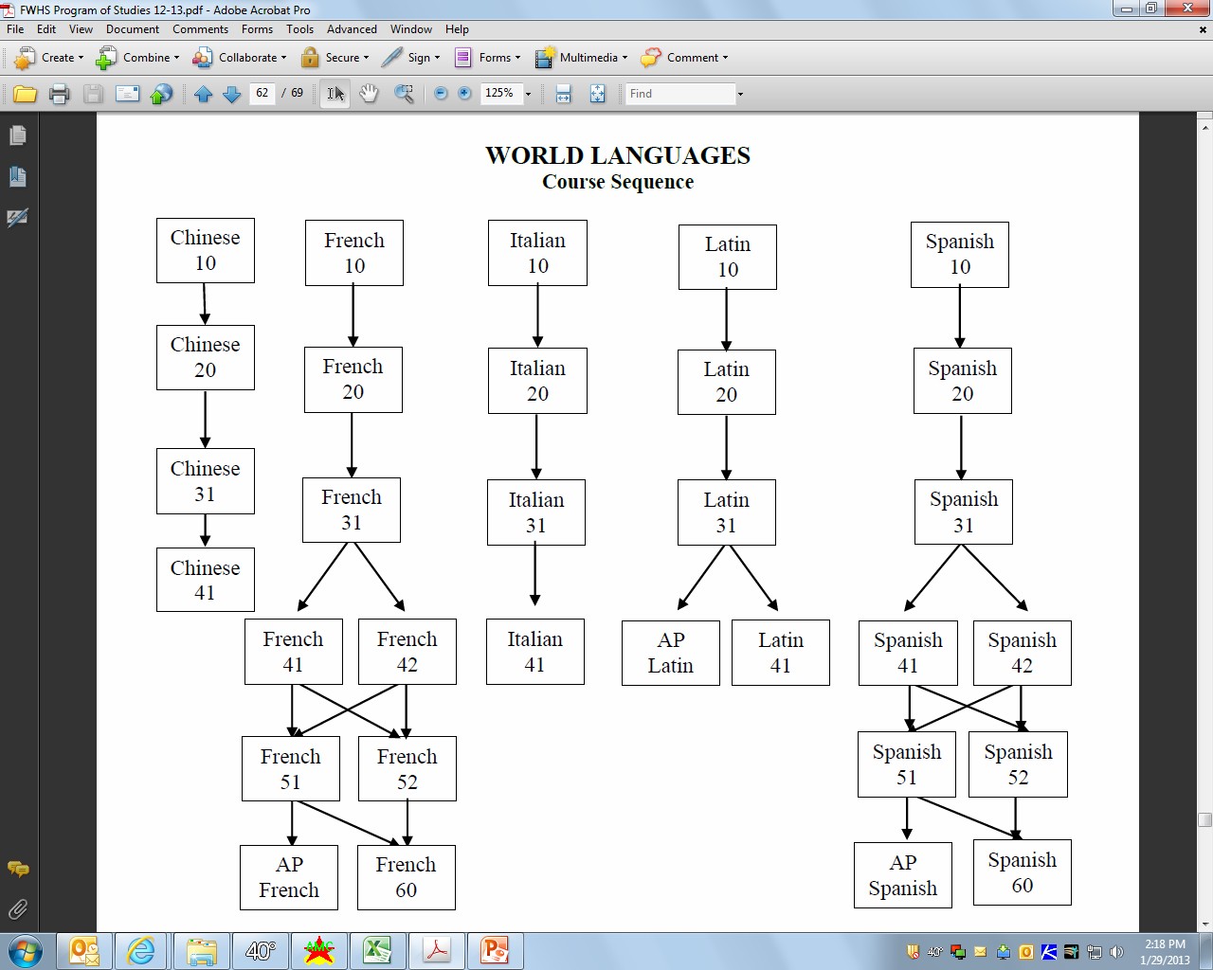

Slide 14
Comparison Among Levels of
World Languages
AP French, Spanish, Latin
  5-8 hrs per week (average) outside of class time
  Most courses have summer assignments
Level 1 courses
  3-6 hrs per week (average) outside of class time
Level 2 courses
  2-4 hrs per week (average) outside of class time
Level O courses
  2-4 hrs per week (average) outside of class time

Slide 15
The Process
1. Get Informed
Read the Program Of Studies and course information posted online, speak with your teachers
Course information night
Class meetings
2. Complete the Course Selection Worksheet with your requests
Be sure all information is accurate and complete
Week of February 3 - 7: Teachers will spend class time discussing department courses and their recommendations, and signing Course Selection Worksheet
Sign your form when completed
Obtain your parent’s signature
Turn your completed signed Worksheet into your school counselor on or before February 11, 2014

Slide 16
The Process
3. Review your requests with your school counselor
Schedule an appointment between February 11 and 28th
Enter your final selections into the Infinite Campus Student system (with counselor’s assistance)
4. Final Step
Print out Final Course Request Form from Infinite Campus (web site to be announced)
Sign and obtain your parent’s signature on the Final Request Form
Return to your school counselor on or before MARCH 3, 2014

Slide 17
Changing/Dropping Courses
Once schedules are finalized, counselors will make changes for the following reasons only:
An incomplete schedule or insufficient credits
A course scheduled in error by the school
Changes needed as the result of courses failed
Changes needed as the result of summer school work
As always, students with concerns regarding their academic progress should speak to their teacher and school counselor.

Slide 18
Calendar for
Changing/Dropping Courses
Course changes will not be approved during the first two weeks of any course (except for reasons posted on previous slide).
After the first quarter of any course, any changes will result in a grade of “W” (withdrawn) which will appear on your transcript—this applies even to level changes. This will not impact GPA. After the 1st semester, any student dropping a full year course which they are failing will receive a grade of WF.

Slide 19
Rationale for Change/Drop Policy
Our goal is to provide students and teachers with balanced classes.
Multiple changes to a schedule causes students to miss critical information shared in the initial days the course meets.
Even a single change can affect enrollment in multiple courses, increasing disruption.
We build the master schedule from student course requests, so it is important to have accurate counts.
Our process is providing students with more opportunity and responsibility to build their schedule – and we are looking to foster commitment to original requests.

Slide 20
Other Elective Offerings
Business
Family Consumer Science
Art
Media Production
Technology Education

Slide 21
Business Courses
COURSE OFFERINGS | Grade 9 | Grade 10 | Grade 11 | Grade 12
Introduction to Business | X | X
Marketing |  | X | X | X
Financial Literacy |  | X | X | X
Accounting |  | X | X | X
Business Law |  | X | X | X
Business Management |  | X | X | X
The Business of Sports & Entertainment |  | X | X | X
AP Economics |  | X | X | X
Advanced Advertising & Design |  |  | X | X
Entrepreneurship |  |  | X | X
Internship & Career |  |  | X | X
Introduction to Investing |  |  | X | X

Slide 22
Business Courses Continued…
COURSE OFFERINGS | Grade 9 | Grade 10 | Grade 11 | Grade 12
Computer Information Systems | X | X | X | X
Computer Game Design & Programming | X | X | X | X
Robotic Programming | X | X | X | X
Web Design | X | X | X | X
AP Computer Science |  |  | X | X

Slide 23
Our Business Students
Consistently demonstrate 21st century skill sets such as creativity, innovation, problem-solving, collaboration and perseverance.
Are constantly challenged to become more effective communicators.
Are provided with a platform to find their niche.

Slide 24
Family & Consumer Sciences
Food & Nutrition | Fashion Design, Merchandising & Interior Design | Human and Child Development
Culinary Arts 10 | Fashion and Textiles 10 | Child Development 30
Culinary Arts 20 | Fashion and Textiles 20 | Early Childhood Education
Food Services 20 | Fashion and Textiles 30/40 | Individual and Family Development
Food Services 30 | Fashion Merchandising and Design
 | Interior Design

Slide 25
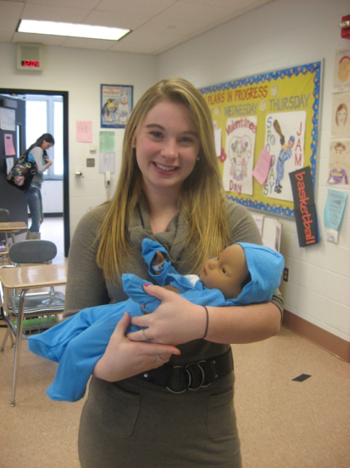
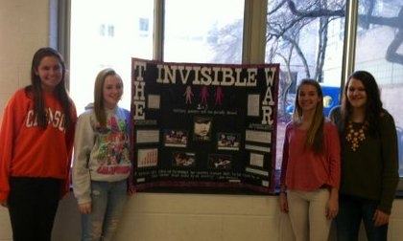
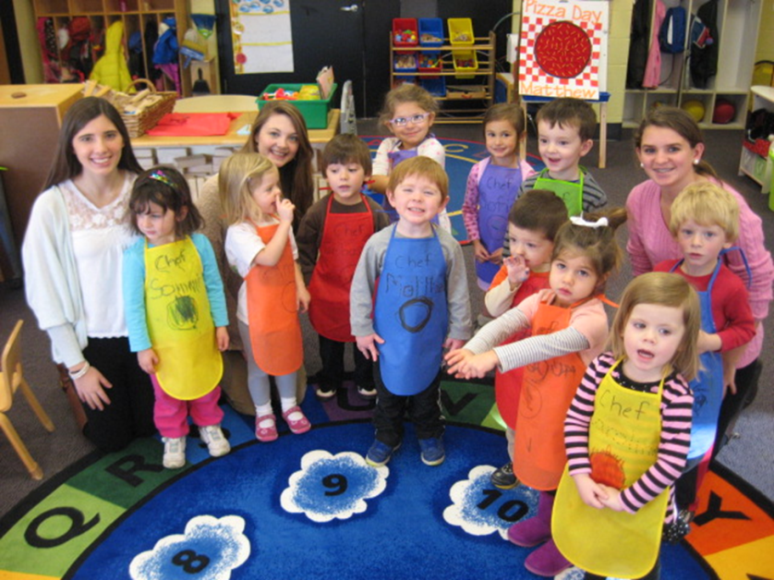
Child Development/Early Childhood Education
Child Development 30 – 1 year
Individual and Family Development– 1 year UConn Early College Experience
Early Childhood Education– 1 year plus lab

Slide 26
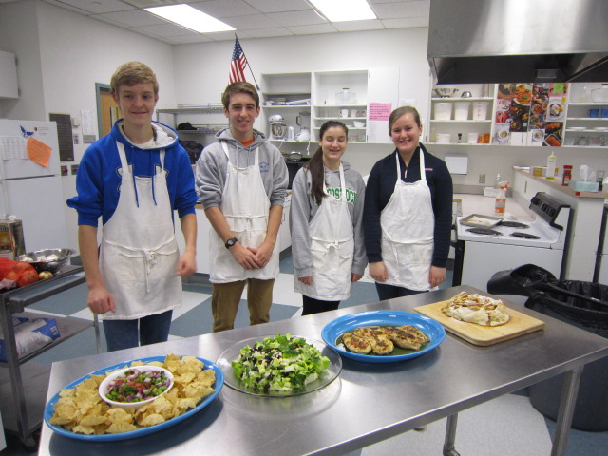
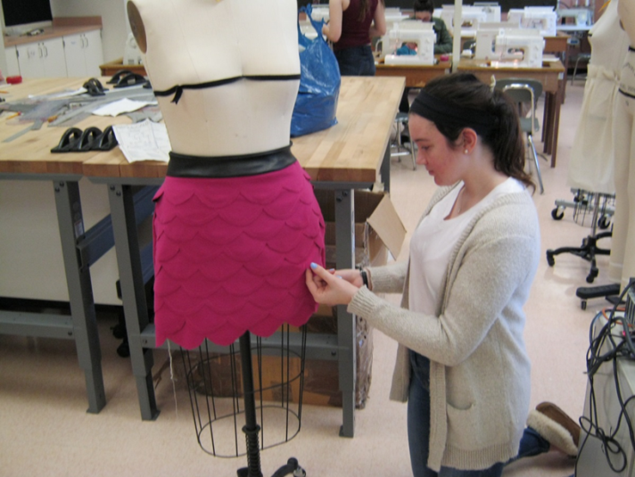
Culinary Arts & Food Service
Culinary Arts 10, 20, -- 1 Semester Each
Food Service 20 & 30– 1 year plus Lab
Fashion and Textiles
Fashion and Textiles 10, 20, 30, 40 -- 1 Year each
Fashion Merchandising -- 1 semester
Interior Design – 1 semester

Slide 27



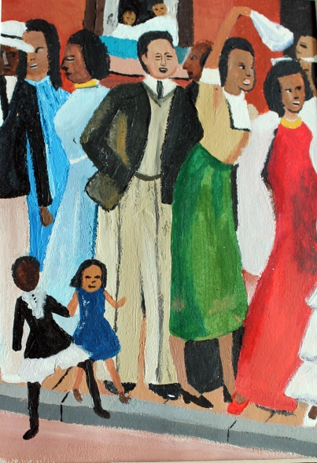
Art Course Selections

Slide 28

Art Course Sequence Options
All Electives are 1 Semester Courses
FOUNDATIONS
FULL YEAR
*Intermediate Art
*Intro to Photo
(Digital or Dark Room)
*Intermediate Photo
*Advanced photo
*AP Studio
(Full Year - 2 Periods)
*Intermediate Art
*Drawing & Painting
*Advanced Drawing & Painting
*AP Studio
(Full Year – 2 Periods)
*Intro to Pottery
*3-Dimensional Design
*Advanced Pottery/
3-Dimensional Design
*AP Studio (3D)
(Full Year - 2 Periods)

Slide 29
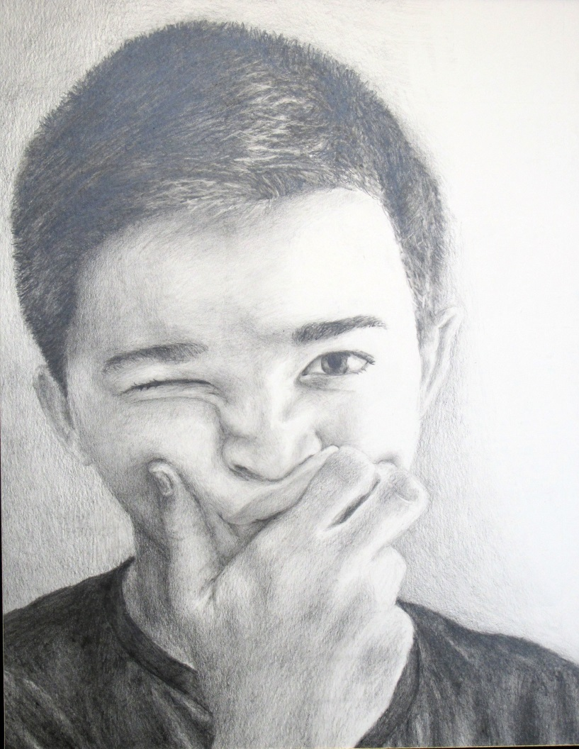
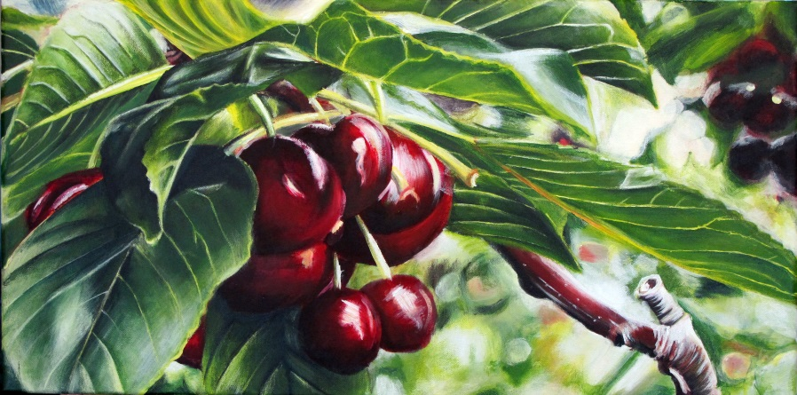
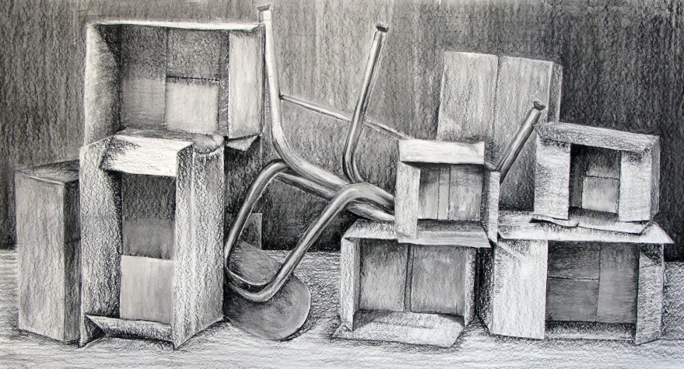
“The Arts are among the ‘six basic academic subjects’. Art is valuable in all areas of study because it engages the imagination, fosters flexible ways of thinking, develops disciplined effort & builds self-confidence.” – The College Board

Slide 30
Media Production:
Telling Visual Stories
Library Media Department
Broadcast Journalism
Producing informative stories of interest and importance to the school and local community.
Documentary Production
Researching and producing stories and people of interest and importance.
Movie Production
Creating and producing visual stories.
Video Production
Exploring the technical side of media production with a focus on camera work and editing.

Slide 31
Technology
Education
.
CAD: Computer Aided Design
Computer Technology
Graphic Communications
Robotics
Transportation/Auto Technology
Wood Manufacturing

Slide 32
Computer
Aided design
Animation
Architecture
Engineering

Slide 33
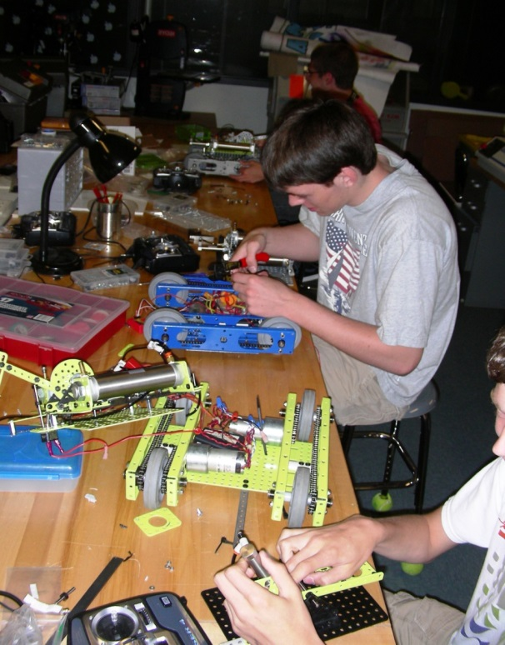

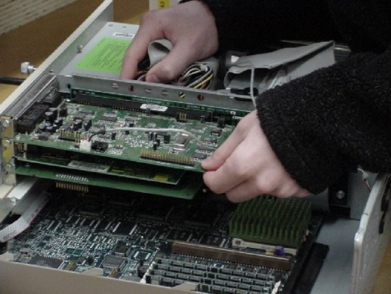
Computer Technology
Hardware
Software
Networking
Diagnostics
Repair
Graphic Communications
Robotics Engineering

Slide 34
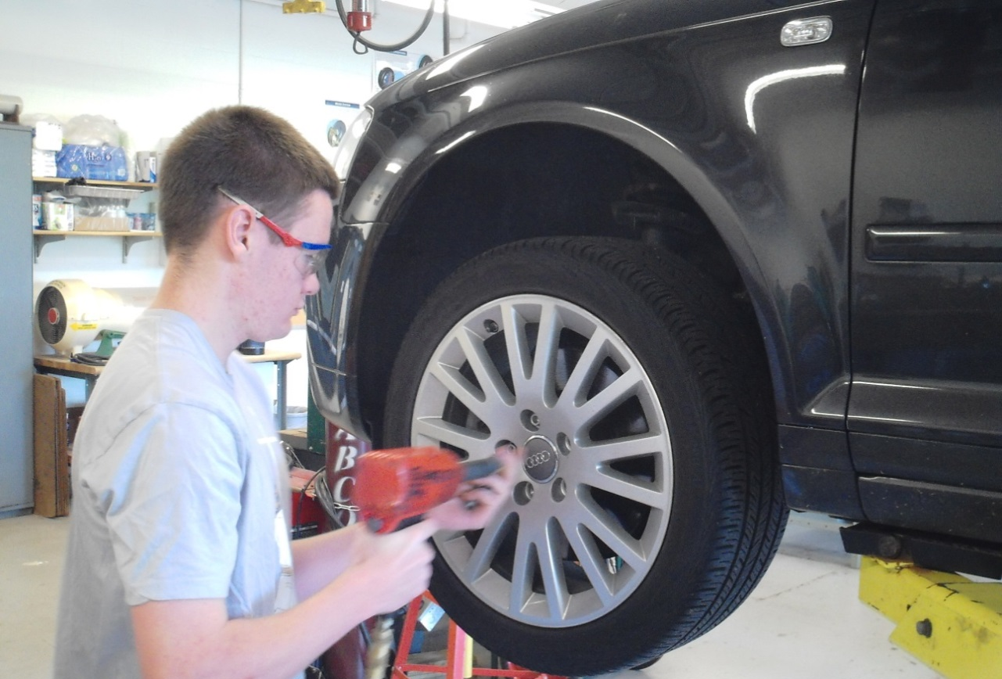
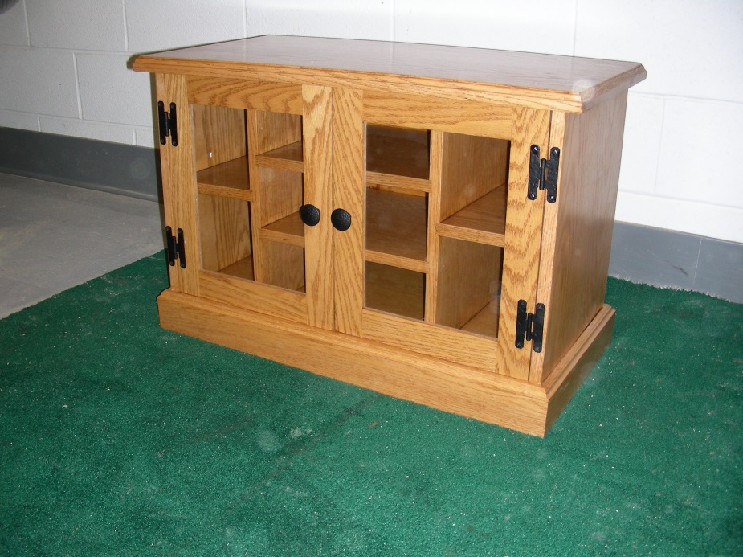
Transportation/Auto Technology
Wood Manufacturing

