Slide 1
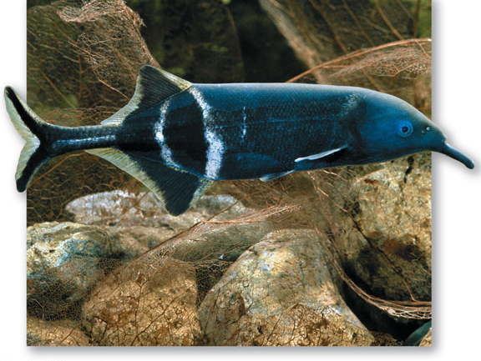
Evolution of Genes and Genomes

Slide 2
24.1 How Are Genomes Used to Study Evolution?
The genome is the full set of genes plus noncoding regions of DNA.
For some viruses it is RNA.
Most genes are on the chromosomes, but some are in mitochondria and chloroplasts.

Slide 3
24.1 How Are Genomes Used to Study Evolution?
The field of molecular evolution:
Study of the mechanisms and consequences of the evolution of macromolecules
The relationships between the structure of genes and proteins and organism function
Using molecular variation to reconstruct evolutionary history

Slide 4
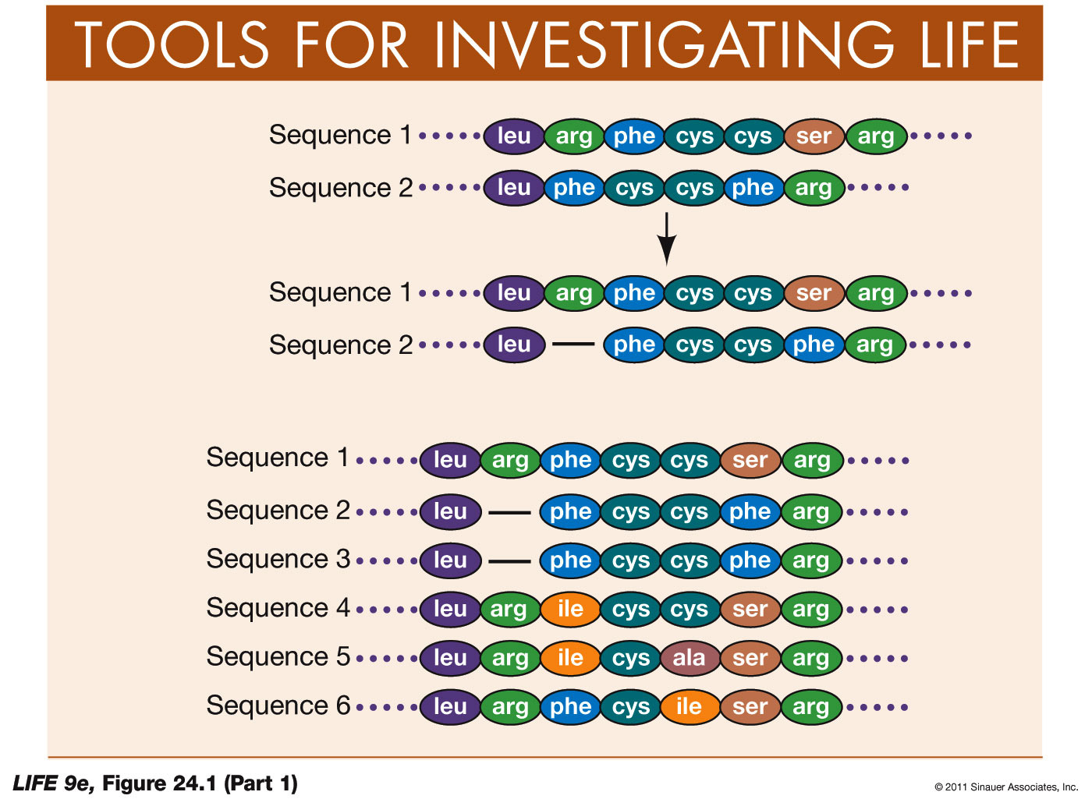
Figure 24.1 Amino Acid Sequence Alignment (Part 1)
Sequence alignment technique: Deletions and insertions in the sequence that have occurred since the two species diverged are determined by adding gaps and aligning sequences.

Slide 5
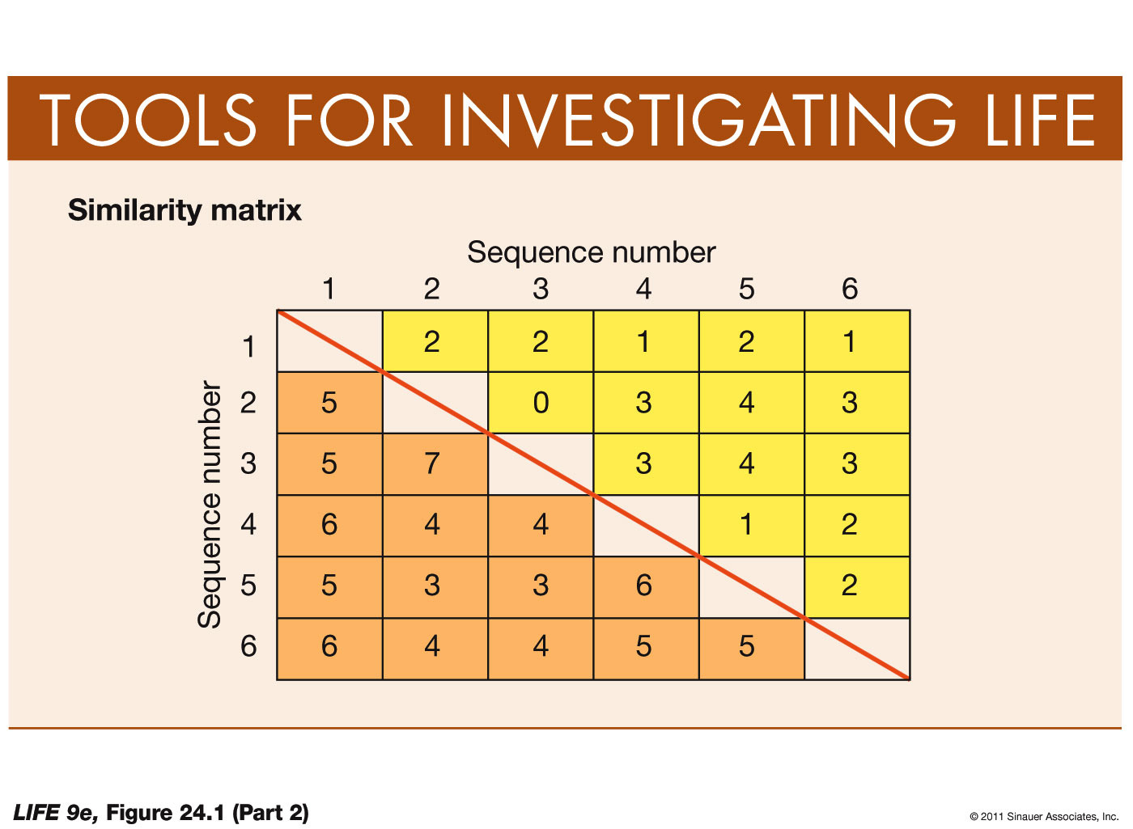
Figure 24.1 Amino Acid Sequence Alignment (Part 2)

Slide 6
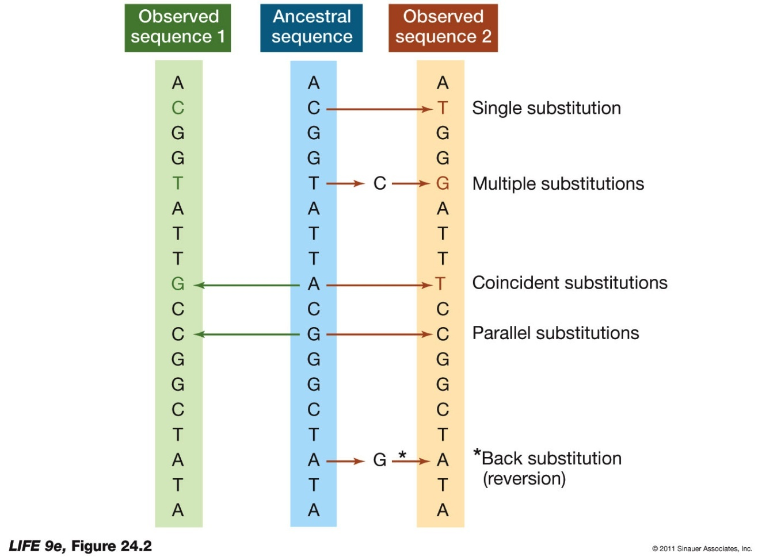
Figure 24.2 Multiple Substitutions Are Not Reflected in Pairwise Sequence Comparisons
But this underestimates the number of actual substitutions that have occurred.
Multiple substitutions—more than one change at a given position
Coincident substitutions—different substitutions in different descendents
Parallel substitutions—same substitution in different descendents
Back substitutions—one change at a position is changed back to the original (reversions)

Slide 7
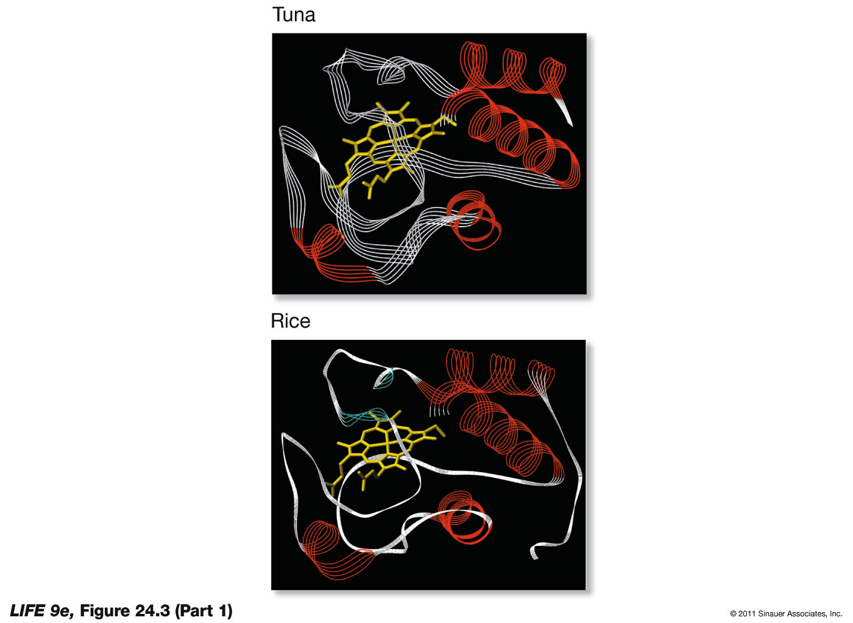
Figure 24.3 Amino Acid Sequences of Cytochrome c (Part 1)

Slide 8
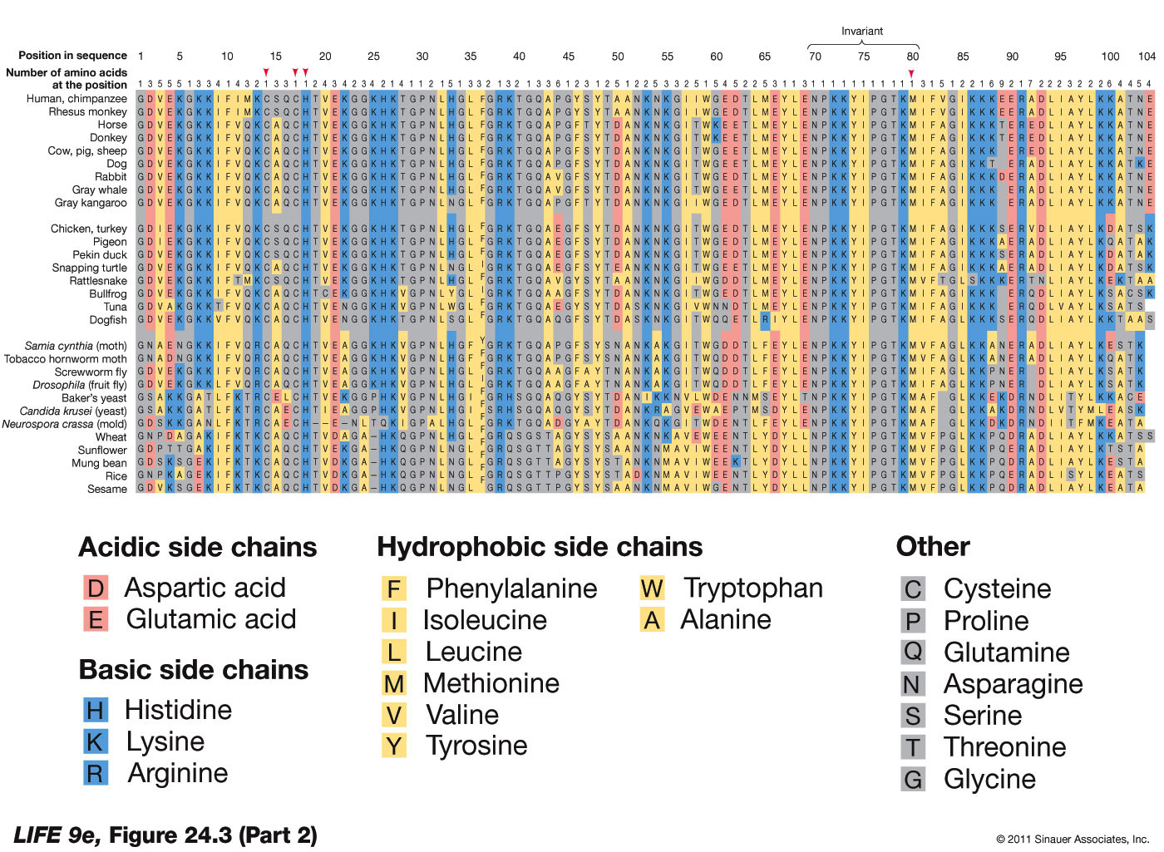
Figure 24.3 Amino Acid Sequences of Cytochrome c (Part 2)

Slide 9
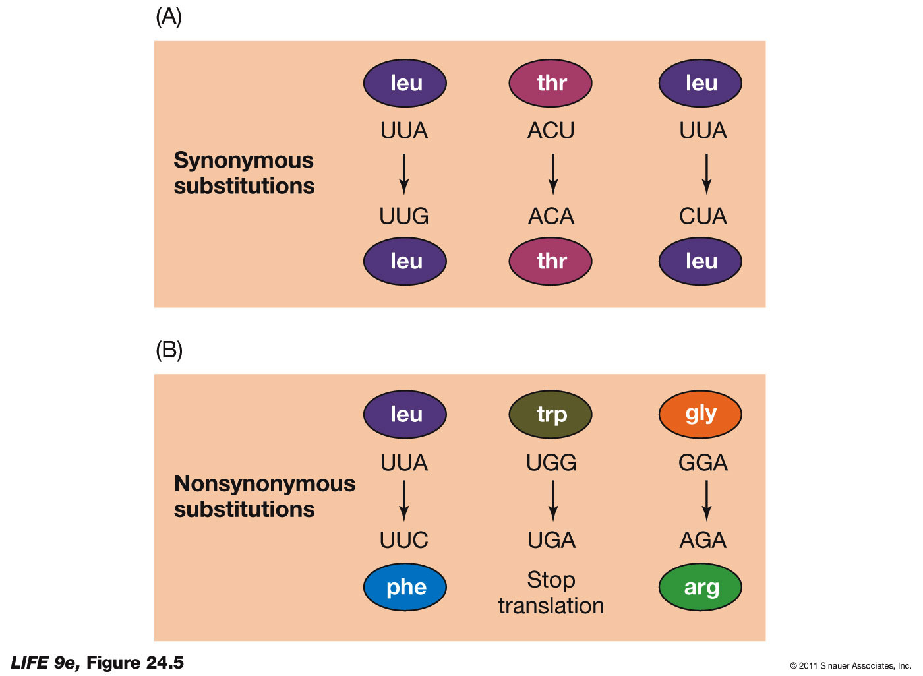
24.2 What Do Genomes Reveal About Evolutionary Processes?
A substitution that does not change the amino acid that is specified is a synonymous or silent substitution.
A substitution that does cause a change in the amino acid specified is a nonsynonymous substitution (or missense substitution).
These are likely to be deleterious; but protein shape and function is not always altered, so it may be selectively neutral.

Slide 10
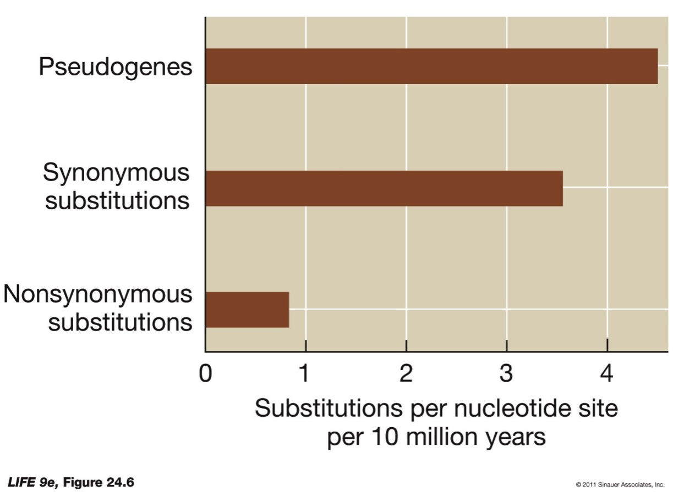
24.2 What Do Genomes Reveal About Evolutionary Processes?
Substitution rates vary.
The rate is even higher in pseudogenes, duplicates copies of genes that are no longer functional.

Slide 11
24.2 What Do Genomes Reveal About Evolutionary Processes?
If most mutations are neutral, and the mutation rate is constant, macromolecules evolving in different populations should diverge from one another at a constant rate: The “molecular clock.”

Slide 12
24.2 What Do Genomes Reveal About Evolutionary Processes?
If an amino acid replacement is neutral with respect to fitness, the two rates are expected to be similar; the ratio would be close to one
If an amino acid position is under positive selection for change, the rate of nonsynonymous substitutions should be much higher than synonymous
If an amino acid position is under purifying selection, the rate of synonymous substitutions should be much higher than nonsynonymous

Slide 13
24.2 What Do Genomes Reveal About Evolutionary Processes?
Lysozyme-coding sequences were compared in foregut fermenters and their non-fermenting relatives, and rates of substitutions were determined.
Replacements in lysozyme happened at a much higher rate in the lineage leading to langurs.

Slide 14
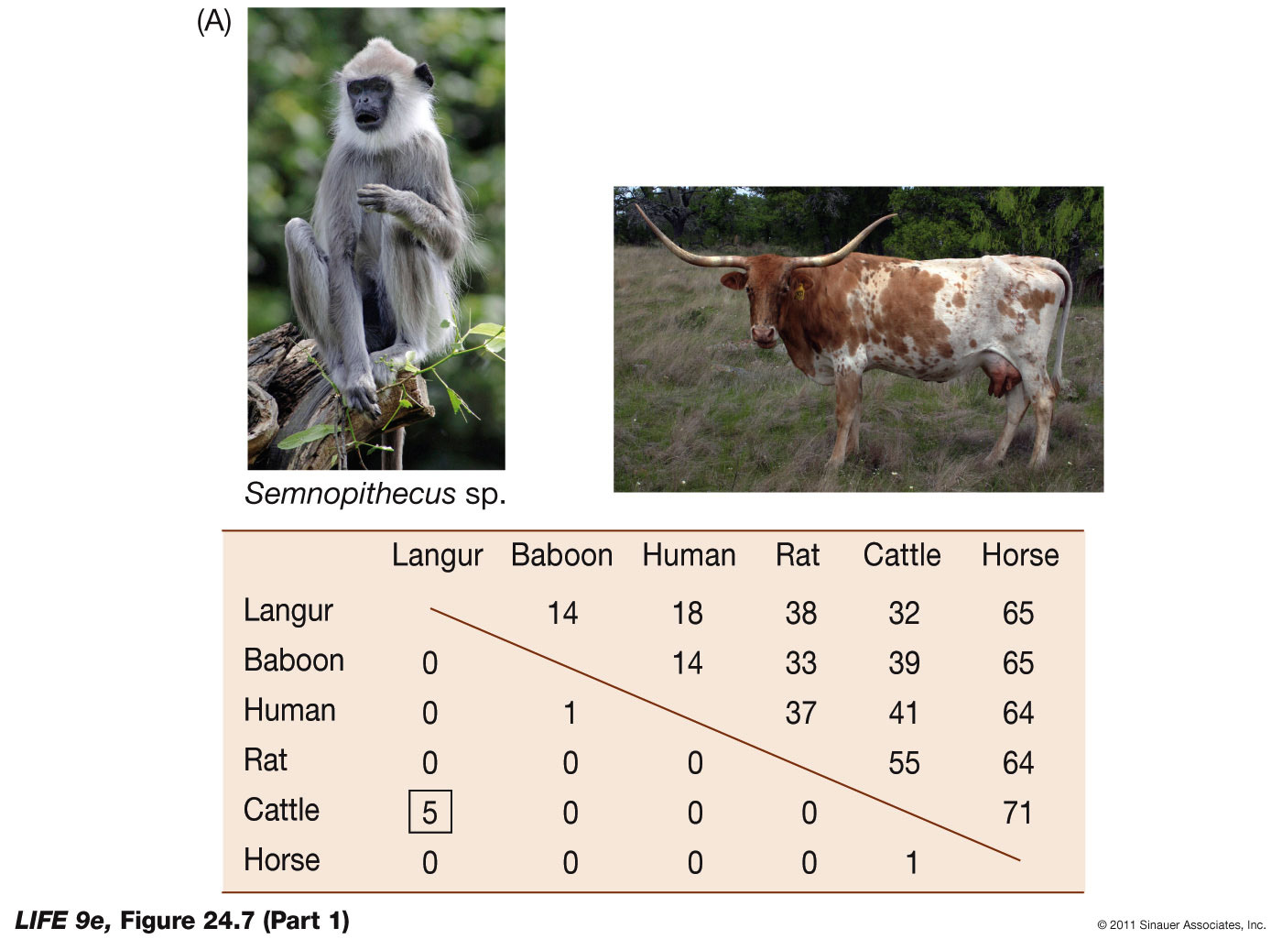
Figure 24.7 Convergent Molecular Evolution of Lysozyme (Part 1)

Slide 15
24.2 What Do Genomes Reveal About Evolutionary Processes?
For many amino acid positions of lysozyme, the rate of synonymous substitutions is higher—indicating purifying selection.
At other positions, the rate of synonymous and nonsynonymous substitutions are similar.

Slide 16

24.2 What Do Genomes Reveal About Evolutionary Processes?
Langurs and ruminants do not share a recent common ancestor. The lysozymes have undergone evolutionary convergence at some amino acid positions.
Lysozyme in the crop of the hoatzin, a foregut-fermenting bird, has similar adaptations as those of langurs and cattle.

Slide 17
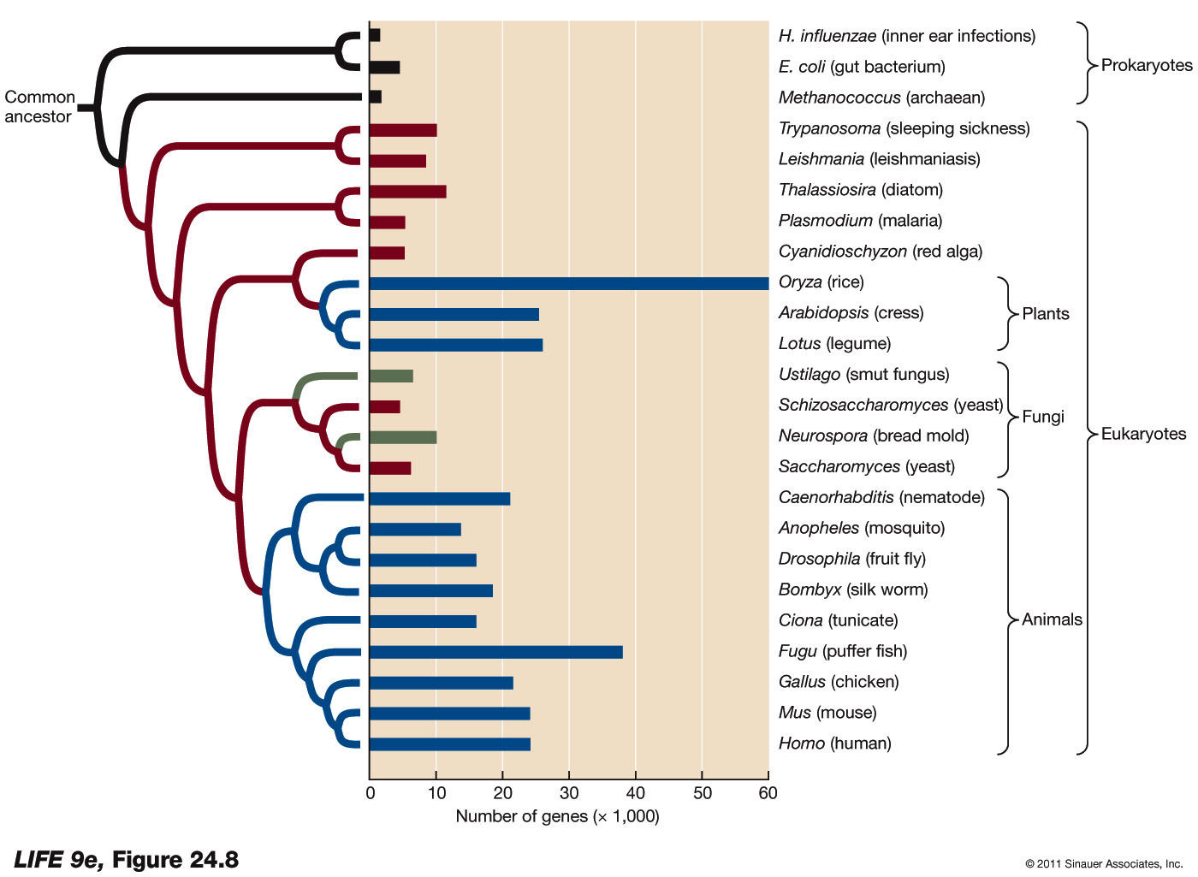
Figure 24.8 Genome Size Varies Widely
A larger genome does not always indicate greater complexity.

Slide 18
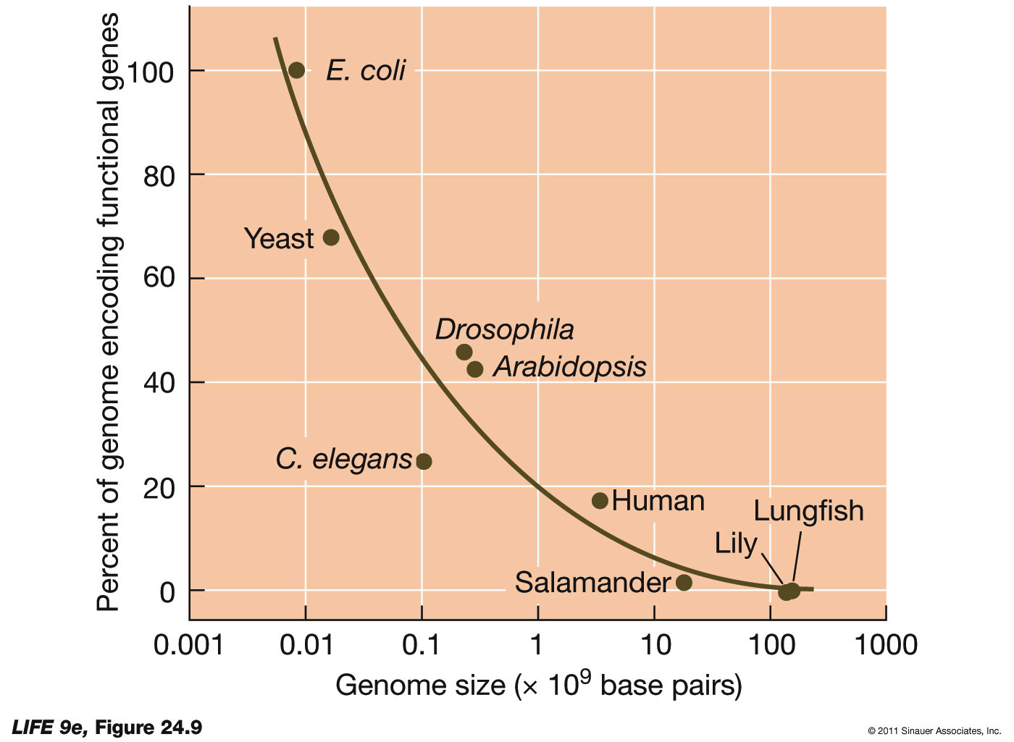
24.2 What Do Genomes Reveal About Evolutionary Processes?
If only the protein and RNA coding portions of genomes are considered, there is much less variation in size.
Much of the variation lies in the amount of noncoding DNA.

Slide 19
24.2 What Do Genomes Reveal About Evolutionary Processes?
Much of the noncoding DNA does not appear to have a function.
Some noncoding DNA can alter the expression of surrounding genes.
Some noncoding DNA consists of pseudogenes.
Some consists of parasitic transposable elements.

Slide 20
24.2 What Do Genomes Reveal About Evolutionary Processes?
Retrotransposons can be used to estimate rates at which species loose DNA.
Retrotransposons commonly carry long terminal repeats (LTRs).
Occasionally, retrotransposons combine with host DNA so that the DNA between them is excised—leaving “orphaned” LTRs.

Slide 21
24.2 What Do Genomes Reveal About Evolutionary Processes?
The number of orphaned LTRs in a genome is a measure of how many retrotransposons have been lost.
A comparison of Hawaiian crickets and Drosophila shows that the crickets lose DNA 40 times more slowly, and their genome is 11 times larger.

Slide 22
24.2 What Do Genomes Reveal About Evolutionary Processes?
Species vary in the rate of gain or loss of functionless DNA. Possible reasons:
Large genomes can slow the rate of development and may be selected against
Amount of nonconding DNA may be related to population size. In small populations genetic drift may overwhelm selection against these sequences

Slide 23
24.3 How Do Genomes Gain and Maintain Functions?
Most multicellular organisms have many more genes than unicellular species.
Some mechanisms must exist that increase genome size over evolutionary time: Genes can be transferred from other species, or duplicated within species.

Slide 24
24.3 How Do Genomes Gain and Maintain Functions?
Lateral gene transfer: Individual genes, organelles, or fragments of genomes move horizontally from one lineage to another.
Some species pick up DNA fragments directly from the environment
Genes may be transferred to a new host in a viral genome
Hybridization between species results in the transfer of many genes

Slide 25
24.3 How Do Genomes Gain and Maintain Functions?
Lateral gene transfer can be advantageous to a species that incorporates novel genes.
Genes that confer antibiotic resistance are often transferred among bacteria species.

Slide 26
24.3 How Do Genomes Gain and Maintain Functions?
On phylogenetic trees, lateral gene transfer events are known as reticulations.
Lateral gene transfer appears to be relatively uncommon among most eukaryote lineages; but endosymbiosis can be viewed as lateral transfer.

Slide 27
24.3 How Do Genomes Gain and Maintain Functions?
Some plants have high levels of hybridization among closely related species.
The greatest degree of lateral transfer occurs among bacteria, to the point that relationships are often hard to decipher.

Slide 28
24.3 How Do Genomes Gain and Maintain Functions?
Gene duplications may give rise to new protein functions. Copies may have one of four fates:
Both copies retain original function (more product could be made)
Both copies retain original function but expression diverges in different tissues or at different times

Slide 29
24.3 How Do Genomes Gain and Maintain Functions?
One copy becomes nonfunctional from accumulation of deleterious substitutions and becomes a pseudogene
One copy accumulates substitutions that allow it to perform a new function

Slide 30
24.3 How Do Genomes Gain and Maintain Functions?
In polyploid organisms, the whole genome is duplicated, providing opportunities for new functions to arise.
Example: Jawed vertebrates have four diploid sets of many major genes.
Two genome duplication events may have occurred in the ancestors of these species. It has allowed specialization of individual genes.

Slide 31
24.3 How Do Genomes Gain and Maintain Functions?
Successive rounds of duplication and mutation can result in gene families, such as the globin gene family.
Amino acid sequencing of globins suggests they arose via gene duplications.
Hemoglobin is a tetramer of two α-globin and two β-globin chains that carries O₂, CO₂, and H⁺.

Slide 32
24.3 How Do Genomes Gain and Maintain Functions?
Myoglobin is less complex, but has a much higher affinity for O₂; it stores O₂ in muscle tissue.
A phylogenetic tree of gene sequences has been constructed for the globin gene family.
The rate of divergence for globin genes is about one substitution every two million years.

Slide 33
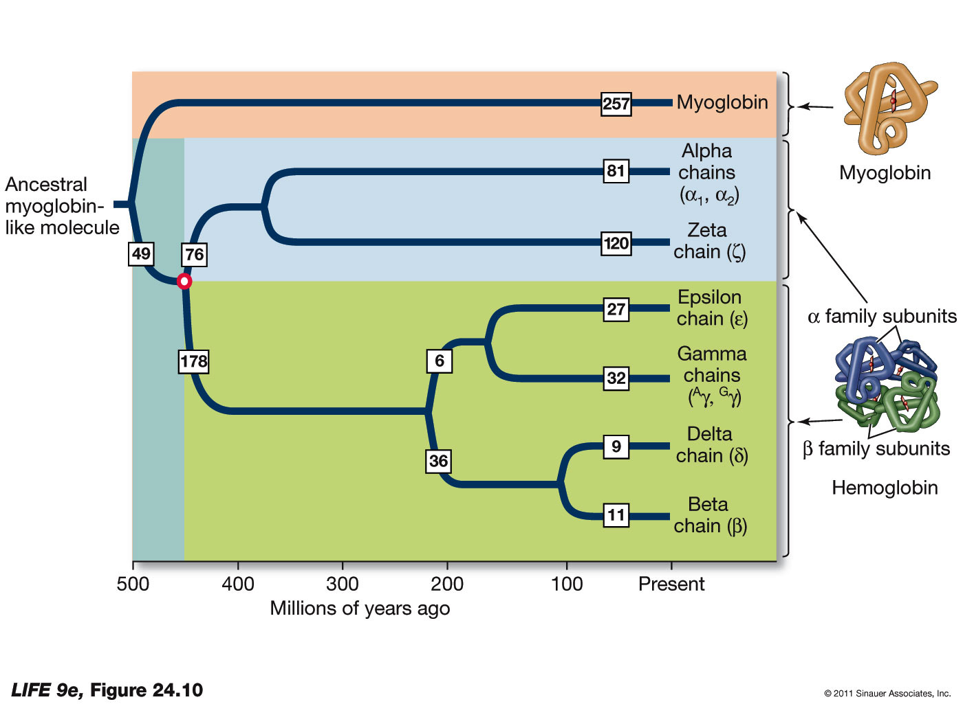
Figure 24.10 A Globin Family Gene Tree

Slide 34
24.3 How Do Genomes Gain and Maintain Functions?
In some gene families, the genes are evolving together, or in concert with one another: Concerted evolution.
Most organisms have many copies of genes for ribosomal RNA, so that high rates of protein synthesis are possible when necessary.
Within a species rRNA genes are very similar.

Slide 35
24.3 How Do Genomes Gain and Maintain Functions?
Possible mechanisms for concerted evolution:
Unequal crossing over during meiosis—repeated segments can be misaligned. One chromosome may end up with more copies; the other chromosome will have fewer
Novel substitutions will be fixed, or will be lost

Slide 36
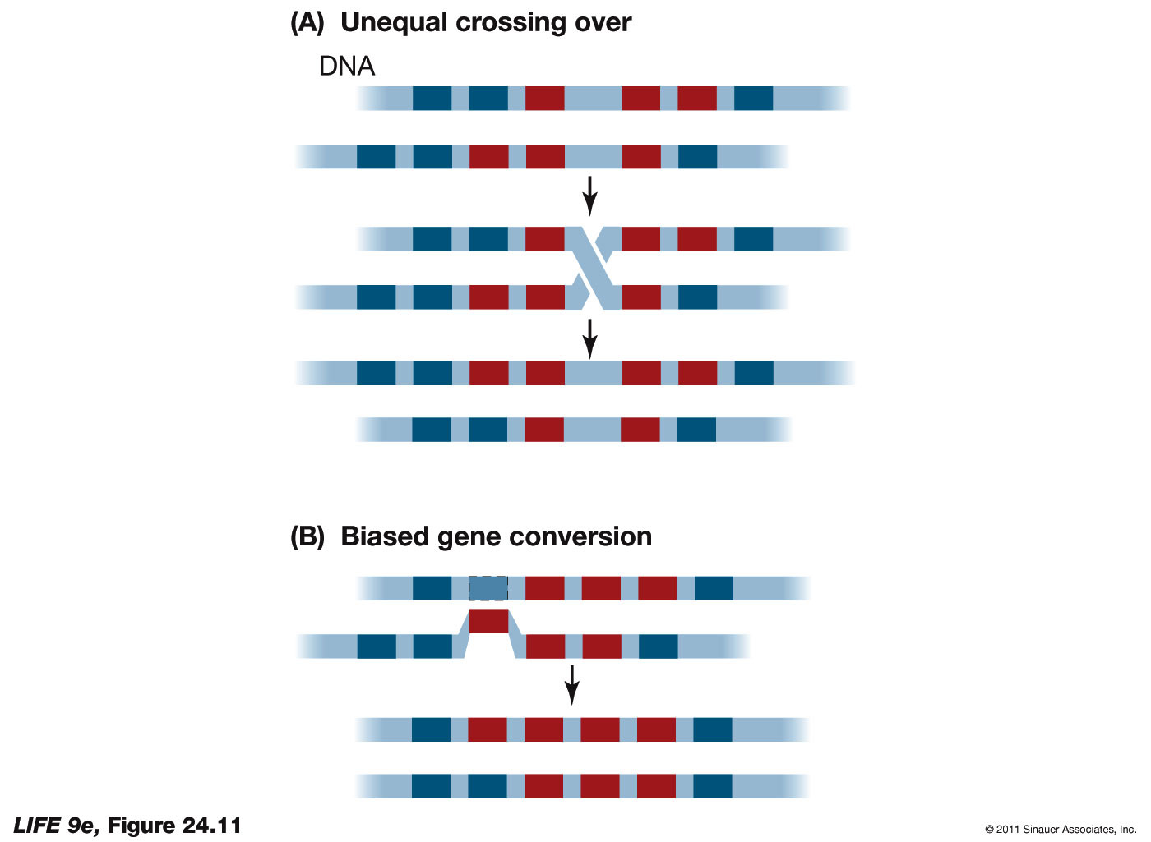
Figure 24.11 Concerted Evolution (A)

Slide 37
24.3 How Do Genomes Gain and Maintain Functions?
Biased gene conversion:
DNA often breaks, and is repaired using the sequence on another chromosome as a template
The repair system is biased in favor of particular gene sequences—these sequences rapidly spread across all copies of the gene

Slide 38
Figure 24.11 Concerted Evolution (B)

Slide 39
24.4 What Are Some Applications of Molecular Evolution?
A gene tree is used to show evolutionary relationships of a single gene in different species or gene families.
Differences between genes are determined, and used to reconstruct the evolutionary history of the gene.
Gene trees and species phylogenetic trees are not necessarily equivalent.

Slide 40
24.4 What Are Some Applications of Molecular Evolution?
Members of a gene family have similar sequences because they share a common ancestor.
Two forms of homology in genes:
Orthologs are genes that can be traced to speciation events
Paralogs are genes that are related through duplication events

Slide 41
24.4 What Are Some Applications of Molecular Evolution?
A tree has been constructed for the gene family called engrailed.
Three gene duplication events have occurred, resulting in four different engrailed genes.
All of the engrailed genes are homologs; speciation events have resulted in orthologous genes; duplication events resulted in paralogous genes.

Slide 42
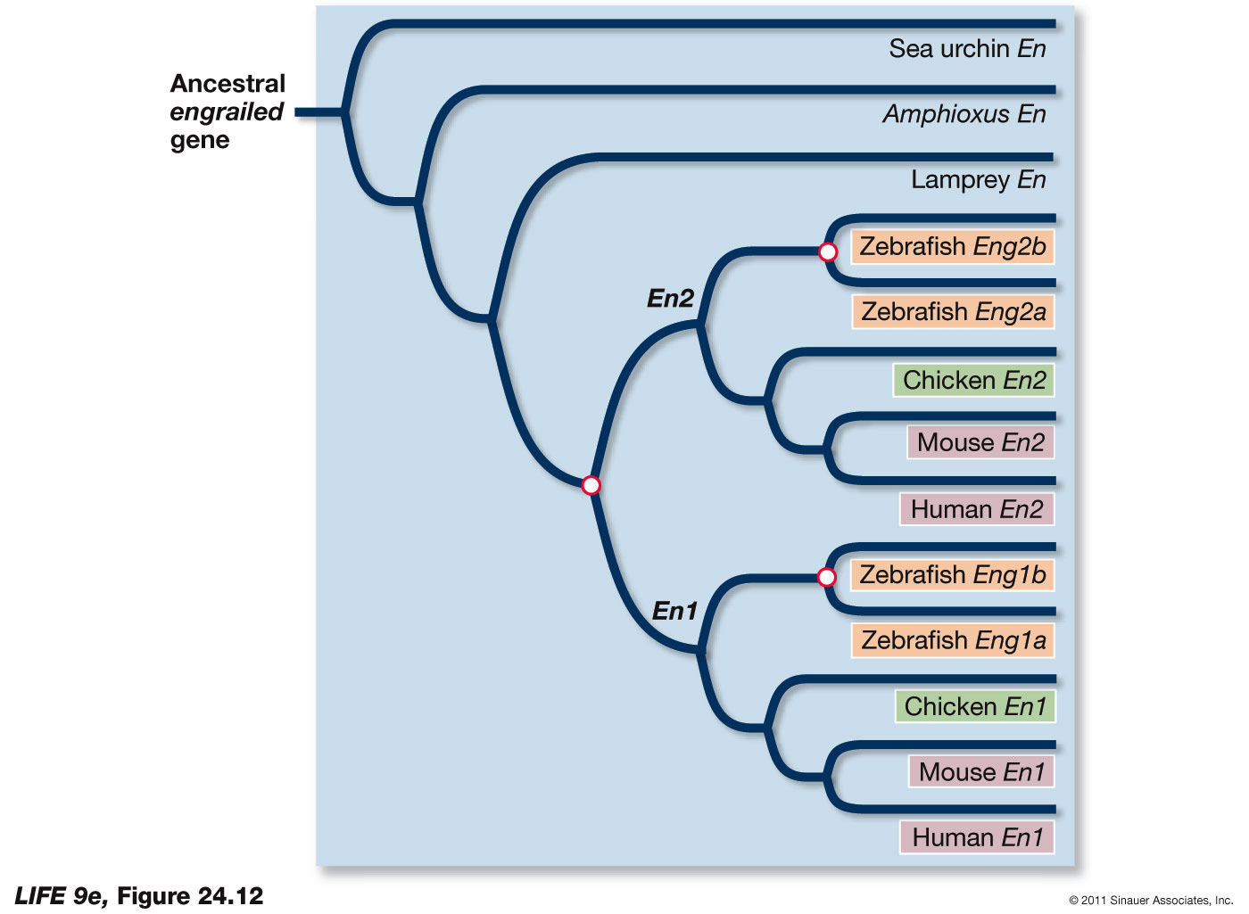
Figure 24.12 Phylogeny of the engrailed Genes

Slide 43
24.4 What Are Some Applications of Molecular Evolution?
Biologists can detect regions of genes that are under positive selection pressure.
Example: Tetrodotoxin produced by some newts, pufferfish, and other animals, blocks sodium channels and prevents nerve and muscle function.

Slide 44
24.4 What Are Some Applications of Molecular Evolution?
Sodium channels of the pufferfish have evolved to be resistant to the toxin.
Nucleotide substitutions in the sodium channel genes resulted in proteins with a different structure, and tetrodotoxin cannot bind to the sodium channel pores.

Slide 45
24.4 What Are Some Applications of Molecular Evolution?
Biologists can learn how the channels work by understanding which changes have been selected for tetrodotoxin resistance.
They do this by comparing rates of synonymous and nonsynonymous substitutions across genes in lineages that have evolved tetrodotoxin resistance.

Slide 46
24.4 What Are Some Applications of Molecular Evolution?
Living organisms produce many compounds useful to humans. The search for such compounds is called bioprospecting.
These molecules result from millions of years of evolution.
But biologists can imagine molecules that have not evolved.

Slide 47
24.4 What Are Some Applications of Molecular Evolution?
In vitro evolution: New molecules are produced in the laboratory.
Example: A new RNA molecule was produced that can join two other RNA molecules (acting as a ribozyme with ligase activity).

Slide 48
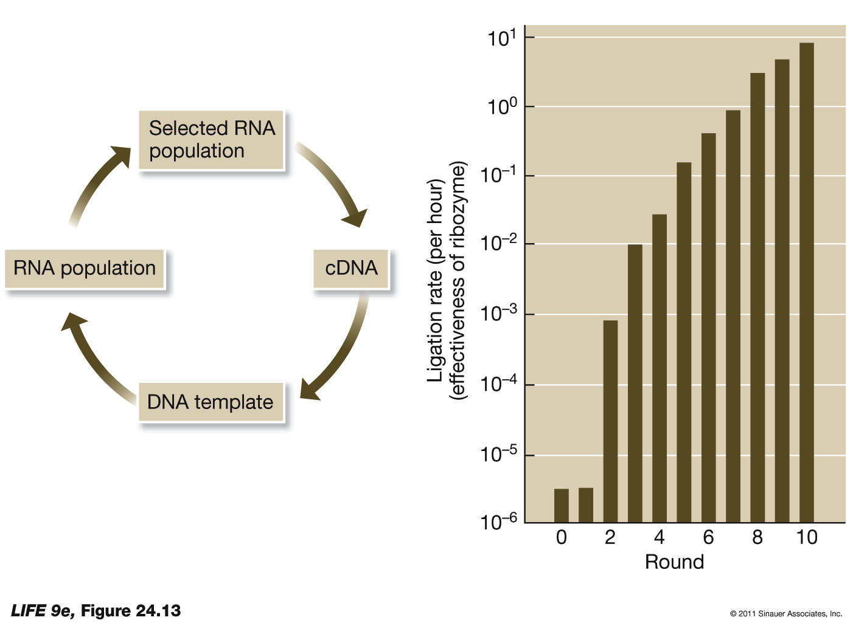
Figure 24.13 In Vitro Evolution

Slide 49
24.4 What Are Some Applications of Molecular Evolution?
Molecular evolution is used to study disease organisms.
The ability of humans to move quickly around the world has also allowed pathogens to be transmitted at high rates, and has led to the global emergence of many “new” diseases.

Slide 50
24.4 What Are Some Applications of Molecular Evolution?
New viral diseases are identified by evolutionary comparison of their genomes with those of known viruses.
Techniques used to develop vaccines, and methods used to track their effectiveness, rely on molecular evolutionary approaches.

