Slide 1
Para empezar
TRADUCE EN EL PRETERITO CON EL VERBO IR:
I went to the jewelry store.
We went to the movies.
3. The students went to school.

Slide 2
Para empezar
TRADUCE:
I went to the jewelry store.
Fui a la joyería
We went to the movies.
Fuimos al cine.
3. The students went to school.
Los estudiantes fueron a la escuela.

Slide 3
COMPRAR
CUT OFF “AR”
compr
Compré I bought
Compraste You bought
Compró He/she/you formal bought
Compramos We bought
Compraron They bought

Slide 4
El pretérito
-ar verb endings
Yo –é Nosotros -amos
Tú – aste
Él/ella/ud. – ó Ellos/ellas/uds. - aron

Slide 5
¿Qué hiciste anoche?

Slide 6
cantaron
Ellas________________(cantar)

Slide 7
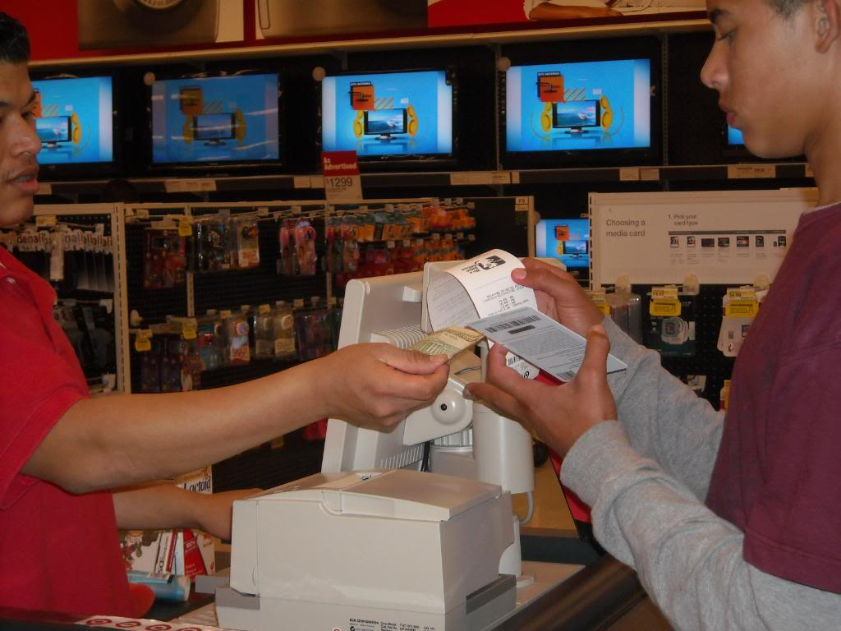
compré
Yo_______________(comprar) un video juego.

Slide 8
estudiaron
Ellos____________________(estudiar)

Slide 9
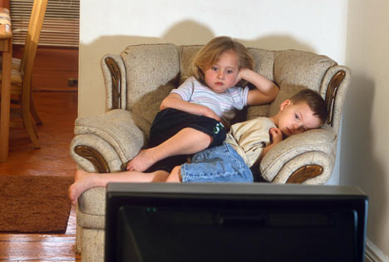
Miraron la tele
Ellos_______________(mirar la tele)

Slide 10
cantaste
Tú_________________(cantar)

Slide 11
nadó
Pablo_________________(nadar)

