Slide 1
LOS MANDATOS FAMILIARES
A command is when you tell someone WHAT TO DO! Eat well! Sleep! Do exercise! Rest!
To form a tú command go to the él/ella/usted form of the present tense
¡Habla!
¡Mira!
¡Come!
¡Descansa!
ᰅ

Slide 2
IRREGULAR COMMANDS
Decir- di say!
Hacer- haz do/make!
Ir- ve go!
Poner- pon put/place!
Salir- sal leave!
Ser- sé be!
Venir- ven come!

Slide 3
FORMING NEGATIVE COMMANDS
1. Put “no” in front of the verb
2. Change the verb to the opposite ending and add “s”
3. AR verbs change to es
4. Er/IR verbs change to as
No fumes
No bailes
No comas
No bebas

Slide 4
Baja de peso
Lose weight!

Slide 5
Bebe leche
Drink milk!

Slide 6
No trabajes demasiado
Don’t work so much

Slide 7
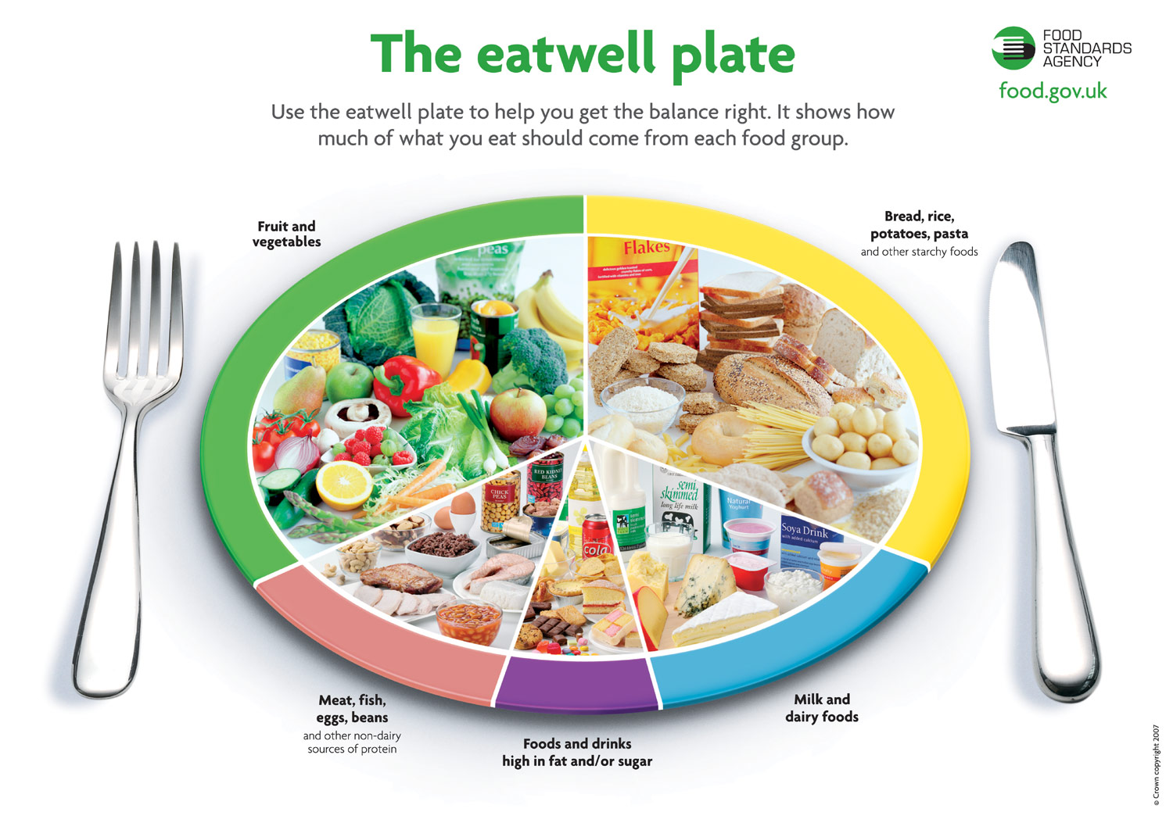
Come bien
Eat well!

Slide 8
Duerme
Sleep!

Slide 9
Come una dieta sana
Eat a healthy diet!

Slide 10
Haz yoga
Do yoga!

Slide 11
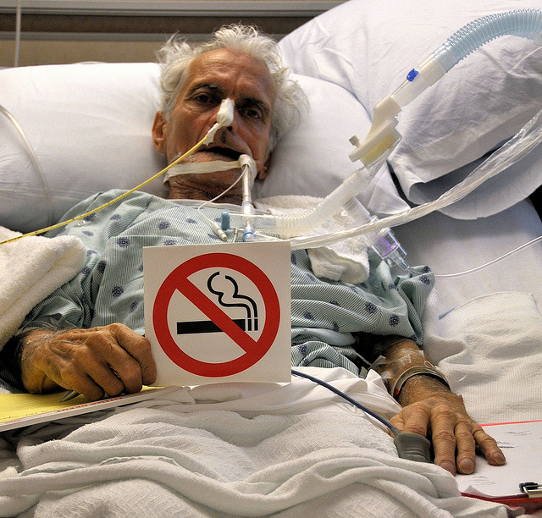
No fumes
Don’t smoke!

Slide 12
No bebas café
Don’t drink cofee

