Slide 1
POR Y PARA

Slide 2
“I’M FIT, PAT B!” (POR)
In
Manner or means
For one’s sake
In exchange for
Time
Percentage
Author
Through
Because

Slide 3
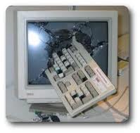
G! PC DIED! (PARA)
Gift
Purpose
Comparison
Deadline
In order to Employment Destination

