Slide 1
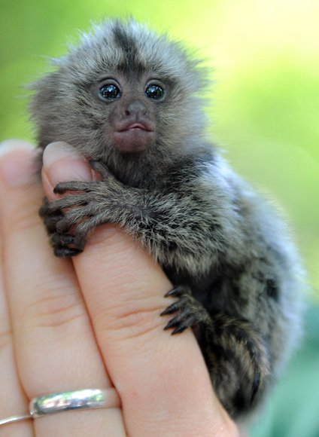
TWAS A DUMB APE
Time
Weather
Action in Progress
Setting the scene
Age

Slide 2
Description
Usually/used to
Mientras
Background
Always
Physical state
Emotional state

