Slide 1
La Gramática Con Capítulo 4
Caroline Casey
Kavya Boorgu
Nicki Brown

Slide 2
The verbs ponerse, decir, and estar are irregular in the preterite. The forms of ser in the preterite are the same as the preterite forms of ir.

Slide 3
Past Participle
To form the past participles of regular verbs, form the infinitive ending and add -ado to -ar verbs and -ido to -er and -ir verbs
hinchar → hinchado swollen
herir → herido hurt

Slide 4
When –er and –ir verbs have a stem that ends in a vowel like caerse, the preterite endings that end in i change to y in the third person forms, and then í

Slide 5
Vocabulary
Unit 4

Slide 6
Ahora lo tengo infectado
Now I have an infected…

Slide 7
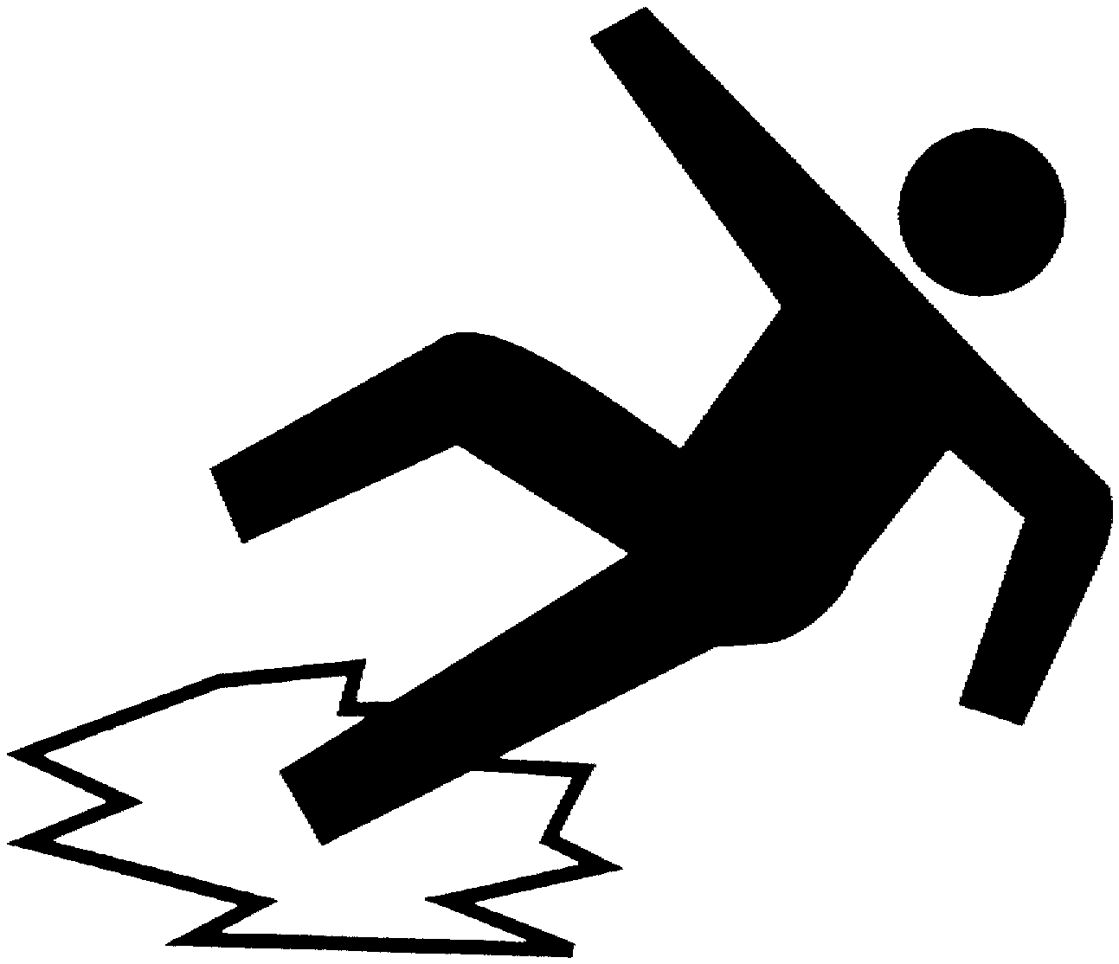
caerse

Slide 8
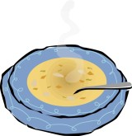
calentarse

Slide 9
Las cejas

Slide 10
El cerebro

Slide 11
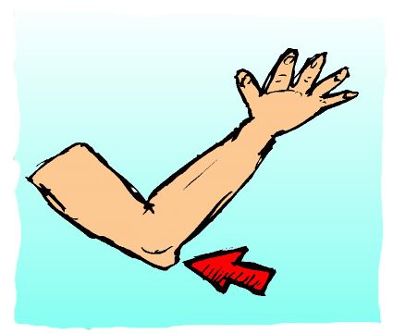
El codo

Slide 12
El corazón

Slide 13
Cortarse

Slide 14
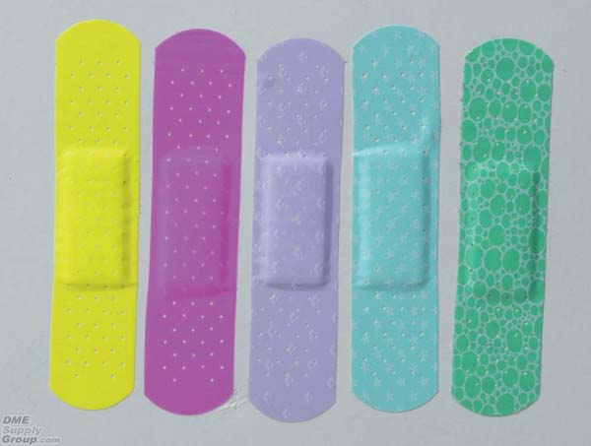
La curita

Slide 15
Darle un calambre
To get a cramp

Slide 16
Darse un golpe en…
To bump one’s…

Slide 17
El dedo del pie

Slide 18
Enfermarse
To get sick

Slide 19
Estar mal
To be sick

Slide 20
Estar resfriado
to have a cold

Slide 21
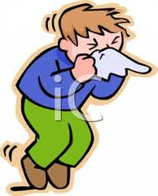
Estornudar

Slide 22
Estoy mal. Tengo tos y me duele la garganta.
I’m sick. I have a cough and my throat hurts.

Slide 23
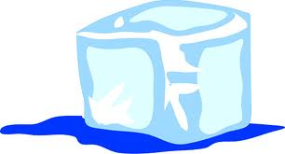
El hielo

Slide 24
Hinchado
Swollen

Slide 25
El hueso

Slide 26
Los labios
Lips

Slide 27
Infectado
Infected

Slide 28
Lastimarse
To injure or hurt oneself

Slide 29
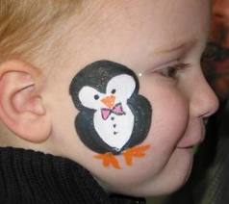
La mejilla

Slide 30
La muñeca
wrist

Slide 31
El muslo
Thigh

Slide 32
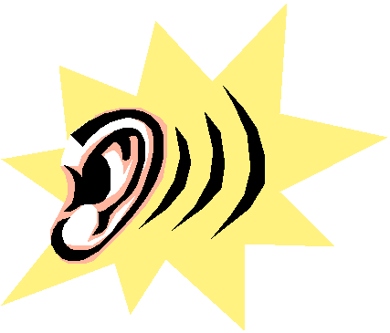
La oreja

Slide 33
La piel
skin

Slide 34
Pobrecito! Tómate unos aspirinas y descansa un poco.
Poor thing! Take some aspirin and rest a bit.

Slide 35
ponerse
To become/to put on one’s self

Slide 36
Los pulmones
lungs

Slide 37
Quédate en cama y tómate este jarabe.
Stay in bed and take this cough syrup.

Slide 38
quemarse
To get burned

Slide 39
resfriarse
To get a cold

Slide 40
La rodilla
knee

Slide 41
romperse (+ body part)
to break (+ body part)

Slide 42
Tener cuidado
To be careful

Slide 43
Tener un calambre
To have a cramp

Slide 44
Tener tos
To have a cough

Slide 45
Tengo un dolor de cabeza que no se me quita.
I have a headache that won’t go away

Slide 46
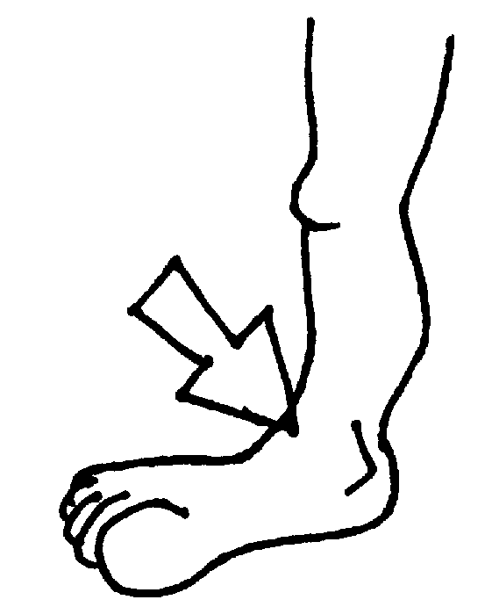
El tobillo

Slide 47
tomarse unas pastillas
To take some pills

Slide 48
torcerse (ue) (+ body part)
to sprain, to twist (+ body part)

Slide 49
el ungüento
Ointment

Slide 50
la uña
Finger nail or toenail

Slide 51
vendarse

