Slide 1
Immune System

Slide 2
Why an immune system?
Attack from outside
  lots of organisms want you for lunch!
  animals are a tasty nutrient- & vitamin-packed meal
    cells are packages of macromolecules
  animals must defend themselves against invaders (pathogens)
    viruses
      HIV, flu, cold, measles, chicken pox
    bacteria
      pneumonia, meningitis, tuberculosis
      Lyme disease
    fungi
      yeast (“Athlete’s foot”…)
    protists
      amoeba, malaria
Attack from inside
  cancers = abnormal body cells
Mmmmm,
What’s in your
lunchbox?

Slide 3
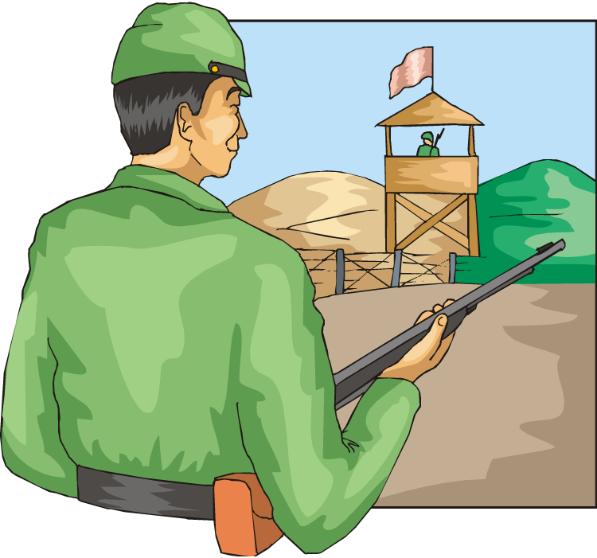
Lines of defense
1st line: Non-specific barriers
  broad, external defense
    “walls & moats”
  skin & mucous membranes
2nd line: Non-specific patrols
  broad, internal defense
    “patrolling soldiers”
  leukocytes = phagocytic WBC
3rd line: True immune system
  specific, acquired immunity
    “elite trained units”
  lymphocytes & antibodies
    B cells & T cells
.

Slide 4
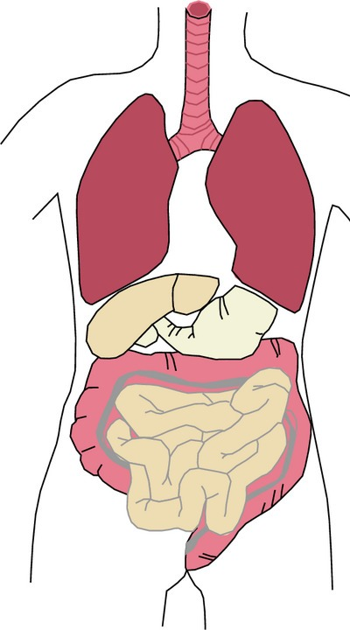
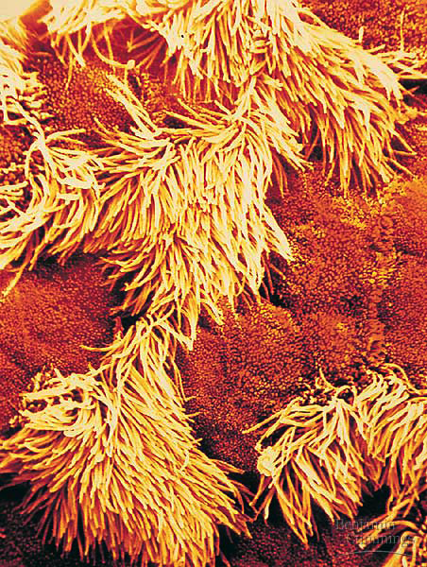

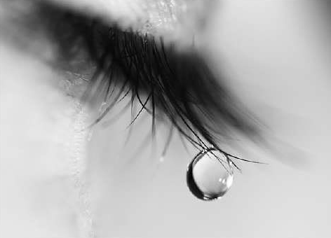
1st line: Non-specific External defense
Lining of trachea:
ciliated cells & mucus secreting cells
Barrier
    skin
Traps
    mucous membranes, cilia,
    hair, earwax
Elimination
    coughing, sneezing, urination, diarrhea
Unfavorable pH
    stomach acid, sweat, saliva, urine
Lysozyme enzyme
    digests bacterial cell walls
    tears, sweat

Slide 5
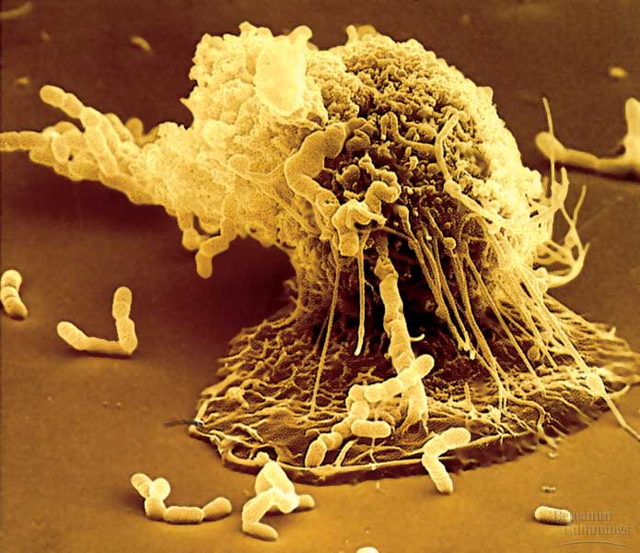
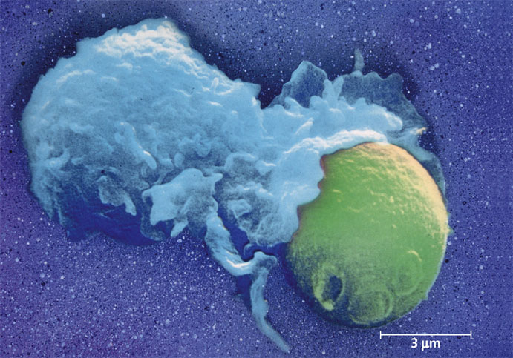
2nd line: Non-specific patrolling cells
Patrolling cells & proteins
  attack pathogens, but don’t “remember” for next time
    leukocytes
      phagocytic white blood cells
      macrophages, neutrophils, natural killer cells
    complement system
      proteins that destroy cells
    inflammatory response
      increase in body temp.
      increase capillary permeability
      attract macrophages
bacteria
macrophage
yeast

Slide 6
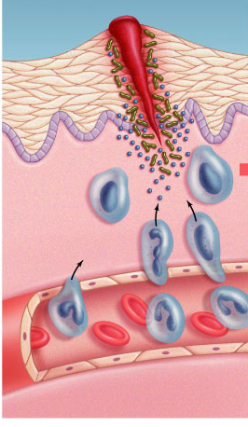
Inflammatory response
Damage to tissue triggers local non-specific inflammatory response
  release chemical signals
    histamines & prostaglandins
  capillaries dilate, become
  more permeable (leaky)
    delivers macrophages, RBCs, platelets, clotting factors
      fight pathogens
      clot formation
  increases temperature
    decrease bacterial growth
    stimulates phagocytosis
    speeds up repair of tissues

Slide 7
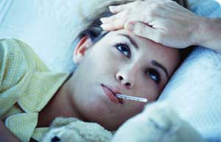
Fever
When a local response is not enough
  system-wide response to infection
  activated macrophages release interleukin-1
    triggers hypothalamus in brain to readjust body thermostat to raise body temperature
  higher temperature helps defense
    inhibits bacterial growth
    stimulates phagocytosis
    speeds up repair of tissues
    causes liver & spleen to store
    iron, reducing blood iron levels
      bacteria need large amounts
      of iron to grow
Notes:
Certain bacterial infections can induce an overwhelming systemic inflammatory response leading to a condition known as septic shock.
Characterized by high fever and low blood pressure, septic shock is the most common cause of death in U.S. critical care units.
Clearly, while local inflammation is an essential step toward healing, widespread inflammation can be devastating.

Slide 8
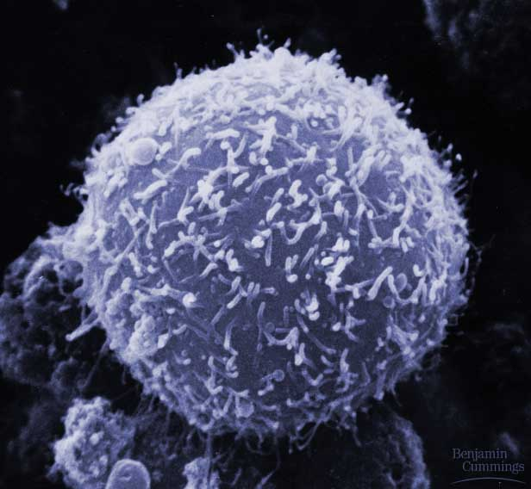
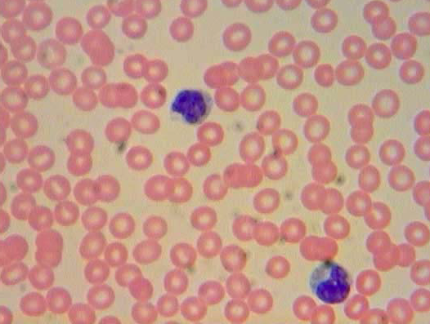
3rd line: Acquired (active) Immunity
Specific defense with memory
  lymphocytes
    B cells
    T cells
  antibodies
Responds to…
  antigens
    cellular name tags
      specific pathogens
      specific toxins
      abnormal body cells (cancer)
B cell

Slide 9
How are invaders recognized?
Antigens
  cellular ID tag proteins
    “self” antigens
      no response from WBCs
    “foreign” antigens
      response from WBCs
      pathogens: viruses, bacteria, protozoa, parasitic worms, fungi, toxins
      non-pathogens: cancer cells, transplanted tissue, pollen
“self”
“foreign”

Slide 10
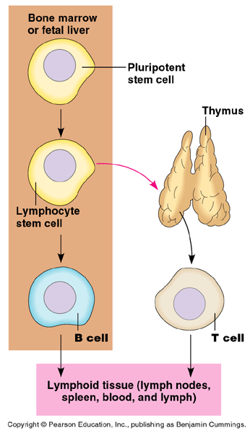
Lymphocytes
bone marrow
B cells
  humoral response system
    “humors” = body fluids
    attack pathogens still circulating
    in blood & lymph
  produce antibodies
T cells
  cellular response system
    attack invaded cells
“Maturation”
  learn to distinguish “self”
  from “non-self” antigens
    if react to “self” antigens, cells
    are destroyed during maturation
Notes:
Tens of millions of different T cells are produced, each one specializing in the recognition of oen particar antigen.

Slide 11
B cells
Attack, learn & remember pathogens’ antigens circulating in blood & lymph
Produce specific antibodies
against specific antigen
Types of B cells
  plasma cells
    immediate production of antibodies
    rapid response, short term release
  memory cells
    continued circulation in body
    long term immunity

Slide 12
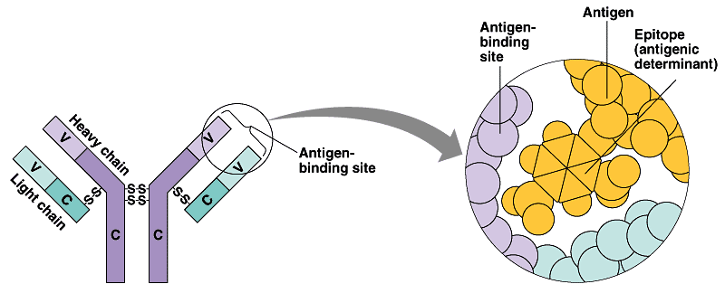
Antibodies
Y
Y
Y
Y
Y
Y
Y
Y
Y
Y
Y
Y
Y
Y
Y
Y
Y
Y
Y
Y
Y
Y
Y
Y
Y
Y
Proteins that bind to a specific antigen
  multi-chain proteins
  binding region matches molecular shape of antigens
  each antibody is unique & specific
    millions of antibodies respond to millions of
    foreign antigens
  tagging “handcuffs”
    “this is foreign…gotcha!”
Y
Y
Y
Y
Y
Y
Y
Y
Y
Y
Y
Y
Y
Y
Y
antigen-
binding site on antibody
antigen
Y
Y
Y
Y
variable
binding region
Y
Y
each B cell
has ~50,000
antibodies

Slide 13
B cell immune response
10 to 17 days for full response
Y
Y
Y
Y
Y
Y
Y
Y
Y
Y
tested by
B cells
(in blood & lymph)
Y
Y
Y
Y
Y
Y
Y
Y
Y
Y
Y
Y
Y
Y
Y
Y
Y
Y
Y
Y
Y
invader
(foreign antigen)
Y
Y
Y
Y
Y
Y
Y
Y
Y
Y
B cells + antibodies
Y
Y
Y
memory cells
“reserves”
Y
Y
Y
Y
Y
Y
Y
Y
Y
Y
Y
Y
Y
Y
Y
Y
Y
Y
Y
Y
Y
recognition
captured
invaders
Y
Y
Y
Y
Y
Y
Y
Y
Y
Y
Y
Y
Y
Y
Y
Y
Y
Y
Y
Y
Y
Y
Y
Y
Y
Y
Y
Y
Y
Y
Y
Y
Y
Y
Y
Y
Y
Y
Y
Y
Y
Y
Y
Y
Y
Y
macrophage
Y
Y
Y
Y
Y
Y
Y
Y
Y
Y
Y
Y
Y
Y
Y
Y
Y
Y
Y
Y
Y
Y
Y
Y
Y
Y
Y
Y
Y
Y
Y
Y
Y
Y
Y
Y
Y
Y
Y
clones
1000s of clone cells
Y
Y
plasma cells
release antibodies
Y
Y
Y
Y
Y
Y
Y
Y
Y
Y
Y
Y

Slide 14
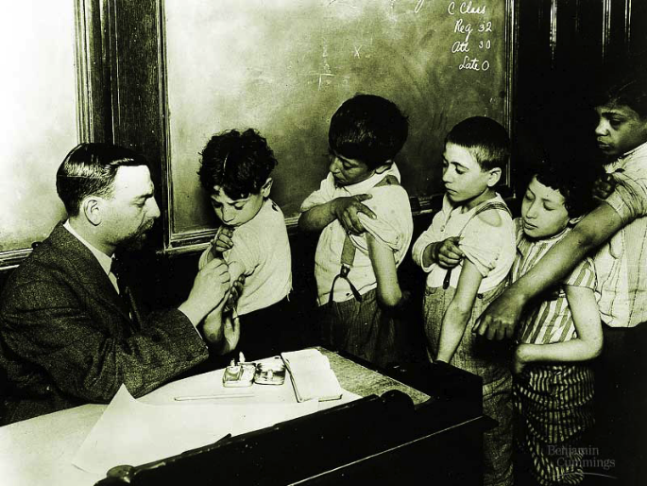
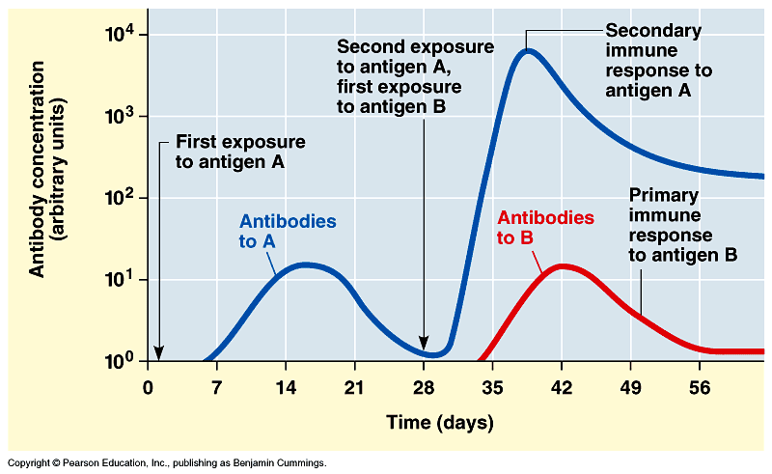
Vaccinations
Immune system exposed
to harmless version of pathogen
  stimulates B cell system to produce
  antibodies to pathogen
    “active immunity”
  rapid response on future exposure
  creates immunity
  without getting
  disease!
Most successful
against viruses

Slide 15
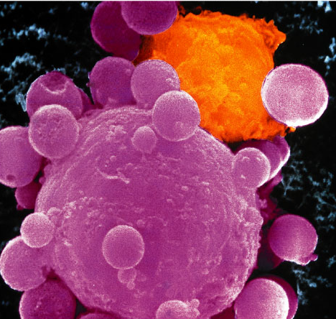
What if the attacker gets past the B cells in the blood & actually infects (hides in) some of your cells?
You need trained assassins to recognize & kill off these infected cells!
Attack
of the
Killer T cells!
T
But how do T cells
know someone is
hiding in there?

Slide 16
How do T cells know a cell is infected?
Infected cells digest some pathogens
  MHC proteins carry pieces to cell surface
    foreign antigens now on cell membrane
    called Antigen Presenting Cell (APC)
      macrophages can also serve as APC
    tested by Helper T cells
infected
cell
MHC proteins displaying
foreign antigens
WANTED
T_{H} cell
T cell with antigen receptors

Slide 17
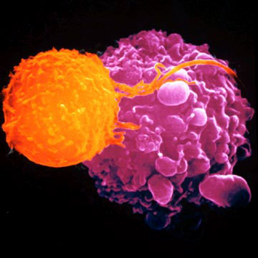
T cells
Attack, learn & remember pathogens hiding in infected cells
  recognize antigen fragments
  also defend against “non-self” body cells
    cancer & transplant cells
Types of T cells
  helper T cells
    alerts rest of immune system
  killer (cytotoxic) T cells
    attack infected body cells
  memory T cells
    long term immunity
T cell attacking cancer cell

Slide 18
T cell response
APC:
infected cell
killer
T cell
recognition
helper
T cell
interleukin 2
activate
killer T cells
helper
T cell
interleukin 1
helper
T cell
stimulate
B cells &
antibodies
or
APC:
activated
macrophage
helper
T cell
interleukin 2
Y
Y
Y
clones
Y
Y
Y
Y
Y
Y
helper
T cell
Y
Y
Y
Y
Y
Y
Y
Y
Y
Y
Y
Y
Y
Y
Y
recognition
Y
Y
Y
Y
Y
Y
Y
Y
Y
Y
Y
Y
Y
Y
Y
Y

Slide 19
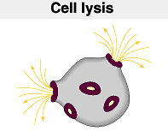
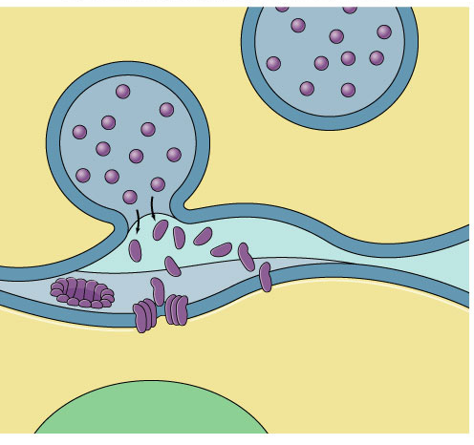
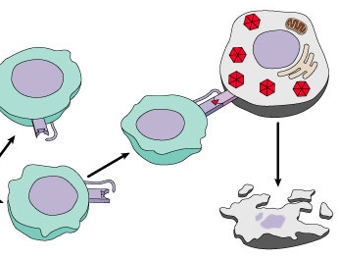
Attack of the Killer T cells
Destroys infected body cells
  binds to target cell
  secretes perforin protein
    punctures cell membrane of infected cell
      apoptosis
vesicle
Killer T cell
Killer T cell
binds to
infected cell
cell
membrane
perforin
punctures
cell membrane
cell
membrane
infected cell
destroyed
target cell

Slide 20
Immune system malfunctions
Auto-immune diseases
  immune system attacks own molecules & cells
    lupus
      antibodies against many molecules released by normal breakdown of cells
    rheumatoid arthritis
      antibodies causing damage to cartilage & bone
    diabetes
      beta-islet cells of pancreas attacked & destroyed
    multiple sclerosis
      T cells attack myelin sheath of brain & spinal cord nerves
Allergies
  over-reaction to environmental antigens
    allergens = proteins on pollen, dust mites, in animal saliva
    stimulates release of histamine

