Slide 1
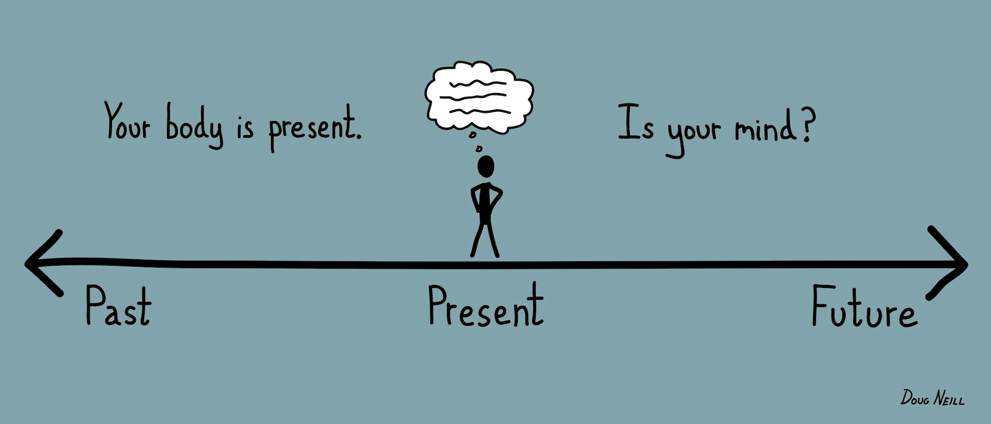
Mindfulness
Notes:
Vanessa: During the next hour we will discuss:
-History & benefits
-How it’s becoming popular in every day culture
-What we did in Cheshire
-Interviews with students/staff
-Practice
Ask ?’s:
“Raise your hand if you’ve ever?....” (just ask a couple of these, no need to ask all)
said something that you wish you could take back?
felt angry and out of control?
been in a bad mood and not sure why?
felt like you needed a break and wanted everyone to leave you alone?
can’t fall asleep at night because your mind won’t quiet down?
been accidentally spacing out in class when the teacher calls on you?
The car metaphore: drive, neutral, reverse

Slide 2
What is Mindfulness?
Being present in every moment to have awareness of our thoughts, feelings, body, and outside environment
Acceptance
Paying attention on purpose
Non-judgmental
Notes:
Vanessa

Slide 3
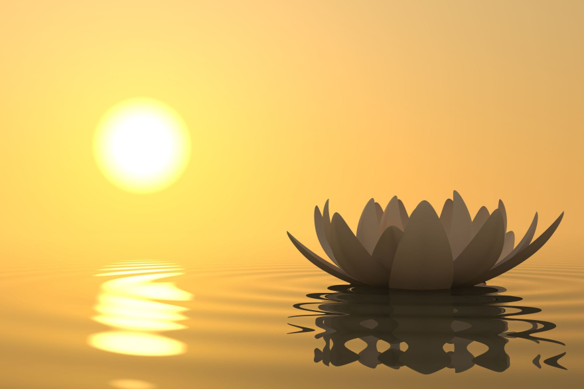
Benefits of Mindfulness
Mindfulness improves:
Well being
Physical health
Mental health
Notes:
Jenna

Slide 4
Types of Mindful Practicing
Mindful movements
Body scan
Mindful eating
Sending compassion
Gratitude
Imagery
Comfort color
Comfort place
http://blogs.plos.org/mindthebrain/2015/05/20/is-mindfulness-based-therapy-ready-for-rollout-to-prevent-relapse-and-recurrence-in-depression/
Notes:
Jenna

Slide 5
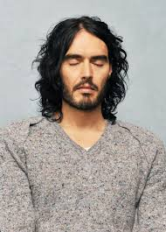
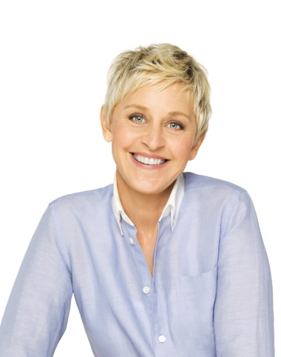
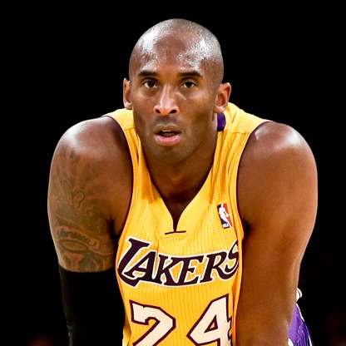
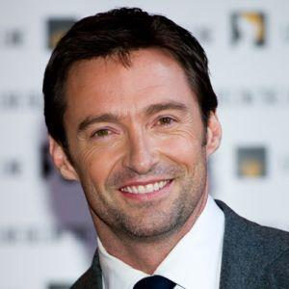
Who else uses Mindfulness?
“ I’m quite an erratic thinker, quite an adrenalized person, but after meditation, I feel this beautiful serenity and selfless connection.”-Russell Brand
“All the benefits that you can achieve from just sitting still and going within, it just really is a beautiful experience.” - Ellen DeGeneres
“It’s crazy to me that meditation is viewed as hokey. Just look at the people who’ve done phenomenal things. Do they meditate? Absolutely.”
- Kobe Bryant
“ In Meditation, I can let go of everything. I’m not Hugh Jackman. I’m not dad. I’m not a husband. I’m just dipping into that powerful source that creates everything. I take a little bath in it” -Hugh Jackman
Notes:
Jenna

Slide 6
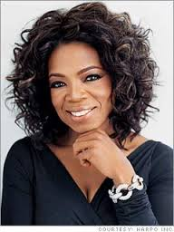
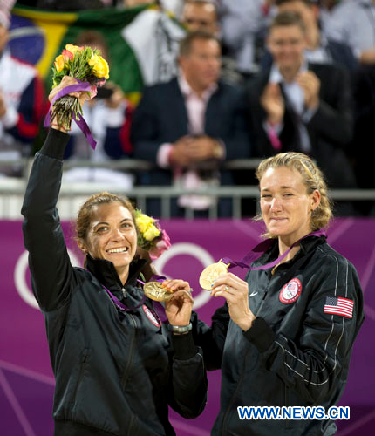
Who else uses Mindfulness?
“That way of being still with ourselves-coming back to the center and recognizing that something is more important than you”
-Oprah
“I’m actually huge into meditation, transcendental meditation, and that really helps create not only a sense of balance, but all the other stuff-this is going to sound cliche-but, serenity and kind of a calm state of mind”
-Eva Mendes
Olympic gold medal-winning volleyball players Misty May-Treanor and Kerri Walsh practice mindfulness skills to maintain high performance under pressure
Notes:
Jenna

Slide 7
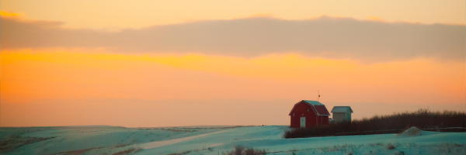
How can I be mindful?
Breath: Begin with respiration
Notice: Take it all in
Engage: Be in the moment
Discover: Delight in the unexpected
Accept: Acknowledge distractions, return to actions
Savor: Revel in the joy of small moments
Notes:
Vanessa
Breath-Engage
Personally vs classroom
Breath: Where do you notice your breath?
Notice: look around. What do you hear/see?
Engage: Focus on the task at hand: reference car again. Don’t worry about your to do list, etc.
Discover: personally-take a walk without headphones in; stop and smell the roses; students walking around halls with headphones in
Accept: No judgment, it’s ok to wander, come back to the present
Savor: So many things throughout our day we tend to miss. Be mindful helps you appreciate the little moments in life.

