Slide 1
Final Exam Preparation:
Tips and Tricks

Slide 2
Final Exam Schedule 2019
 | Monday June 10th | Tuesday June 11th | Wednesday June 12th | Thursday June 13th
7:30AM – 9:30AM | Day 2, Period 2 | Day 3, Period 2 | Day 4, Period 3 | Day 1, Period 1
My exam is:
9:30AM – 9:50AM | BREAK | BREAK | BREAK | BREAK
9:55AM – 11:55AM | Day 2, Period 4 | Day 3, Period 4 | Day 3, Period 3 | Day 4, Period 1
My exam is:

Slide 3
Please Note:
You are NOT required to be in school if you are not scheduled to take a final exam.
All morning buses run on the usual schedule. Afternoon buses will leave the school at 12:10.
Make-up exams may take place each afternoon, June 14th, or June 17th.
Students must make arrangements with their teachers to make up an exam.

Slide 4
Preparing for Exams:
Once the exam is announced, or you receive a study guide, find out what kind of exam it will be: multiple choice, short answer, essay
Immediately start working on completing the study guide or creating a content summary sheet
Spend the days leading up to the exam, reviewing the completed study guides/summary sheets
Don’t forget about the Academic/Math Center and After School Homework Club located in the LLC!

Slide 5
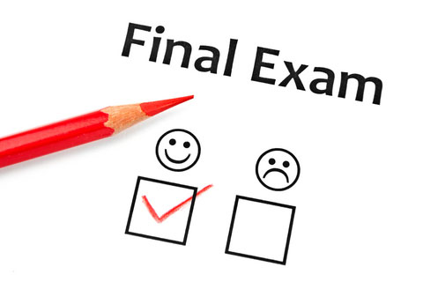
Tips for Day of Exams:
Eat before a test, having food in your stomach will give you energy and help you focus.
Don’t try to pull an all-nighter, get at least eight hours of sleep before the test.
When you first receive the test, do a quick survey of the entire test so that you know how to efficiently budget your time.
Do the easiest problems first; don’t stay on a problem you are stuck on, especially when time is a factor.

Slide 6
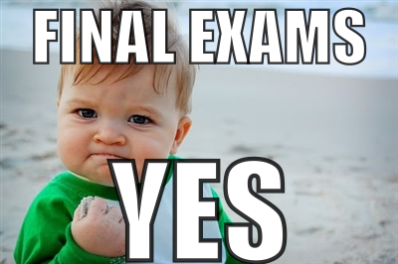
Tips Continued:
Don’t rush, but pace yourself, read the entire question and look for key words.
Write legibly, if the teacher can’t read what you wrote, you can’t get credit for the right answer!
Keep a positive attitude throughout the whole test and try to stay relaxed. If you start to feel nervous, take a few deep breathes to relax.
Don’t worry if others finish before you; focus on the test in front of you.

