Slide 1
The Milgram Experiment
Adapted from simplypsychology

Slide 2
Purpose of Experiment
Milgram was interested in researching how far people would go in obeying an instruction if it involved harming another person.
Stanley Milgram was interested in how easily ordinary people could be influenced into committing atrocities for example, Germans in WWII.

Slide 3
Participants of Experiment
Volunteers were recruited for a lab experiment investigating “learning”.
Participants were 49 males, ages between 20 and 50, whose jobs ranged from unskilled to professional.

Slide 4
Procedure of Experiment
Volunteers were introduced to another participant, who was actually working with Milgram. They drew straws to determine their roles-learner or teacher
This was fixed; the participant working with Milgram always was the learner.
There was also an “experimenter” dressed in a white lab coat, played by an actor.

Slide 5
Procedure of Experiment
2. The “learner” was strapped to a chair in another room with electrodes. After he has learned a list of word pairs given, the “teacher” tests him by naming a word and asking the learner to recall its pair from a list of four possible choices.
Click on the star to hear audio of the actual experiment!

Slide 6
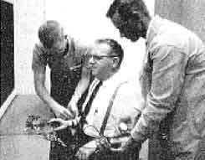
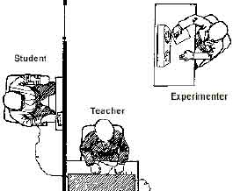
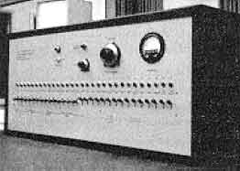
Set up of Experiment

Slide 7
Procedure of Experiment
The teacher is told to administer an electric shock every time the learner makes a mistake, increasing the level of shock each time. There were 30 switches on the shock generator marked from 15 volts (slight shock) to 450 (danger – severe shock).
The learner gave mainly wrong answers (on purpose) and for each of these the teacher gave him an electric shock. When the teacher refused to administer a shock and turned to the experimenter for guidance, he was given the standard order (consisting of 4 prods):
Prod 1: please continue.
Prod 2: the experiment requires you to continue.
Prod 3: It is absolutely essential that you continue.
Prod 4: you have no other choice but to continue.
Click the circle to hear an experimenter prod a teacher

Slide 8
Clip of Milgram Experiment

Slide 9
Results
65% (two-thirds) of participants (i.e. teachers) continued to the highest level of 450 volts. All the participants continued to 300 volts.
Milgram did more than one experiment – he carried out 18 variations of his study. All he did was alter the situation (IV) to see how this affected obedience (DV).

Slide 10
Milgram’s Conclusions
Ordinary people are likely to follow orders given by an authority figure, even to the extent of killing an innocent human being. Obedience to authority is ingrained in us all from the way we are brought up. Obey parents, teachers, anyone in authority etc.

Slide 11
Clip of Stanly Milgram Explaining his Experiment

