Slide 1
Fairfield Warde High School
SOPHOMORE PARENT MEETING

Slide 2
Getting Involved
Daily Bulletin
PTA Blast
Infinite Campus
Student Activities – Activity Period
Athletics, Community Service, Work Experience, Junior Job Shadow Opportunity
Encourage your child to explore and evaluate their current involvement

Slide 3
Naviance Family Connection
Login Information
Resume
Career Interest Profiler-
Administered through English classes April 7-11, 2014
Notes:
11th Grade Comprehensive Guidance Program: Workshops in resume writing/essay writing

Slide 4
CAPT / SBAC
Connecticut Academic Performance Test Science and
Smarter Balance Assessment Consortium
Tips to prepare:
Get lots of rest
Eat a healthy breakfast
Take the assessments seriously

Slide 5
Graduation Requirements
8 credits - English
6 credits - Math
6 credits - Science
7 credits - Social Studies- (USHistory & Civics)
3.2 credits (16 units) - Physical Education & Health
2 credits – Arts/Vocational
Computer Information Systems
No World Language Graduation Requirement – Important for College Admission

Slide 6
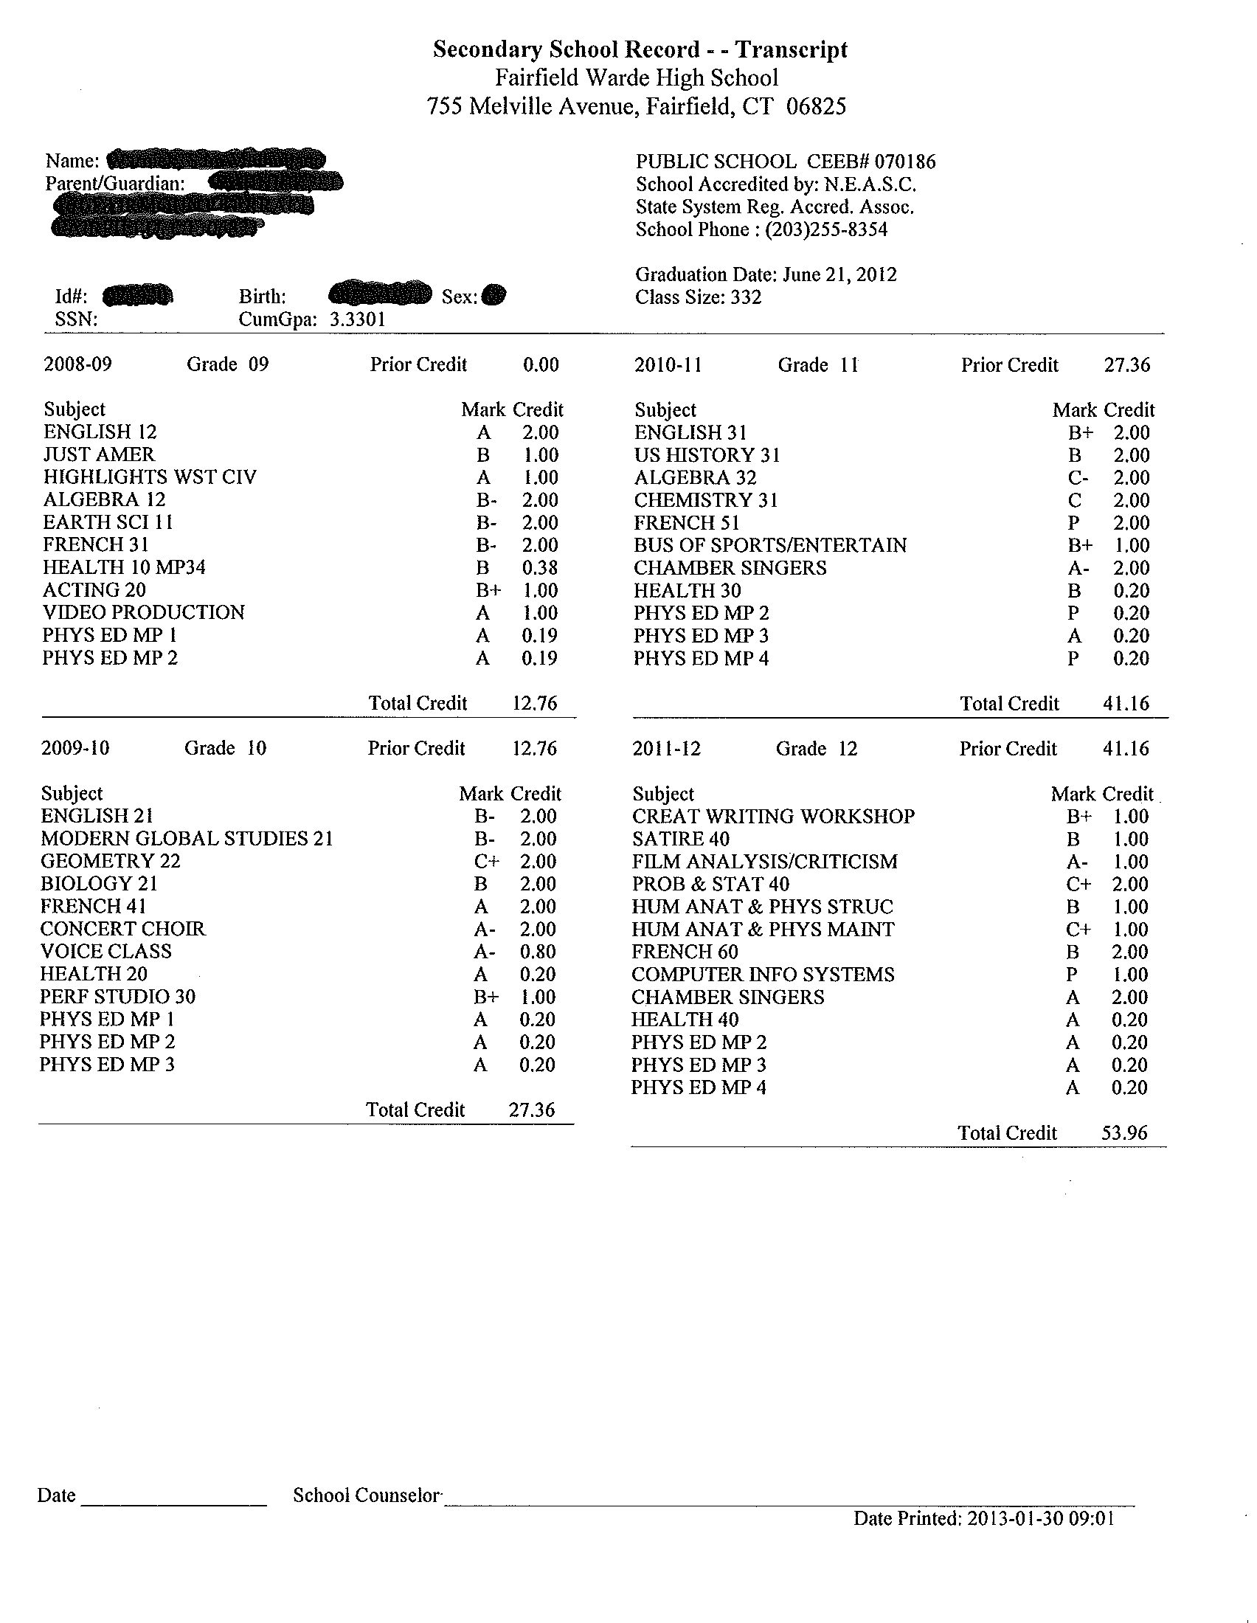
Transcript

Slide 7
What to Expect - Junior Year
Self-Exploration
PSATS in October ONLY- All juniors are strongly encouraged to take, even if they took it sophomore year
College Rep Visits - Fall
PHSP Kick-Off & Workshop Series –
ACTs, SATs, Subject Tests, AP Exams – Spring
Free Test Prep through Naviance Family Connection
Notes:
How to sign up

Slide 8
Academic Support
Academic Center
Math Lab
Extended Library Hours – Monday through Thursdays till 4pm

Slide 9
Pequot House School Counselors
Jill Cutter jcutter@fairfieldschools.org
Jim Perna jperna@fairfieldschools.org
Gloria Piche gpiche@fairfieldschools.org
Office Phone Number: (203) 255-8351
Welcoming Academic Respectful Dynamic Ethical

