Slide 1
Welcome Class of 2019 Parents and Guardians

Slide 2
Welcoming Academic Respectful Dynamic Ethical

Slide 3
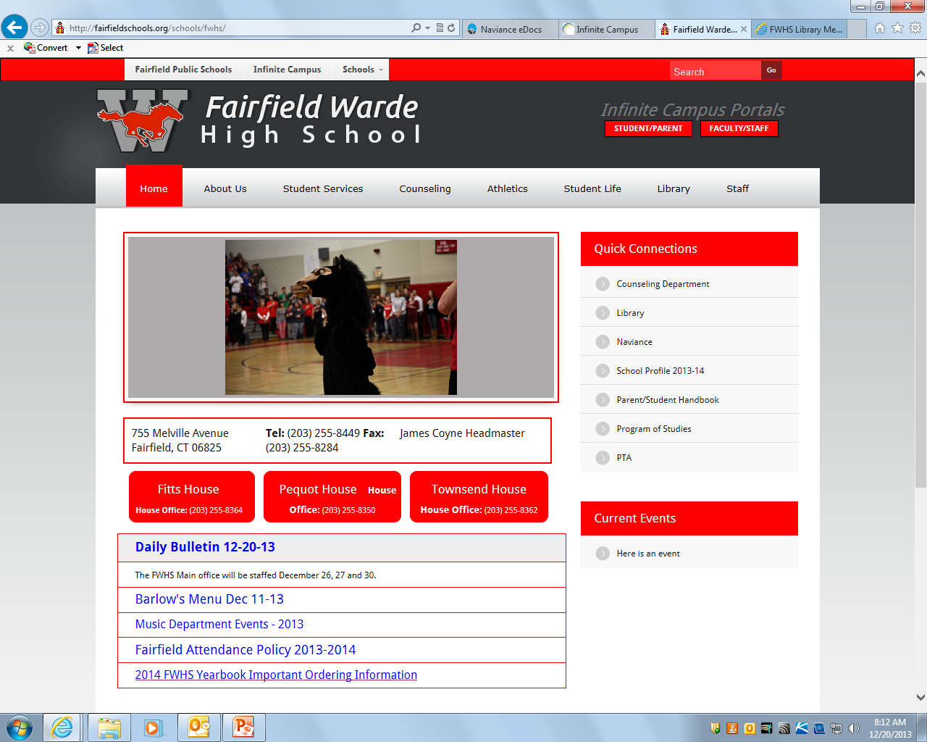
Website, Naviance and IC
Homepage
IC Support – reghelp@fairfieldschools.org

Slide 4
Naviance and Learning Style Inventory
All 9th grade students took the Learning Style earlier in the year.
The Learning Style Inventory (LSI) is an online assessment that identifies students’ unique learning styles.
This 30-minute assessment helps build student self-awareness and provides methods for students to improve their study habits. To review these results log onto your students Naviance account.

Slide 5
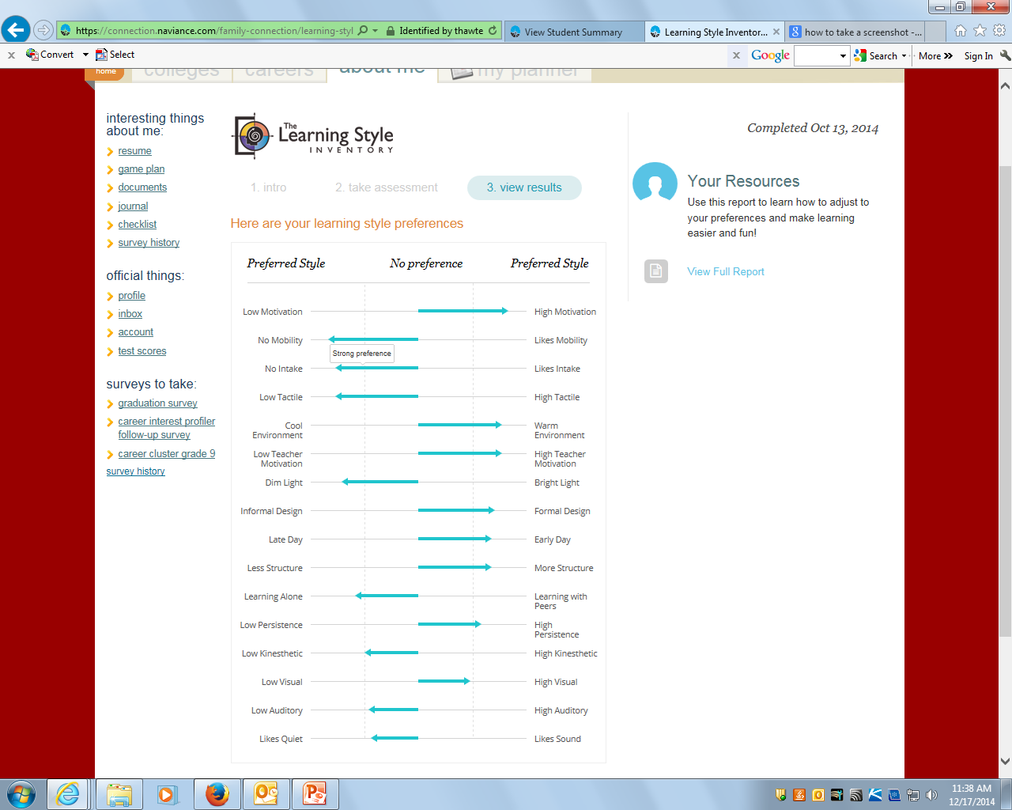

Slide 6
Mid Term Exam Schedule 2016
Tips to prepare:
*Get lots of rest
*Eat a healthy breakfast
*Start to review early – Study Guides
Refer to exam schedule handout

Slide 7
At the end of January students will receive a Program of Studies with detailed information about academic and elective courses offered.
Current teachers will make recommendations for students based on present grades. Having a conversation with the teacher is extremely important and we encourage students and parents to speak with the teacher if they are concerned about the course recommended.
Counselors will be meeting with students individually to answer questions, review course choices, prerequisites and overall course load.
Using Infinite Campus students will input courses for the 2016-2017 school year.
Course Selection Parent Night on January 27, 2016
Course Selection

Slide 8
Policy on Change of Program
A great deal of time and effort on the part of the staff is devoted to developing an individual program for each student. It is also essential that students and parents put sufficient time and thought into the process to assure a satisfactory program. There are a few legitimate reasons for making program changes during the school year. Any program elected should be started with the idea of completion in mind.
The counselors will make changes for the following reasons ONLY; the first two weeks of school:
Incomplete or insufficient credit
A course scheduled in error by the school
Changes needed as the result of course failed in June
Changes needed as the result of successful completion of summer school
Weeks two through marking period one:
An approved level change
After the first marking period of any course any changes will result in a grade of “W” (withdrawn) on the transcript, this applies even to changes in the level of a course.

Slide 9
Graduation Requirements
8 credits – English
6 credits – Math
6 credits – Science
7 credits – Social Studies (US History and Civics)
2 credits – Physical Education
1 credit - Health
2 credits – Arts/Vocational
Computer Information Systems
No World Language Graduation Requirement – Important for College Admission

Slide 10
Academic Support
Extra help sessions with classroom teacher
Academic Center (during school hours)
Math Lab (during school hours)
The LMC is open Monday - Thursday from 7:15am - 4:00pm and on Fridays from 7:15am - 3:30pm
Homework Help Program
Monday, Wednesday and Thursday 2:15-3:45
College and Career Center

Slide 11
Get Involved!
For Parents/Guardians
Daily Bulletin
PTA Blast
Infinite Campus
Communicating with teachers
For Students
Student Activities – Activity Period
*Online registration will be available for second semester.
Athletics, Community Service
Encourage your child to explore and evaluate their current involvement

Slide 12
Counseling Center
Individual and Group Counseling
Psycho-educational Evaluations
Assessment and education regarding emotional well-being
Community Referrals
Crisis Intervention
Halley Ceglia – School Social Worker
Michael Saad – School Social Worker
Stephanie Swist – Student Assistance Counselor
Ryan Passarelli - School Psychologist
Sue Redgate – School Psychologist
Chelsea Ackerman-School Psychologist Intern

Slide 13
Ali Chagnon achagnon@fairfieldschools.org Gina DiGiacomo gdigiacomo@fairfieldschools.org Danielle Jurkiewicz djurkiewicz@fairfieldschools.org Kristen Arsenault (Administrative Assistant) karsenault@fairfieldschools.org 203-255-8363

