Slide 1
The Course Selection Process
Fairfield Warde High School

Slide 2
Resources for Students/Parents
Program of Studies – the most thorough resource you have
Your School Counselor
Student assemblies
Conversations with teachers, counselors, curriculum leaders, administrators
Course Selection Night, January 29– all materials posted online
Informational website:
www.fairfieldschools.org/highschoolcourse_selection.html
(Includes: Course descriptions, AP syllabi, AP sample tasks and exemplary student work samples, table of time commitment expectations for each class)

Slide 3
Goals for All Students
Develop critical and creative thinking skills
Solve problems of increasing complexity
Analyze and synthesize information
Apply knowledge/skills to new and different situations
Become more independent learners and self-advocates
Develop skills to communicate and collaborate

Slide 4
Graduation Requirements
Credit Requirements for Graduation
To meet the minimum requirements for a high school diploma, a student must earn 43 credits and achieve the following credit distribution:
English 8 credits
Math 6 credits
Science 6 credits
Social Studies (includes US History and Civics) 7 credits Physical Education & Health 3.2 credits (16 units)
Arts/Vocational 2 credits
Computer Information Systems Proficiency

Slide 5
Grade Level Promotion Requirements
• To be in a sophomore homeroom a student should have completed at least ten (10) credits.
• To be in a junior homeroom a student should have completed at least twenty (20) credits, including four (4) credits of English, two (2) credits of science, two (2) credits of math and two (2) credits of social studies plus seven (7) units of physical education/health.
• To be in a senior homeroom a student should have completed at least thirty (30) credits, including five (5) credits of English, four (4) credits of science, two (2) credits in math, two (2) credits in social studies plus ten (10) units of physical education/health.

Slide 6
Expectations for each Level
Level 2: (College Preparatory)
Reading material at grade level
Complexity of the material and work expectation at grade level
Level 1 (Honors)
Reading material above grade level
Complexity of the material and work expectation above grade level
Accelerated pace
Advanced Placement
Equivalent to a freshman college course in a major
Reading material at the college/university level
Significant volume of independent work
Level of synthesis, critical thinking and problem solving significantly above that of a high school course
Very rapid pace

Slide 7
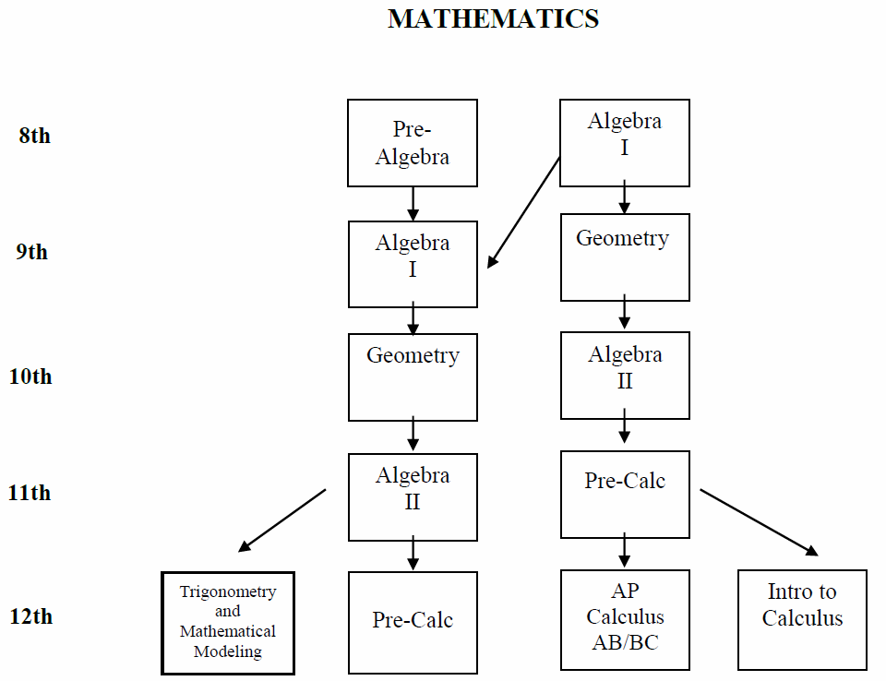

Slide 8
Math Courses for Seniors
PRE-CALCULUS 40 2 credits
PRE-CALCULUS 41 2 credits
FINANCIAL ALGEBRA 42A and 42B 2 credits
PROBABILITY AND STATISTICS 40 2 credits
MATHEMATICAL MODELING 42 1 credit
TRIGONOMETRY 42 1 credit
INTRODUCTION TO CALCULUS 50 2 credits
AP STATISTICS 2 credits
AP CALCULUS AB 2 credits
AP CALCULUS BC 2 credits
MULTIVARIABLE CALCULUS 2 credits

Slide 9
Comparison Among Levels of Mathematics
AP Calculus AB and BC
5-6 hrs per week (average) outside of class time
AP Statistics
4-6 hrs per week (average) outside of class time
Level 1 courses
3-6 hrs per week (average) outside of class time
Level 2 courses
1.5-2 hrs per week (average) outside of class time
Level O courses
1.5-3 hrs per week (average) outside of class time

Slide 10
ENGLISH
 | AP Level |  | Level 1 | Level 2
Grade 9 |  |  | English 11 | English 12
Grade 10 |  |  | English 21 | English 22
Grade 11 | AP American Studies | AP Language and Composition | American Cultural Studies 31 | American Cultural Studies 32
Grade 12 | AP Literature |  | English 41 | English 42
 | Senior English Elective Semester Courses *
*Available to all seniors as the required English courses or in addition to other English courses. If taken as the required English courses, must take one writing and one literature course. All Senior English electives are Level O. Also available to juniors in addition to their required full-year course.

Slide 11
ENGLISH
 | Level 1 |  |  |  | Level 2
Grade 9 | English 11 |  |  |  | English 12
Grade 10 | English 21 |  |  |  | English 22
Grade 11 | American Cultural Studies 31 | AP American Studies |  | AP Language and Composition | American Cultural Studies 32
Grade 12 | AP Literature |  | English 41 |  | English 42
 | Senior English Elective Semester Courses *

Slide 12
ENGLISH ELECTIVES The Elective Courses have been grouped in two general categories: Literature Course and Writing Courses. A student must take a minimum of one course from each column.
Literature |  | Writing
Contemporary Global Literature |  | Creative Writing Workshop
Call of the Wild |  | Poetry
Gender Perspectives in Literature |  | Satire
The Supernatural in Literature |  | Film Analysis and Criticism
Dramatic Literature & Performance |  | Journalism

Slide 13
Comparison Among Levels of English
AP Literature and Composition
7-10 hrs per week (average) outside of class time
Summer assignment
AP Language and Composition and AP American Studies
6-9 hrs per week (average) outside of class time
Summer assignment
Level 1 courses
4-6 hrs per week (average) outside of class time
Level 2 courses
2.5-4 hrs per week (average) outside of class time
Level O courses
3-5 hrs per week (average) outside of class time

Slide 14
SOCIAL STUDIES
Three and one-half years of Social Studies is required. The course sequence is described below: (7 Credit Requirement)
Global Studies 10
9th
Modern Global Studies
22 or 21
10th
US History 32, 31, or AP
AP American Studies
11th
11th or 12th *
Civics*
Civics & Contemporary Issues
Civics & International Relations
Civics & Youth and the Law
12th
Elective Courses
AP Modern European History Humanities AP American Gov’t & Politics Psychology
AP Psychology Economics
Modern European History
*1 semester of civics may be taken in either 11th or 12th grade
(AP American Gov’t and Politics will also fulfill the Civics Requirement)

Slide 15
Comparison Among Levels of Social Studies
AP Government and Politics
5-7 hrs per week (average) outside of class time
Summer assignment
AP Modern European History
4-7 hrs per week (average) outside of class time
Summer assignment
AP Psychology
4-7 hrs per week (average) outside of class time
Summer assignment
AP American Studies
6-9 hrs per week (average) outside of class time
Summer assignment
AP United States History
6-8 hrs per week (average) outside of class time
Summer assignment
Level 1 courses
3-4 hrs per week (average) outside of class time
Level 2 courses
2-3 hrs per week (average) outside of class time
Level O courses
1.5-3 hrs per week (average) outside of class time

Slide 16
SCIENCE
SUGGESTED COURSE SEQUENCE

Slide 17
Comparison Among Levels of Science
AP Environmental Science, Biology, Chemistry, Physics
7-10 hrs per week (average) outside of class time
Most courses have summer assignments
Level 1 courses
3-4 hrs per week (average) outside of class time
Level 2 courses
1.5-2 hrs per week (average) outside of class time
Level O courses
1.5-2 hrs per week (average) outside of class time

Slide 18
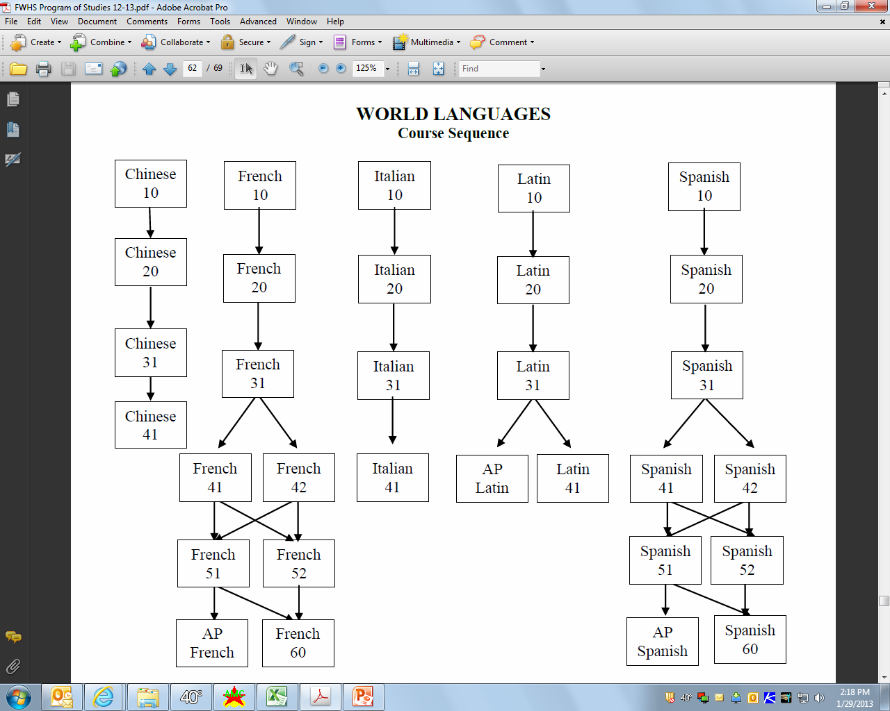

Slide 19
Comparison Among Levels of World Languages
AP French, Spanish, Latin
5-8 hrs per week (average) outside of class time
Most courses have summer assignments
Level 1 courses
3-6 hrs per week (average) outside of class time
Level 2 courses
2-4 hrs per week (average) outside of class time
Level O courses
2-4 hrs per week (average) outside of class time

Slide 20
The Process
1. Get Informed
Read the Program Of Studies and course information posted online, speak with your teachers
Course information night
Class meetings Friday
2. Complete the Course Selection Worksheet with your requests and input your requests into IC
Be sure all information is accurate and complete
Week of February 3 - 7: Teachers will spend class time discussing department courses and their recommendations, and signing Course Selection Worksheet
Sign your form when completed
Obtain your parent’s signature
Enter your Requests into Infinite Campus
Turn your completed signed Worksheet into your school counselor on or before February 10th, 2014

Slide 21
NAME: _________________________
Counselor: __________________ Homeroom: _______ CURRENT GRADE: ______
This form is due to your school counselor by Monday February 11, 2013
FAIRFIELD WARDE HIGH SCHOOL COURSE SELECTION SHEET—GRADES 9, 10, 11
SCHOOL YEAR 2013—2014
PLEASE PRINT CLEARLY IN PENCIL
Notes:
COURSE TITLE | COURSE # (4 DIGITS) | CREDITS | Teacher Comment: | TEACHER INITIALS
Sample: US Hist31 | 1331 | 2.0 | Rec US 31 | J P R
Sample: Eng 31 | 0031 | 2.0 | Rec Eng 32 | L D H
1.
2.
3.
4.
5.
6.
7.
8
9.
10.
Alternate Courses |  | Total Credits:
1.
2.
3.
Physical Education |  |  | Added automatically to all students
Health |  |  | Added automatically to all students

Slide 23
The Process
3. Review your requests with your School Counselor
Schedule an academic advisory appointment with your School Counselor between February 10th and 28th
Confirm your final selections into the Infinite Campus Student system (with counselor’s assistance)
Print out Final Course Verification Form from Infinite Campus
4. Final Step
Sign and obtain your parent’s signature on the Final Course Verification Form
Return to your school counselor on or before March 3, 2014

Slide 24
Changing/Dropping Courses
Once schedules are finalized, counselors will make changes for the following reasons only:
An incomplete schedule or insufficient credits
A course scheduled in error by the school
Changes needed as the result of courses failed
Changes needed as the result of summer school work
As always, students with concerns regarding their academic progress should speak to their teacher and school counselor.

Slide 25
Calendar for Changing/Dropping Courses
Course changes will not be approved during the first two weeks of any course (except for reasons posted on previous slide).
After the first quarter of any course, any approved changes will result in a grade of “W” (withdrawn) which will appear on your transcript—this applies even to level changes. This will not impact GPA. After the 1st semester, any student dropping a full year course which they are failing will receive a grade of WF, which does impact GPA.

Slide 26
Rationale for Change/Drop Policy
Our goal is to provide students and teachers with balanced classes.
Multiple changes to a schedule causes students to miss critical information shared in the initial days the course meets.
Even a single change can affect enrollment in multiple courses, increasing disruption.
We build the master schedule from student course requests, so it is important to have accurate counts.
Our process is providing students with more opportunity and responsibility to build their schedule – and we are looking to foster commitment to original requests.

