Slide 1
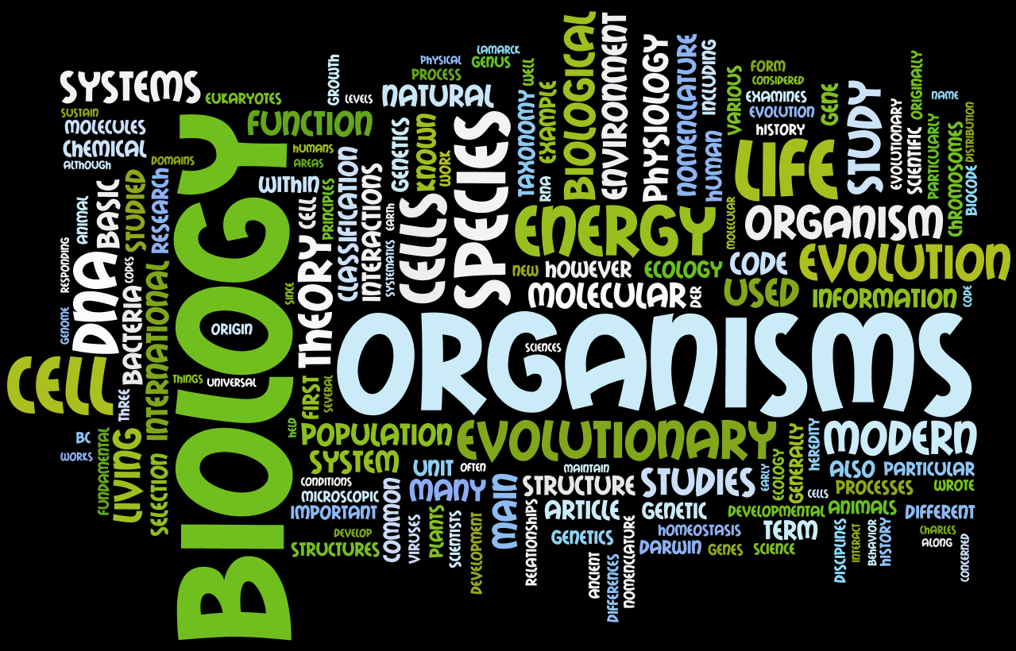
Welcome to Biology!

Slide 2
DAY 1

Slide 4
Who am I?

Slide 6
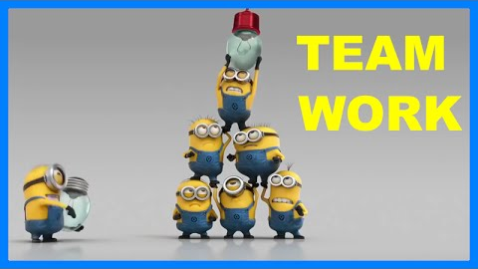
In Science you have to work as a team!

Slide 7
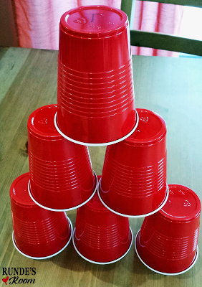
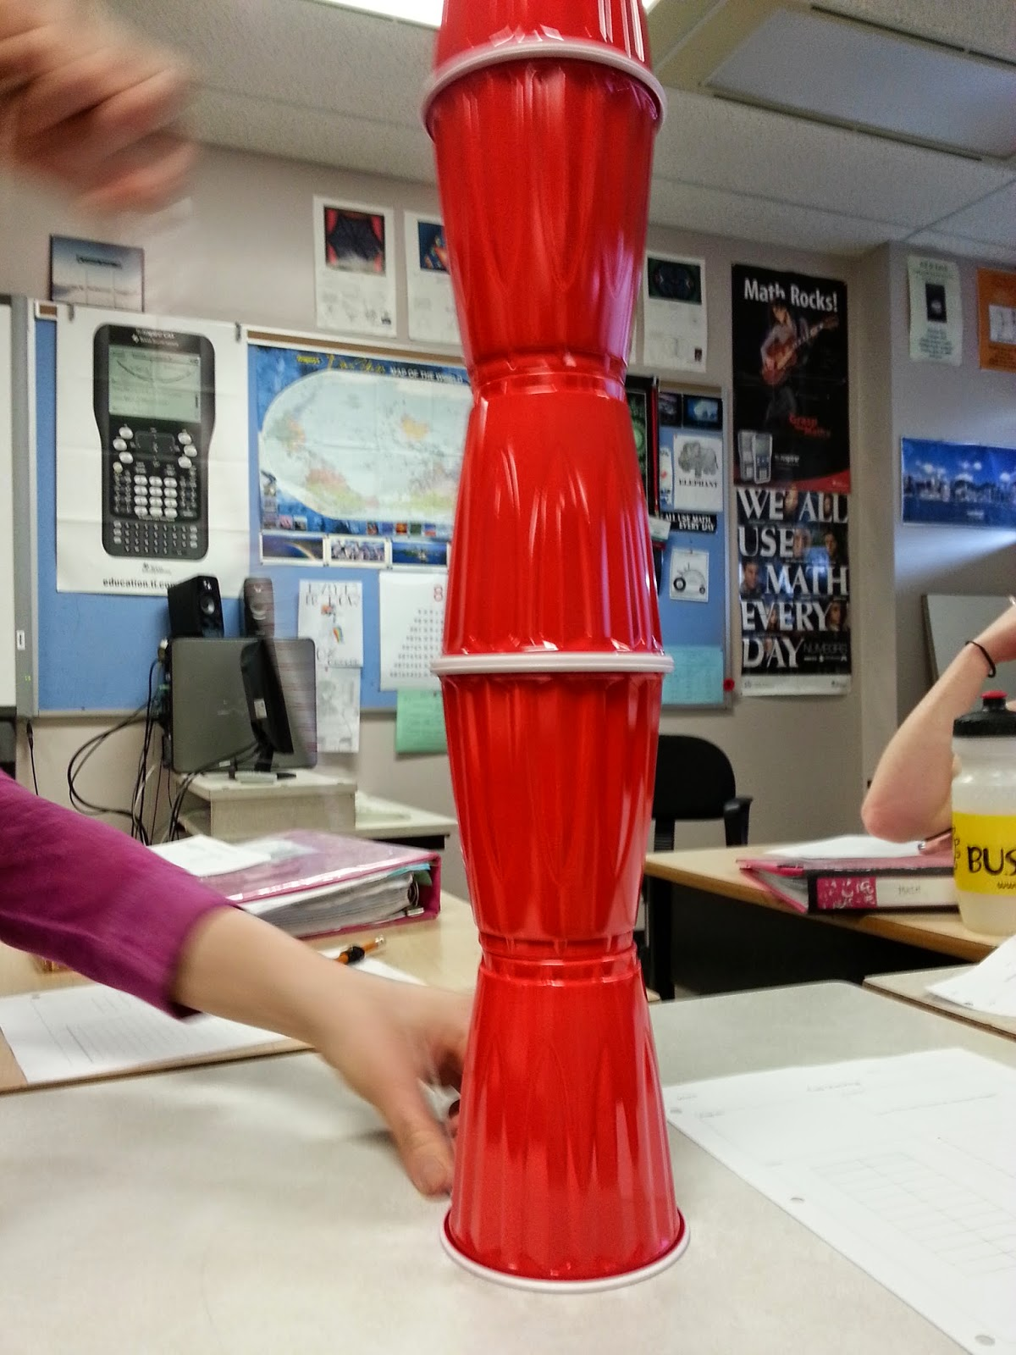

Slide 8
Classroom Syllabus/Expectations

Slide 9
DAY 2

Slide 10
Online Resources
http://fairfieldschools.org/schools/fwhs/racioppo/

Slide 11
DAY 2 SKINNY

Slide 12
Pre-Test

Slide 13
DAY 3
Charoflifegraphic.docx
1 saving fred.docx

Slide 14
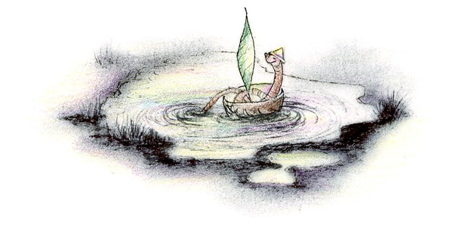
OH NO!!!!!!

Slide 16
STEPS TO THE SCIENTIFIC METHOD
IV
DV
VARIABLES HELD CONSTANT
CONTROL GROUP

Slide 17
Day 4

Slide 18
THINK ON YOUR OWN….
On Loose leaf paper answer the following:
What is it?
Is it living? How do you know?
What characteristics do all living things have?

Slide 19
PAIR Brainstorm
As a group, answer the same questions.
What is it?
Is it living? How do you know?
Come up with a list that as a group you believe that all living things have.

Slide 20
SHARE
Characteristics of living things.

Slide 21
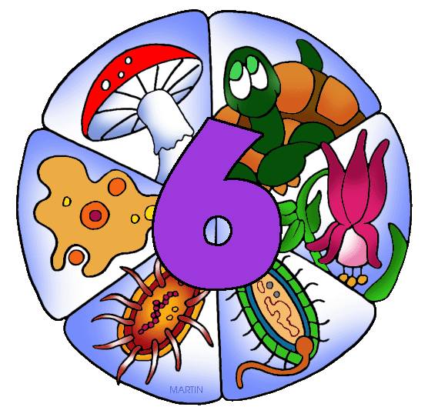
How are these organisms arranged into groups?
What are the groups called?

Slide 22
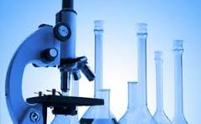
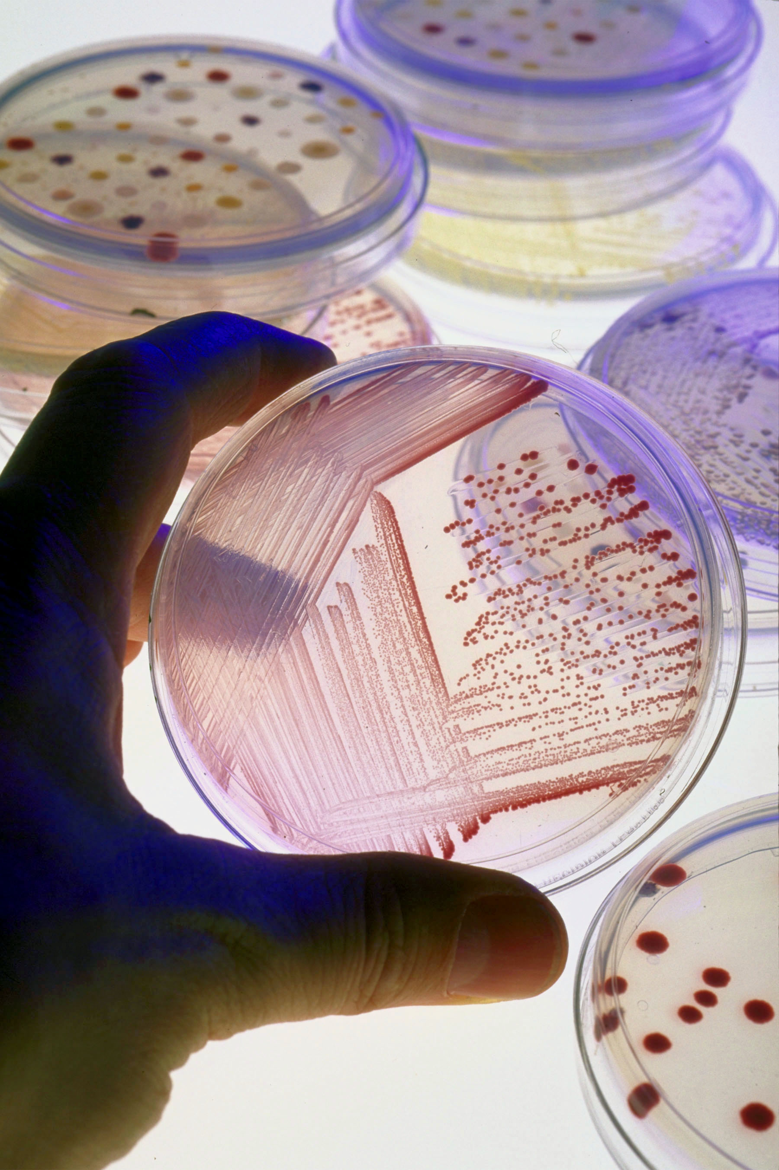
How will you as a team test to see if your “thing” is living?
Design a lab
What is the scientific method? How will you satisfy all the steps?
How will you ensure that it is valid?

