Slide 1
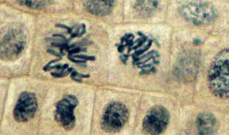
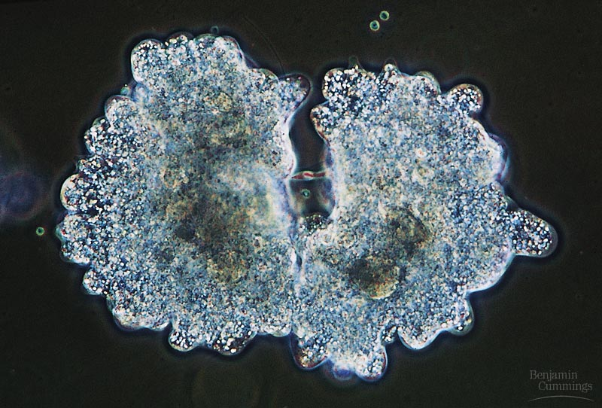
Biology is the only subject in which multiplication is the same thing as division…

Slide 2
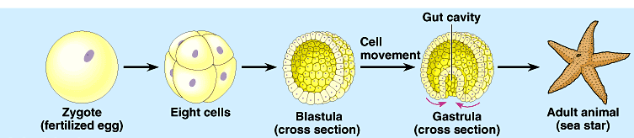

Making New Cells
Making New DNA

Slide 3
Where it all began…
You started as a cell smaller than
a period at the end of a sentence…

Slide 4
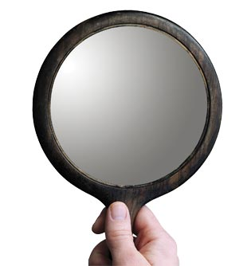
And now look at you…
How did you get from there to here?

Slide 5
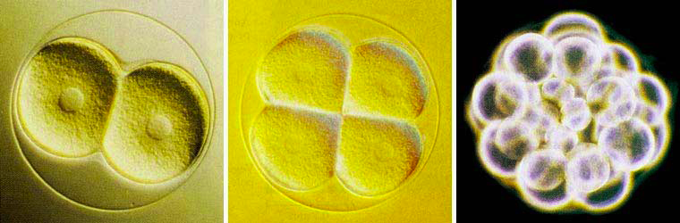
Getting from there to here…
Going from egg to baby….
  the original fertilized egg has to divide…
and divide…
and divide…
and divide…

Slide 6
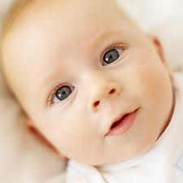
Why do cells divide…
amoeba
Reproduction
Growth & Development
starfish
Repair
Notes:
Unicellular organisms
Cell division = reproduction
Reproduces entire organism& increase population
Multicellular organisms
Cell division provides for growth & development in a multicellular organism that begins as a fertilized egg
Also use cell division to repair & renew cells that die from normal wear & tear or accidents

Slide 7
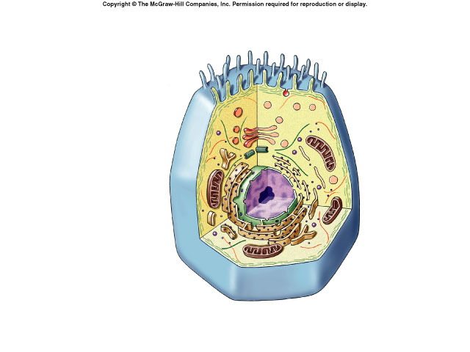
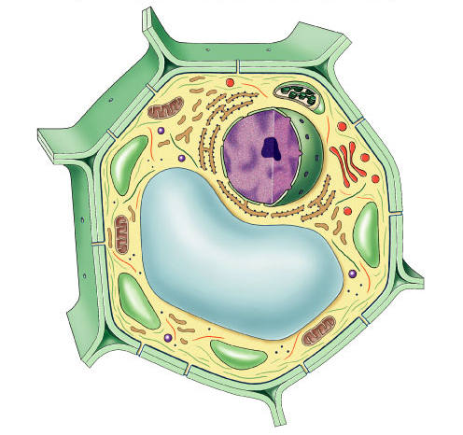
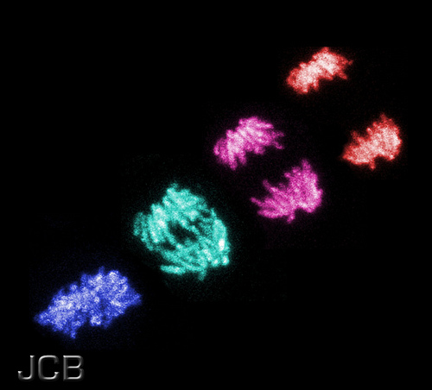
What must be copied in order for a cell to divide?
animal cell
plant cell

Slide 8
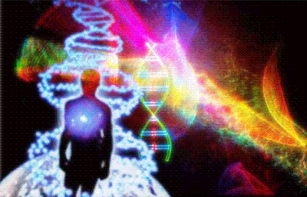
Copying DNA
A dividing cell duplicates its DNA.
But what is DNA?

Slide 9
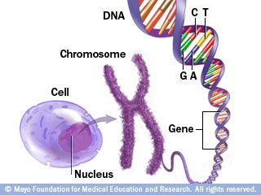
Isn’t a gene, chromosome and DNA all interchangeable?

Slide 10
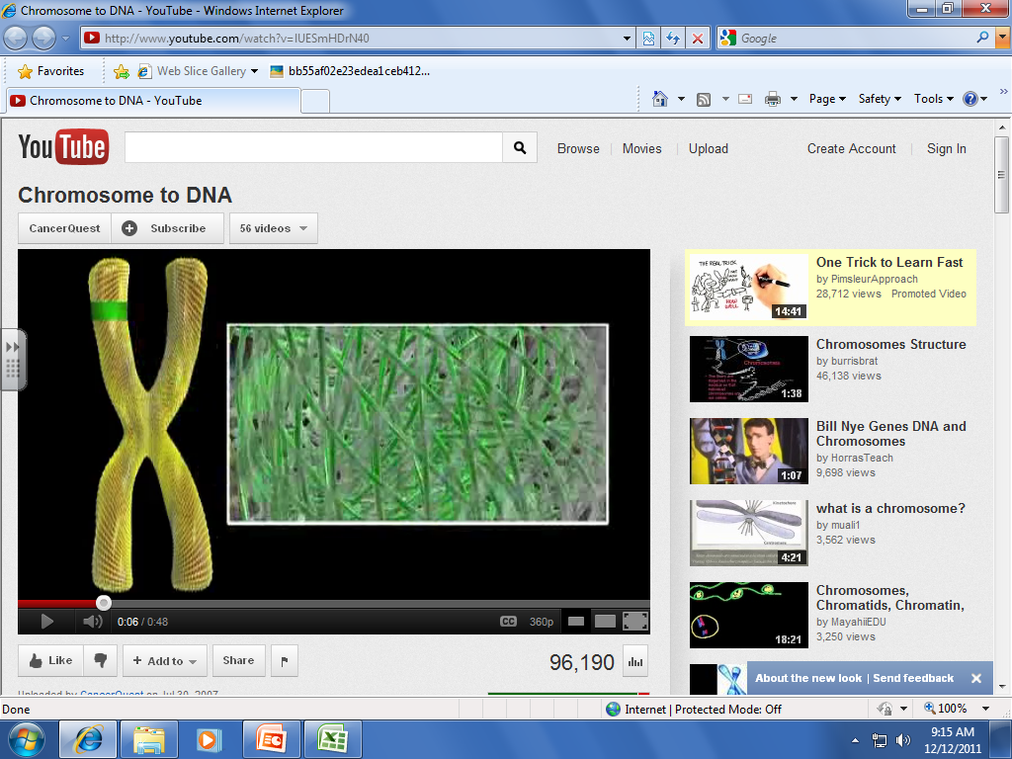

Slide 11
T
G
A
T
C
C
A
A
G
Each gene codes for a particular protein
G
A
T
C

Slide 12
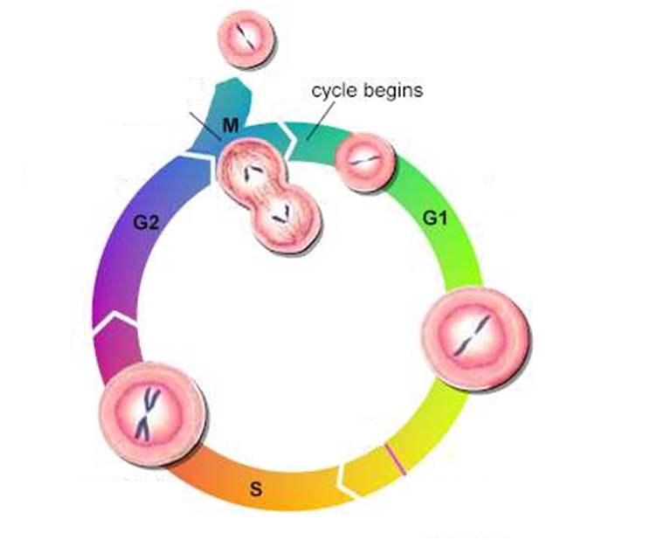
Mitosis: Cell Division
CELL CYCLE
Growth
(in organelles)
Growth
(in size)
Synthesis
(Replicate DNA)

Slide 13
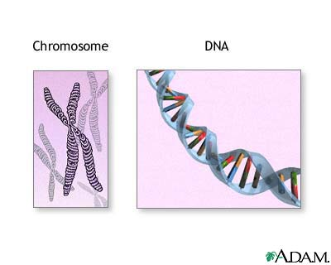
Humans have 46 chromosomes.
That is 46 individual strands of DNA.

Slide 14
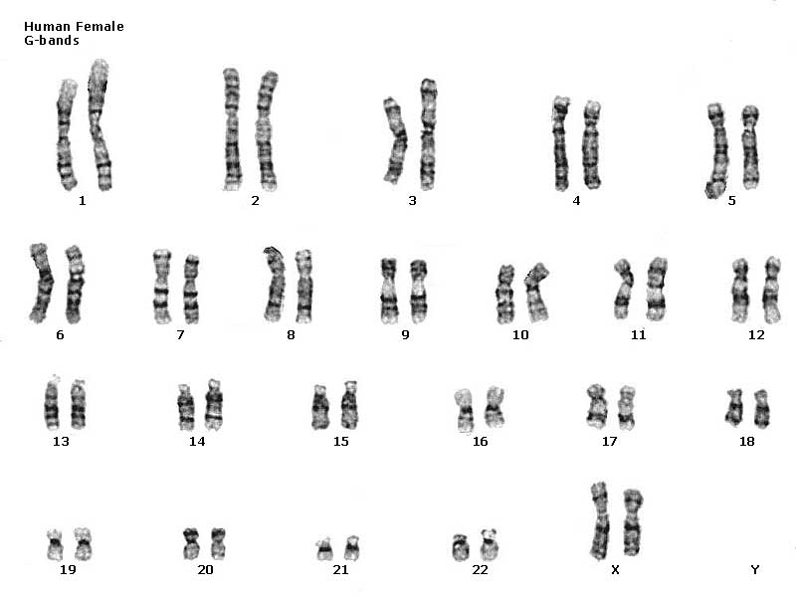
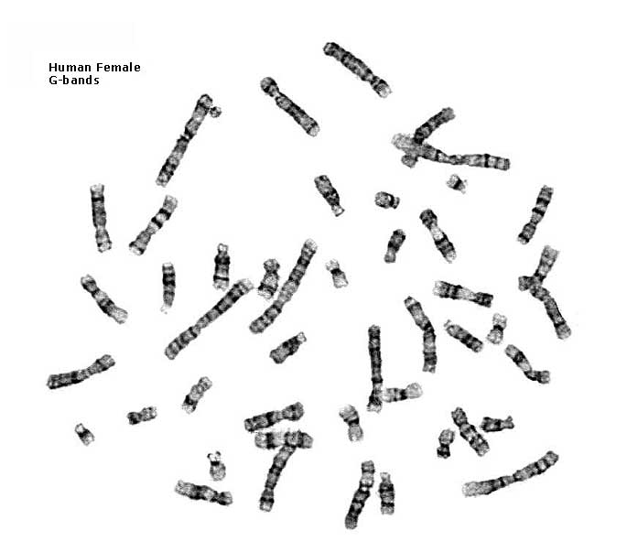
Chromosomes of Human Female
Karyotyping
46 chromosomes
23 pairs

Slide 15
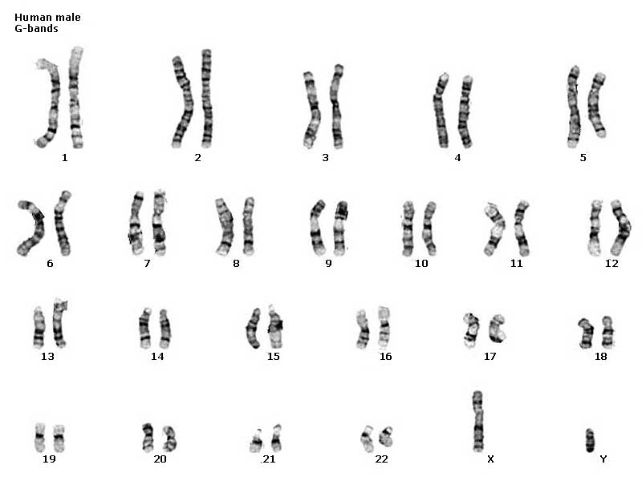
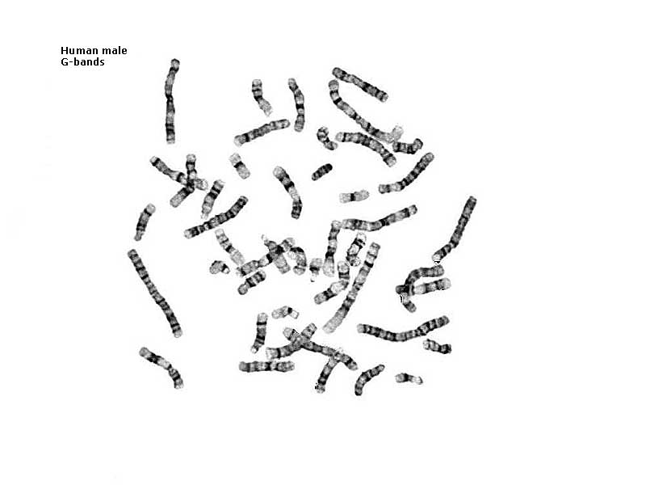
Chromosomes of Human Male
Karyotyping
46 chromosomes
23 pairs

Slide 16
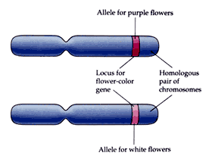
Why are chromosomes paired?
Homologous chromosomes
Homo=same
One from each parent
Similar in size, shape and genetic content

Slide 17


DNA, the Blueprint of Life
DNA, the Blueprint of Life
The only difference between living organisms is the amount and order of the DNA alphabet.

Slide 18
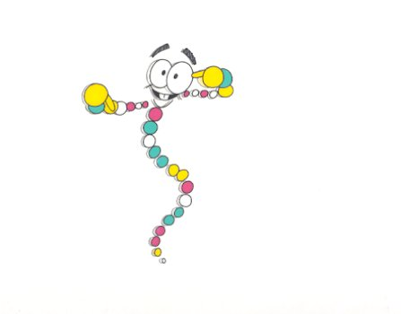
Where do you find DNA?

Slide 19

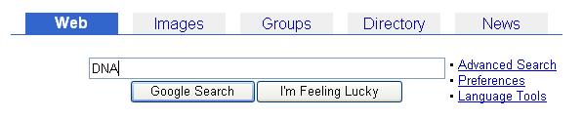

Slide 20
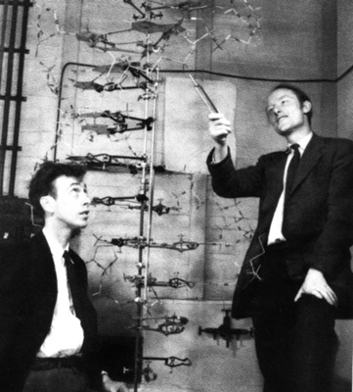
DNA: deoxyribonucleic acid
England 1953
James Watson and Francis Crick
http://bioweb.wku.edu/asp/bisc/images/WatsonCrick.jpg

Slide 21
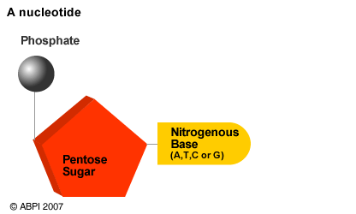
Structure of DNA
Monomer: NUCLEOTIDE
Made of 3 parts
A = Adenine
T = Thymine
C = Cytosine
G = Guanine
Deoxyribose/

Slide 22
sugar
N base
POLYMER: DNA
phosphate
SHAPE: Double Helix
sugar
N base
phosphate
strong bonds
sugar
N base
phosphate
sugar
N base
phosphate

Slide 23
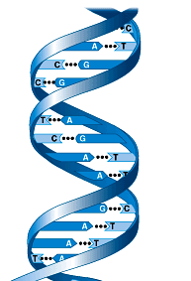
DNA Structure
A pairs with T C pairs with G
A - T C - G
weak HYDROGEN bonds between nitrogen bases join the 2 strands
Why do the bonds have to be weak?
REPLICATION OF CELLS & DNA
Notes:
It’s a helix or B sheet within a single region. Can have both in one protein but a specific region is one or another

Slide 24
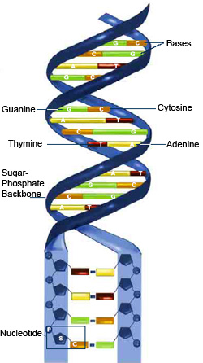

Shape of DNA

Slide 25
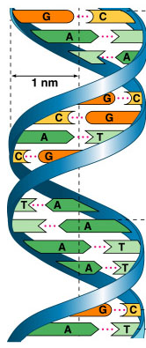
Why does DNA Replicate?
Cell Reproduction
Notes:
when cells divide, they must duplicate DNA exactly for the new “daughter” cells
Why is this a good system?

Slide 26
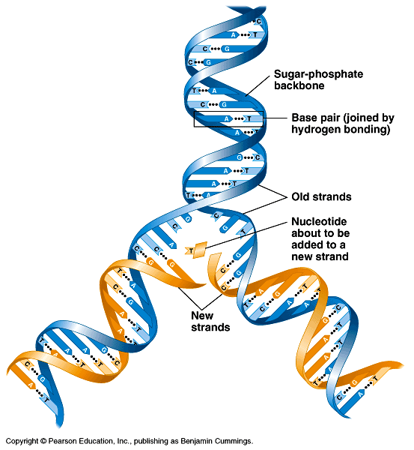
How does DNA replicate?
What enzymes are used?
Helicase
Polymerase
Newly copied strands of DNA
Notes:
The greatest understatement in biology!

Slide 27
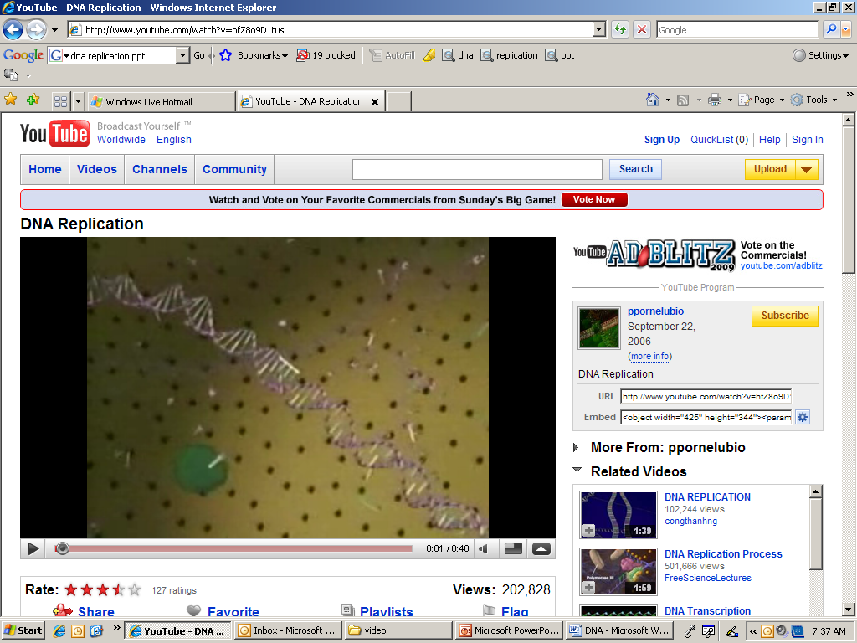
DNA REPLICATION

Slide 28
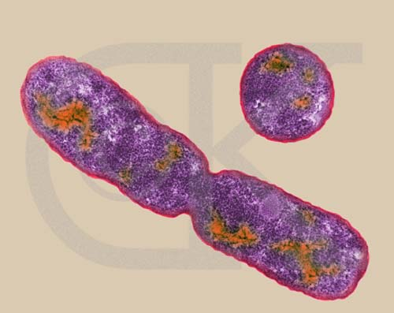
MITOSIS: Asexual Reproduction
Cell Division
Creating 2 new identical cells

Slide 29
Mitosis: Cell Division
CELL CYCLE
Growth
(in organelles)
Growth
(in size)
Synthesis
(Replicate DNA)
Interphase = G1, S & G2

Slide 30
Copying DNA for Mitosis
What does the DNA look like?
What would happen if you tried to copy it now?
DNA
cell
nucleus

Slide 31
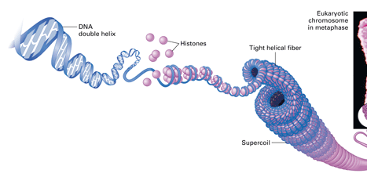
Organizing & packaging DNA
DNA
cell
nucleus
DNA has been
“wound up”
cell
How many chromosomes
in this organism?
nucleus

Slide 32

MITOSIS

Slide 33
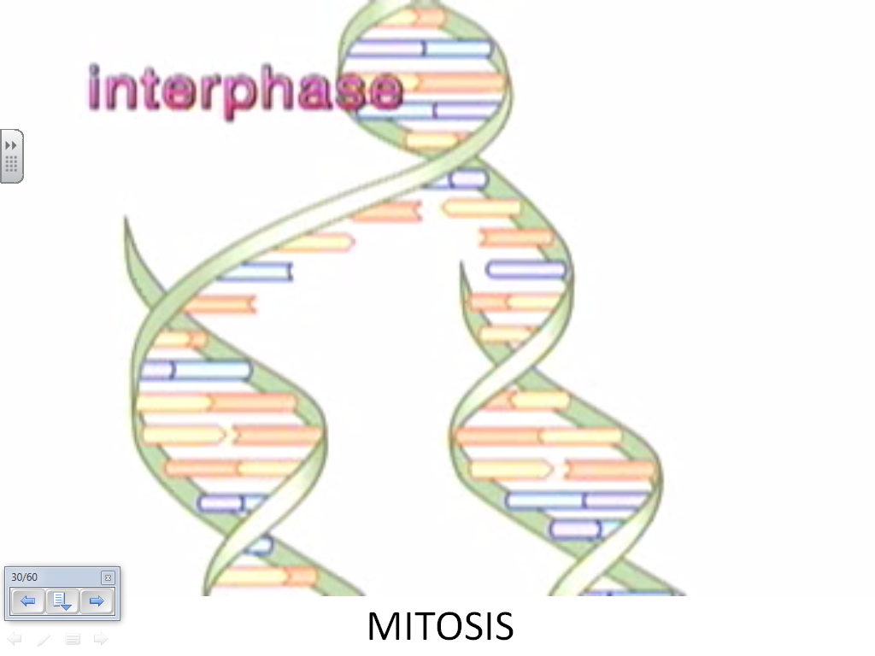

Slide 34
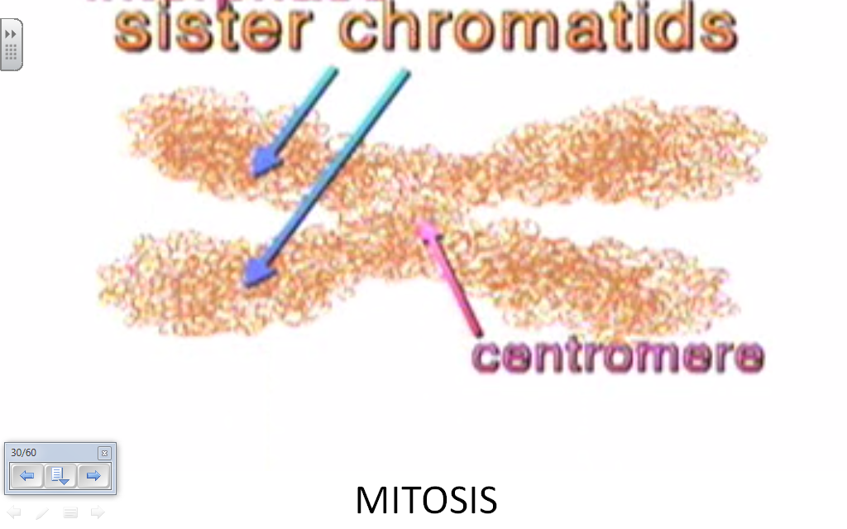

Slide 35
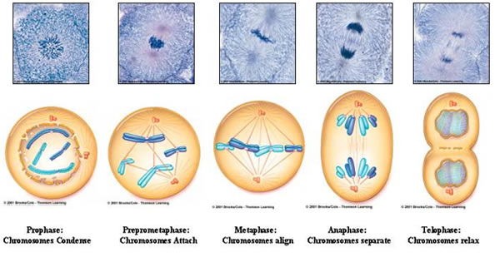

Slide 36
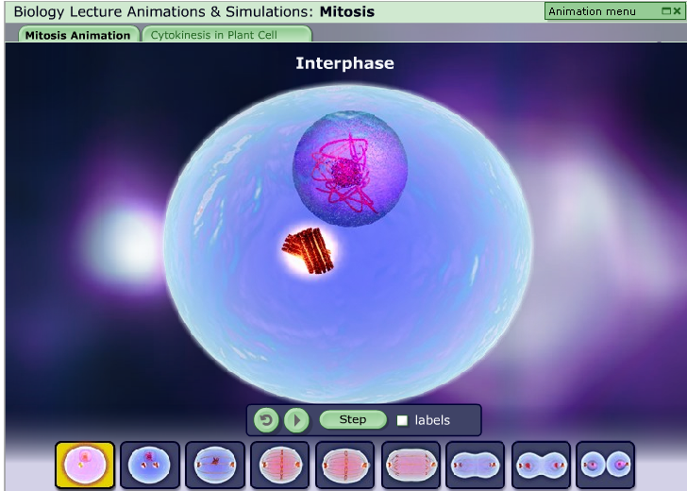

Slide 37
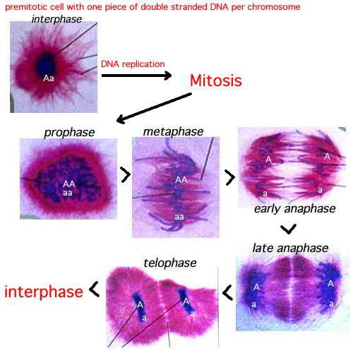
DNA Replication

Slide 38
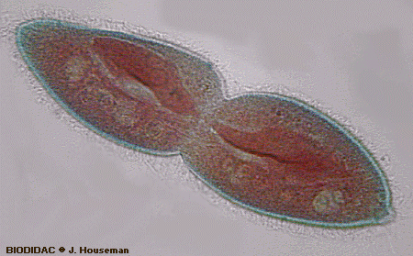
End Result
2 IDENTICAL
DAUGHTER CELLS

Slide 39
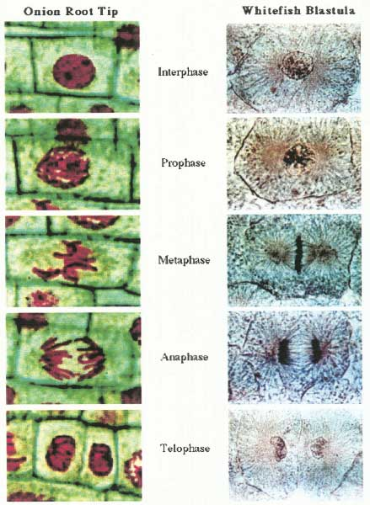
Plant vs. Animal Mitosis
ANIMAL
Cytokinesis: splitting of the cells
PLANT
Cell Plate: cuts cell wall in half

Slide 40
Cell division / Asexual reproduction
Mitosis
  produce cells with same information
    identical daughter cells
  exact copies
    clones
  same number of chromosomes
    same genetic information
Aaaargh!
I’m seeing
double!

Slide 41
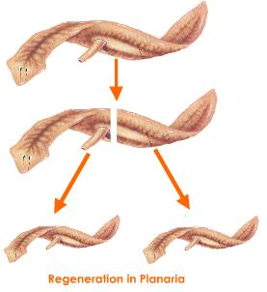
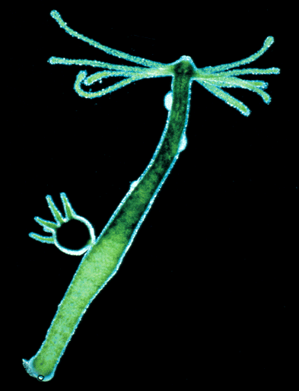
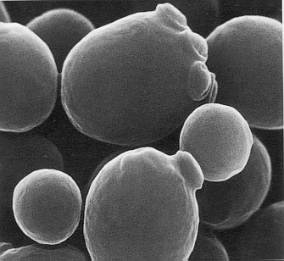
Who does Asexual reproduction?
Complex eukaryotes
--regeneration
Single-celled eukaryotes
  yeast
  Paramecium
  Amoeba
Simple multicellular eukaryotes
  Hydra
What are the
disadvantages of
asexual reproduction?
What are the
advantages?

Slide 42
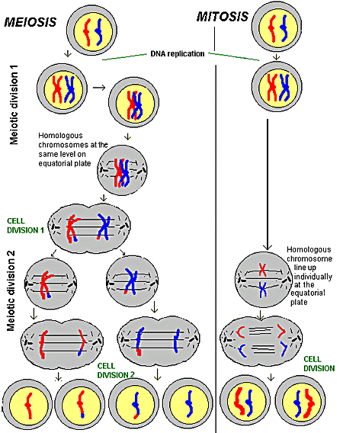

Slide 43
How about the rest of us?
What if a complex multicellular organism (like us) wants to reproduce?
Do we make egg & sperm by mitosis?
No!
What if we did, then….



46
+
46
92
egg
sperm
zygote
Doesn’t work!

Slide 44
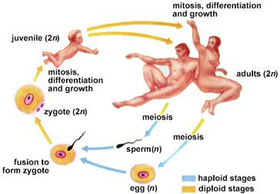
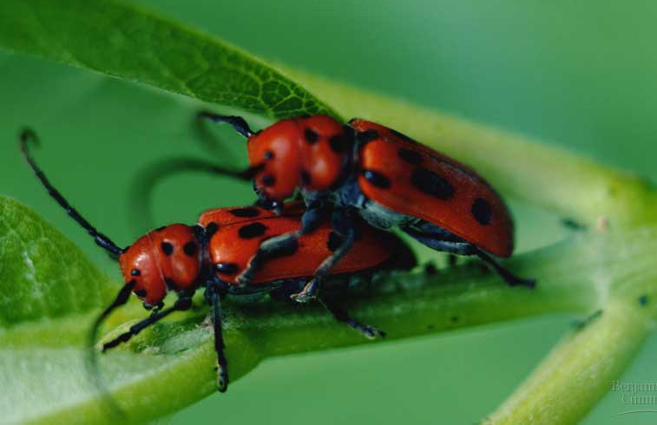
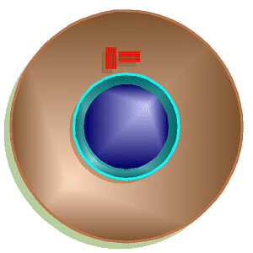
Meiosis &
Sexual Reproduction

Slide 45

MEIOSIS

Slide 46
Human female karyotype
diploid = 2 copies
2n
46 chromosomes
23 pairs
XX

Slide 47
Human male karyotype
diploid = 2 copies
2n
46 chromosomes
23 pairs
XY

Slide 48
How do we make gametes (sex cells)?
Must reduce 46 chromosomes → 23
  must half the number of chromosomes
  haploid
23
zygote
46
23
egg
46
meiosis
23
46
23
fertilization
sperm
gametes

Slide 49
Meiosis makes sperm & eggs
46 chromosomes to 23 chromosomes
23
46
meiosis
egg
46
23
diploid
haploid
sperm

Slide 50
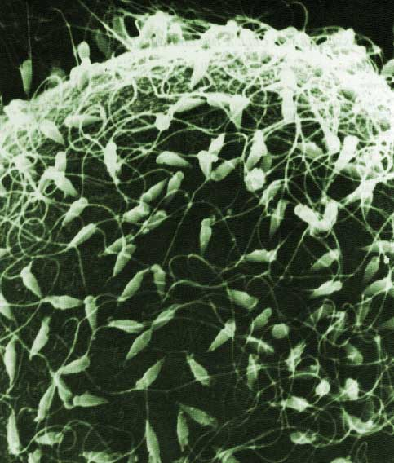
Meiosis = reduction division
  special cell division in sexually reproducing organisms
  reduce number of chromosomes
    2n → 1n
    diploid → haploid
      half
  makes gametes
    sperm, eggs

Slide 51
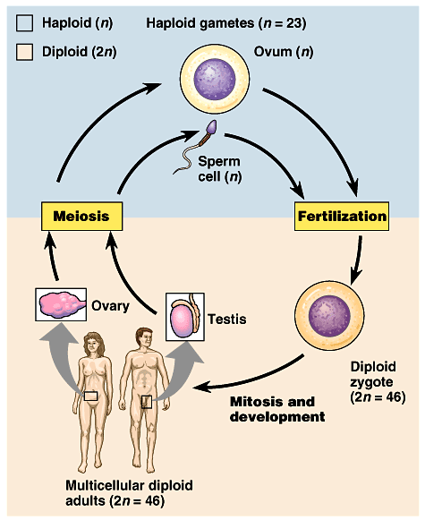
Meiosis & Mitosis
Meiosis to make gametes
Mitosis to make copies of cells: growth, repair, development

Slide 52
Sexual reproduction lifecycle
2 copies
diploid
2n
1 copy
haploid
1n
1 copy
haploid
1n
fertilization
meiosis
We’re mixing
things up here!
A good thing?

Slide 53
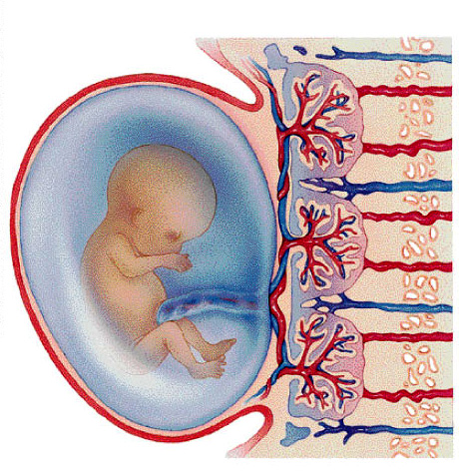
Putting it all together…
meiosis → fertilization → mitosis + development
gametes
46
23
46
23
46
46
46
46
46
meiosis
egg
46
46
23
46
46
23
zygote
fertilization
mitosis &
development
mitosis
sperm

Slide 54
The value of meiosis 1
Consistency over time
  meiosis keeps chromosome number same from generation to generation
from Mom
Mom
Dad
offspring
from Dad
Notes:
Consider the greater variation with 23 pairs of chromosomes = mixing and matching

Slide 55
We’re
mixing things
up here!
  Meiosis introduces genetic variation
    gametes of offspring do not have
    same genes as gametes from parents
    new combinations of traits
from Dad
variation
from Mom
offspring
new gametes made by offspring
Notes:
Consider the greater variation with 23 pairs of chromosomes = mixing and matching

Slide 56
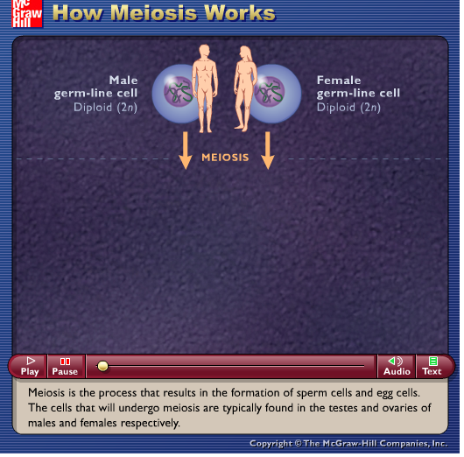

Slide 57
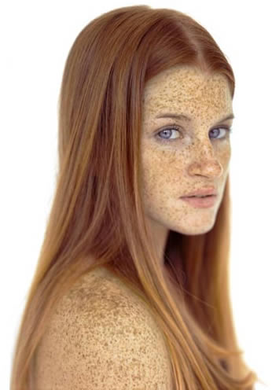
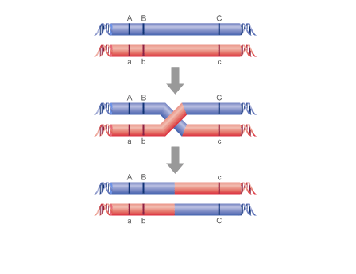
Why are red hair and freckles usually inherited together?
Red Hair
Freckles

Slide 58


Slide 59

And sometimes not?
Crossing over

Slide 60
No Freckles
No Freckles
Freckles
Brown Hair
Red Hair
Red
Hair

Slide 61

Non-disjunction
Sometimes the chromosomes don’t split properly
Some cells have extras, some with
less

Slide 62
Any Questions??
What are the
advantages of
asexual reproduction?
What are the
DISadvantages of
asexual reproduction?
What are the
advantages of
sexual reproduction?
What are the
DISadvantages of
sexual reproduction?

Slide 63
Cancer

Slide 64
Gametogenesis in Humans

