Slide 1
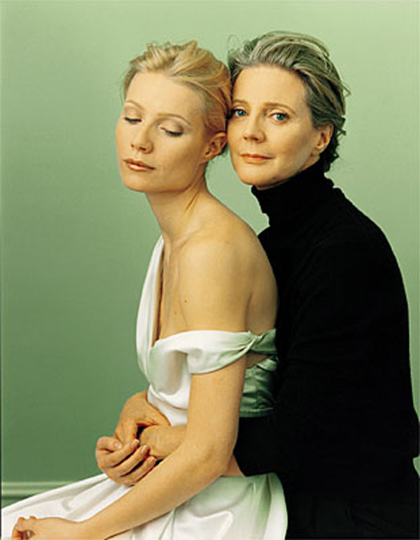
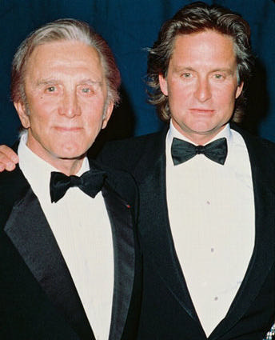
Protein Synthesis:
How Genes Becomes Traits

Slide 2
How does this explain: family resemblance & differences!
Why are the kids so similar to the parents but not exact?
Michael & Kirk
Douglas
Baldwin brothers
Martin & Charlie Sheen, Emilio Estevez

Slide 3
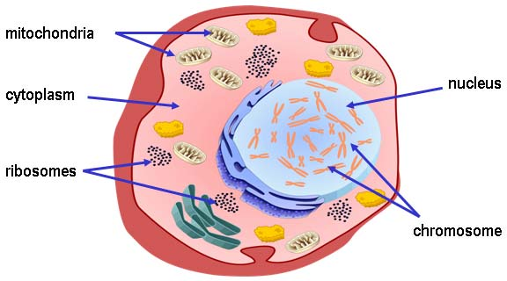
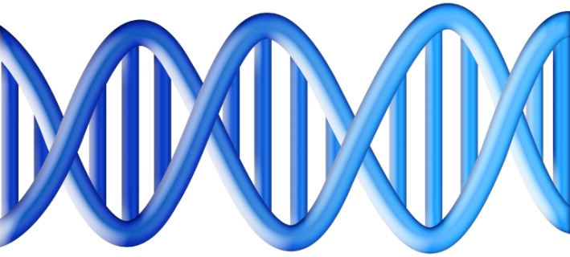
PROTEIN SYNTHESIS
Where in the cell are proteins made?
RIBOSOME
Who has the code that makes proteins?
DNA

Slide 4
Where is DNA located?
NUCLEUS
Is DNA a monomer or a polymer?
Polymer
Can diffuse through the nucleus?
NO!!!

Slide 5

If DNA can’t leave, how can the message get to the ribosome?
RNA

Slide 6
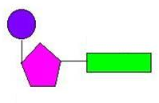
It has a helper!
RNA:
Ribonucleic Acid
Phosphate
2. Sugar: RIBOSE
3. Nitrogen Bases:
  Guanine
  Cytosine
  Adenine
  URACIL
NO THYMINE

Slide 7
DNA vs. RNA
DNA
RNA
Double helix
Deoxyribose sugar
A, C, G, T (has THYMINE)
In Nucleus
Single helix
Ribose Sugar
A, C, G, Uracil (NO THYMINE)
In Nucleus, cytoplasm, ribosome

Slide 8

1st Half

Slide 9
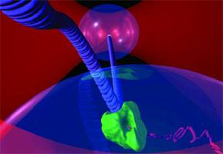
3 Types of RNA to help!
mRNA: messenger RNA
tRNA: transfer RNA
rRNA: ribosomal RNA

Slide 10
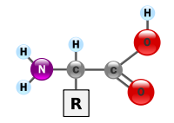
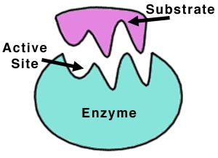
What is the monomer of a protein?
Amino Acid
What are proteins used for?
Hormones
Hemoglobin
Enzymes
Chemical traits (hair, eyes, skin colors)

Slide 11
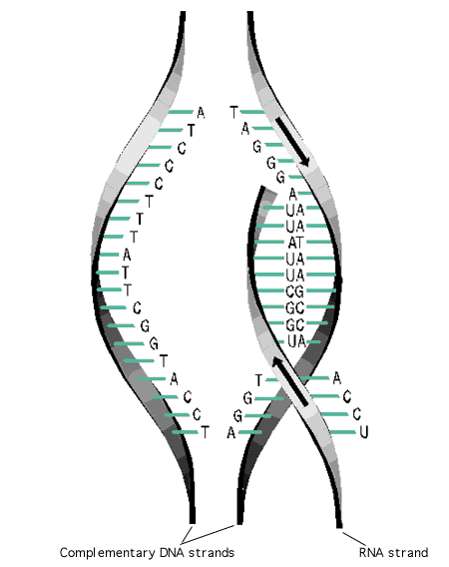
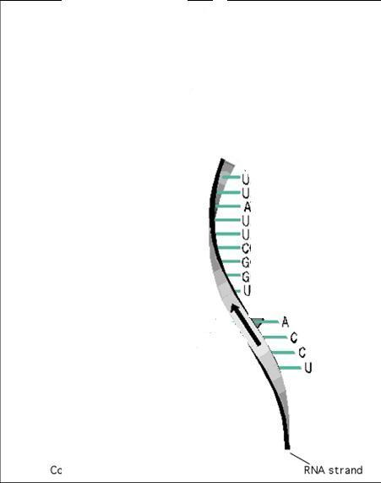
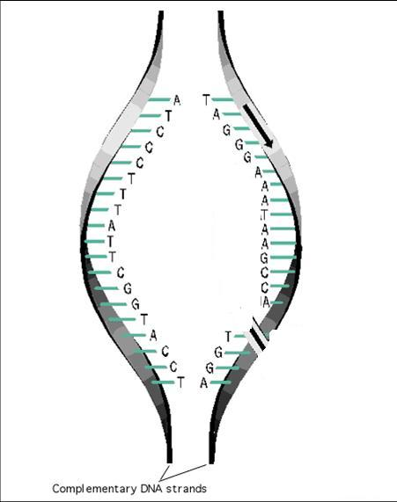
Making mRNA:
Transcription
To the ribosome

Slide 12
Use the DNA Template to make mRNA.
DNA
C G G A C C G T A T T A
G C C U G G C A U A A U
RNA
TRANSCRIPTION

Slide 13
Each 3 letters in mRNA codes for an amino acid.
RNA
G C C U G G C A U A A U

Slide 14
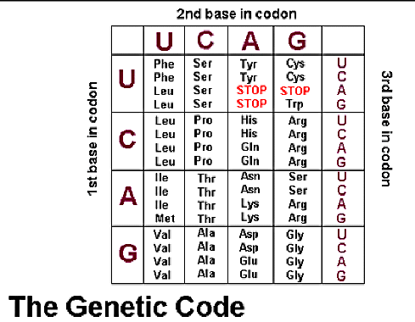

Slide 15
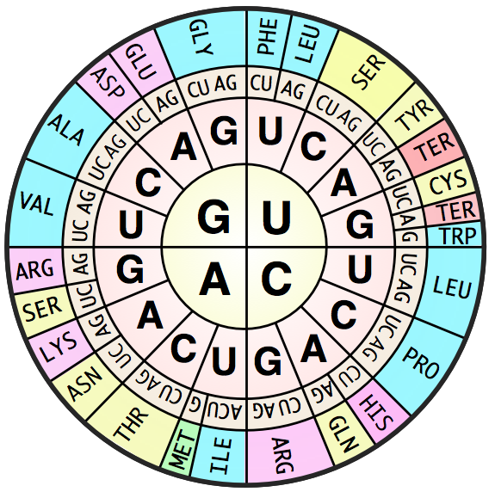

Slide 16
What would be the amino acid sequence?
DNA: C G G A C C G T A T T A
mRNA: G C C U G G C A U A A U

Slide 17
G C C U G G C A U
Ala
Trp
His

Slide 18
Translation
DNA: C G G A C C G T A T T A
mRNA: G C C U G G C A U A A U
Ala – Trp – His – Asn
From code to protein
Protein Synthesis

Slide 19
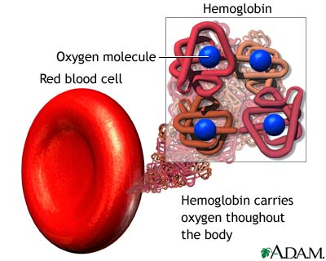
Amino acid sequence:
Ala– Trp– His
Codes for a protein…
Which then carries out a job

Slide 20
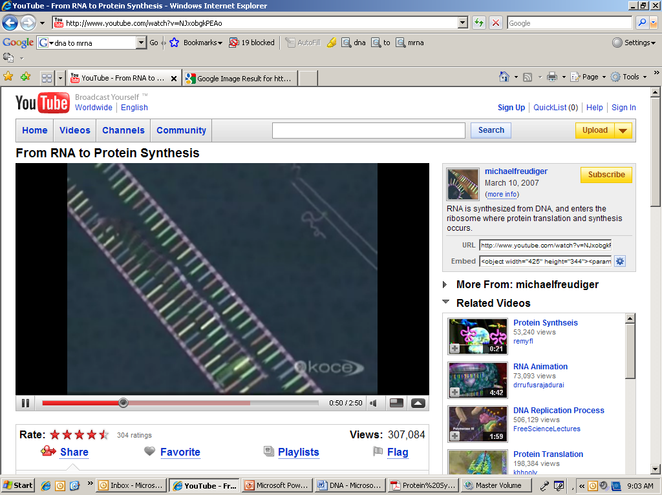

Slide 21
Protein synthesis:
3 important stages in protein synthesis:
The coding by triplets of bases to produce mRNA (Transcription)
The linking of mRNA to tRNA at ribosomes (Translation)
The linking of amino acids to form polypeptides

Slide 22
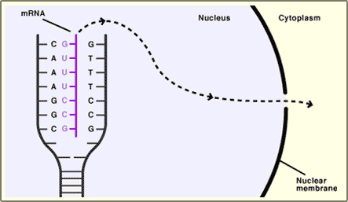
Transcription of mRNA

Slide 23
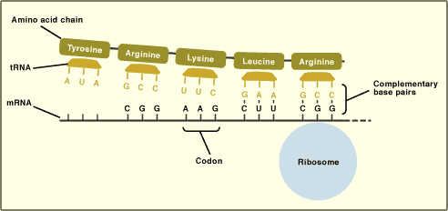
Translation of mRNA to make protein

Slide 24
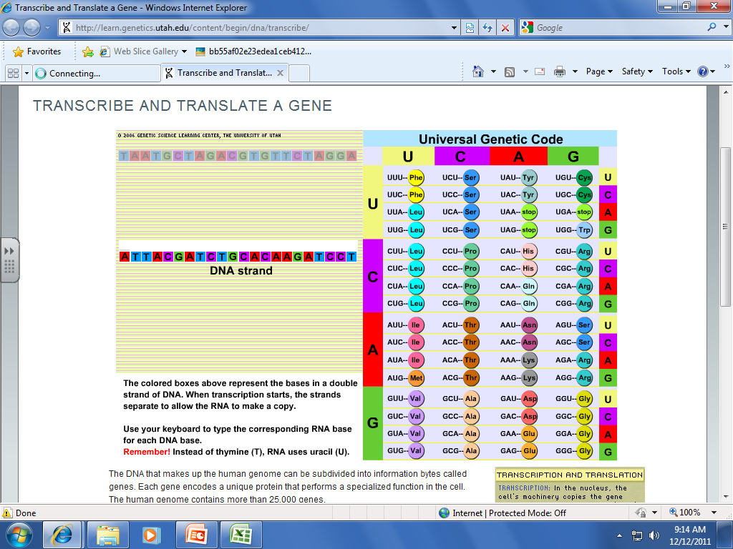

Slide 25
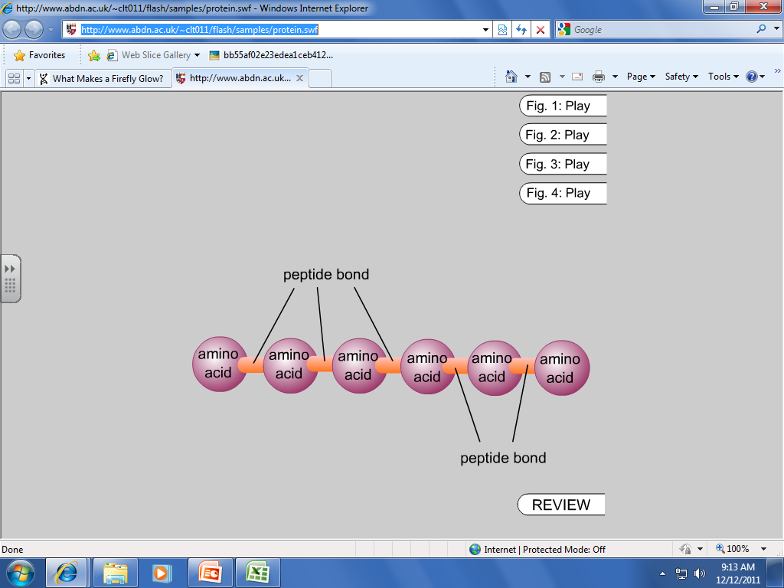
http://www.abdn.ac.uk/~clt011/flash/samples/protein.swf

Slide 26
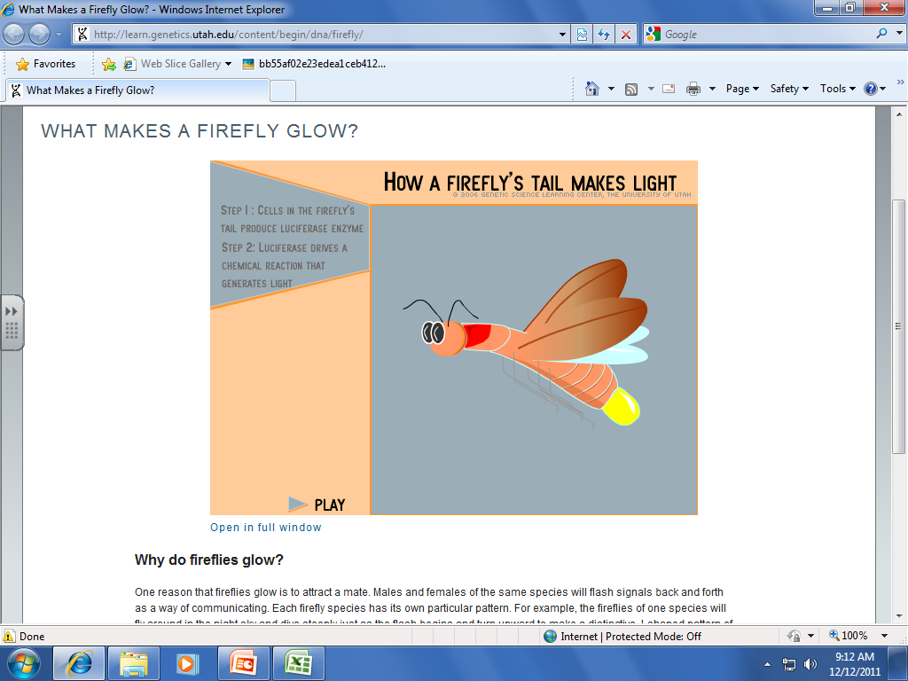

Slide 27


Slide 28
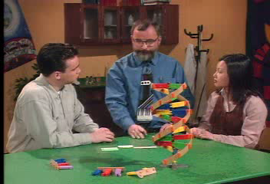

Slide 29
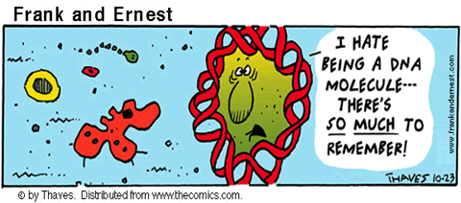
DNA
DNA
The Blueprint of Life
Determines characteristics of all living organisms
Composed of a four-letter nucleotide/molecule alphabet referred to as A, T, C, and G.
Order of the alphabet determines the characteristics of the living organism, much like the order of letters in our alphabet determines the words.
Each cell in the human body contains >3 BILLION letters.

Slide 30
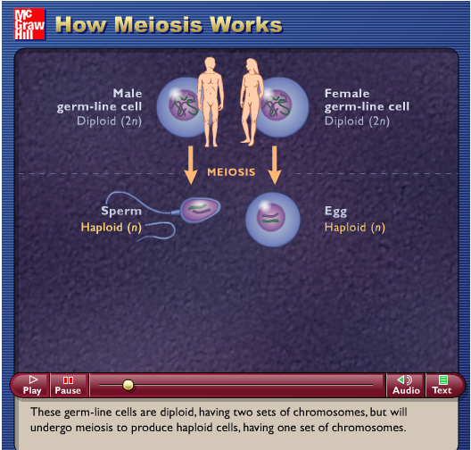

Slide 31
How about the rest of us?
What if a complex multi-cellular organism (like us) wants to reproduce?
  joining of egg + sperm
Do we make egg & sperm by mitosis?
No!
What if we did, then….



46
+
46
92
egg
sperm
zygote
Doesn’t work!

Slide 32
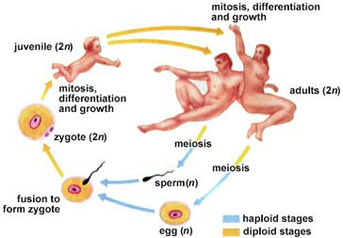
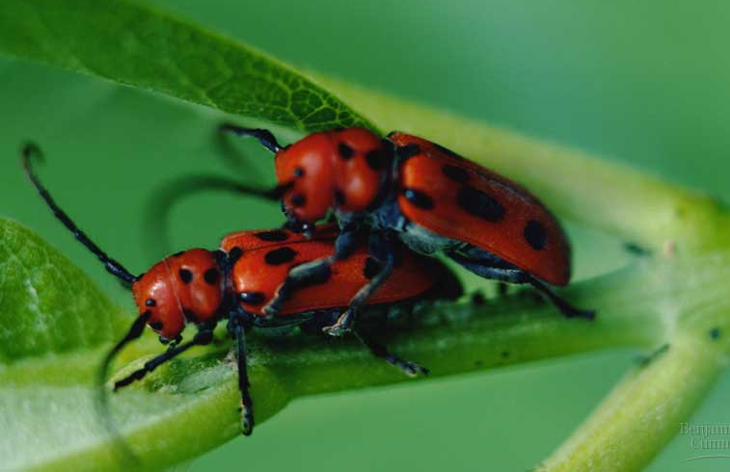
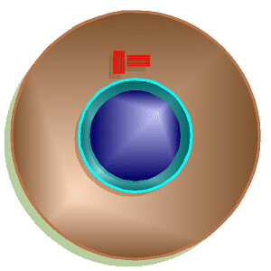
Meiosis &
Sexual Reproduction

Slide 33

MEIOSIS

Slide 34
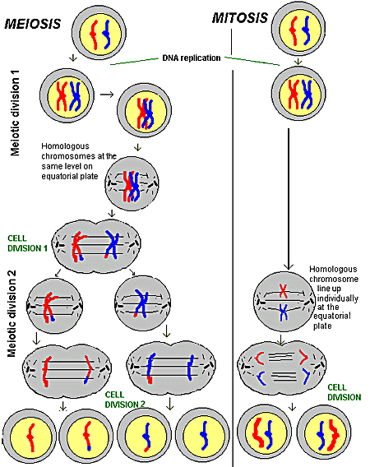

Slide 35
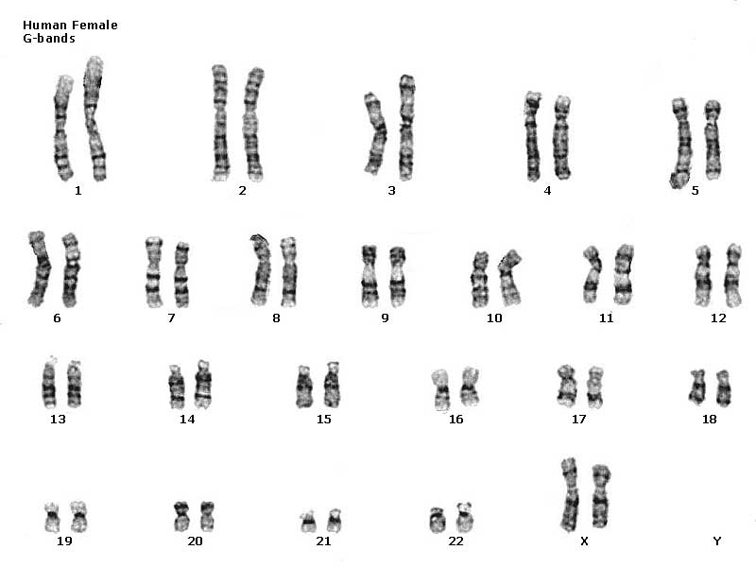
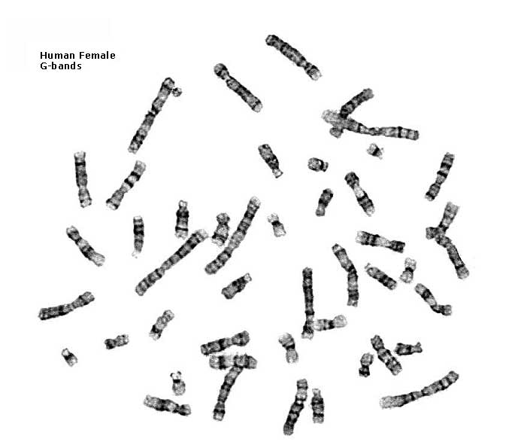
Human female karyotype
diploid = 2 copies
2n
46 chromosomes
23 pairs
XX

Slide 36
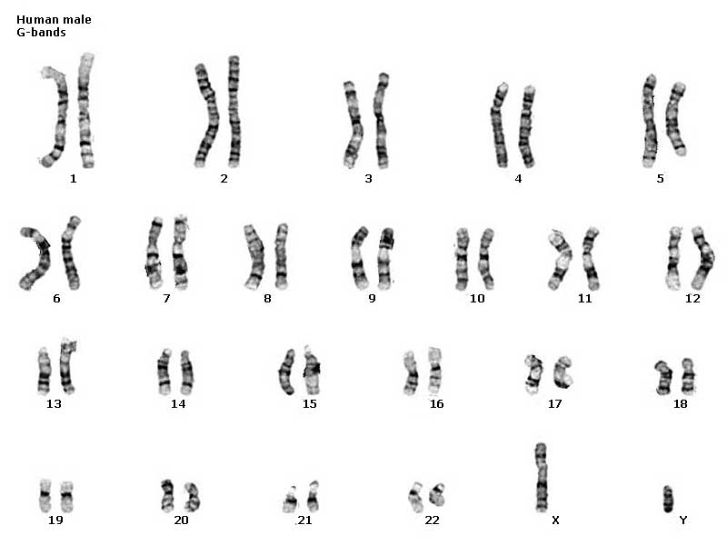
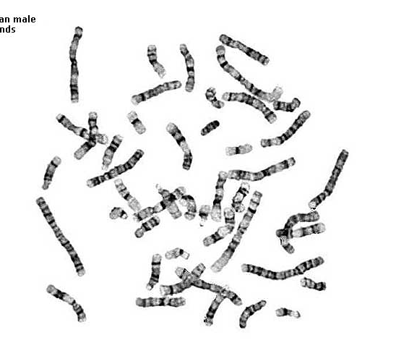
Human male karyotype
diploid = 2 copies
2n
46 chromosomes
23 pairs
XY

Slide 37
How do we make gametes (sex cells)?
Must reduce 46 chromosomes → 23
  must half the number of chromosomes
  haploid
23
zygote
46
23
egg
46
meiosis
23
46
23
fertilization
sperm
gametes

Slide 38
Meiosis makes sperm & eggs
46 chromosomes to 23 chromosomes
  half the number of chromosomes
23
46
meiosis
egg
46
23
diploid
haploid
sperm

Slide 39
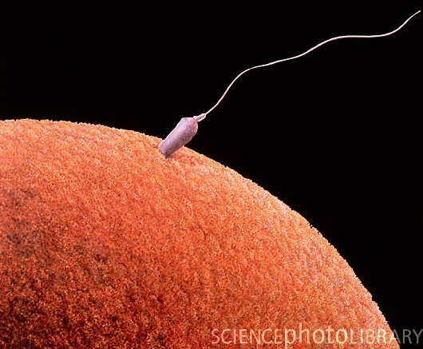
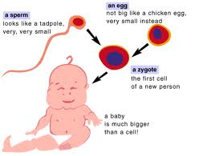
How is a new unique individual created?
Sperm & Egg Join
FERTILIZATION
Produces a ZYGOTE (fertilized egg cell)
By mitosis: grows into a baby

Slide 40
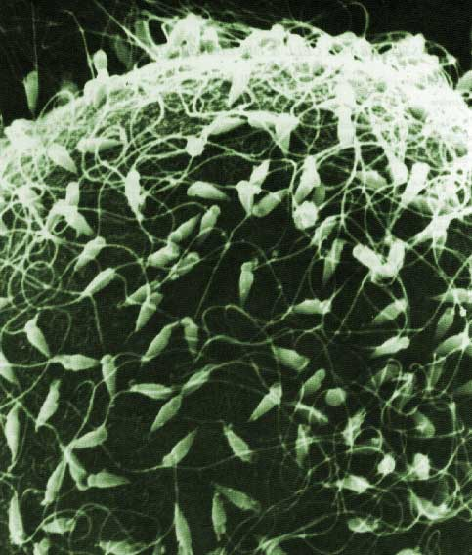
Meiosis = reduction division
  special cell division in sexually reproducing organisms
  reduce number of chromosomes
    2n → 1n
    diploid → haploid
      half
  makes gametes
    sperm, eggs

Slide 41
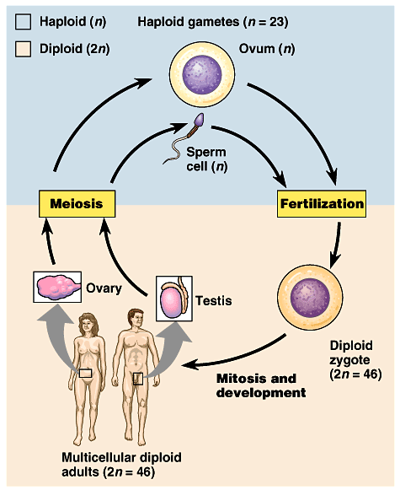
Meiosis & Mitosis
Mitosis to make copies of cells: growth, repair, development
Meiosis to make gametes

Slide 42
Sexual reproduction lifecycle
2 copies
diploid
2n
1 copy
haploid
1n
1 copy
haploid
1n
fertilization
meiosis
We’re mixing
things up here!
A good thing?

Slide 43
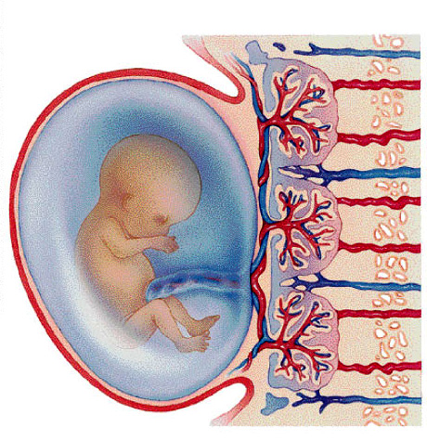
Putting it all together…
meiosis → fertilization → mitosis + development
gametes
46
23
46
23
46
46
46
46
46
meiosis
egg
46
46
23
46
46
23
zygote
fertilization
mitosis &
development
mitosis
sperm

Slide 44
The value of meiosis 1
Consistency over time
  meiosis keeps chromosome number same from generation to generation
from Mom
Mom
Dad
offspring
from Dad
Notes:
Consider the greater variation with 23 pairs of chromosomes = mixing and matching

Slide 45
The value of meiosis 2
We’re
mixing things
up here!
Change over time
  meiosis introduces genetic variation
from Dad
variation
from Mom
offspring
new gametes made by offspring
Notes:
Consider the greater variation with 23 pairs of chromosomes = mixing and matching

Slide 46
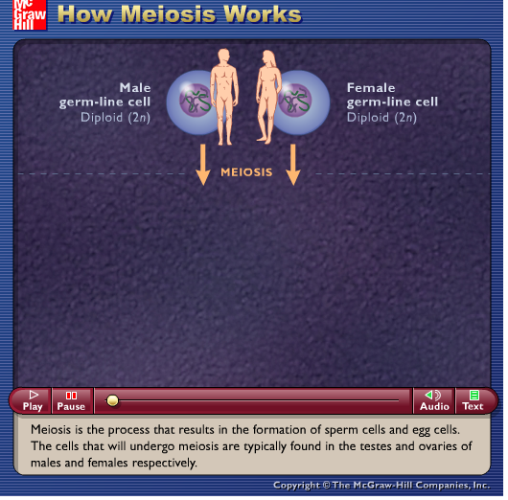

Slide 47
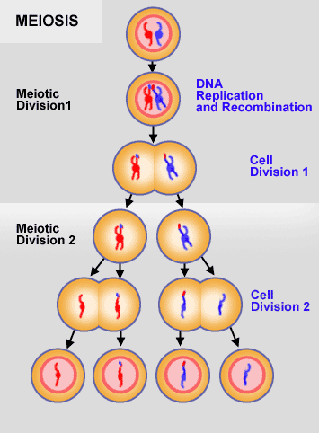
Steps to Meiosis
Chromosomes Replicate
Pair up with their homologous match
Homologous match splits
2 new cells with ½ the # of chromo
Replicated chromo split

Slide 48
Independent
Assortment
Segregation

Slide 49
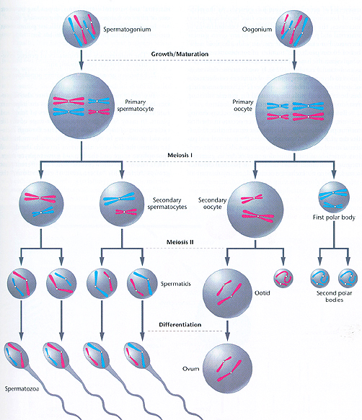
Gameto-genesis

Slide 50
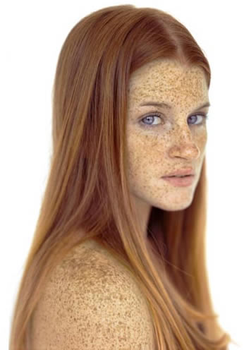
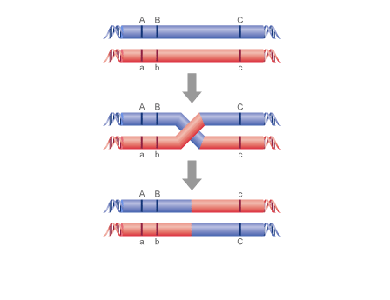
Why are red hair and freckles usually inherited together?
Red Hair
Freckles

Slide 51
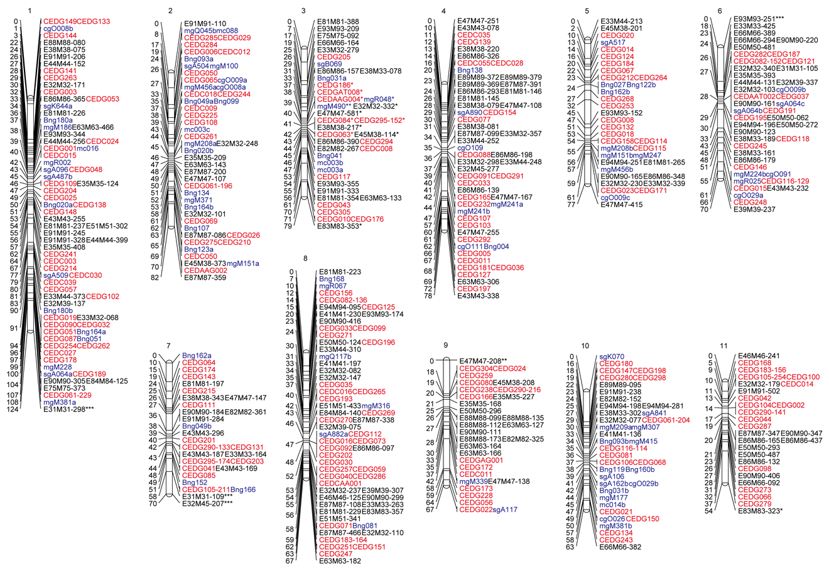

Slide 52
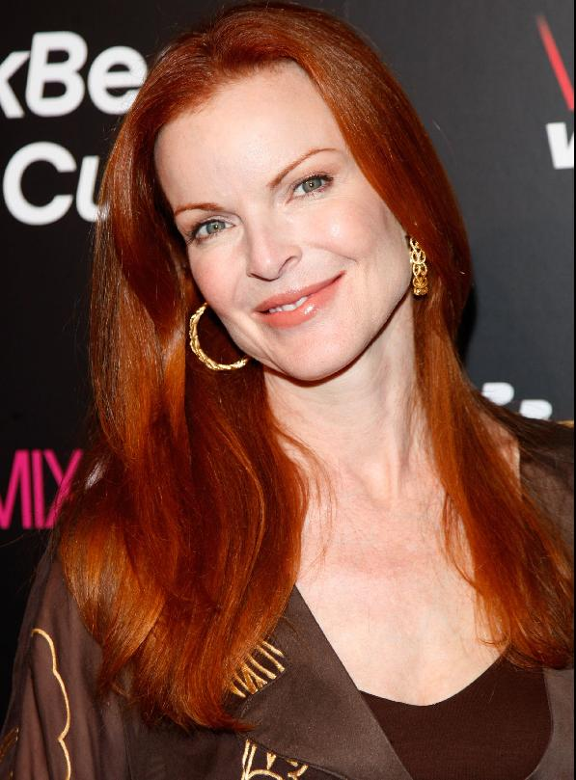
And sometimes not?
Crossing over

Slide 53
No Freckles
No Freckles
Freckles
Brown Hair
Red Hair
Red
Hair

Slide 54
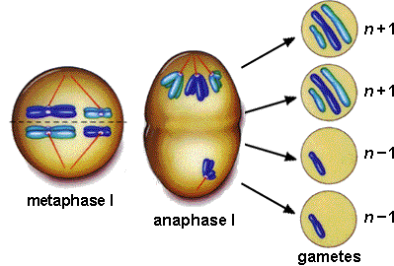
Non-disjunction
Sometimes the chromosomes don’t split properly
Some cells have extras, some with
less

Slide 55
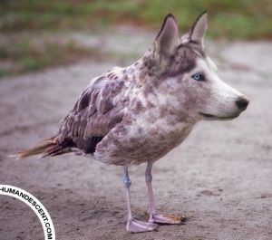
MUTATIONS

Slide 56
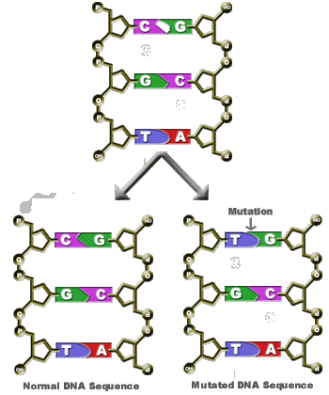
Mutations
Changes in DNA
Can Be:
Good
Bad
Indifferent

Slide 57
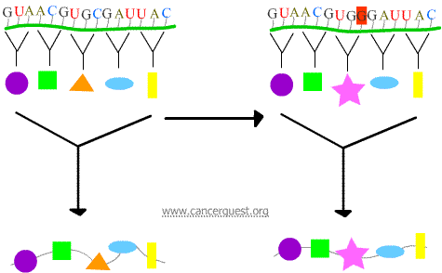
Substitution:
causes 1 nucleotide changed

Slide 58
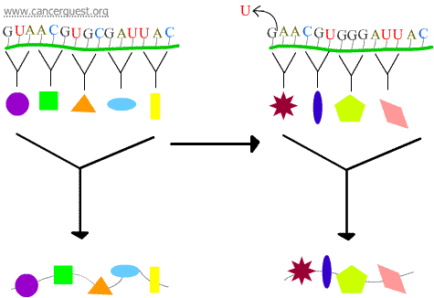
Frameshift: caused by addition or deletion

Slide 59
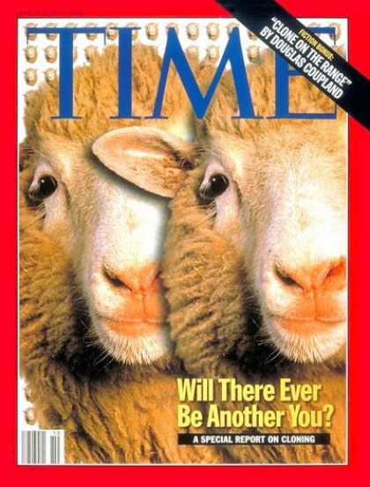
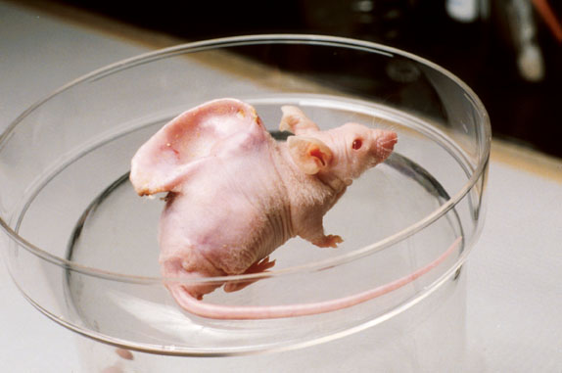
Genetic
Engineering

Slide 60

Cloning

Slide 61
Any Questions??
What are the
advantages of
asexual reproduction?
What are the
DISadvantages of
asexual reproduction?
What are the
advantages of
sexual reproduction?
What are the
DISadvantages of
sexual reproduction?

