Slide 1
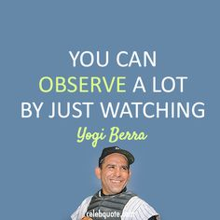
EVIDENCE & OBSERVATION
Anything that tends to prove or disprove an alleged fact.

Slide 2
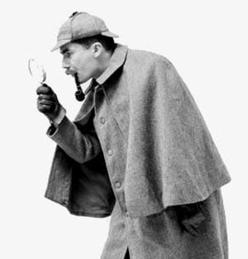
What do Forensic Scientist Do?
Use deductive reasoning to solve a crime by:
  Observing a situation
  Organizing it into component parts
  Evaluating it
  Drawing appropriate conclusions
  (general to specific)
  Modern day Sherlock Holmes.

Slide 3
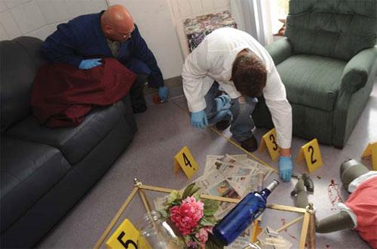
How to be a good forensic observer
1. Make a conscious effort to examine our environment systematically.
Ex. At crime scene look from one corner to the other
Turn off filters of trying to determine what is important – act like a data-gathering robot
Gather as much information first, then interpret information when as much as possible is present
When observing, document everything (write details down and take photos)
  – need that info when testifying in court

Slide 4

Find the 6 differences between the two pictures.
Answers: Tail feathers, flame, monkey’s tail, lion’s mane, cake tray, frosting

Slide 5
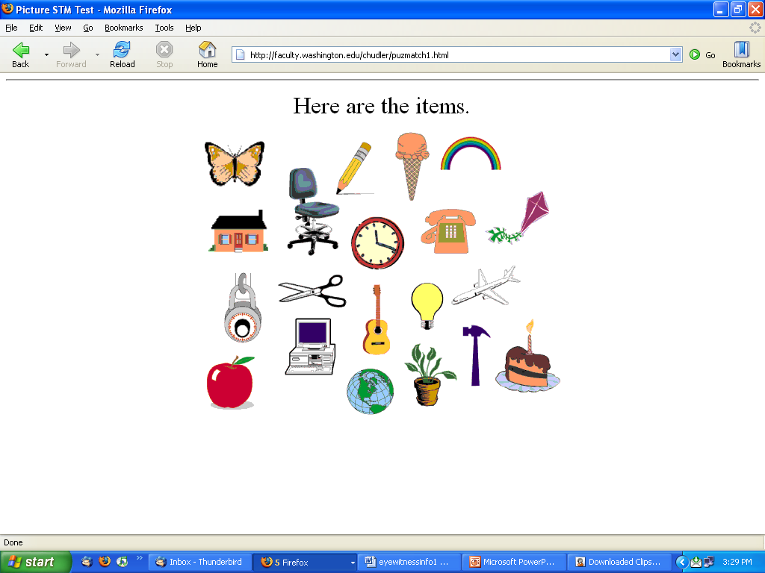
Memory Challenge
Directions:
You will have 30 seconds to view the next screen.
Try to memorize all 20 items you see!
You are NOT allowed to write anything down
You CANNOT talk to anyone else.

Slide 6
Items to remember ...
Neuroscience for Kids - http://faculty.washington.edu/chudler/puzmatch1.html

Slide 7
What do you remember?
You have 2 minutes to list as many of the items as you can!
How did you do?
All 20 – Awesome
15-19 – Great
10-14 – Pretty swell
5-9 – Could be better
4 or Less – Wake up
Notes:
Teacher Note: Try to influence the students’ memory of the items. As they are writing down the items they remember, suggest two or three items that were not shown, such as a banana (on the info slide), a nail (goes with hammer), or pen (instead of the pencil). As you go over the correct items, ask the students if they added any of the ones you told them to remember. Tie this into the discussion (next slide) on how a person’s memory can be affected by another person.

Slide 8
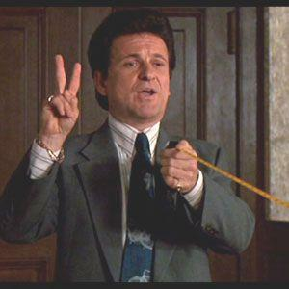
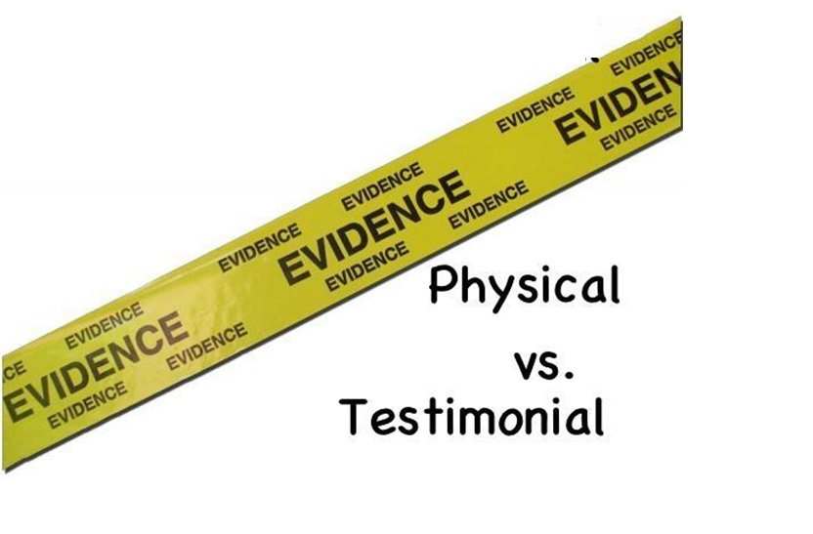
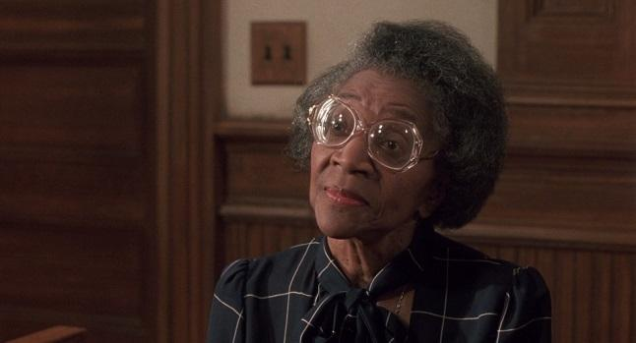
TWO MAIN TYPES
Information obtained through interviewing and interrogating

Slide 9
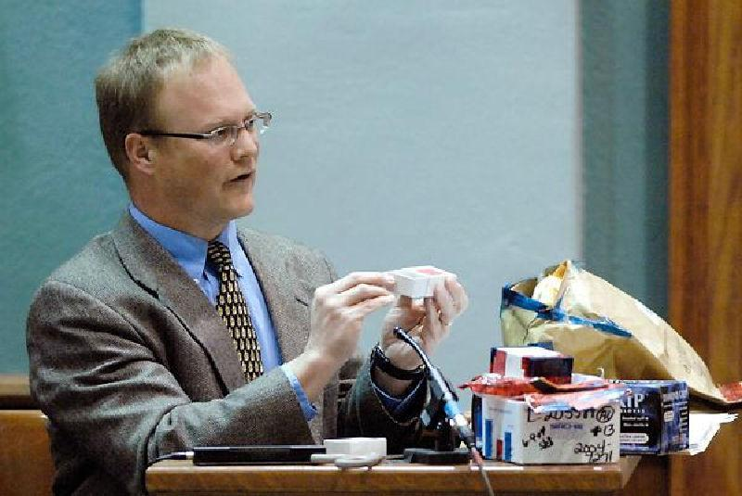
I. Testimonial Evidence
Two basic types:
Expert witness –
specialist in a particular subject. Doesn’t have to witness any aspect of the crime. Gives an opinion based upon his expertise.

Slide 10
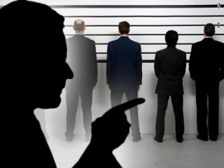
I. Testimonial Evidence
2. Eyewitness to a crime –
Juries are heavily influenced by eyewitness identification. Their reliability is dependent on their accuracy and believability.

Slide 11
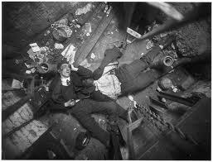
Observations
The ability to observe, interpret, and report observations clearly is the most important job of a forensic investigator

Slide 12
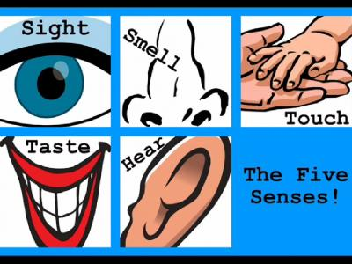
What is an observation?
Using our senses to notice the world around us

Slide 13
Get Ready to Observe!

Slide 14
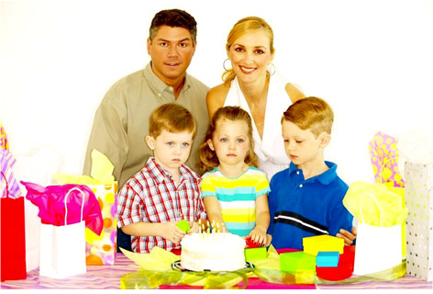

Slide 15
1. How many people were in photos 4 5 6 7
2. How many young boys were in picture? 1 2 3 4
3. How many females were in the picture ? 1 2 3 4
4. What was the color of the cake? Dark Brown White Light Brown Pink
5. Did the man have a moustache? Yes No
6. What was the color of the gift the girl was holding? Green yellow blue red
7. What was the color of the young boys t-shirt on the right side?
Red Brown Black Blue
8. What was the color of the man’s pants? Black Khaki White Gray
9. What was the woman wearing? White top Pink Dress Blue Shirt Yellow dress
10. What was the shape of the women’s earrings? Square Pentagon Circular Triangular
How many children were looking at the cake? 1 2 3 none
How many green boxes were visible? 1 2 3 4

Slide 16
Get Ready to Observe!

Slide 17
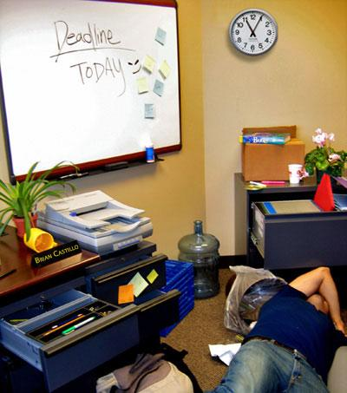

Slide 18
Answer each question below.
1. What color coffee mug was in the picture? Blue Red Yellow
2. When was the deadline? Yesterday Today Tomorrow
3. What time was on the clock on the wall? 10:40 11:05 1:55
4. How many sticky notes were on the whiteboard? Four Six Eight
5. Which of the following was NOT in the picture? Stapler Trash Can Printer
6. What was the name on the plaque on the desk? Bill Brian Carl
7. What color was the victim's shirt? Black Blue Red
8. How many plants were in the picture? None One Two
9. What was the color of the marker in the desk drawer? Red Blue Green
10. Where was the book in the picture? On a box In the trash can Under the body
Source: http://forensics.rice.edu/html/picture_begin.html

Slide 19
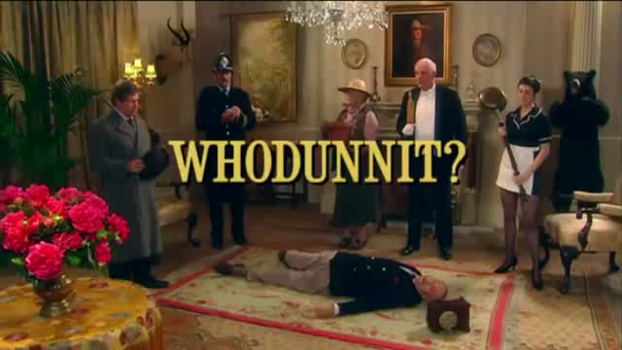
Crime scene video
http://www.youtube.com/watch?v=8-hapS2SPz4

Slide 20
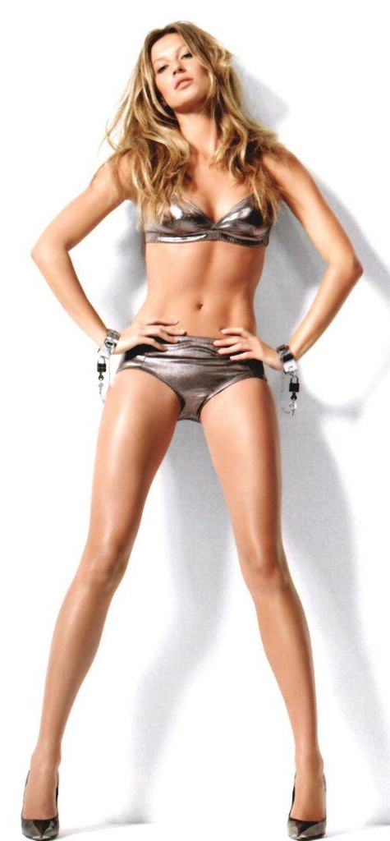
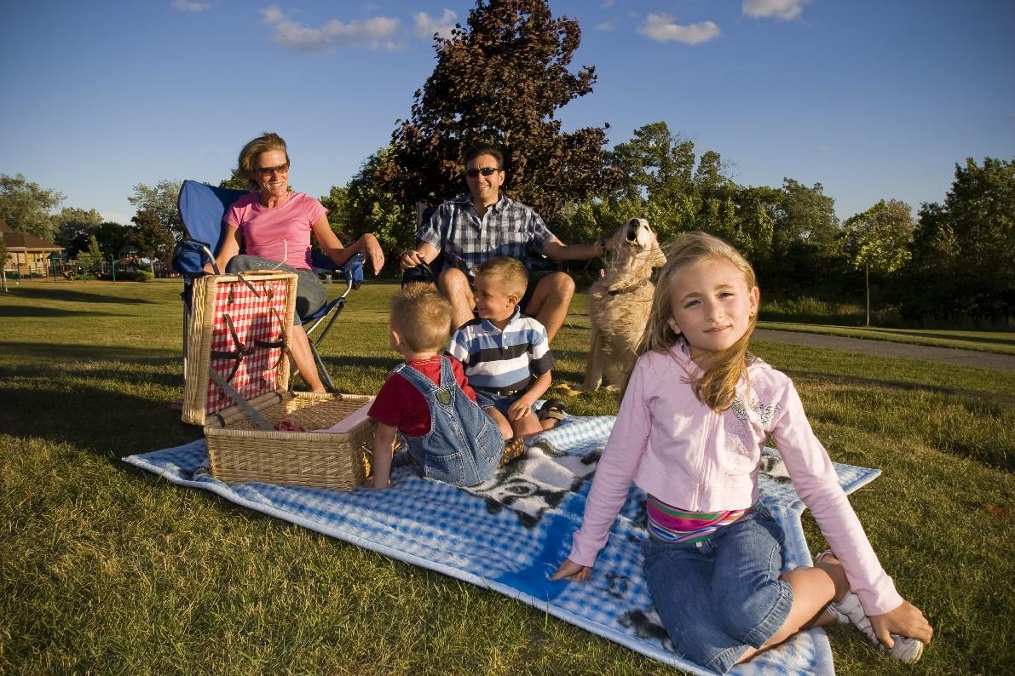
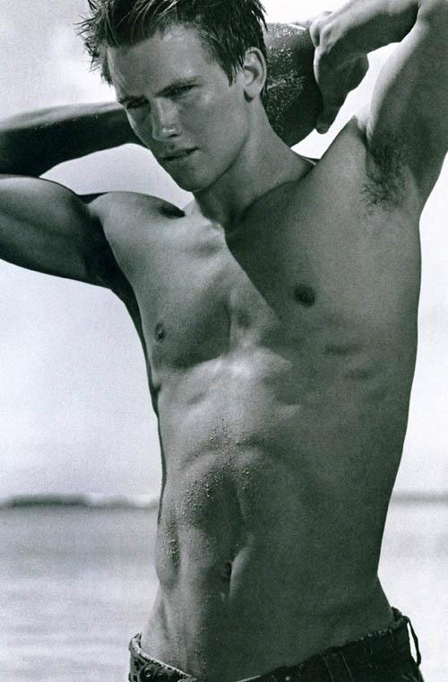
We pay attention to what is important to us.
      Paying attention requires a conscious effort
http://viscog.beckman.illinois.edu/flashmovie/15.php

Slide 21

http://www.youtube.com/watch?v=Ahg6qcgoay4

Slide 22
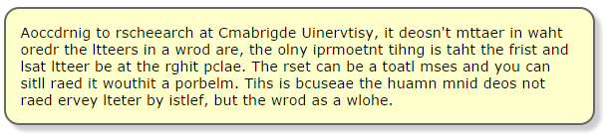
Another problem with observation is:
PERCEPTION
  Brains can play tricks on us. – It is FAULTY.
  Our brains have the ability to fill in the blanks.

Slide 24
Read the statement below
The girl was walking around and she saw a dog chasing a cat. The cat was chasing the mouse. The mouse chasing a ball. The ball rolled away and the mouse was not able to get it.
    McGurk Effect –
    http://www.youtube.com/watch?v=G-lN8vWm3m0

Slide 25
  Bunny effect - http://www.youtube.com/watch?v=_RLvSGYxDIs

Slide 26
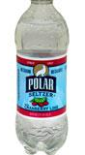

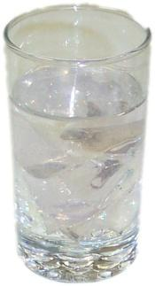


Another Perception Example
What is in
the glass?

Slide 28
http://www.awarenesstest.co.uk/

Slide 29
Perception can effect witnesses in a crime investigation.
Many times a person believes what they saw to be true.
They are not lying. It is what they perceive.
Emotions and anxiety can alter what we perceive or remember.
http://www.dailymotion.com/video/x26tts_lily-allen-ldn_music
In a certain crime – different eyewitness have different descriptions of the same people.

Slide 30
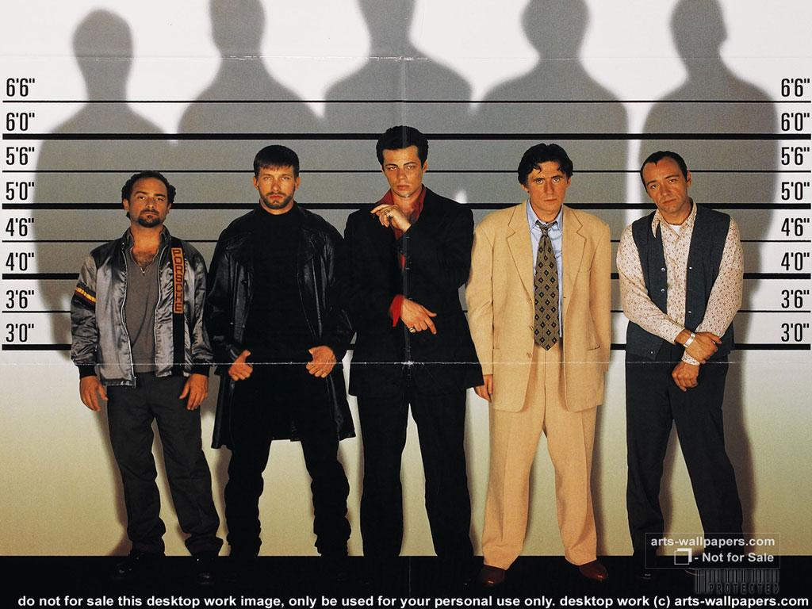
The success of a police lineup depends on an eyewitness’s ability to recognize a person seen at a crime.
http://www.youtube.com/watch?v=P3ldO66qrb0

Slide 31
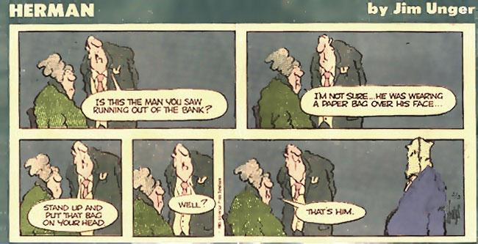

Slide 32
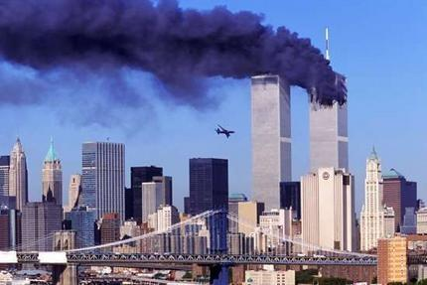
In an unusual situation our ability to observe is heightened
People can recall more easily:
  Whether you are alone or with a group of people
  The number of people or animals there
  What type of activity is going on around you
  How much activity is occurring around you
  All of these factors influence the accuracy of a witness’s observations.

Slide 33
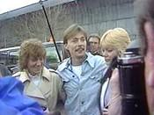
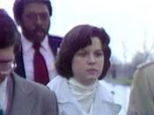
INNOCENCE PROJECT
Reexamines post-conviction cases using DNA
Found that faulty eyewitness contribution lead to approximately 87% wrongful conviction.
Gary Dotson was 1st to be shown innocent (exonerated) – was in prison for 9 years after being accused of rape of a 16 year old girl.

Slide 34
http://www.youtube.com/watch?v=xtDt-THaH_o

Slide 35
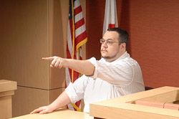
Juries are heavily influenced by eyewitness identification
If a witness points directly at a person and said that they were the one that committed the crime, it strongly influences a jury
Even if the evidence points to the fact that a person is innocent.

Slide 36
Rubber hand trick
    http://www.youtube.com/watch?v=sxwn1w7MJvk

Slide 37
Reliability of a Witness
How they observed the crime
  Was the crime committed to them
  How far away were they
Type of crime committed
  Was the crime really scary and stressful?
  People often concentrate on the weapon
Type of witness
  Does the person have something to gain, influenced by drugs or alcohol, mentally challenged,
  older people make people believe more in the validity of what they say, however adults are more reliable then older or younger witnesses
Police lineup identification
  People feel obligated to pick someone,
  better to give them one person at a time, not all at once
Witness interviewing technique
  Leading questions by police or lawyers may skew what someone would normally say or believe. Use open ended questions
Notes:
Gender and hair color are better remember than

Slide 38
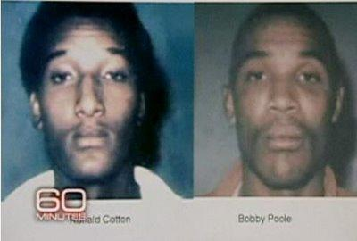
Ronald Cotton
http://www.youtube.com/watch?v=u-SBTRLoPuo – Part 1
http://www.youtube.com/watch?v=I4V6aoYuDcg&feature=relmfu – Part 2

Slide 39
http://www.innocenceproject.org/know/
http://www.youtube.com/watch?v=ngdfTgfFIlQ&feature=relmfu
Stress and memories excerpt

Slide 41
How to remember better
http://www.youtube.com/watch?v=xdK-ebSVFmY
Memory champion
http://www.youtube.com/watch?v=oY6DznRX6L0

Slide 42
Commercial Activity
1st commercial –
http://www.youtube.com/watch?v=WEJJUGJZxpU
2nd commercial –
  http://www.youtube.com/watch?v=Has8vDacmo8

Slide 43
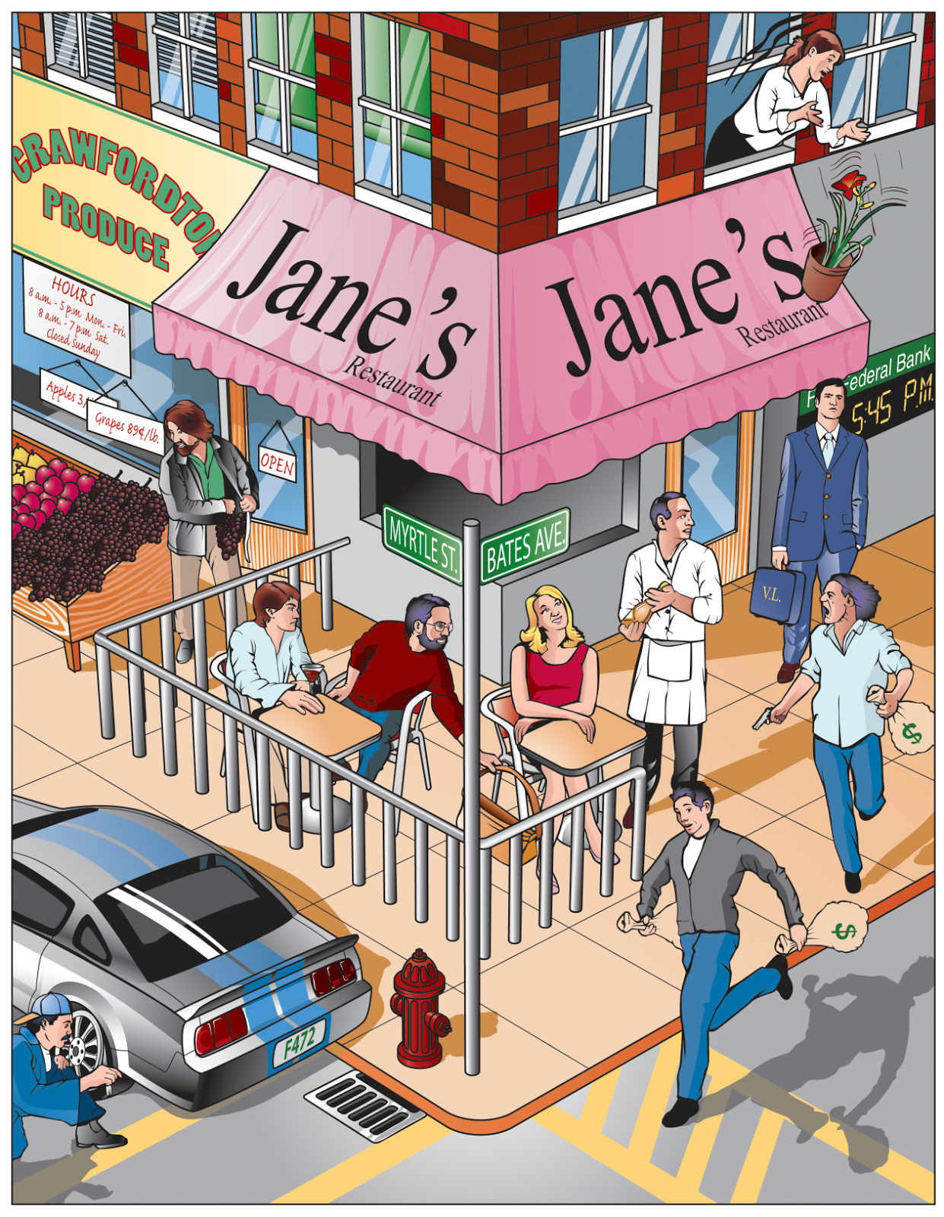

Slide 44
I. Testimonial Evidence
Points to consider:
  How the witness saw crime. Witnesses remember sex and hair color characteristics better age, height or race.
  Type of crime. More serious crimes tend to result in more accurate witnesses.

Slide 45
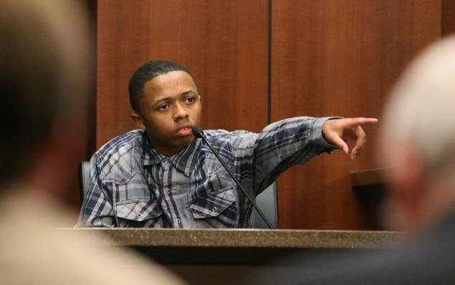
Type of witness. Adults better than kids. Elderly worse-poor hearing and sight. LD, mental disorders, alcohol or drugs, or head injury can all weaken memory.
Witness interviewing techniques. Better with open ended questions.

Slide 46
Additional factors:
  Witness’s prior relationship with the accused
  Length of time between the offense and the identification
  Any prior identification or failure to identify the defendant
  Any prior identification of a person other than the defendant by the eyewitness

Slide 47
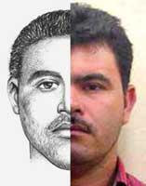
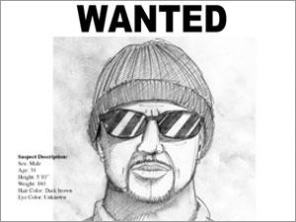
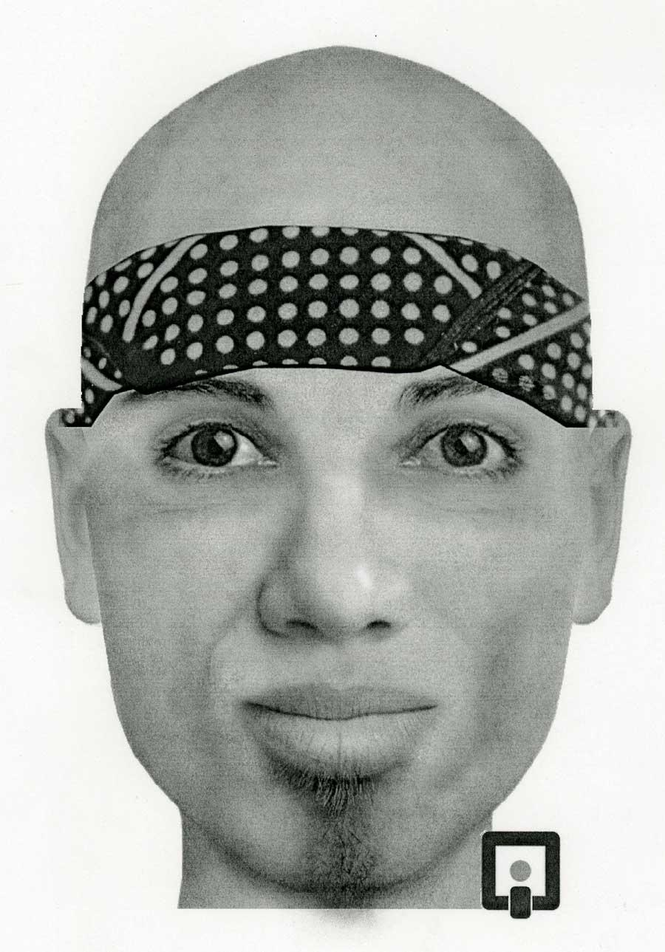
Eyewitness
A police composite may be developed from the witness testimony by a computer program or forensic artist.
“Perception is reality.”
As a result of the influences in eyewitness memory, physical evidence becomes critical.
Faces—a composite program
by InterQuest

Slide 48
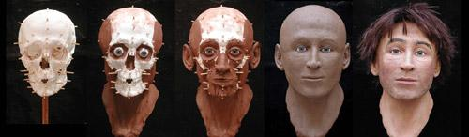
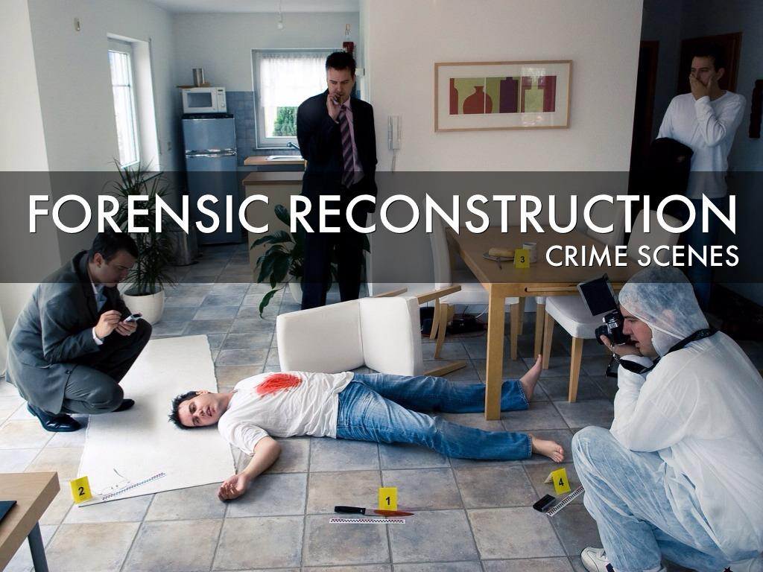
Reconstruction
Physical Evidence is used to answer questions about:
A forensic scientist will compare the questioned or unknown sample with a sample of known origin.
  what took place
  how the victim was killed
  number of people involved
  sequence of events

Slide 49
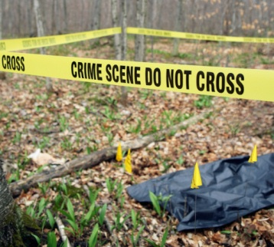
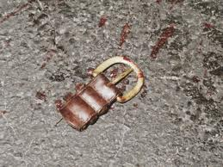
II. Physical Evidence
Types of Common Physical Evidence
drugs fibers paints soil, glass gunshot residue blood firearms body fluids impressions fingerprints hair tissues alcohols pollen bones feathers explosive residues serial numbers documents resins, plastics
any object or material that is relevant in a crime. It can be most any tangible thing.

Slide 50
Physical Evidence Purpose
        Proves that a crime has been committed
        Links suspect with victim or crime scene
        Provides new leads
        Corroborates statements/testimony
        Allows reconstruction of events of crime
        Establishes identity of person associated with crime

Slide 51
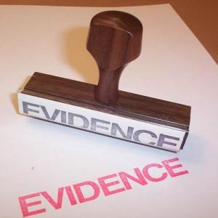
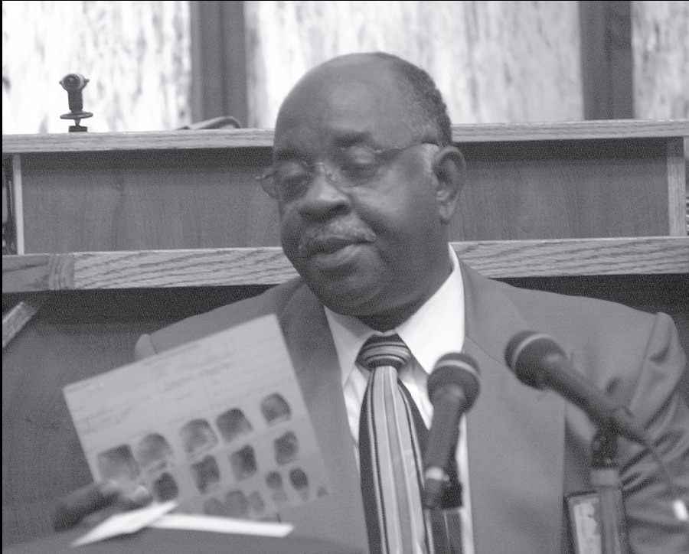
Federal Rules of Evidence
In order for evidence to be admissible, it must be:
Probative—actually prove something
Material—address an issue that is relevant to the particular crime

Slide 52
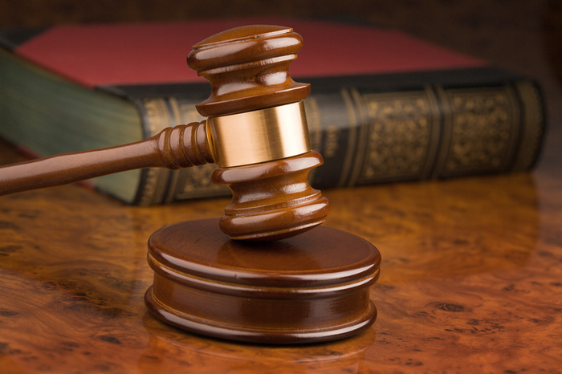
Is it Admissible?
Governed by two legal decisions

Slide 53
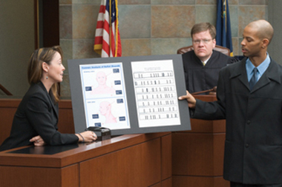
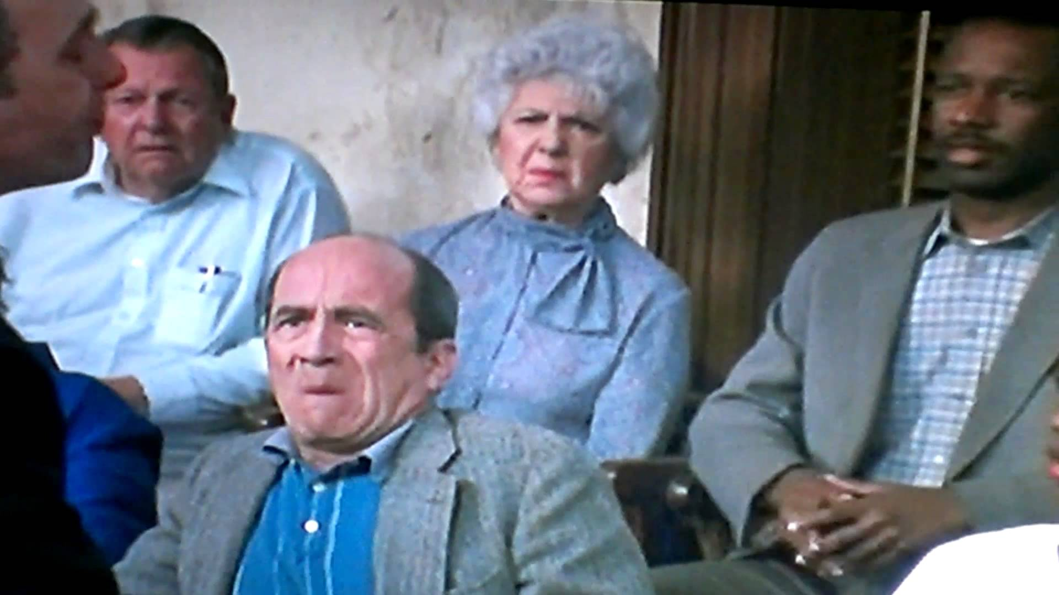
1923 Frye v. United States
Scientific evidence is allowed into the courtroom if it is
generally accepted by the relevant scientific community.
The Frye standard does not offer any guidance on reliability.
The evidence is presented in the trial and the jury decides if it can be used.

Slide 54

Frye Standard
Evidence must be given by an expert witness and has “general acceptance.”
It must be accepted by a meaningful segment of the scientific community
http://www.cnn.com/2011/CRIME/07/15/casey.anthony.forensic.evidence/
http://en.wikipedia.org/wiki/Death_of_Caylee_Anthony#Evidence

Slide 55
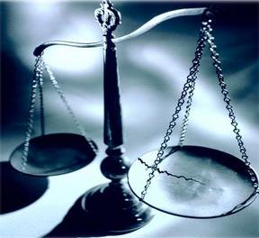
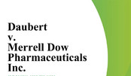
1993 Daubert v. Merrell Dow Pharmaceuticals
Jason Daubert and Eric Shuller were born with limb reduction defects. Their mothers had taken an anti-nausea drug, Bendectin, during pregnancy. They brought a product liability action against the drug's manufacturer, Merrell Dow.
Merrell Dow moved for summary judgment on the ground that plaintiffs had no admissible evidence to establish general causation.
http://homepages.law.asu.edu/~kayed/talks/se-bassv-98/soundness/daubert.htm

Slide 56

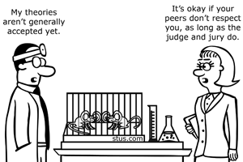
1993 Daubert v. Dow
Admissibility is determined by:
Whether the theory or technique can be tested
Whether the science has been offered for peer review
Whether the rate of error is acceptable
Whether the method at issue enjoys widespread acceptance.
Whether the opinion is relevant to the issue
The judge decides if the evidence can be entered into the trial.

Slide 57
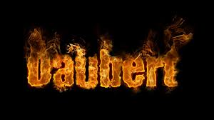
States Frye standard is not an absolute requirement for admissibility of scientific evidence
Only applies to Federal Court
Trial judge determines responsibility for admissibility of evidence

Slide 58
Guidelines for Judgment of Admissibility of Evidence of Daubert Ruling
The scientific theory or technique must be testable
The theory or technique must be subject to peer review and publication
Rate of error or potential errors must be stated
The technique must follow actual standards
The theories or techniques used must have widespread acceptance within a relevant scientific community

Slide 59
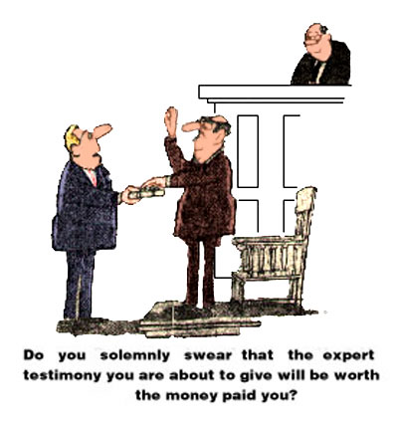

Slide 60
Value of Physical Evidence:
Generally more reliable than testimonial
Can prove that a crime has been committed
Can corroborate or refute testimony
Can link a suspect with a victim or with a crime scene
Can establish the identity of persons associated with a crime
Can allow reconstruction of events of a crime

Slide 61
II. Physical Evidence
Most evidence does not prove a fact = indirect evidence
Some physical evidence may be considered proof of fact.
Ex: possessing drugs or driver’s blood-alcohol
greater than 0.10%
Circumstantial evidence implies a fact or event.
The greater the volume of circumstantial evidence there is, the greater the weight it carries.
Probability and statistics come into play here.

Slide 62
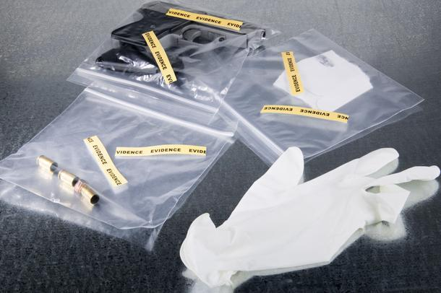
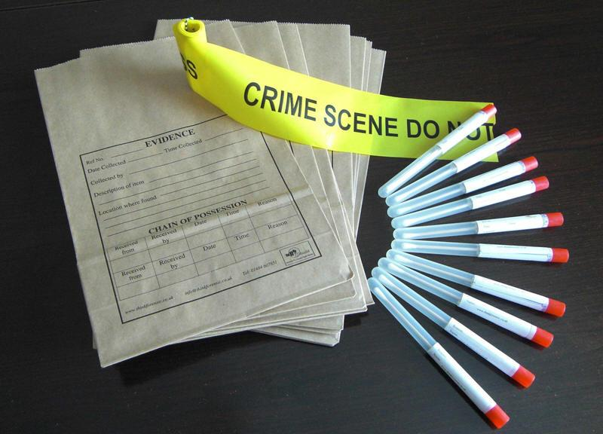
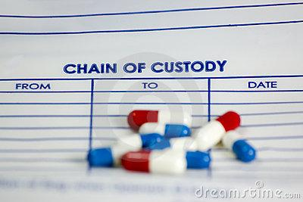
VALUE OF EVIDENCE
DEPENDS ON WHAT HAPPENS TO IT AFTER ITS FOUND.
INTEGRITY OF EVIDENCE – must be the same as when it was found when used in court
CHAIN OF CUSTODY (Evidence) – documentation of what has happened to the evidence from the time it was discovered until it is needed in court.

Slide 63
Classification of
Evidence by Nature
Biological—blood, semen, saliva, sweat, tears, hair, bone, tissues, urine, feces, animal material, insects, bacterial, fungal, botanical
Chemical—fibers, glass, soil, gunpowder, metal, mineral, narcotics, drugs, paper, ink, cosmetics, paint, plastic, lubricants, fertilizer
Physical science—fingerprints, footprints, shoe prints, handwriting, firearms, tire marks, tool marks, typewriting
Miscellaneous—laundry marks, voice analysis, polygraph, photography, stress evaluation, psycholinguistic analysis, vehicle identification

Slide 64
EVIDENCE CLASSIFICATION
DIRECT EVIDENCE –
establishes proof without any other evidence – through an eyewitness or record of a criminal act.
Example - if a witness testifies that the defendant was seen actually stabbing the victim, that is direct evidence.

Slide 65
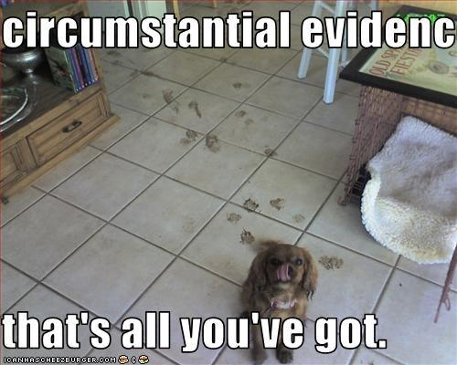
EVIDENCE CLASSIFICATION
INDIRECT EVIDENCE –
Based on one fact being inferred from another fact. (class or individualized)
ex. CIRCUMSTANTIAL EVIDENCE – (an – indirectly establishes the existence of a fact – uses probability

Slide 66




TRACE EVIDENCE – small items
MATERIAL EVIDENCE - evidence that is relevant to the specific case and has an influence on the decision of the case.
PRIMA FACIE EVIDENCE – “at first sight” evidence without proof or reasoning
PROBATIVE EVIDENCE – evidence vital to investigate or prosecute a case - evidence that proves something
EXCULPATORY EVIDENCE – physical evidence that clears a person of blame.
EVIDENCE MUST BE LEGALLY SEIZED AND PROPERLY PROCESSED

Slide 67





Evidence Characteristics
Class—common to a group of objects or persons. Ex: Hair, fibers, soil, glass fragments
Individual—can be identified with a particular person or a single source. Involves comparison and can be linked with a high degree of probability Ex: fingerprints, handwriting, DNA patterns, physical matches, such as a piece of broken glass that fits like a jigsaw puzzle to its mate.
Fingerprints
Blood DNA Typing

Slide 68
Individualized is the type that can be linked to a single source.
This type specifically confirms a link pertaining to Locard’s Principle. Involves comparison.
EXAMPLE – torn fabric to a shirt matches up
_______________________________________

Slide 69
Class is associated with a group or class.
Alone it may not be that powerful but if a lot is admissible it can be convincing.
EXAMPLES – hair, fibers, soil, glass fragments

Slide 70


Class vs Individual Evidence
These fibers are class evidence; there is no way to determine if they came from this garment.
The large piece of glass fits exactly to the bottle; it is individual evidence.

Slide 71





Class vs Individual Evidence
Which examples do you think could be individual evidence?

Slide 72





USES FOR EVIDENCE
PROVIDES PROBABLITIES (fingerprints and DNA)
SOME HAVE IDENTIFICATION MARKS
(tire impressions, bullet marks, torn clothing)
USED FOR COMPARISON (ex. Fingerprints)
HOW EVIDENCE FITS WITH SURROUNDINGS
(man’s handkerchief found in women’s locker room)

Slide 73



PROPER PACKAGING (label and take notes)
AVOID CROSS-CONTAMINATION Of EVIDENCE
PRESERVING OF EVIDENCE – avoid plastic
(Brown paper bags are best)
UV light are useful in finding small evidence
(makes evidence easier to see)
Thermal imaging – detect heat emitted from
substance scientists are looking for.

Slide 74
EQUIPMENT
HAVING CORRECT EQUIPMENT IS IMPORTANT.
IT IS USUALLY CARRIED IN:
  POLICE VEHICLE
  INVESTIGATOR’S VEHICLE
  CRIME VAN – (MOBILE CRIME LAB)
  SHOULD HAVE RADIO COMMUNICATION

Slide 75
Forensic Investigations
Include some or all of these seven major activities
  1. Recognition—ability to distinguish important evidence from unrelated material
    Pattern recognition
    Physical property observation
    Information analysis
    Field testing
  2. Preservation—collection and proper preservation of evidence

Slide 76
Investigations
3. Identification—use of scientific testing
  Physical properties
  Chemical properties
  Morphological (structural) properties
  Biological properties
  Immunological properties
4. Comparison—class characteristics are measured against those of known standards or controls; if all measurements are equal, then the two samples may be considered to have come from the same source or origin.

Slide 77
Investigations
5. Individualization—demonstrating that the sample is unique, even among members of the same class
6. Interpretation—gives meaning to all the information
7. Reconstruction—reconstructs the events of the case
  Inductive and deductive logic
  Statistical data
  Pattern analysis
  Results of laboratory analysis
  —Lee, Dr. Henry. Famous Crimes, 2001

Slide 78

People in the News
Dr. Henry Lee—Chief Emeritus for Scientific Services and the former Commissioner of Public Safety for the state of Connecticut. He served as that state’s Chief Criminality from 1979 to 2000. Lee was the driving force in establishing the modern forensic lab in Connecticut. He has worked with many high profile cases including O.J. Simpson, Jon Benet Ramsey, and the “wood chipper” case. He is also seen on many of the true crime shows, including his own, “Trace Evidence: The Case Files of Dr. Henry Lee”. Learn more at his website:
www.drhenrylee.com/review.shtml

