Slide 1
MACROEVOLUTION

Slide 2
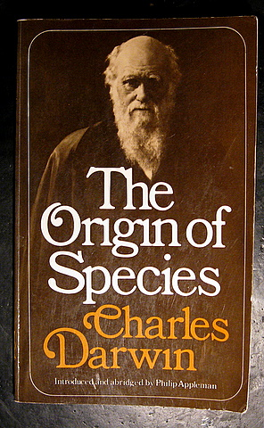
Charles Darwin

Slide 3
Six Principles
Overproduction
Variation
Competition
Natural Selection
Adaptation
Speciation

Slide 4
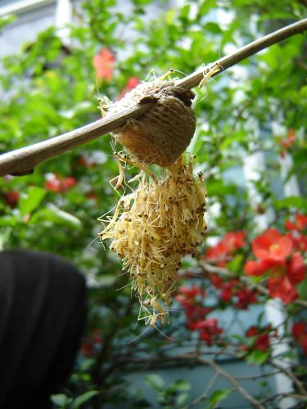
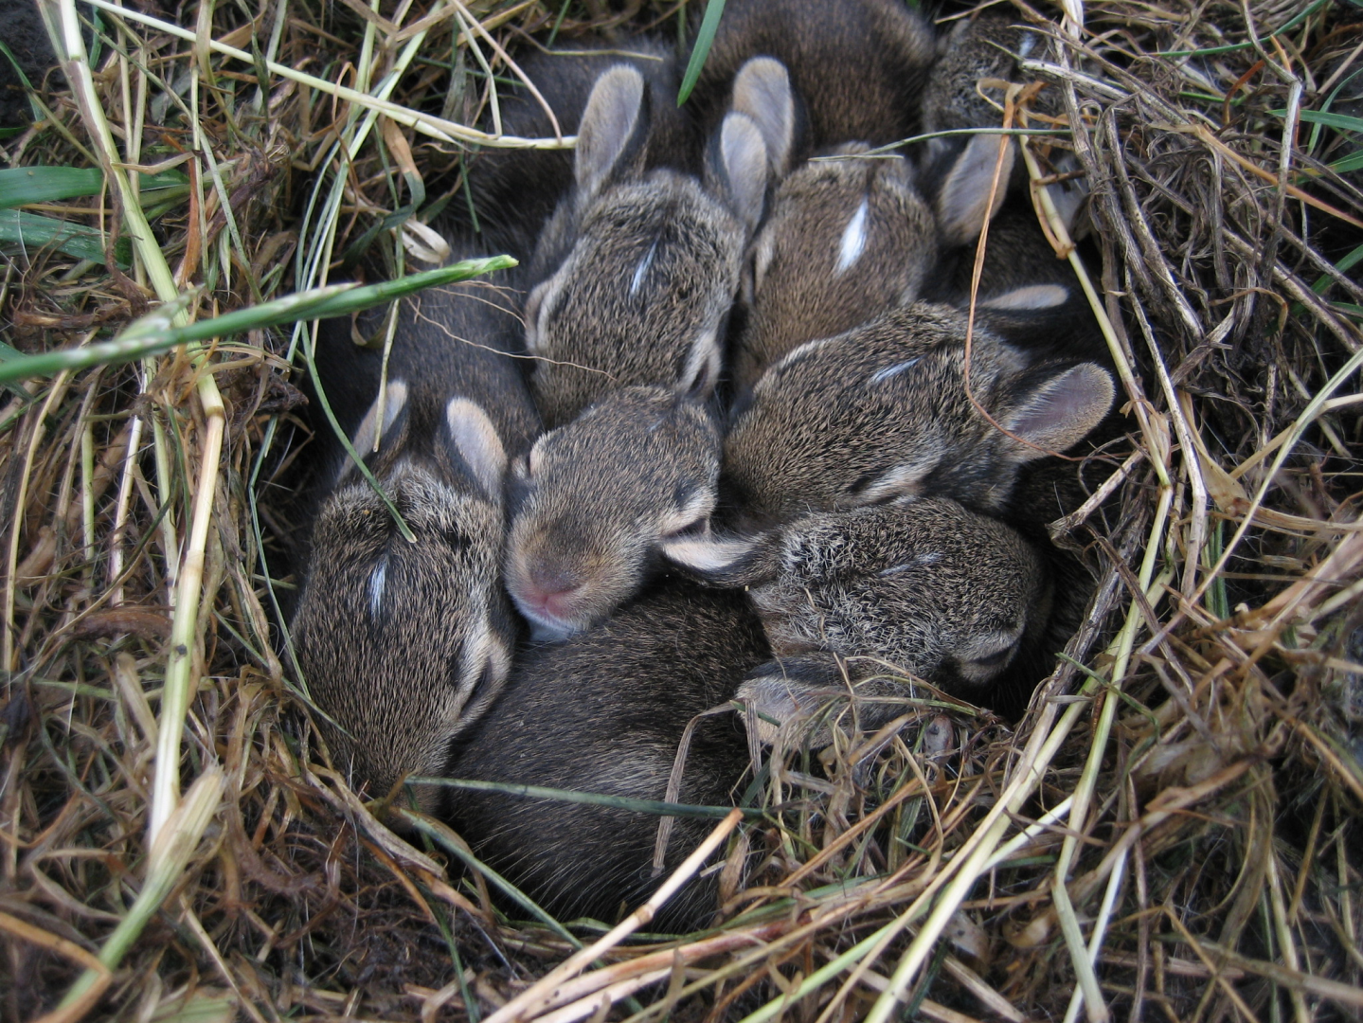
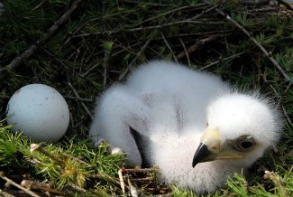
Overproduction
More babies are born than can possibly survive.

Slide 5
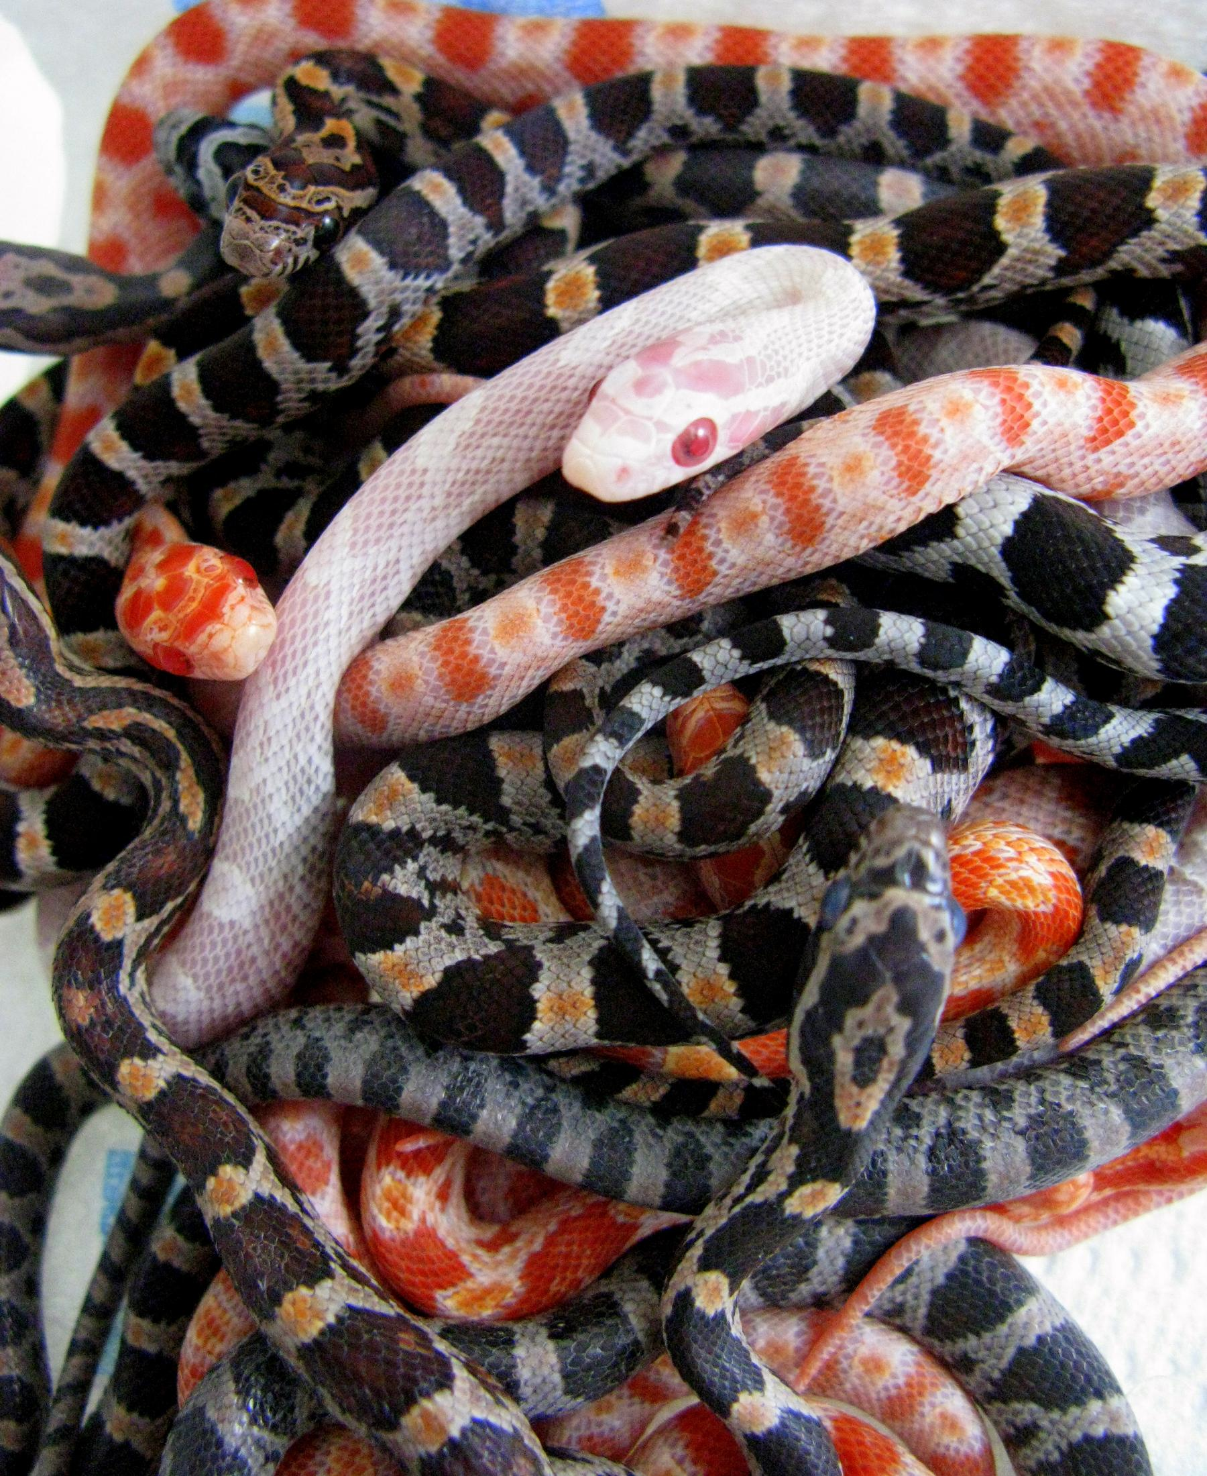
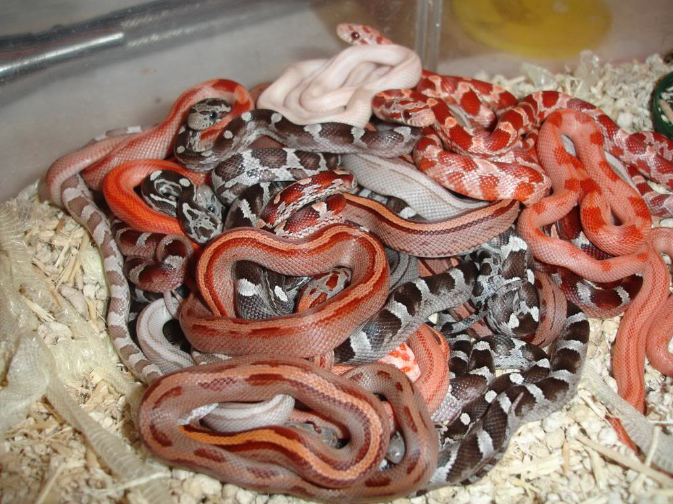
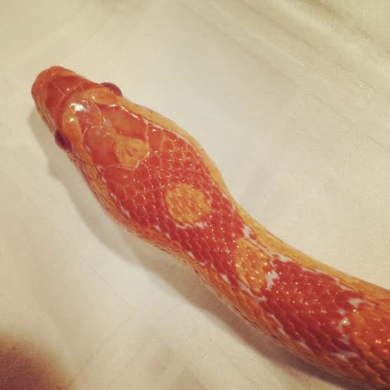
Variation
Genetic variety
Examples:
Size, color, shape, strength, speed, resistance, ability to get food, escape, find mate

Slide 6
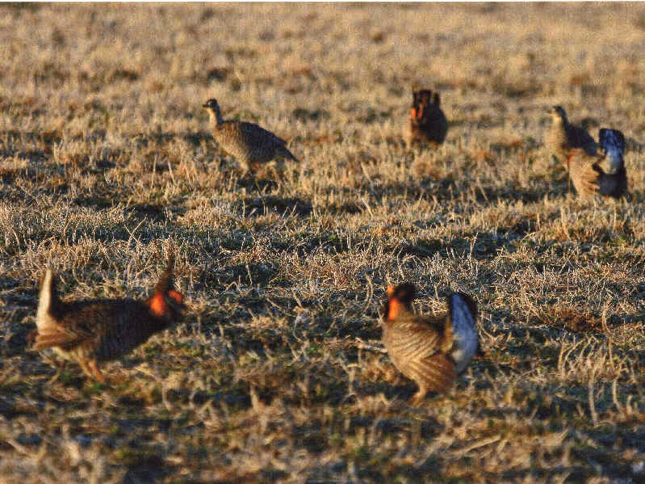
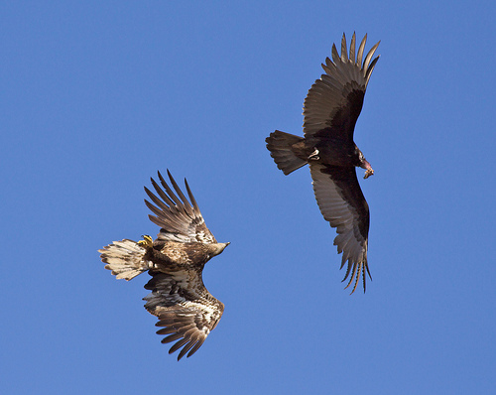
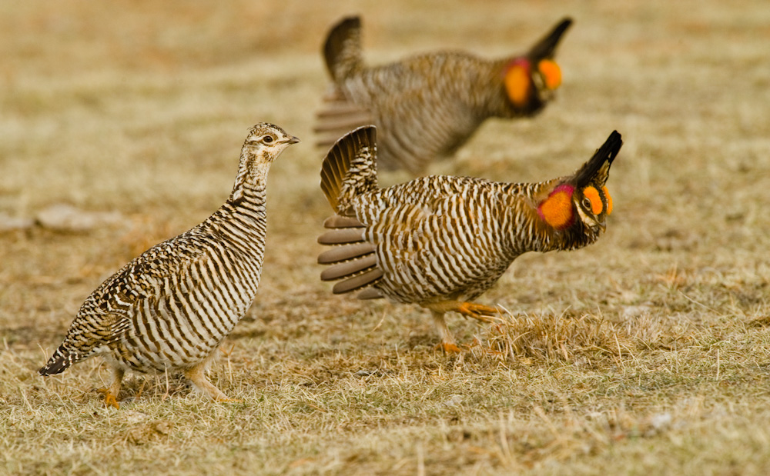
Competition
Species compete for:
Food, space,
shelter, water,
mate, sun

Slide 7
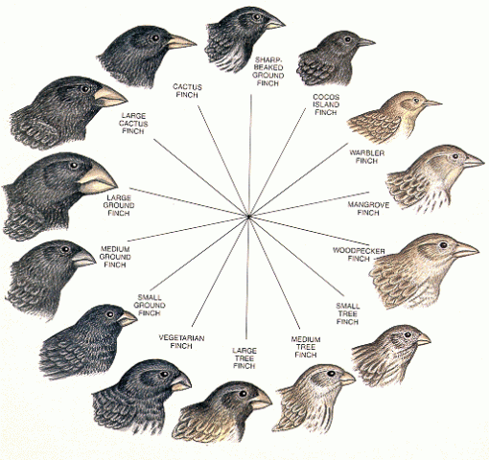
Natural Selection
Environment “nature” selects genetic variations that are best suited to adapt

Slide 8
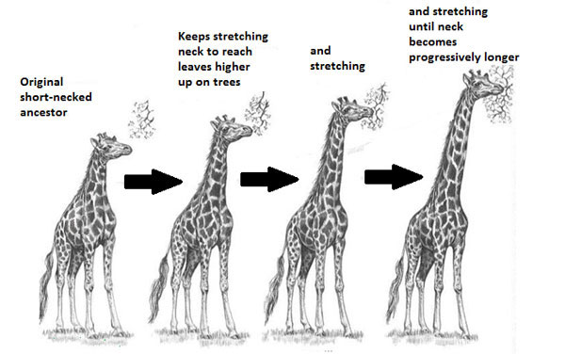
Adaptation
Best suited to survive
Ability to adapt (survive and reproduce) based on genetic variation

Slide 9
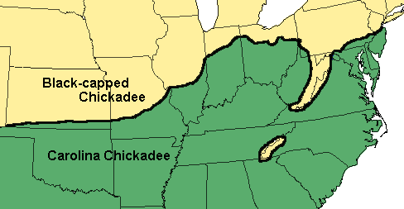
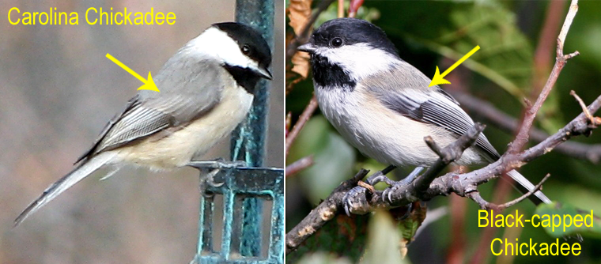
Speciation
Many changes over time result in a new species.

Slide 10
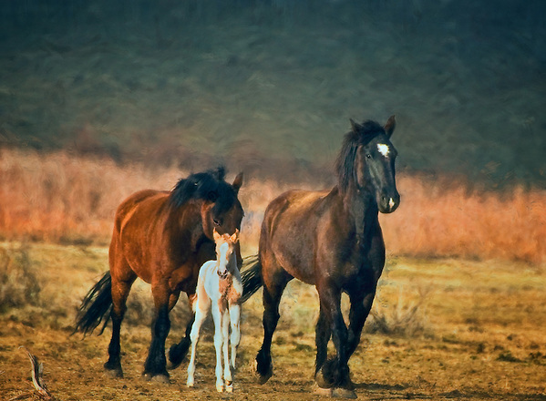
What is speciation?
Creation of a new species
What is a SPECIES?
Two organisms that breed and produce FERTILE offspring.

Slide 11
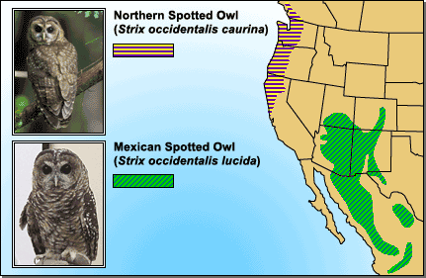
MACROEVOLUTION
How does speciation occur?
ISOLATION
Geographic
Reproductive

Slide 12
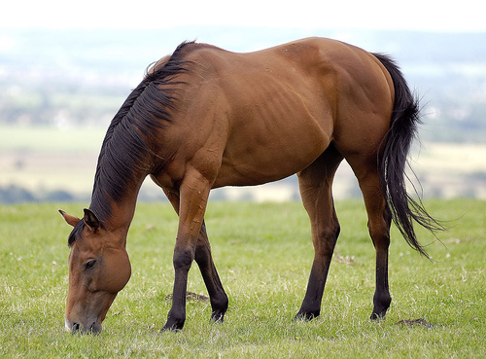
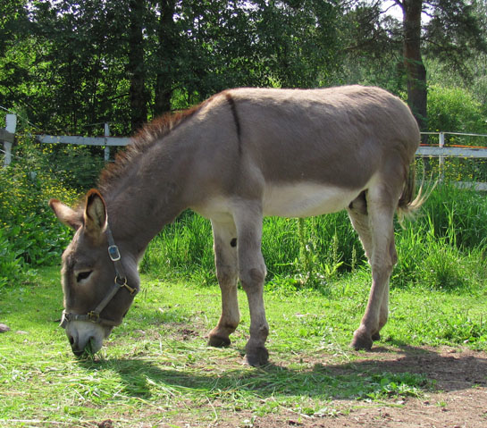
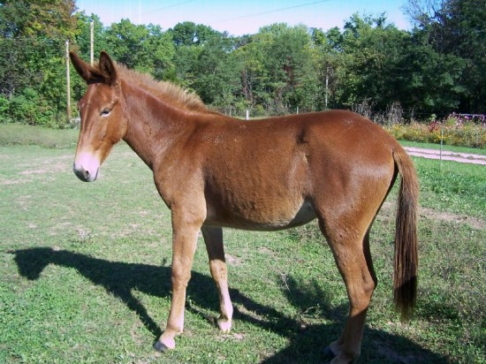
How do you know if speciation occurred?
When 2 animals can no longer interbreed and produce fertile offspring they are 2 different species.

Slide 13
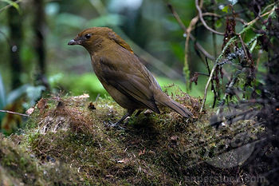
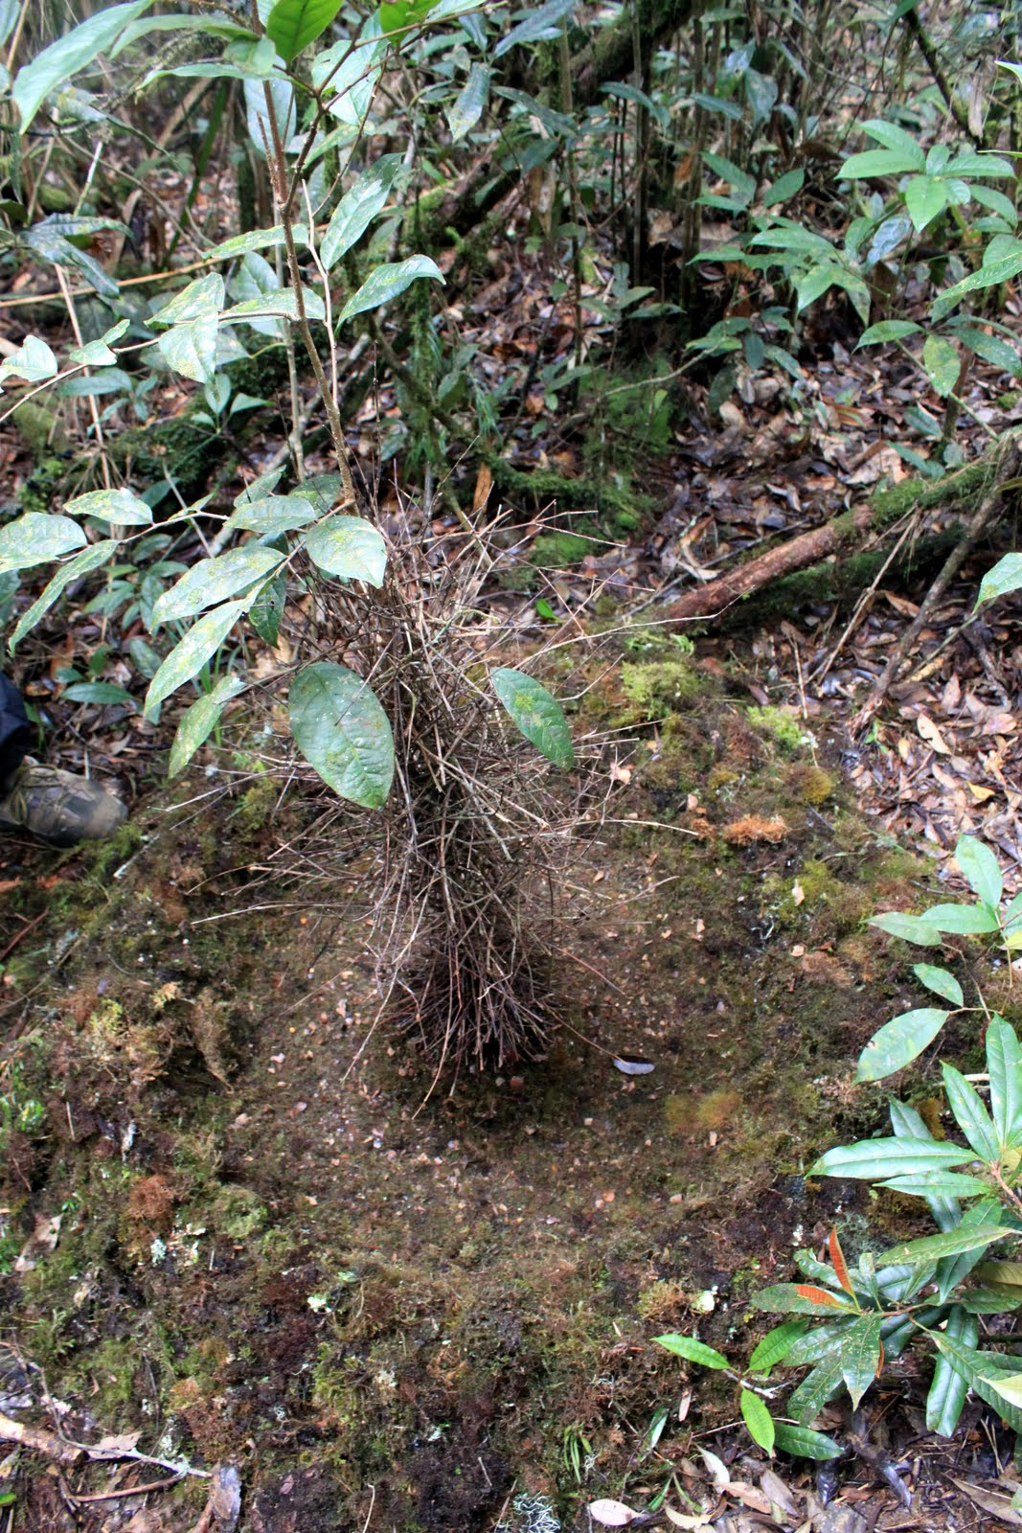

Slide 14
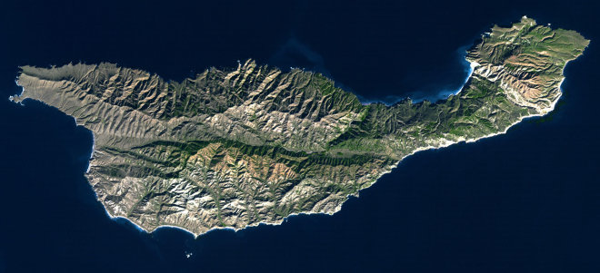
Speciation is constantly happening
California Island Santa Cruz

Slide 15
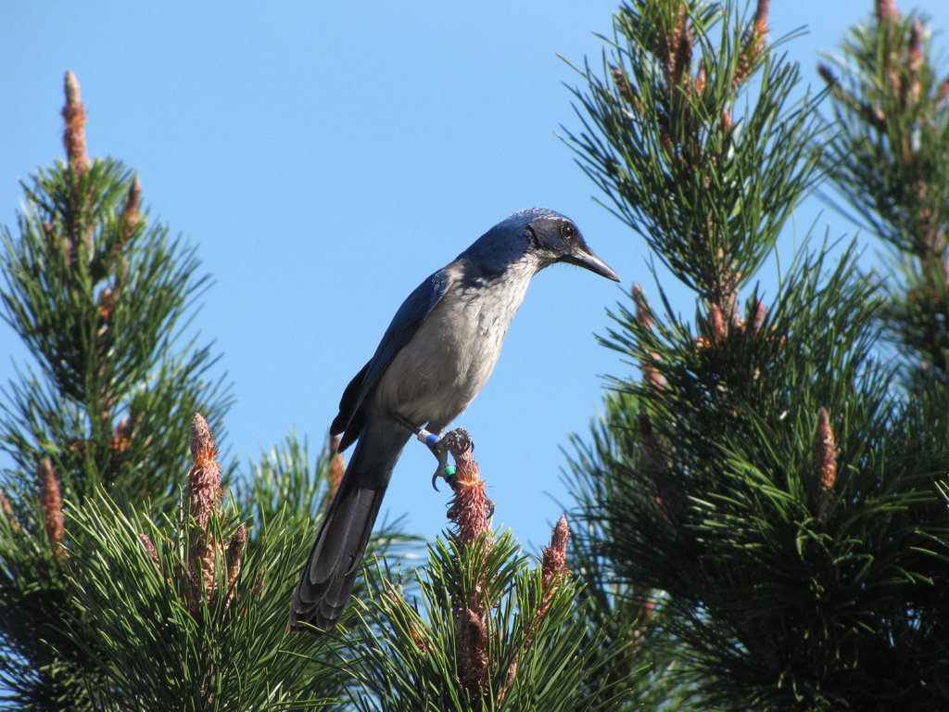
pine-eating island scrub jay

Slide 16
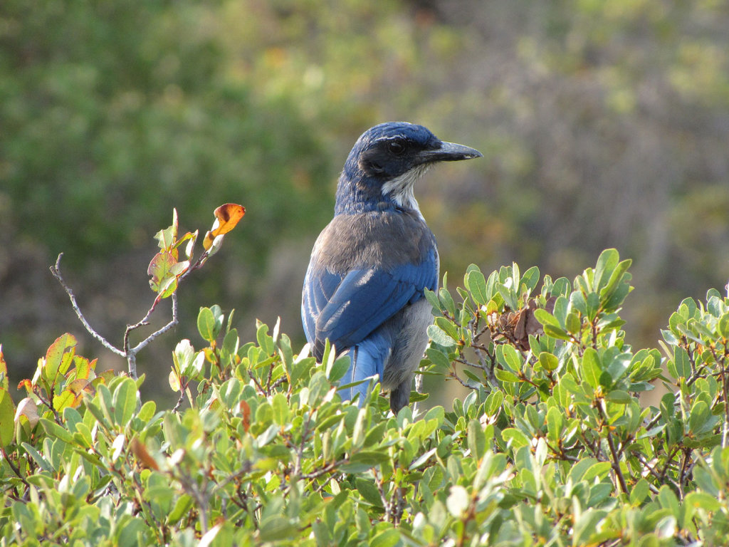
acorn-eating island scrub jay

Slide 17
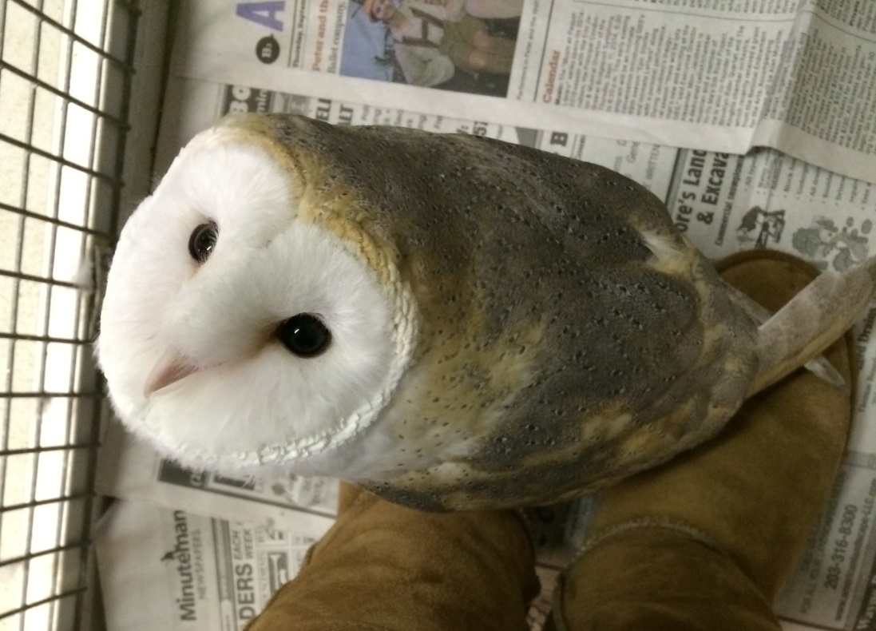
How to write a scientific name
Genus & Species
Genus is capitalized
species is lowercase
Both are italicized
Example: Tyto alba

Slide 18
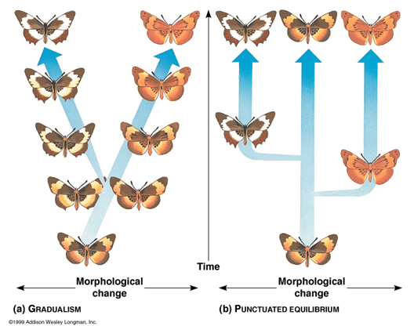
GRADUALISM
Natural Selection
Gradual accumulations of small variations

Slide 19
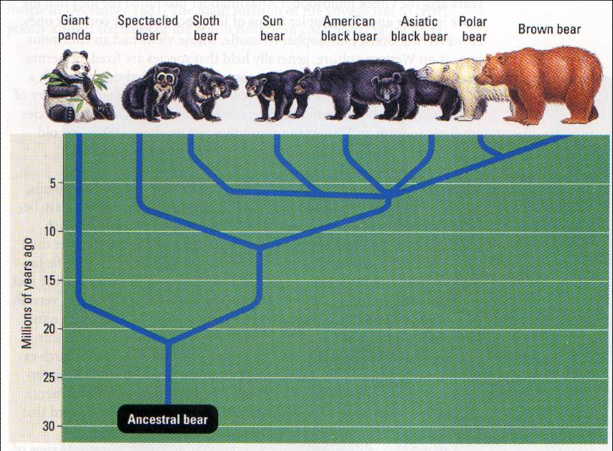
How would you explain the evolution of a polar bear?

Slide 20
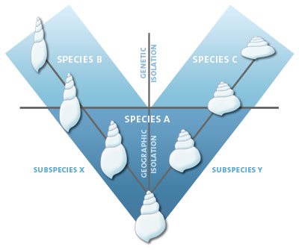

Slide 21
PUNCTUATED EQUILIBRIUM
Long stable periods
Brief periods of change

Slide 23
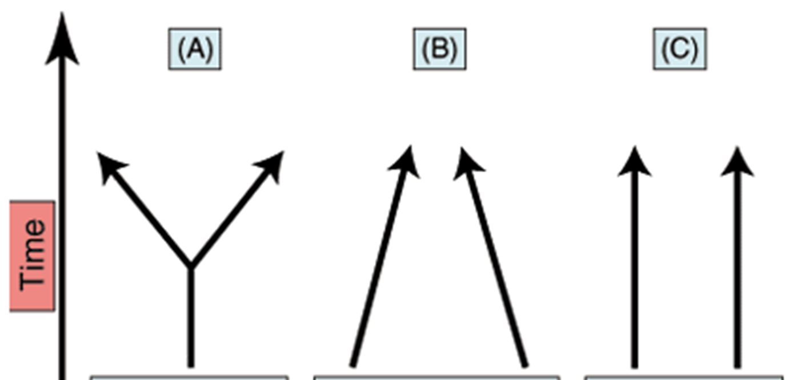
3 TYPES OF EVOLUTION

Slide 24
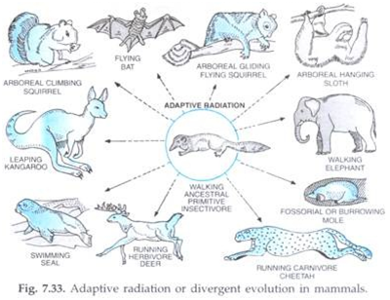
DIVERGENT EVOLUTION
One species splits usually through isolation and genetic variety and evolves to multiple species

Slide 25
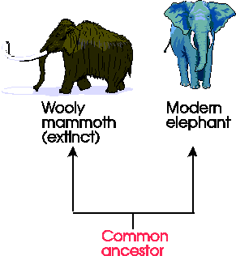

Slide 26
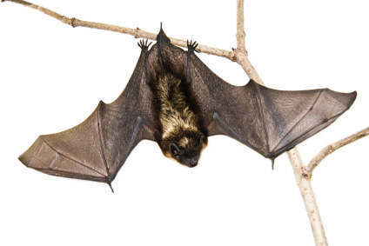
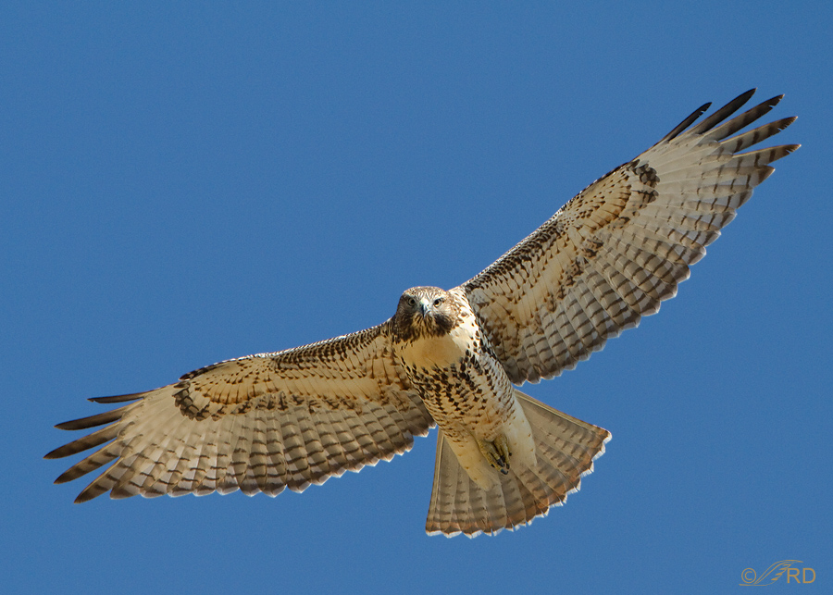
Convergent Evolution
Species evolve to be similar.

Slide 27
Why would species evolve to be similar?
Filling the same niche in an ecosystem
Diet
Habitat
Predators

Slide 28
Echidna- egg laying mammal
Hedgehog- placental mammal

Slide 29
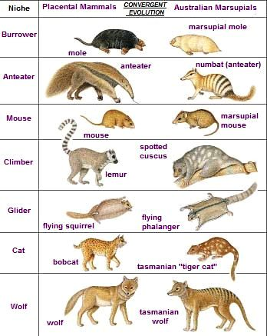
ONLY IN AUSTRALIA!

Slide 30
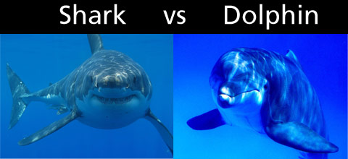

Slide 31
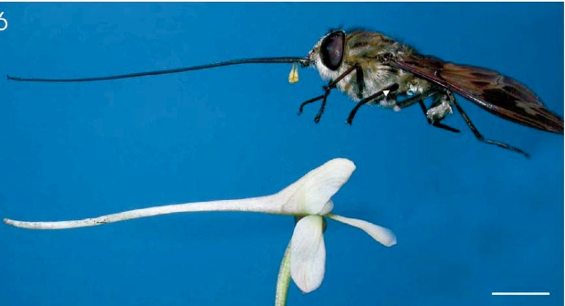
Evolve together, change together.

Slide 32
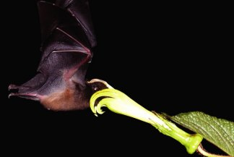
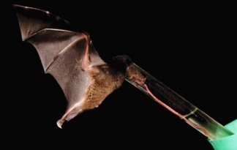

Slide 33
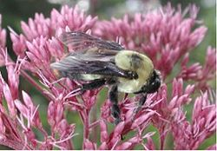
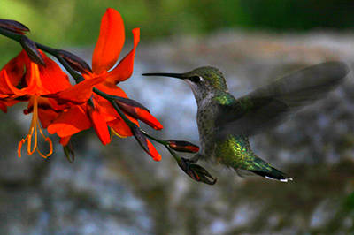

Slide 34
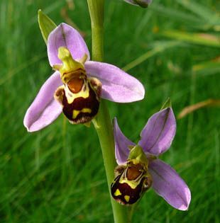
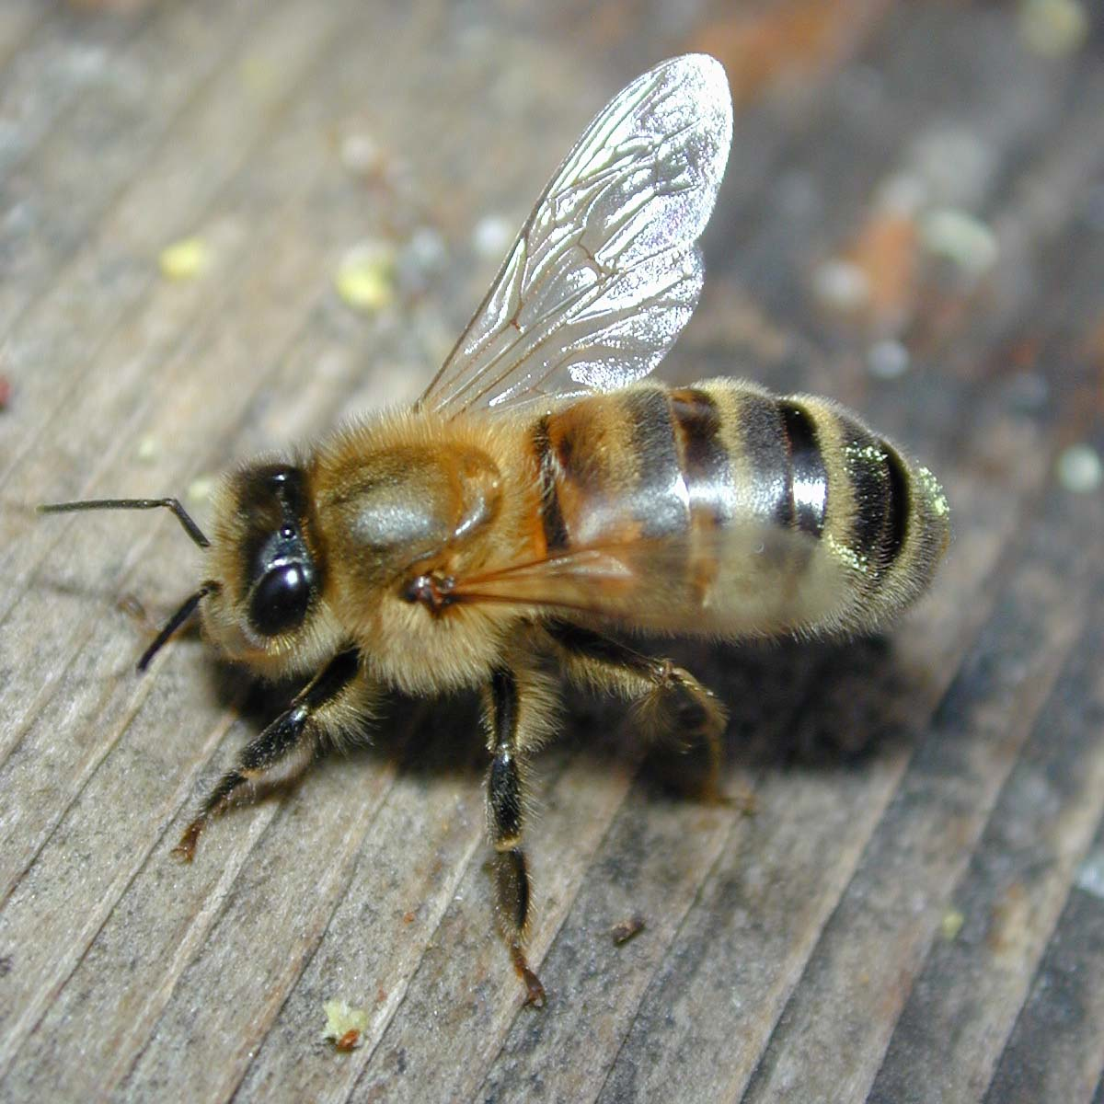
https://www.youtube.com/watch?v=-h8I3cqpgnA

Slide 35
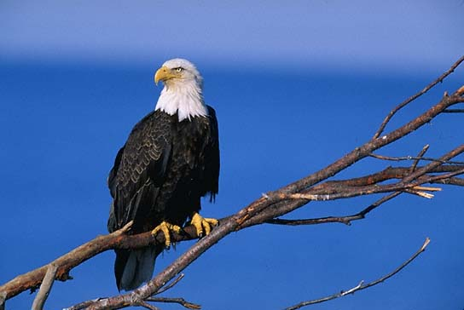
BALD EAGLES
Why were bald eagles put onto the endangered species list?
DDT

Slide 36
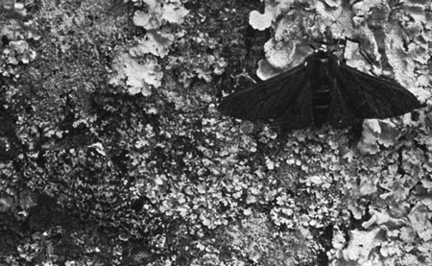
MICROEVOLUTION
Evolution of small populations or communities of a species
What was the case of microevolution that we worked on in class?

Slide 37
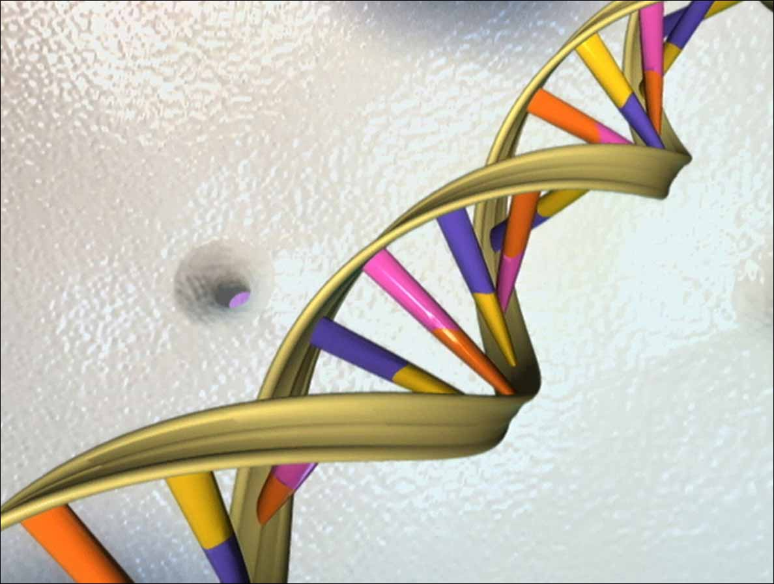
Causes of Variations
Gene mutation
Crossing over during meiosis
Independent assortment
Fertilization
Change in chromosome structure or number

Slide 38
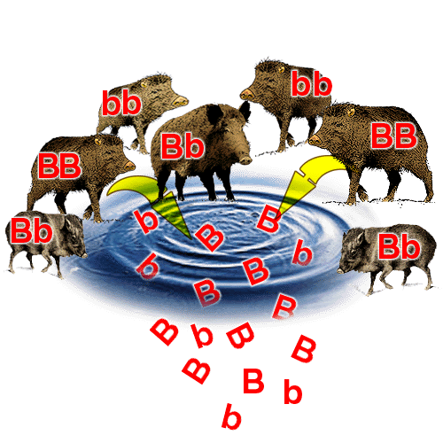
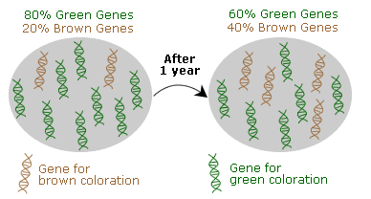
Population Genetics
Gene pool: total of all genes available in population.
What was the activity that we worked on in class that worked with alleles frequency?!
Gene frequency: how often a certain allele appears in a population

Slide 39
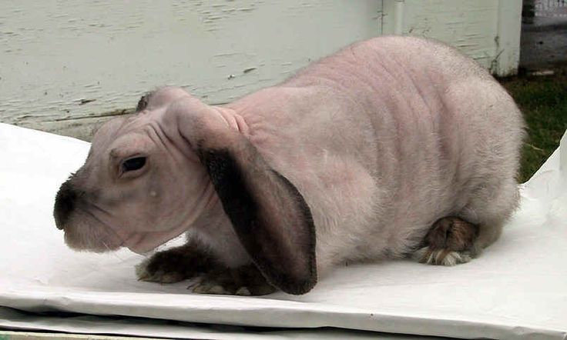
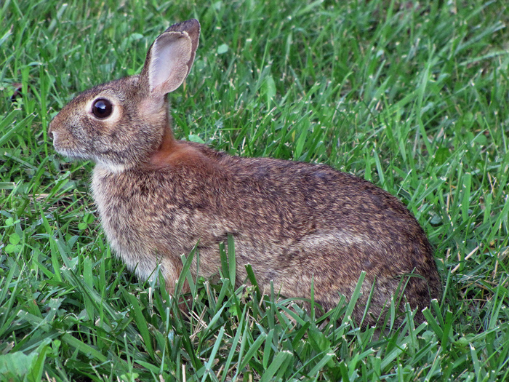

Slide 40
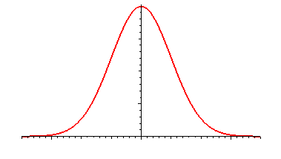
Variation of Traits Within a Population
Notes:
Traits vary and can be mapped along a bell curve, which shows that most individuals have average traits, whereas a few individuals have extreme traits.

Slide 41
One extreme has greater fitness than average

Slide 43
Average has highest fitness.

Slide 46
Extremes have greatest fitness

Slide 48
What is artificial selection? Who choses the trait?

