Slide 1

GENETICS

Slide 2
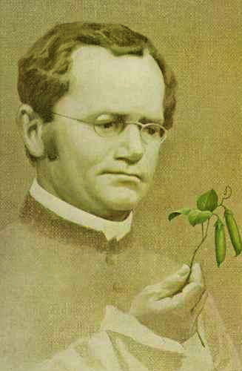
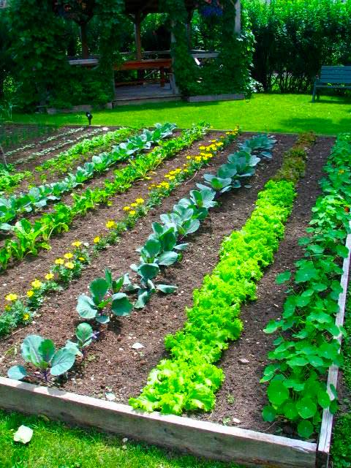

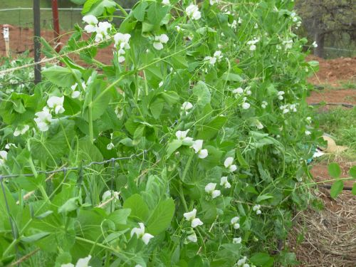
Medelian Genetics
Gregor Mendel
1800’s

Slide 3
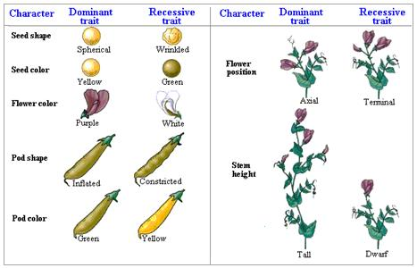

Slide 4
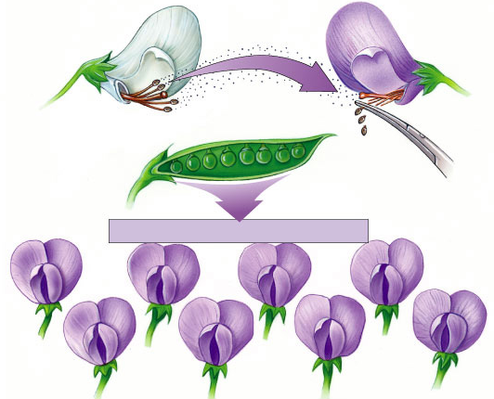
Medelian Genetics
Pollen transferred from white flower to stigma of purple flower
all purple flowers result
self-pollinate
?

Slide 5
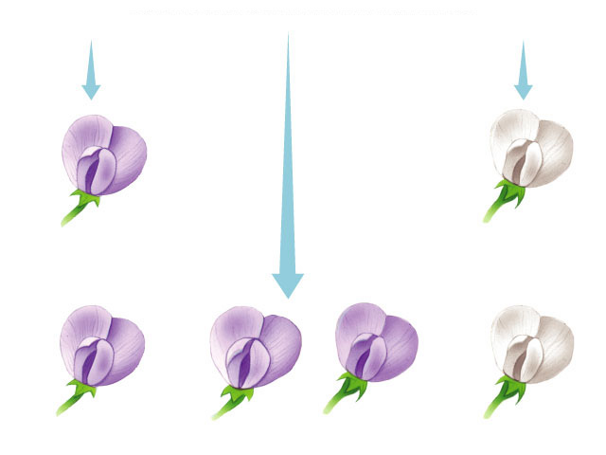
Looking closer at Mendel’s work
true-breeding
purple-flower peas
true-breeding
white-flower peas
Parents
X
F1
generation
(hybrids)
100%
purple-flower peas
100%
self-pollinate
75%
purple-flower peas
25%
white-flower peas
3:1
F2
generation
Notes:
In a typical breeding experiment, Mendel would cross-pollinate (hybridize) two contrasting, true-breeding pea varieties.
The true-breeding parents are the P generation and their hybrid offspring are the F₁ generation.
Mendel would then allow the F₁ hybrids to self-pollinate to produce an F₂ generation.

Slide 6
We use letters to represent the alleles or genes.
P = purple
p = white
Purple is dominant over white.
White is recessive.
Genotype
Phenotype
PP
Purple
Homozygous dominant
Pp
Purple
Heterozygous or hybrid
pp
White
Homozygous recessive

Slide 7
Predicting Inheritance
Let’s cross a totally dominant tall plant (TT) with a short plant (tt).
Each plant will give only one of its’ two genes to the offspring or F₁ generation.
TT x tt
T
T
t
t

Slide 8
Predicting Inheritance
Let’s cross a totally dominant tall plant (TT) with a short plant (tt).
Each plant will give only one of its’ two genes to the offspring or F₁ generation.
TT x tt
Mendels’ “Law” of Segregation
Each gene (allele) separates from the other so that the offspring get only one gene from each parent for a given trait.
T
T
t
t

Slide 9
Punnett Squares
 | Tt | Tt
 | Tt | Tt
The genes from one parent go here.
The genes from the other parent go here.

Slide 10
Punnett Squares
 | Tt | Tt
 | Tt | Tt

Slide 11
Punnett squares
Aaaaah,
phenotype & genotype
can have different
ratios
Pp x Pp
1st
generation
(hybrids)
%
genotype
%
phenotype
male / sperm
PP
P
p
25%
Pp
75%
P
PP
Pp
50%
Pp
female / eggs
p
Pp
pp
25%
25%
pp
1:2:1
3:1

Slide 12
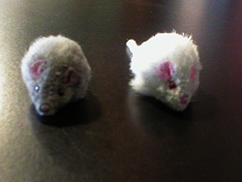
What if you didn’t know the genotype of an individual?
TEST CROSS
Let’s say Gray is dominant over white in mice.
If we have a gray individual, how could we determine if it is homozygous or heterozygous gray?

Slide 13
Cross the gray mouse by a white mouse.
What do you get?
If you get
100% all gray, then the genotype must have been
1 white individual, then the genotype must have been
GG
Gg

Slide 14
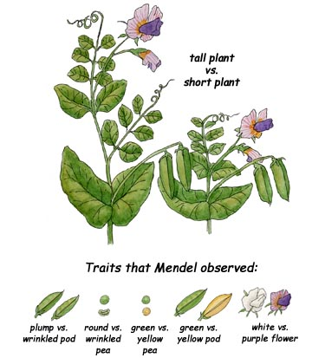
Dihybrids
More than 2 traits are crossed at a time.

Slide 15
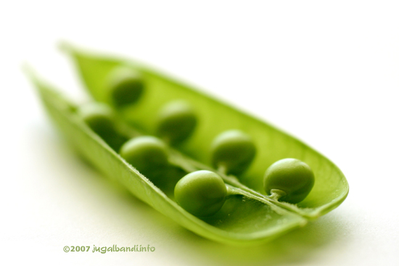
What is the genotype for a heterozygous tall and green pea plant?
T = tall
t = short
G = green
g = yellow
TtGg
What gametes can it produce?

Slide 16
TtGg
Inner
First
Last
Outer
TG
Tg
tG
tg

Slide 17
Dihybrid Cross
 | TG | Tg | tG | tg
TG
Tg
tG
tg

