Slide 1
ntroduction to Forensic Science
“Forensics”
What is it all about?

Slide 2
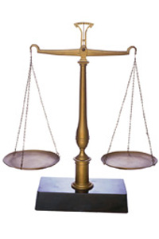
What is Forensic Science?
relates to the application of science to the law using forensic evidence to solve a crime.
The term can be used interchangeably with the term Criminalistics
Notes:
Forensics = Forensis (latin) – forum where in Roman times, sentators and others debated and held judicial proceedings

Slide 3
http://www.youtube.com/watch?v=_58XsN6XJWQ

Slide 4
What science subjects does forensic science include?
Chemistry
Physics
Geology
Biology
Notes:
ACTIVITY: types of science in forensics, graphic organizer

Slide 5
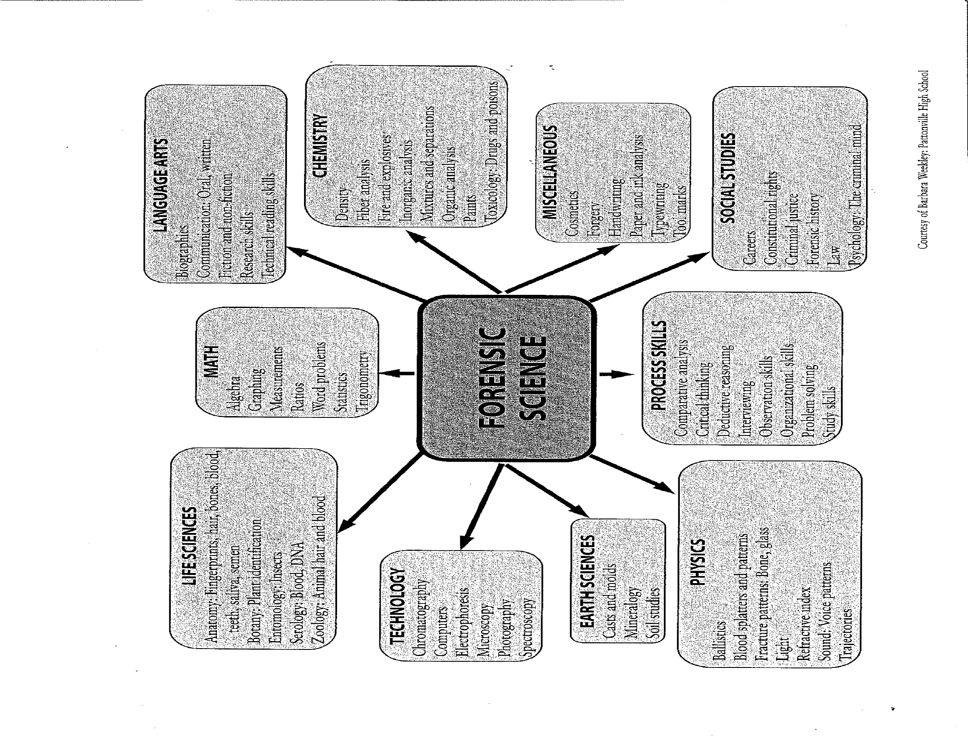

Slide 6
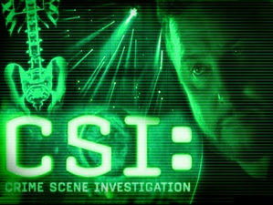
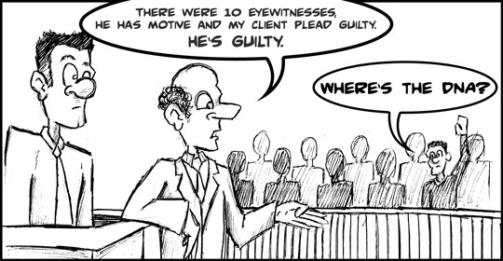
The CSI Effect
Notes:
ACTIVITY: CSI reading and questions

Slide 7
https://www.youtube.com/watch?v=fGc4PaLB-ek

Slide 8
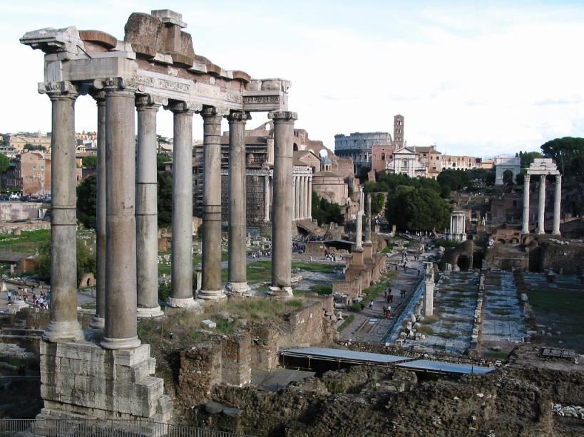
Forensics Term
Derived in the mid-17th century.
From Latin word forensis: “of legal proceedings”
originally derived from
“of the forum”
(as a place of discussion).
(In Roman times, senators and others debated and held judicial proceedings)

Slide 9
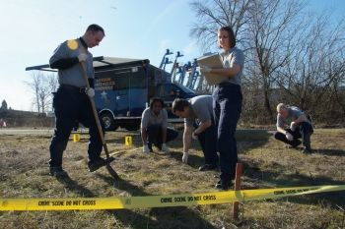
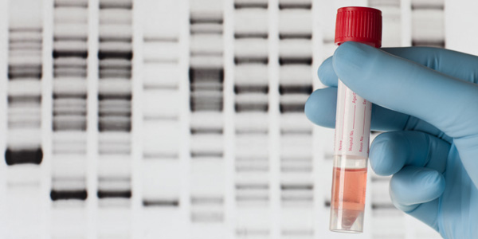
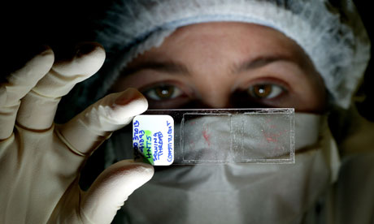
Forensic Scientists…
are responsible for applying forensic science and solving crimes and scenarios.

Slide 10
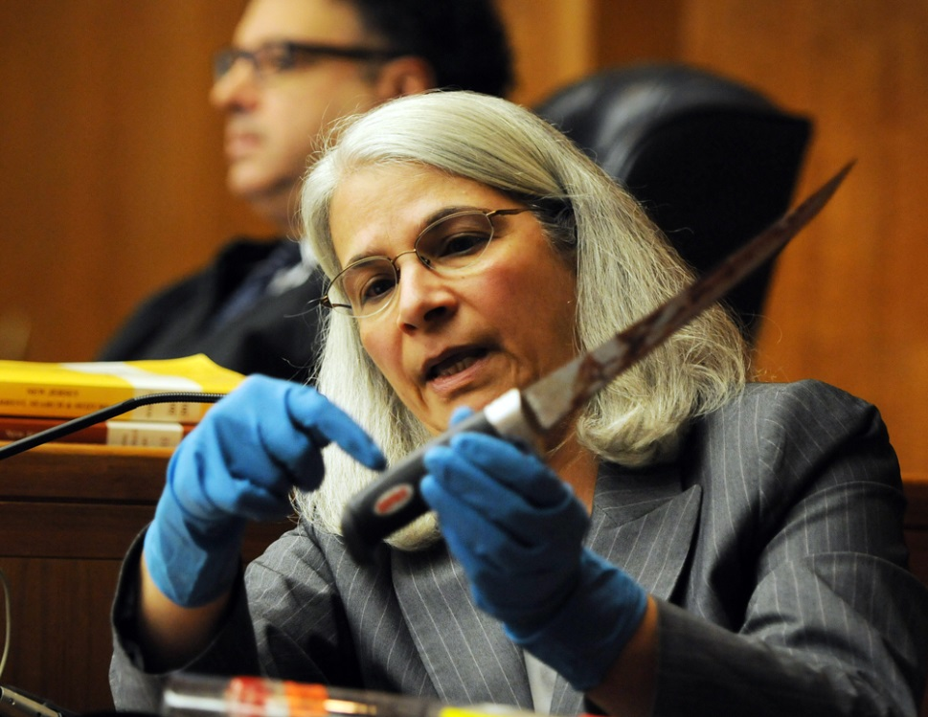
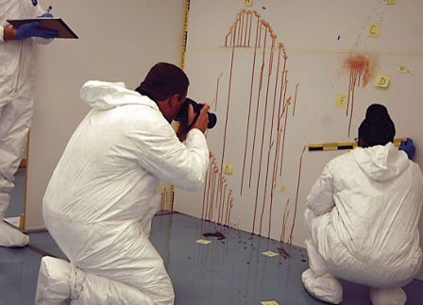
The Job of Forensic Scientists...
Study the different types of evidence found at a crime scene.
Must be ready to testify as an expert witness at a trial or hearing.
    Presenting data, weighs evidence, and gives an impartial opinion to the court
Perform scientific research and train others in the field of forensics.
Notes:
ACTIVITY: careers

Slide 11
http://www.youtube.com/watch?v=TbuTirBdZjQ

Slide 12
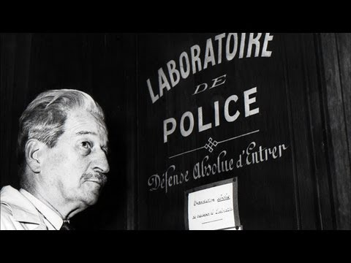
People of Historical Significance
Edmond Locard (1877-1966)
French professor
Considered the “Father of Criminalistics”
Built the world’s First Forensic Laboratory in France in 1910
Locard Exchange Principle
  Whenever two objects come into contact with each other, traces of each are exchanged.
Notes:
ACTIVITY: locard activity the next day

Slide 13
LOCARD’S PRINCIPLE MODEL
PHYSICAL EVIDENCE
VICTIM
CRIME SCENE
SUSPECT

Slide 14
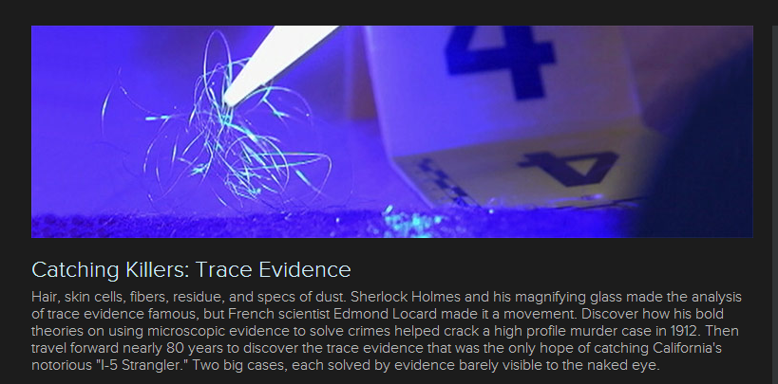
http://www.smithsonianchannel.com/sc/web/series/1003122/catching-killers/3375550/trace-evidence#the-original-sherlock-holmes

Slide 15

The perpetrator will take away traces of the victim and the crime scene,
The victim will have traces of the perpetrator
Victim leave traces of himself on the perpetrator
The perpetrator will leave behind traces of himself at the crime scene.

Slide 16
  Materials may be small or large
  May be difficult to detect
  What are some specific pieces of evidence that you could leave behind at a crime scene?
It is the responsibility of the Forensic Team to gather all material however small they may be and prove that an exchange of material occurred.

Slide 17
Forensic Scientists use Crime Labs to help them examine Evidence.
Forensic Scientists specialize in a specific area and are experts in specific fields not all of them
They use the scientific method to solve the crime.

Slide 18
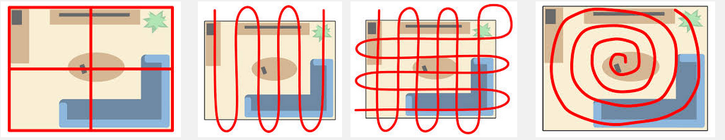

Slide 19
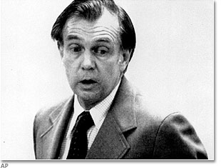
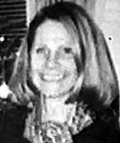
Richard Crafts
Disk 1 #6
https://www.youtube.com/watch?v=RwkYk9IyN-s
Notes:
ACTIVITY: watch forensic file

Slide 20
Forensic Scientist use the Scientific Method to solve a problem.
PROBLEM
HYPOTHESIS (Inductive Reasoning)
  Idea based on previous knowledge
COLLECT EVIDENCE/DATA
ANALYZE EVIDENCE/DATA (Deductive R.)
  Idea based on data and evidence.
MAKE CONCLUSIONS
  Theory – Legal Opinions

Slide 21
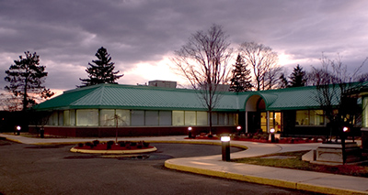
Major Crime Laboratories
Federal, State, and
Local Agencies
FBI – Federal Bureau of Investigation – national security
DEA – Drug Enforcement Administration Laboratories
U.S. Postal Service
ATF – Alcohol, Tobacco, Firearms, and Explosives
U.S. Fish and Wildlife Services
Secret Service – money counterfeiting
What does our State Crime Lab have?
Forensics Laboratory in Connecticut: http://www.ct.gov/dps/cwp/view.asp?Q=296214&a=2155&dpsNav=%7C

Slide 22

https://www.youtube.com/watch?v=NleXS2d53Is

Slide 23
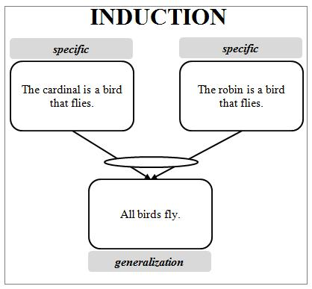
Deductive vs. Inductive Reasoning
Inductive reasoning – ability to generalize based upon a specific observation. Specific to general
HYPOTHESIS BASED
Ex: Find a stethoscope at a scene, therefore crime committed by a medical person.

Slide 24
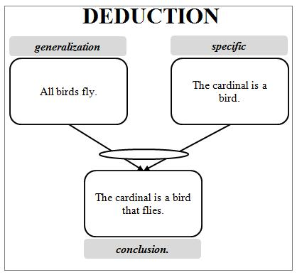
Deductive vs. Inductive Reasoning
Deductive reasoning – ability to make a specific conclusion based upon known general premise. General to specific.
EVIDENCE BASED
Ex: Footprints cross over one another so prints on bottom came 1st.

Slide 25
Inductive Reasoning –
Deductive Reasoning

Slide 26

U.S. Laws
The U.S. Constitution –
overarching laws for the whole country. Overrules the Constitutions of the individual states.
Statutory Law –
written laws or codes declaring, commanding or prohibiting something and is created by the government. Based on the Constitution.
Common Law or Case Law –
made by judges. Precedents are set in appellate court. Stare decisis –”to stand by a decision”. Makes for consistency in how law is applied.

Slide 27
Civil Law –
laws established to deal with relationships between individuals. Ex: property, marriage, contracts and businesses.
Criminal Law –
laws meant to protect the rights of individuals.
Equity Law –
laws for cases not covered by common law. Ex: injunctions, restraining orders.
Administrative Law –
rules or laws established by agencies such as the IRS, Social Security Administration, or branches of the military

Slide 28
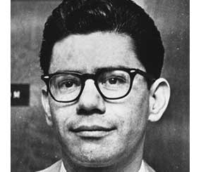
Miranda v Arizona
1963
accused of kidnapping and raping an 18-year-old woman in Phoenix, Arizona.
confessed to the crime.
not told that he did not have to speak or that he could have a lawyer present.
At trial, Miranda's lawyer tried to get the confession thrown out, but the motion was denied.
Supreme Court in 1966. The Court ruled that the statements made to the police could not be used as evidence, since Mr. Miranda had not been advised of his rights.
Notes:
In 1963, Ernesto Miranda, a 23 year old mentally disturbed man, was accused of kidnapping and raping an 18-year-old woman in Phoenix, Arizona.
He was brought in for questioning, and confessed to the crime. He was not told that he did not have to speak or that he could have a lawyer present.
At trial, Miranda's lawyer tried to get the confession thrown out, but the motion was denied.
The case went to the Supreme Court in 1966. The Court ruled that the statements made to the police could not be used as evidence, since Mr. Miranda had not been advised of his rights.

Slide 29
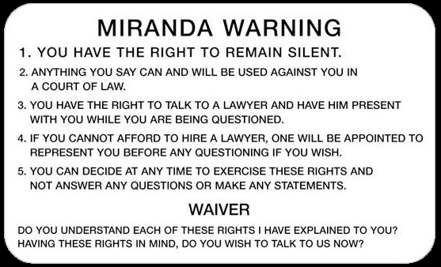

Slide 30

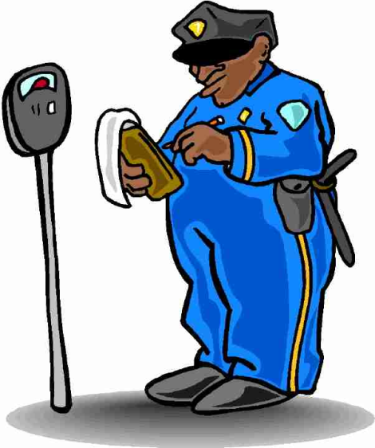
3 Types of Crimes:
Violation = a broken law and can be a minor or major crime
Infraction –
minor offense.
Penalty is generally a fine.
Ex: jaywalking, traffic violations and littering.

Slide 31

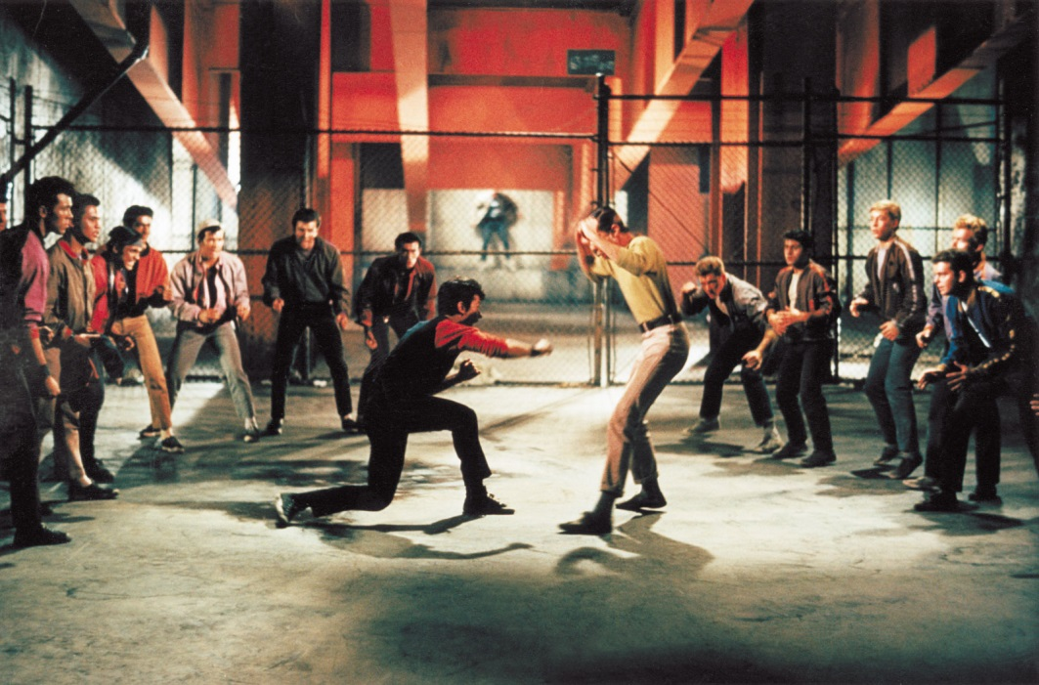
2. Misdemeanors –
punishable by no more than 1 year in jail. Fines range from $250 to $2,500 and sometimes include community service.
Ex: first offense of drunk driving, vandalism, assault, and prostitution. Cases heard by district court.

Slide 32
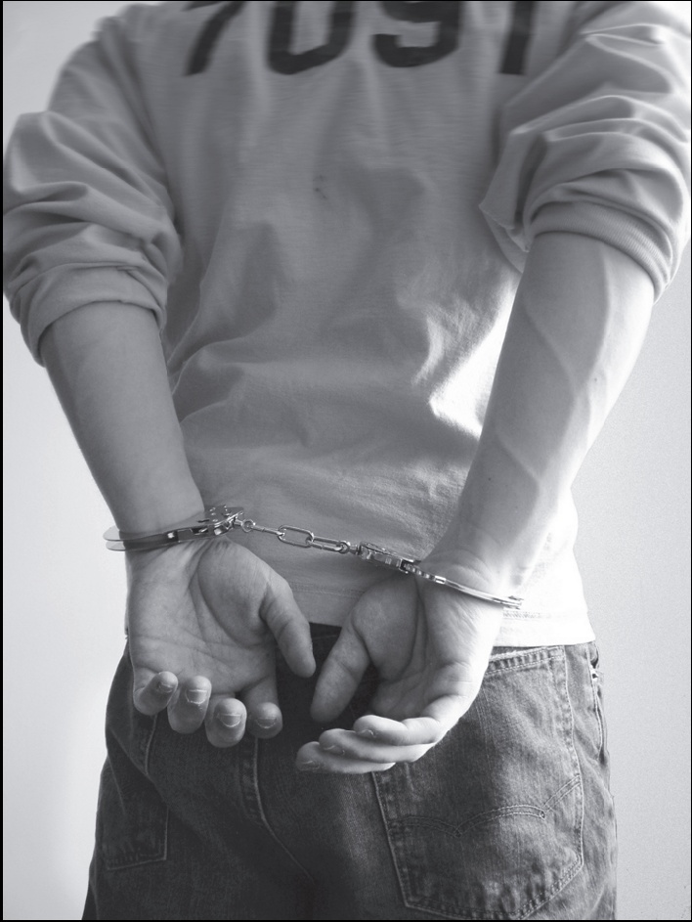
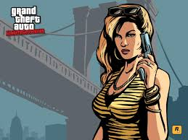

3. Felonies –
more serious crimes. Generally transferred to circuit court.
Punishments range from five years up to life and may include the death penalty. Fines up to $100,000
Ex: rape, homicide, arson, aggravated assault, burglary, robbery.

Slide 33

Find the 6 differences between the two pictures.
Answers: Tail feathers, flame, monkey’s tail, lion’s mane, cake tray, frosting

Slide 34
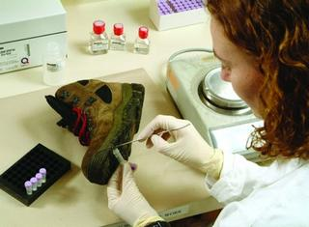
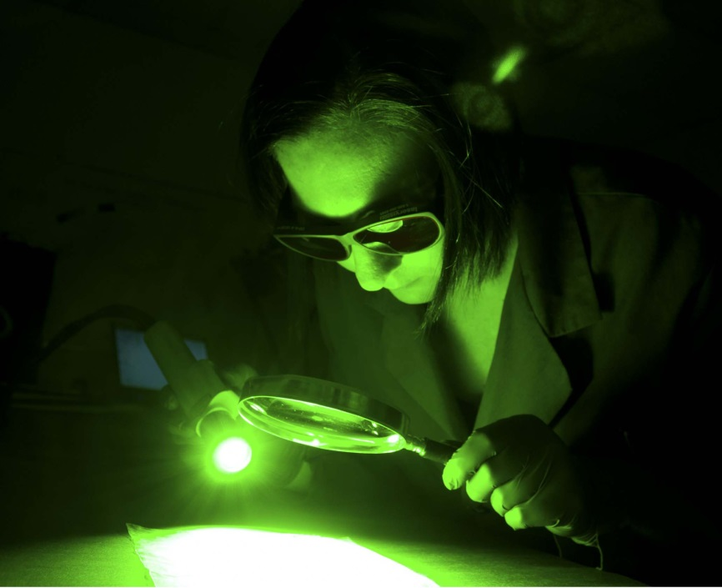
Today, we will research what the different fields pertain to and then you will pick the career that best interests you and create a Wanted Poster.

Slide 35
Common subjects involved with Crime Laboratories
Most Common
Chemistry
Biology
Firearms
Document Examination
Photography
Toxicology and Drug Analysis
Fingerprints
Polygraphy
Pathology
Anthropology
Forensic psychology
Odontology
Engineering
Computer Technology
Geology
Environmental Science
Entomology
Physics

Slide 36
Crime Lab History
First police crime lab in the world was established in France in 1910 by Edmond Locard
First police crime lab in the U.S. opened in 1923 in Los Angeles
The Scientific Crime Detection Lab was founded in Evanston, Illinois in 1929
The first FBI crime lab opened in 1932

Slide 37
Major Developments in Forensic Science History
  700s AD—Chinese used fingerprints to establish identity of documents and clay sculptures
  ~1000—Roman courts determined that bloody palm prints were used to frame a man in his brother’s murder
  1149—King Richard of England introduced the idea of the coroner to investigate questionable death
  1200s—A murder in China is solved when flies were attracted to invisible blood residue on a sword of a man in the community
  1598—Fidelus was first to practice forensic medicine in Italy
  1670—Anton Van Leeuwenhoek constructed the first high-powered microscope
  1776—Paul Revere identified the body of General Joseph Warren based on the false teeth he had made for him
  1784—John Toms convicted of murder on basis of torn edge of wad of paper in pistol matching a piece of paper in his pocket

Slide 38
Major Developments in Forensic Science History
  1859—Gustav Kirchhoff and Robert Bunsen developed the science of spectroscopy.
  1864—Crime scene photography developed
  1879—Alphonse Bertillon developed a system to identify people using particular body measurements
  1896—Edward Henry developed first classification system for fingerprint identification
  1900—Karl Landsteiner identified human blood groups
  1904—Edmond Locard formulated his famous principle, “Every contact leaves a trace.”
  1922—Francis Aston developed the mass spectrometer.
  1959—James Watson and Francis Crick discover the DNA double helix
  1977—AFIS developed by FBI, fully automated in 1996
  1984—Jeffreys developed and used first DNA tests to be applied to a criminal case

Slide 39
Important Scientists
Mathieu Orfila – “Father of Toxicology” advanced detection of poisons
Alphonse Bertillon – developed personal identification system using Anthropometry (systematic procedure of taking a series of body measurements)
Francis Galton – studied and established foundation for today’s understanding of fingerprinting

Slide 40
Important Scientists Cont.
Leone Lattes – established that a forensics connection can be used with blood typing
Calvin Goddard – studied bullet comparison
Albert Osborn – examined documents for authenticity
Walter McCrone- used microscopy for forensic science cases
Hans Gross – developed principles of Forensics

Slide 41
Crime Scene Team
A group of professional investigators, each trained in a variety of special disciplines.
Team Members
  First Police Officer on the scene
  Medics (if necessary)
  Investigator(s)
  Medical Examiner or Representative (if necessary)
  Photographer and/or Field Evidence Technician
  Lab Experts
    Ex. Pathologist, serologist, DNA expert, toxicologist,
    forensic – odontologist, anthropologist, psychologist entomologist, firearm examiner, bomb and arson
    expert, document and handwriting analysis, fingerprint analyst

Slide 42
Where to begin…
Describe how the scientific method is used to solve forensic problems
Describe the applications of forensics
Describe the relationship of science, forensics and the law
Explain forensics practices using specific court cases
Discuss the importance of the work of various forensics pioneers
Discuss the careers that contribute to the field of forensics
Describe the development of technology important to forensics
Discuss the “CSI effect” on the field of forensics

Slide 43
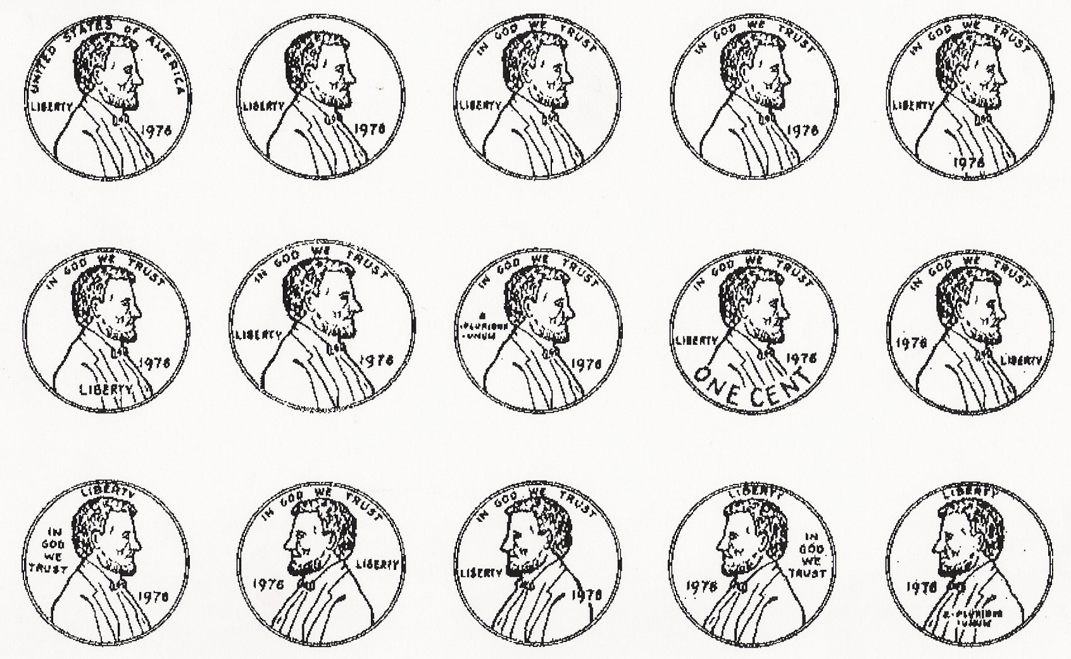
Which is the correct penny?
NOTE: You cannot look at a real penny!
1
2
3
4
5
6
7
8
9
10
11
12
13
14
15

Slide 44
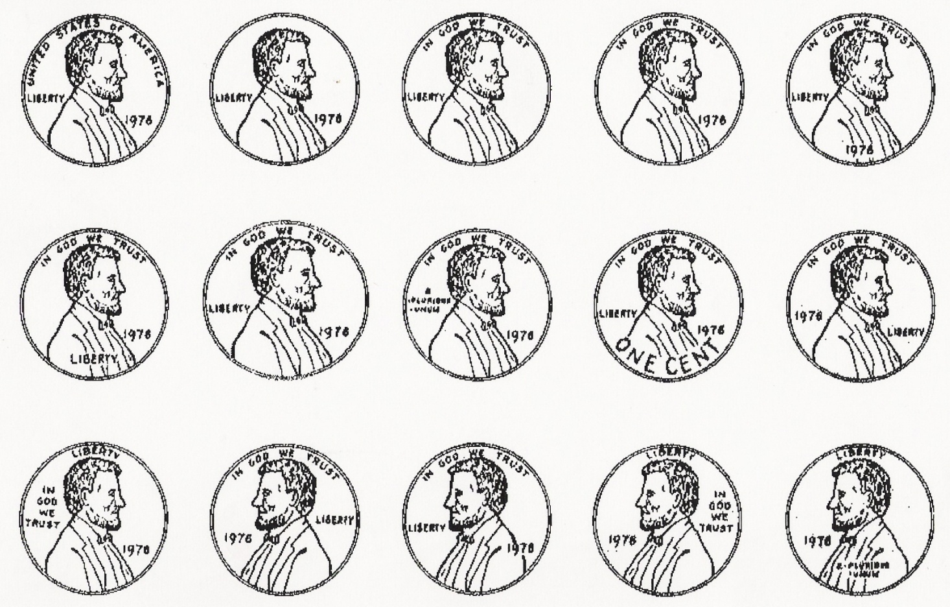
Answer
1
2
3
4
5
6
7
8
9
10
11
12
13
14
15

Slide 45

Find the 6 differences between the two pictures.
Answers: Fish gill, tree stump, cat’s foot, dog’s mouth, bird’s beak, dog’s ear

