Slide 1
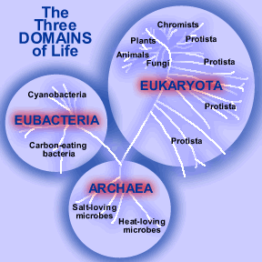
Notes:
Archaea Methanogens, Halophiles, Extreme Thermophiles

Slide 2
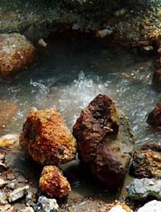
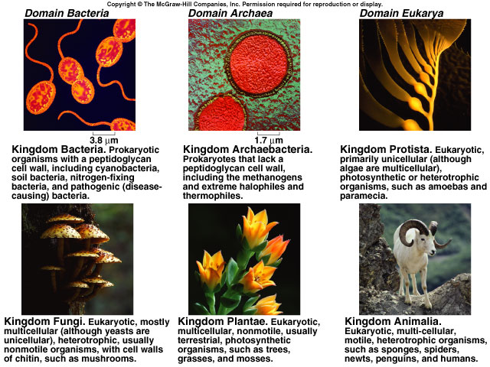
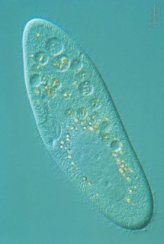
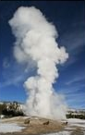
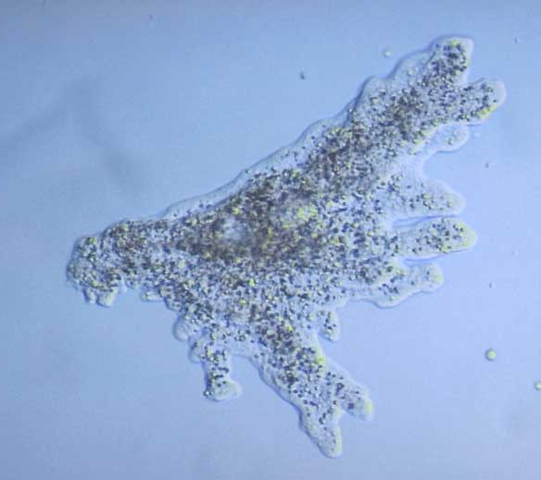
Prokaryotes
Kingdom Bacteria
Kingdom Archaebacteria
Kingdom Protist
Eukaryotes
Kingdom Fungi
Kingdom Plant
Kingdom Animal

Slide 3
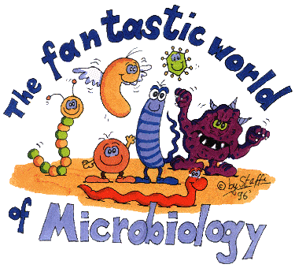

Slide 4
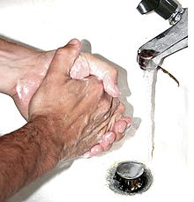
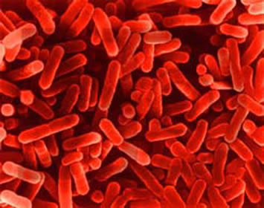
Bacteria - what comes to mind?
1% cause human diseases
4% cause plant diseases
95% non-pathogens
leginoella

Slide 5
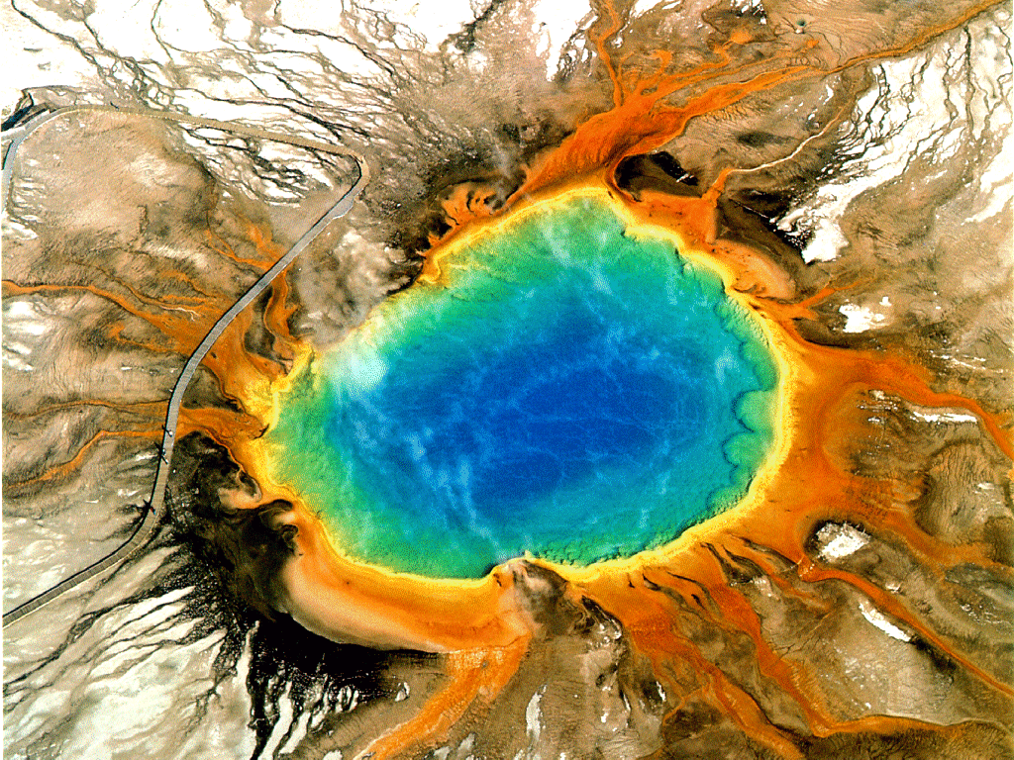
ARCHAEBACTERIA
Unicellular prokaryotes with cell wall

Slide 6
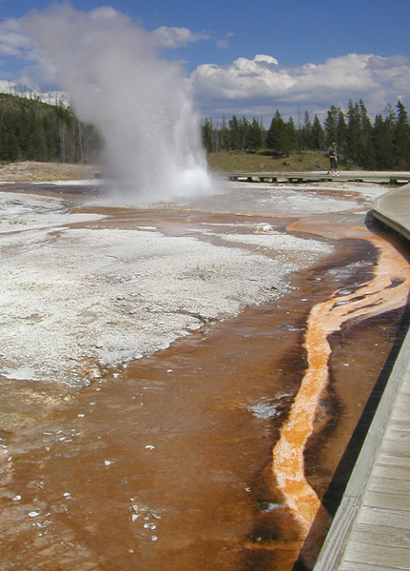
Archaebacteria
Ancient bacteria
live in extreme environments
high heat
high salt

Slide 7
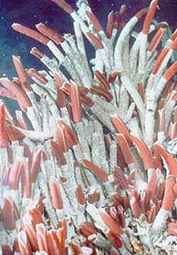
Chemoautotrophs
Make food from inorganic molecules in the water
No sun

Slide 8
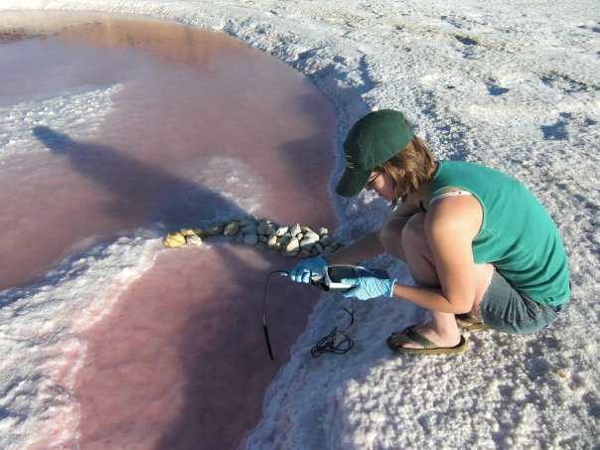
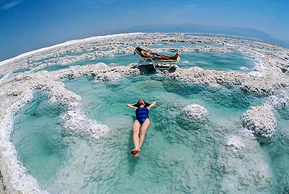
The Dead Sea
Lake Tyrrell,
Australia

Slide 9
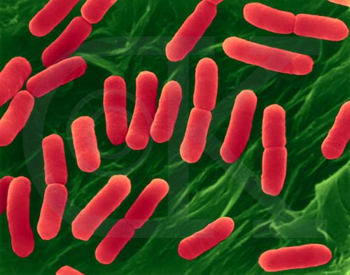
EUBACTERIA
Unicellular prokaryotes with cell wall.

Slide 10
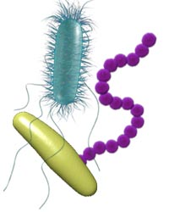
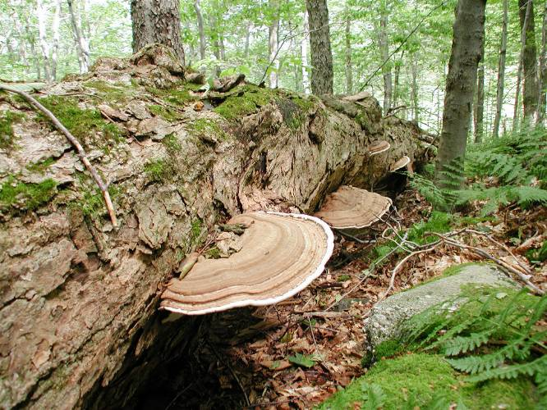
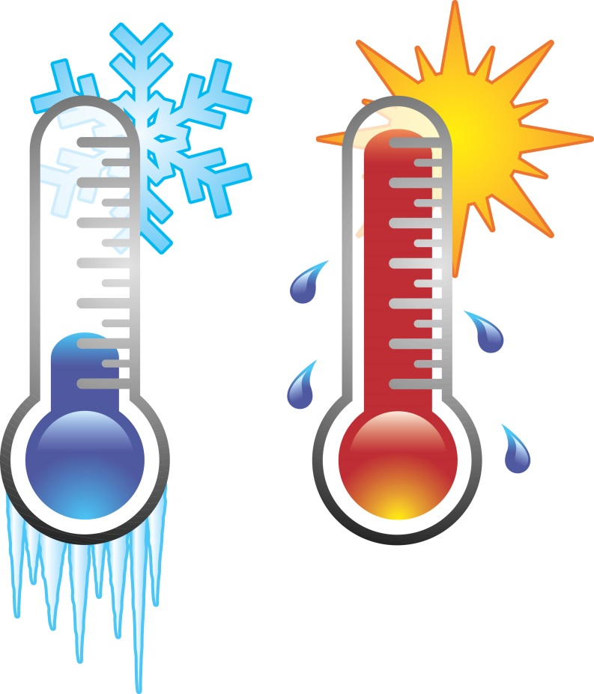
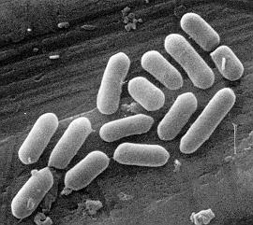
Bacteria live EVERYWHERE
E.coli, Strept, and Tuberculosis

Slide 11
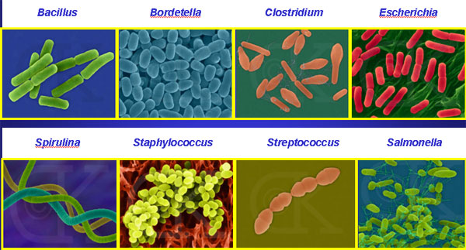
Bacterial diversity
rods and spheres and spirals… Oh My!
Notes:
Rods
Spheres
Spirals

Slide 13
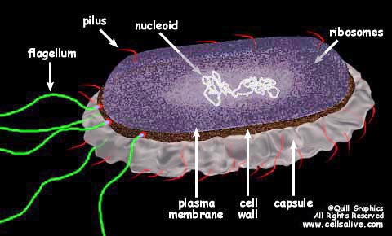
Note: cell wall & single circular DNA

Slide 14
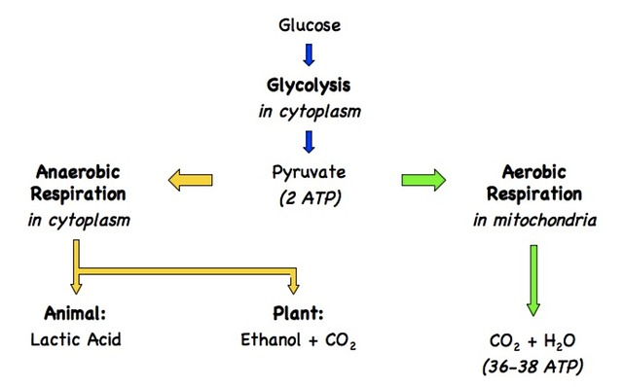
Bacteria can do both!
Where do they occur in bacteria?

Slide 15
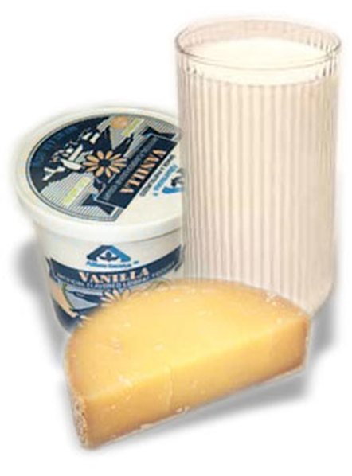
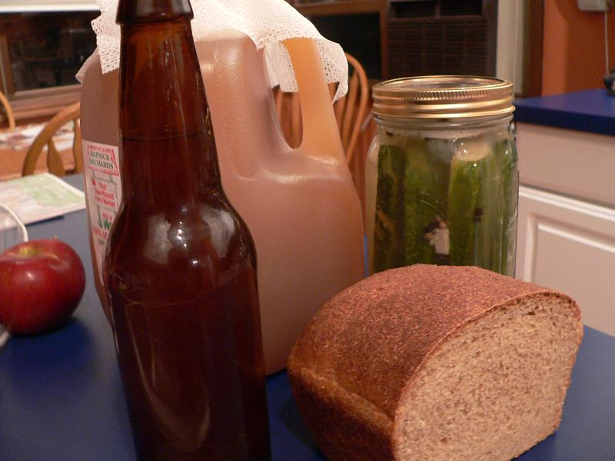
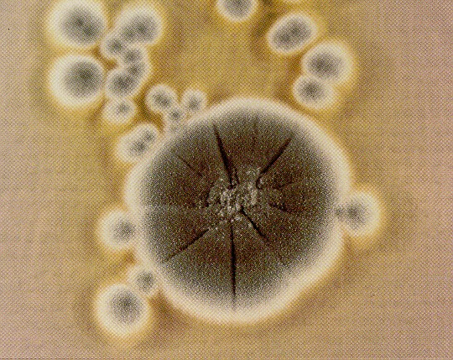
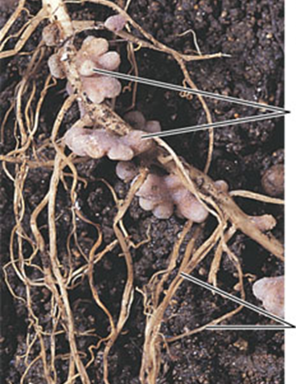
Are there any benefits of microbes to humans?

Slide 16
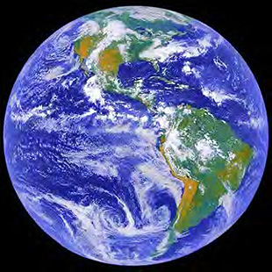
Uses in an Ecosystem
1. Bacteria are primary decomposers
2. Nitrogen Fixation

Slide 17
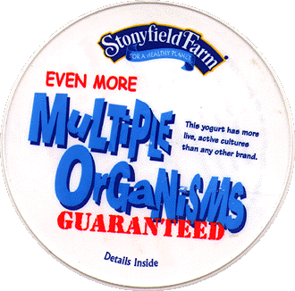

Slide 18
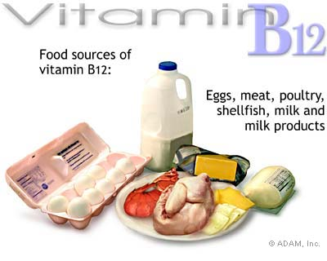
Human Uses
Antibiotics
Obtain Vitamins from food - E. coli
METABOLISM

Slide 19
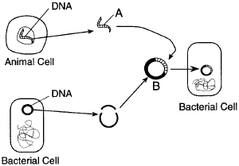
Recombinant DNA Technology Genetic Engineering
Hormones
Gene Therapy

Slide 20
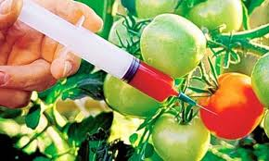
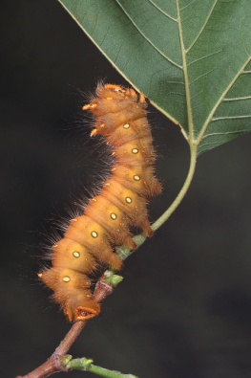
Biotechnology – DNA manipulation
To control the growth of insects
Bacillus thuringiensis
Caterpillars, bollworms, corn borers

Slide 21
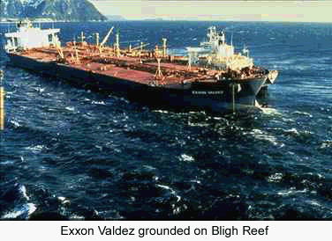
Bioremediation
Using microbes to clean up pollutants and toxic wastes
Exxon Valdez - 1989

Slide 22
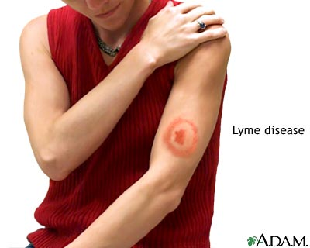
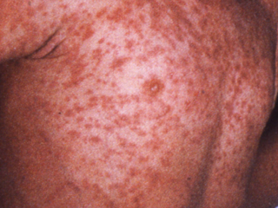
Microbes do benefit us, but they are also capable of causing many diseases
Pneumonia Whooping Cough Gangrene
Botulism Typhoid Fever Measles
Cholera Scarlet Fever Mumps
Syphilis Gonorrhea Herpes 1
Chlamydia Tuberculosis Herpes 2
Meningitis Tetanus RMSV
Strep Throat Lyme Disease AIDS
Black Plague Diarrhea

Slide 23
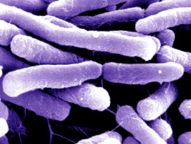
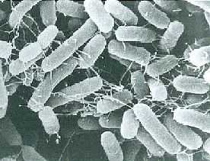
Bacteria causing food poisoning
Salmonella
E. coli

Slide 24
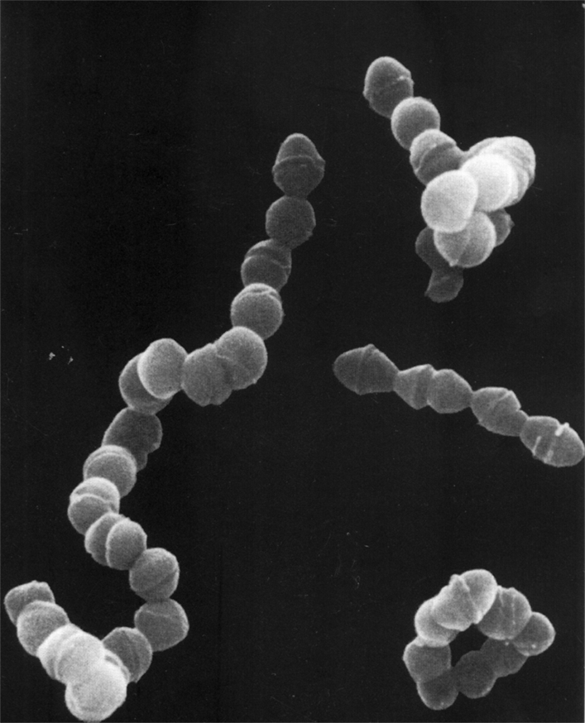
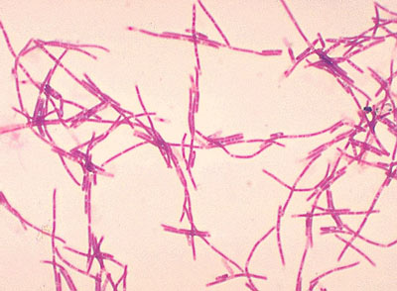
Other Bacterial Diseases
Anthrax: causes respiratory problems
Streptococcus: causes strept throat

Slide 25
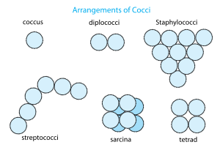
Naming of Bacteria
Information usually given:
1. Describes an organism
2. Identifies a habitat
3. Honors a scientist or researcher

Slide 26
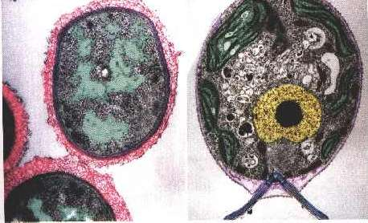
Prokaryotic vs. Eukaryotic Cells
Cell Wall of peptidoglycan
Binary Fission
1 circular chromosome (5-100 genes
If cell wall, Cellulose or chitin
Mitosis
Linear chromosomes (100-1000’s of genes)

Slide 27
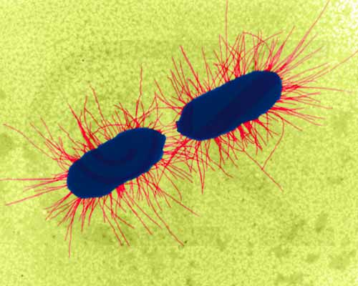
Motility
Almost all Spiral bacteria are motile
About 1/2 of Bacilli are motile
Almost all Cocci are non-motile

Slide 28
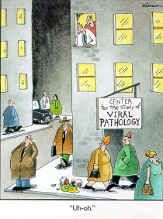
Viruses
Notes:
Viroids – infectious pieces of naked RNA
Proins – infectious proteins

Slide 29
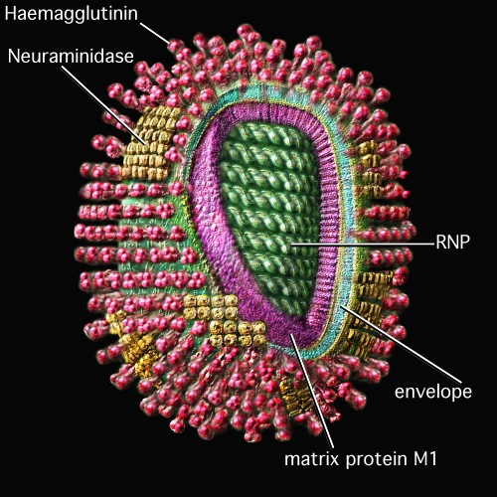
Viruses are:
Acellular
Obligate intracellular
No ATP generating system
No Ribosomes or means of Protein Synthesis

Slide 30
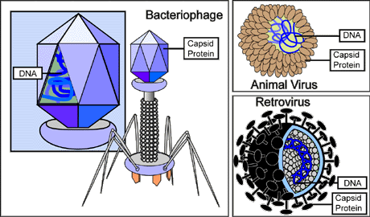

Slide 31
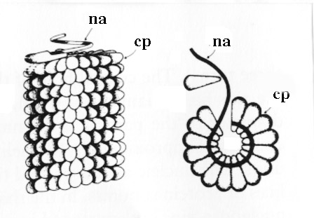
Basic virus structure - nucleic acid (na) wrapped in a protein coat (pc)

Slide 32
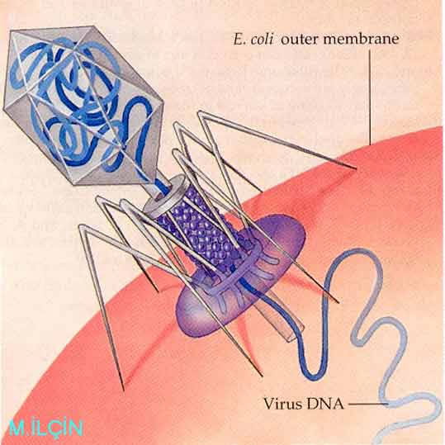

Slide 34
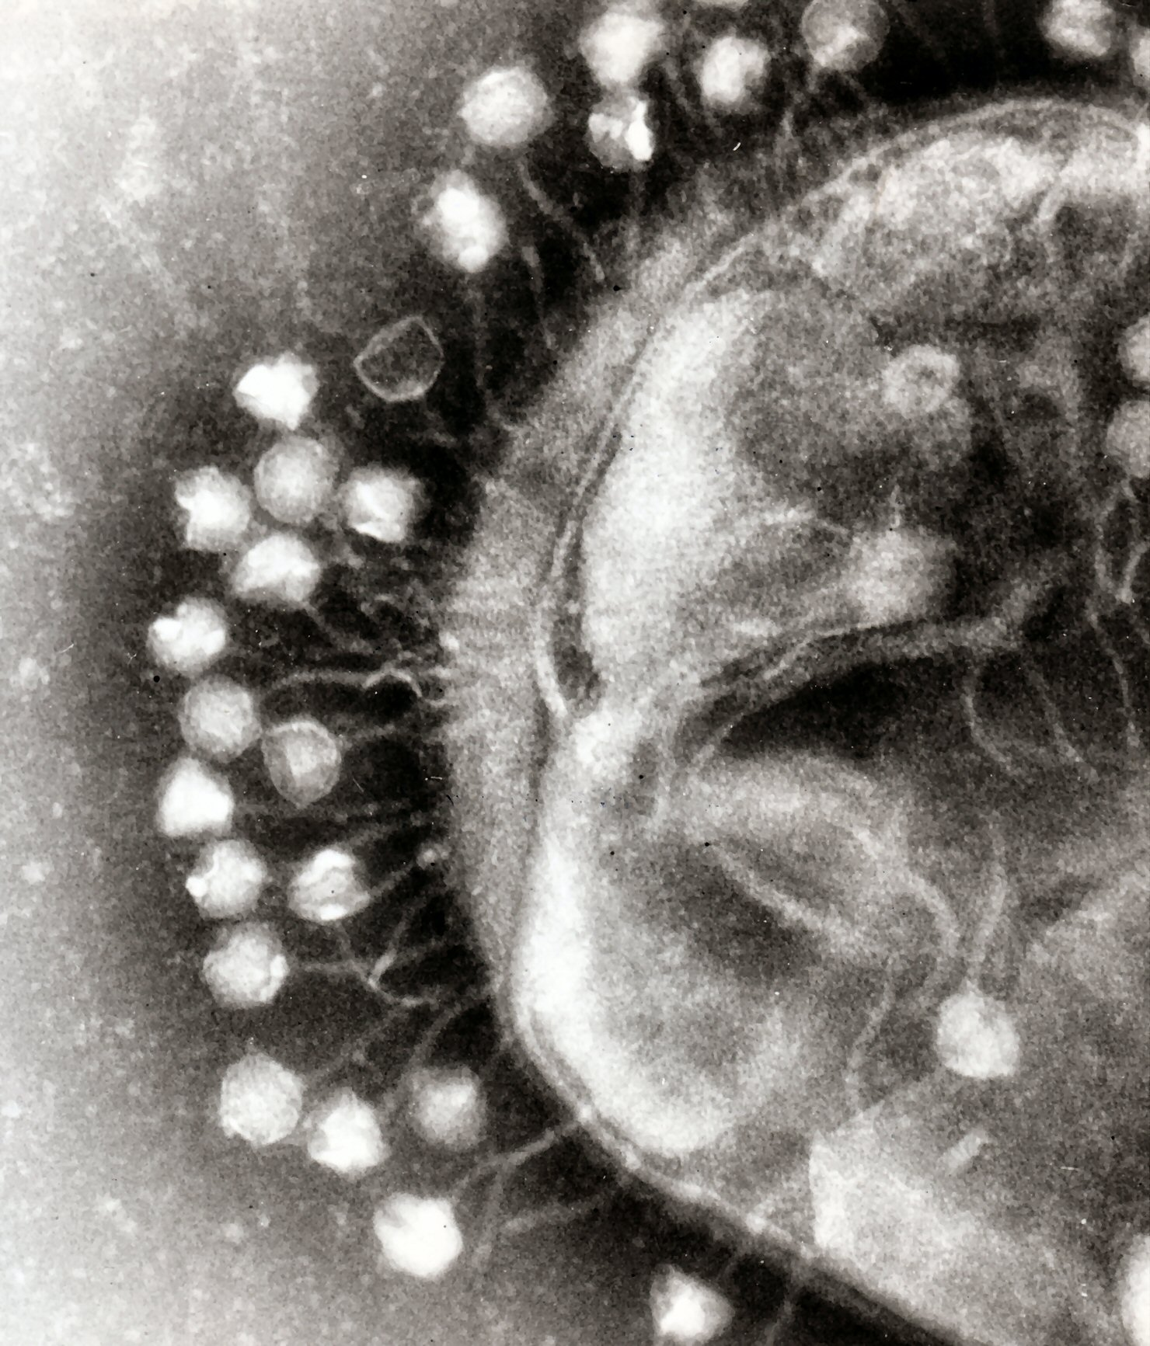
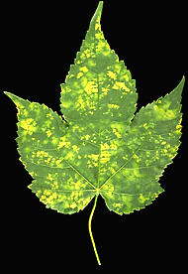
Spectrum of host cells that a virus can infect is very specific:
plants
invertebrates
protists
fungi
bacteria

Slide 35
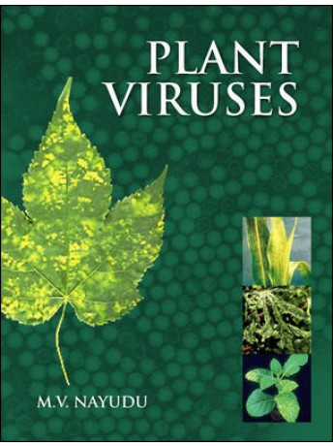
Blueberry
Potato leafroll virus (PLRV)

Slide 36
Polio virus - nerve cells
Adenovirus - cells in upper Respiratory Tract

Slide 38
Binding Sites match Receptor Sites
Binding Sites - on viral capsid or envelope
Receptor Sites - on host cell membrane

Slide 39
Prions
Proteinaceous infectious particle
1982
Diseases
Scrapie (sheep)
Creutzfeldt-Jacob disease (CJD)
Kuru (Tribes in New Guinea)
Bovine Spongiform Encephalopathy (BSE)
Mad Cow Disease
Notes:
CJD – Neurological disorder
Kuru – Transmitted by contact with brain and tissue of dead victims

Slide 40
Viral Replication
Bacteriophage
1. Lytic Cycle
2. Lysogenic Cycle

Slide 41
Lytic Cycle
Biosynthesis
Genome replication
Transcription
Translation
Virus uses Host Cells enzymes and machinery

Slide 44
LYSOGENIC CYCLE
Inserts DNA
Lays Dormant
Lytic!

Slide 47
HIV Structure
Retro Virus
Nucleic acid - RNA (2 strands)
envelope (gp 120 binding sites)
Reverse Transcriptase

Slide 48
HIV Infection (Cellular Level)
1. Attachment
HIV gp 120 binding sites must match CD4 receptor sites
CD4 Receptor Sites
1. Macrophages
2. Some cells of CNS
3. T4 Helper Cells (CD4 Cells)

Slide 49
Colony morphology

Slide 50
Viral Morphology
1. Helical

Slide 51
Viral Morphology
2. Polyhedral
icosahedral

Slide 52
Viral Morphology
3. Enveloped

Slide 53
Viral Morphology
4. Complex

Slide 54
Viral Classification
1. Nucleic Acid
2. Morphology
3. Strategy for replication

Slide 55
Viroids
Viroids
Naked RNA (no capsid)
300 – 400 nucleotides long
Plant pathogens

Slide 56
Bacteria can do both!
Where do they occur in bacteria?

Slide 57
Treatment of Viral Infections
No treatment
Only prevention with immunization (inject the disease into your system

Slide 60
Bacterial cell wall - chemically unlike any other structure in Animal cells
How to Fight a Bacteria?
MANY ANTIBIOTICS are specifically directed at Cell Wall
Ex. Penicillin

Slide 61
What can you do about Infectious Diseases?
Treatment: Antibiotics for bacterial infections
What about Viruses?
Antibiotics don’t work on viruses.

Slide 62
First Line of Defense

Slide 63
Second Line of Defense
Digestive enzyme that damages bacterial cell walls
found in tears, saliva & mucus

Slide 64
Specific vs. Non-Specific Defense

Slide 65
WHITE BLOOD CELLS (specific)
ANTIBODIES
PHAGOCYTES
Immunity
Disposal

Slide 66
Antibody/Antigens

Slide 68
Antimicrobial Agents
Disinfectants and Antiseptics
many are aimed at disrupting the cell membrane

