Slide 1
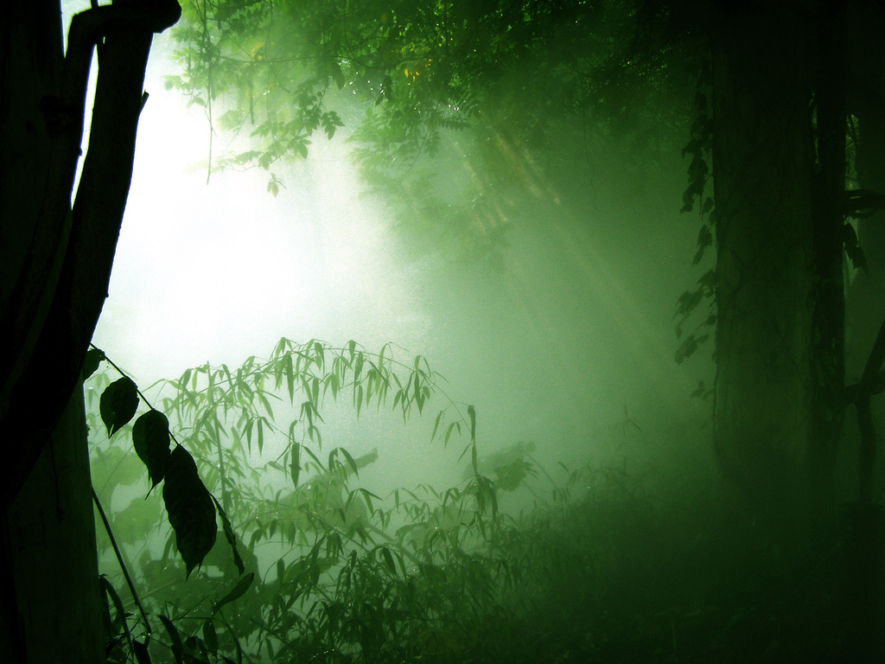
PLANT EVOLUTION

Slide 2
What is a Plant?
Eukaryotic
Multicellular
Autotrophic
Organized tissues and organs

Slide 3
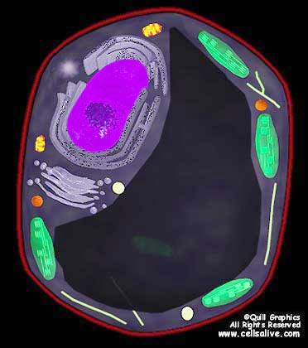
Note: cell wall (cellulose), chloroplasts

Slide 4
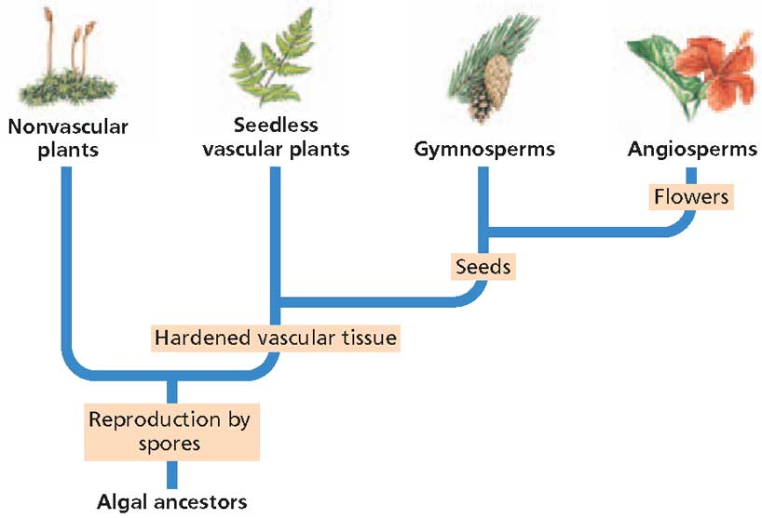

Slide 5
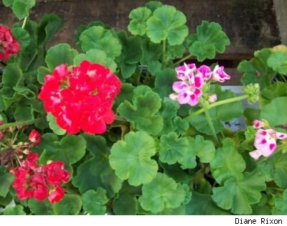
http://www.5min.com/Video/Plants-Adaptations-1354343
Notes:
VEGETATIVE PROPAGATION LAB

Slide 6
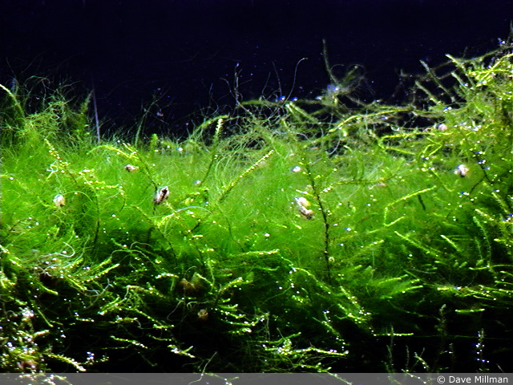
Where did land plants come from?
Algae
Seaweed
What kingdom do they belong to?
PROTIST

Slide 7
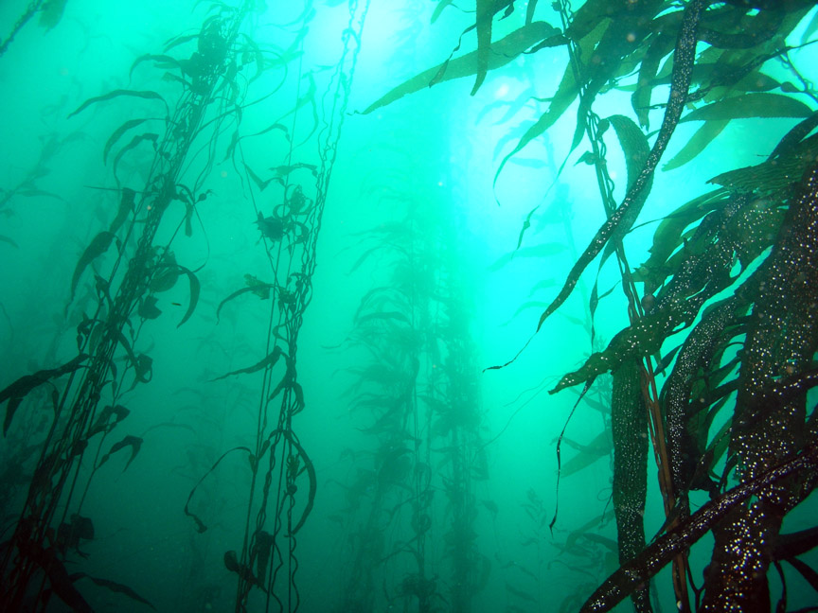
What obstacles might exist on land that do not exist in water?
Gravity
Nutrients always available in water
Reproduction is easy

Slide 8
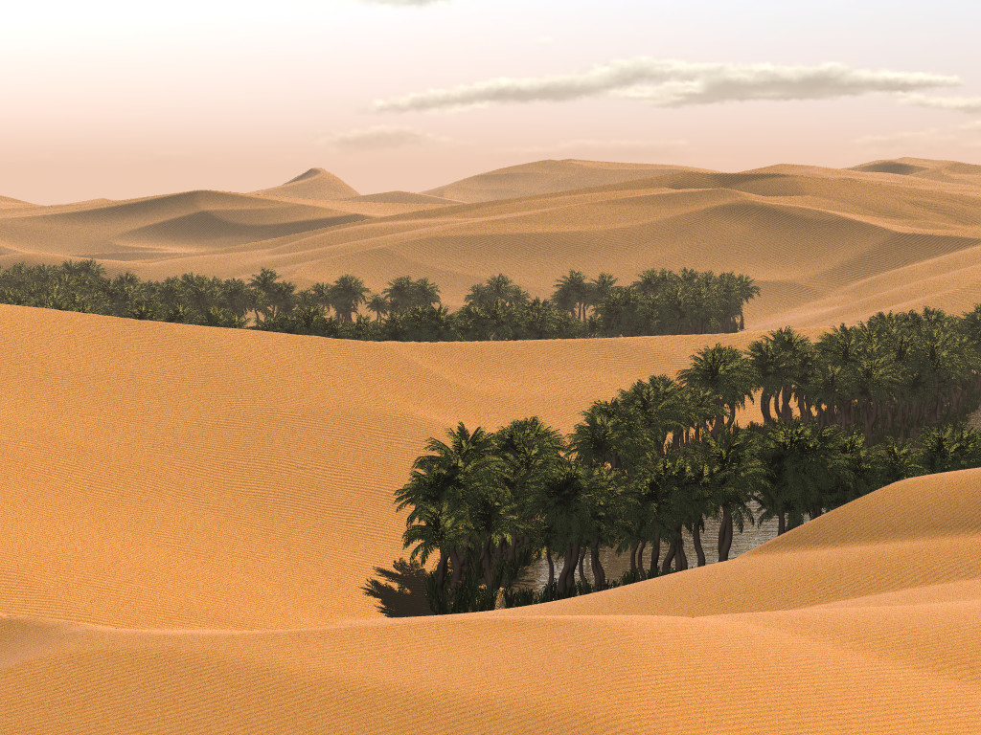
Desiccation

Slide 9
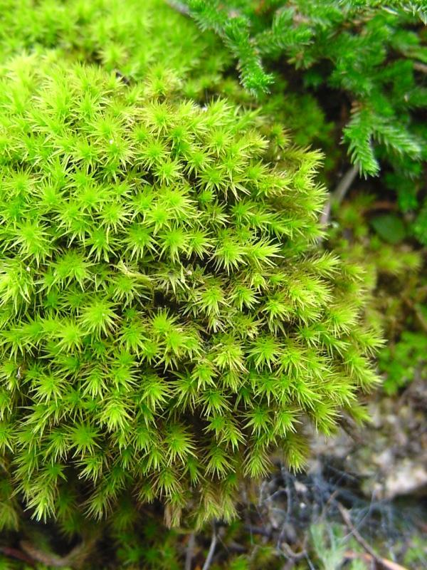
Who are the simplest land plants?

Slide 10
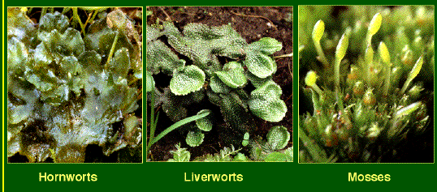

Slide 11
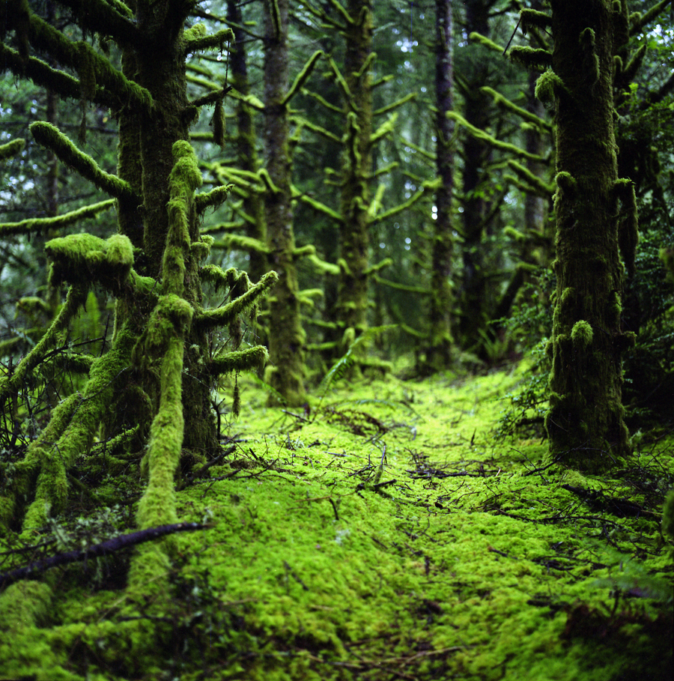
Where do bryophytes live?
Why?

Slide 12
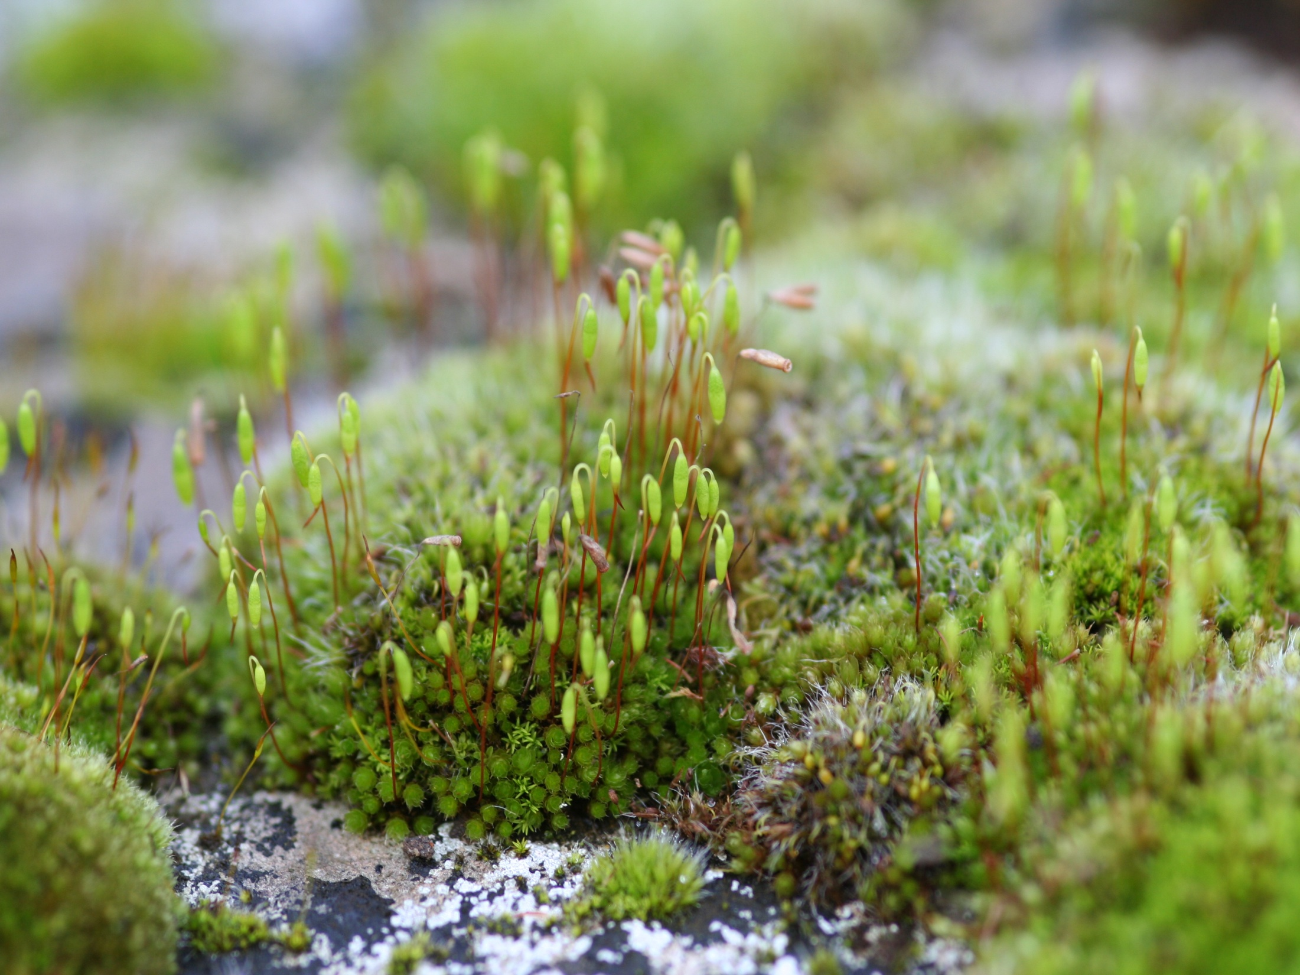
No Vascular Tissue
Not believed to be a direct descendent from algae
Notes:
CELERY/CARNATION VEIN DEMO

Slide 13
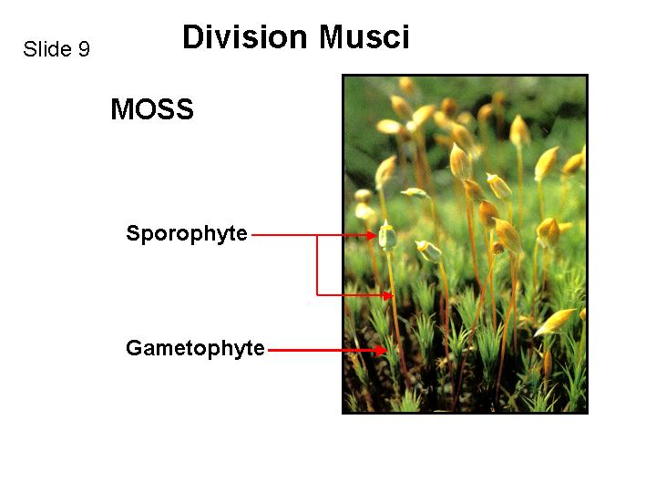
2n=diploid
n=haploid
Dominant Generation

Slide 14
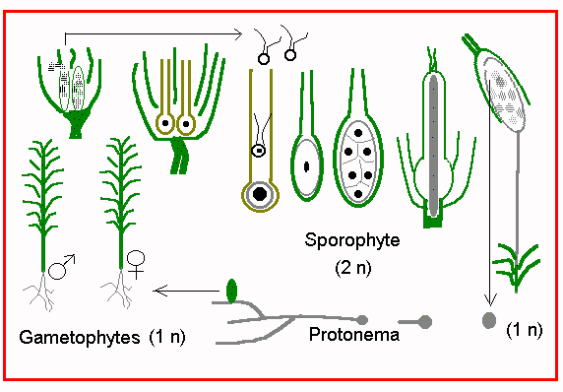
Spores develop into either male or female gametophytes by mitosis
Male sperm
Female eggs

Slide 15
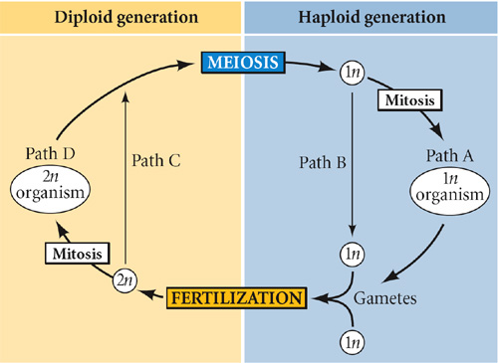
Sporophyte
Gameteophyte

Slide 16
Depend on the gametophyte for photosynthesis
Do photosynthesis for sporophytes
EVOLUTION: Sporophytes dependent on Gametophytes

Slide 17
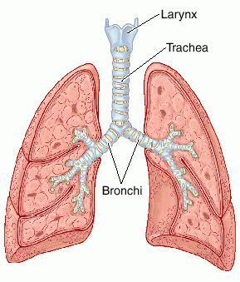
Tracheophytes
What is your trachea?

Slide 18
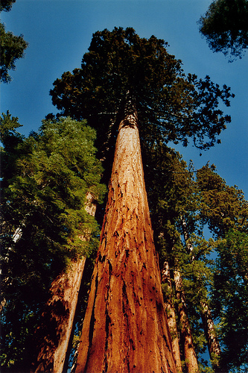
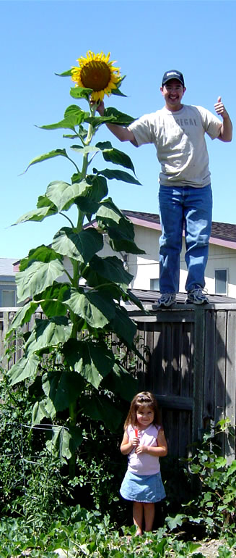
Tracheophytes

Slide 19
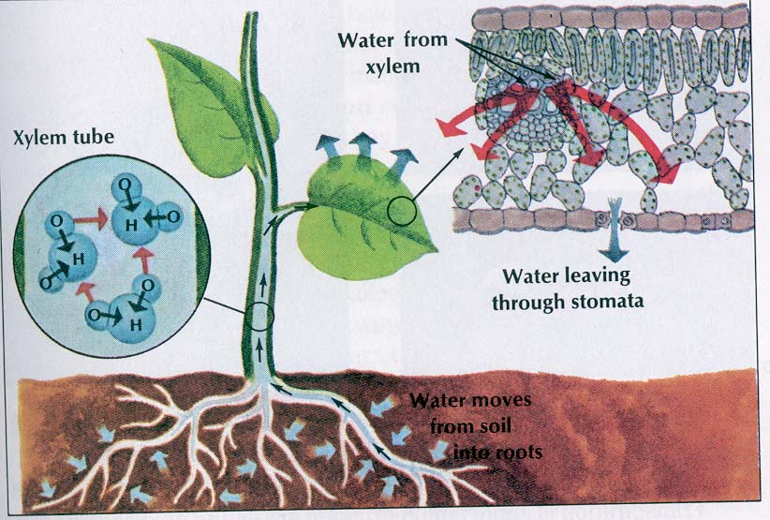
VASCULAR TISSUE: Xylem & phloem
ROOTS
STEMS
LEAVES

Slide 20
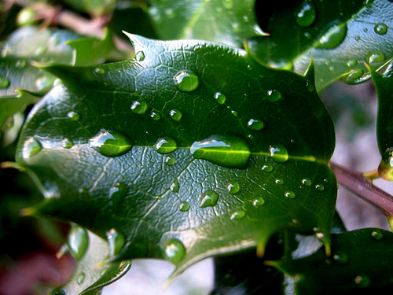
DESSICATION
Cuticle
Notes:
STOMATE NAILPOLISH LAB

Slide 21
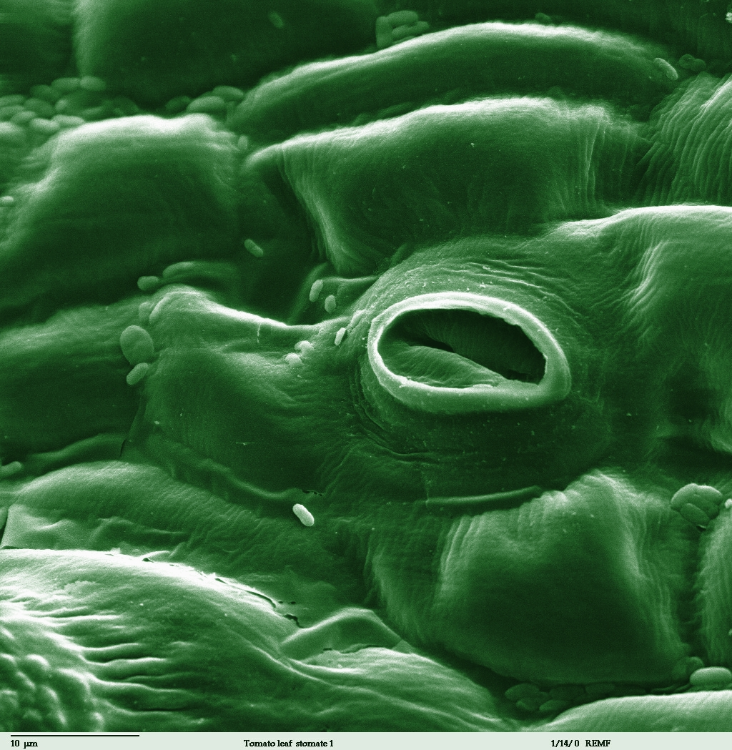
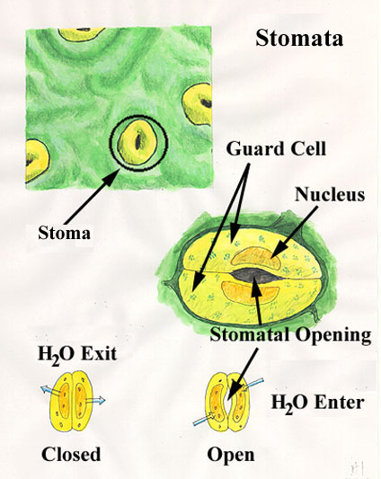
Stomate

Slide 22
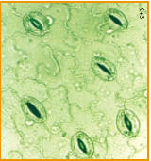
http://www.youtube.com/watch?v=QX4Gi9wkKsA

Slide 23
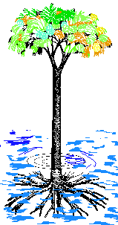
Who were the first land plants?

Slide 24
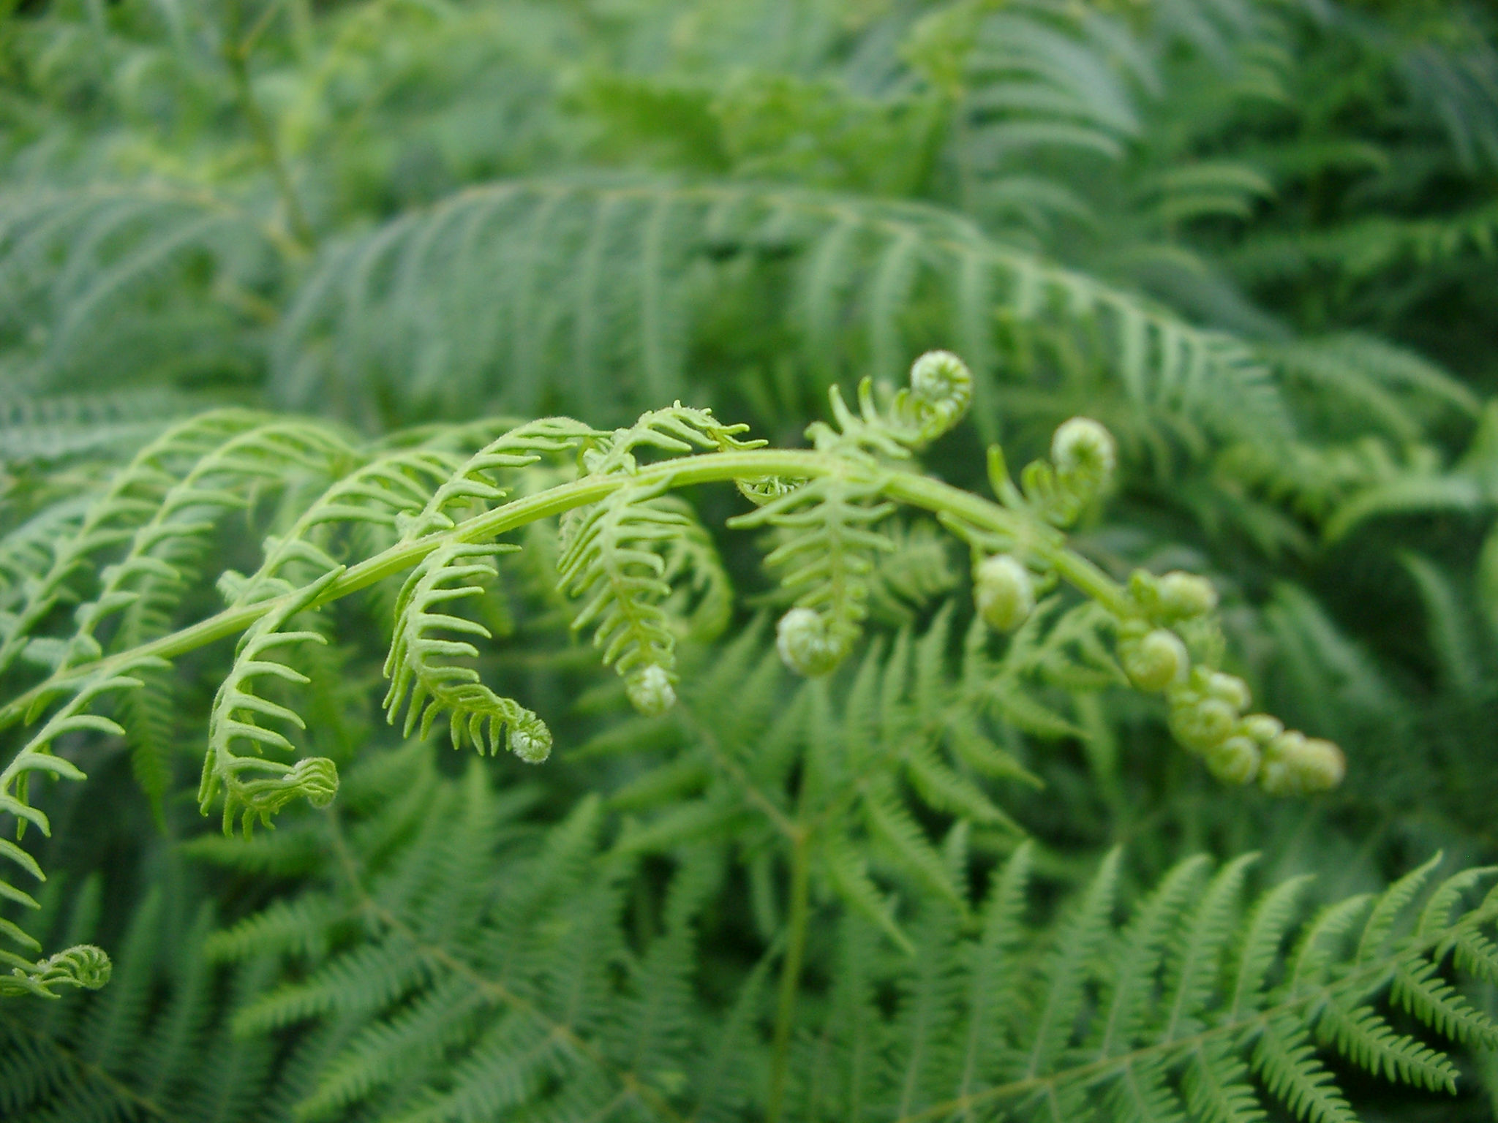
FERNS: Polypodiophyta
Oldest group of plants: 300 mya
Vascular
Seedless, reproduces using spores in the water

Slide 25
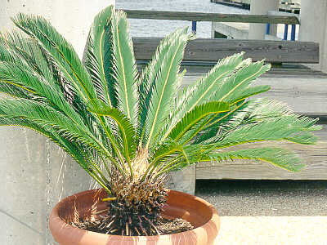
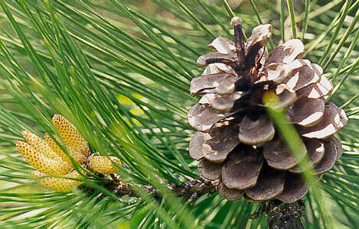
GYMNOSPERMS: Cones
Non-flowering plants
Seeds: not develop within an enclosed structure

Slide 26
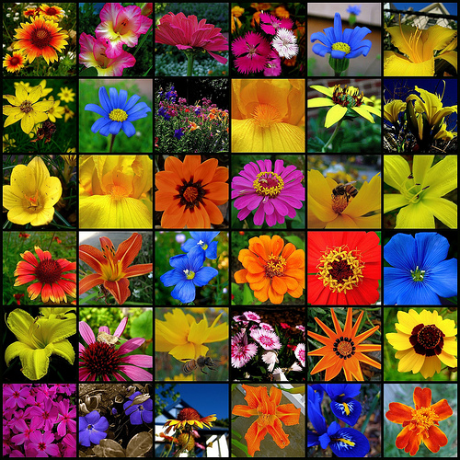
ANGIOSPERM: Flowers
Flowering plants
Seeds: within an enclosed structure
Notes:
FLOWER DISSECTION

Slide 27
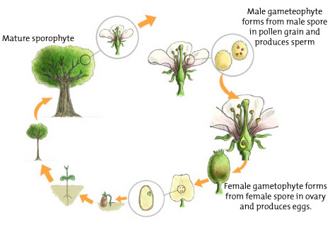
2n=diploid
n=haploid
Dominant Generation?

Slide 28
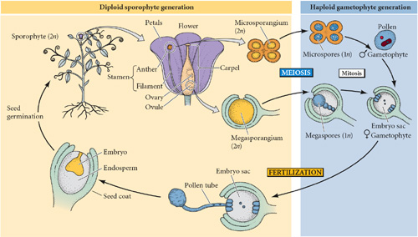
Gametophytes depend upon Sporophytes for food

Slide 29
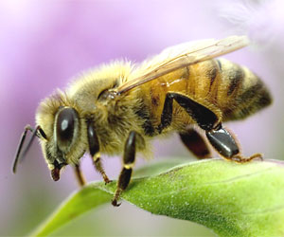
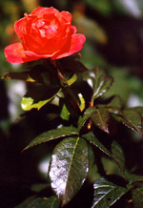
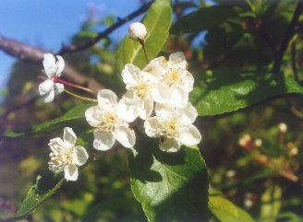
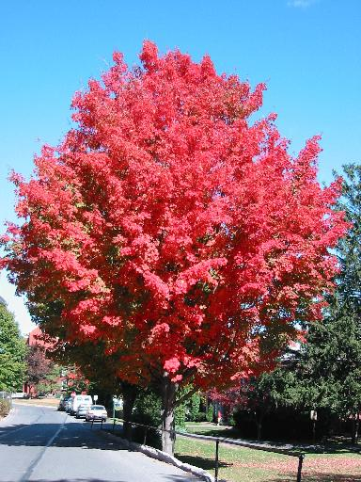
What is the function of a flower?

Slide 30
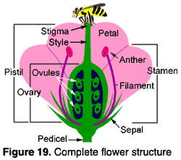
FEMALE
MALE

Slide 31
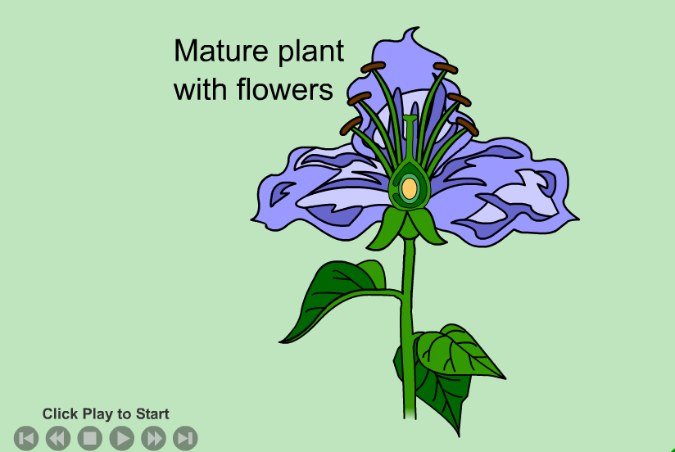

Slide 32
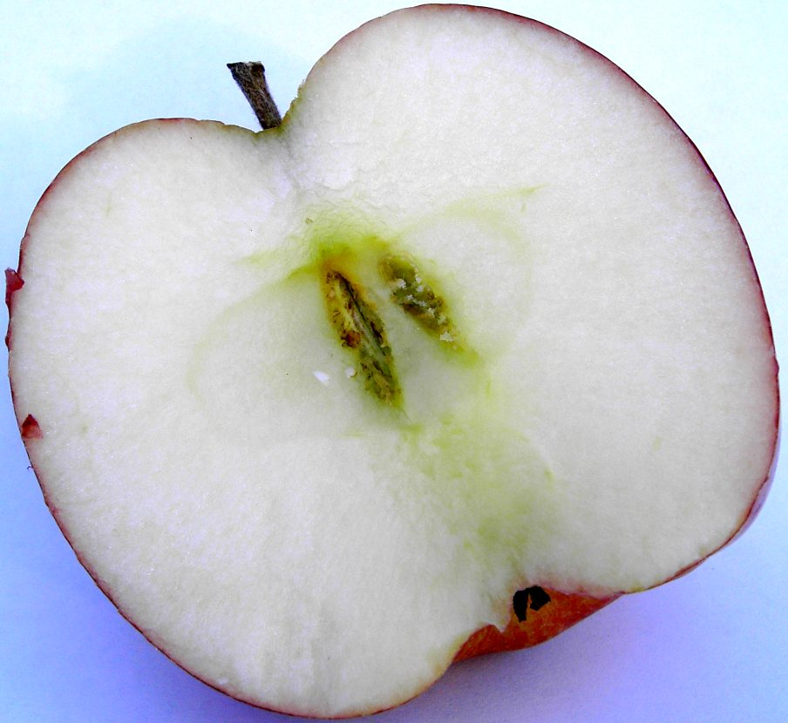
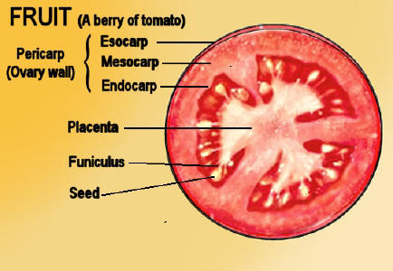
OVARY
SEED = fertilized egg
Notes:
SEED DISPERSAL LAB

Slide 33
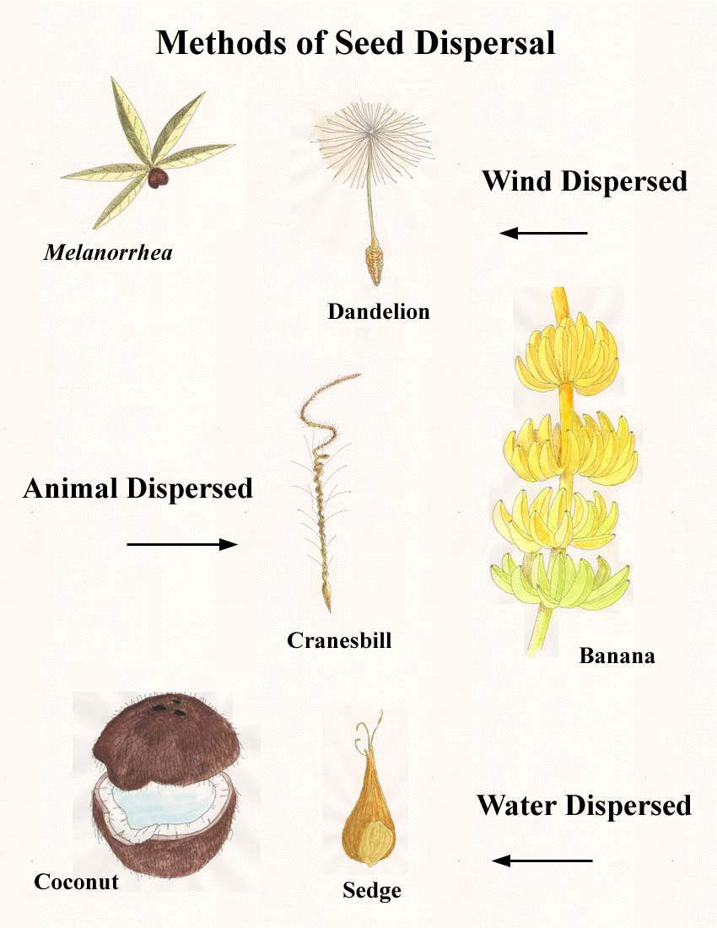

Slide 34
Going hormonal? Plants have hormones too!

Slide 35
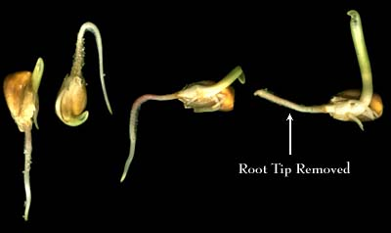
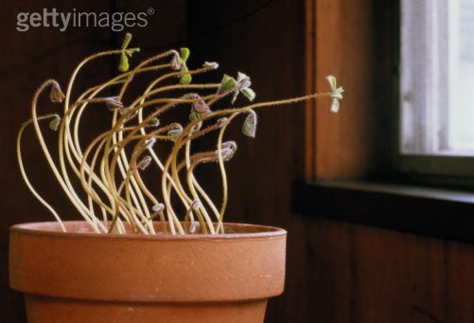

Slide 36
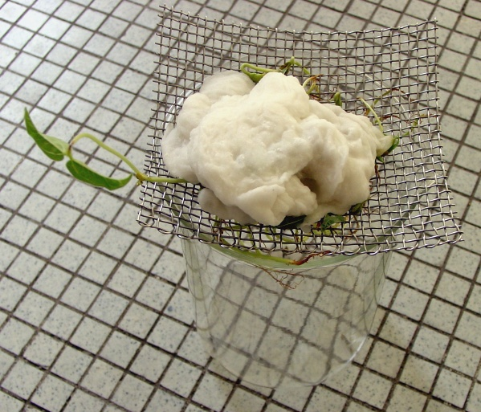
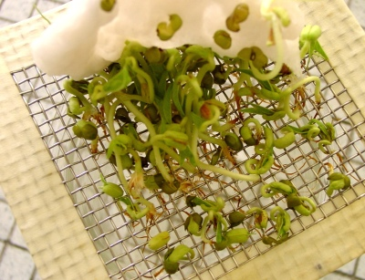

Slide 37
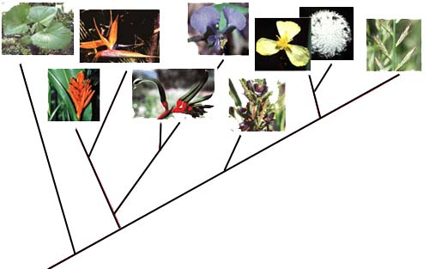

Slide 38
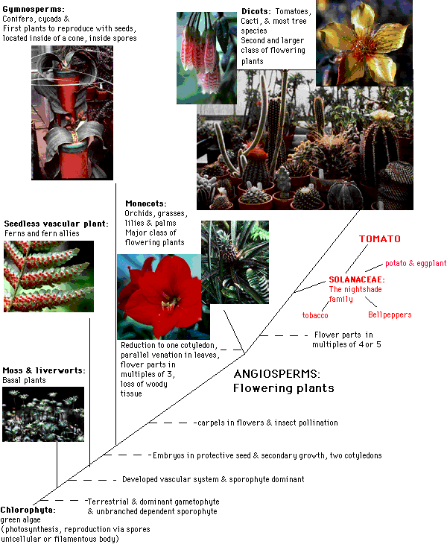

Slide 40
http://www.youtube.com/watch?v=clw_OcDX5lI&NR=1&feature=fvwp

Slide 41
Download utube seed dispersal from u of Wyoming

Slide 42
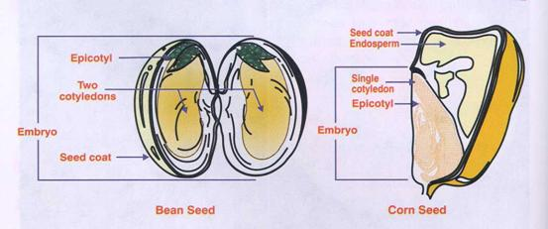
Dicot vs. Monocot

Slide 43
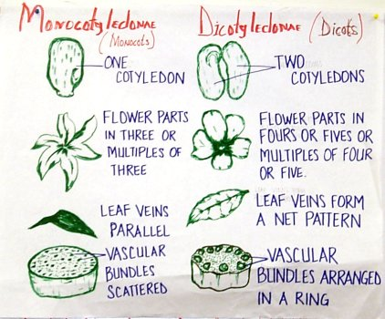
Notes:
SEED GERMINATION/TROPISM LAB

Slide 44
Structure | Dicotyledonous Plants | Monocotyledonous Plants
Leaf ventilation | Veins are usually netlike | Parallel veins
Distribution of vascular tissue | Vascular tissue arranged in a ring | Vascular tissue is scattered
Number of cotyledons | Two cotyledons | One cotyledon
Floral organs | Floral organs found in multiples of four or five | Floral organs usually in multiples of three
Roots | Tap root present with lateral branches | Fibrous root system (no main root)
Pollen | Pollen grains with three openings | Pollen grains with one opening

