Slide 2
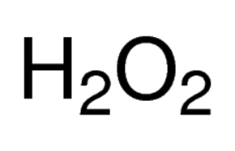
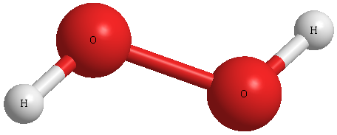
What is this?
Dihydrogen dioxide

Slide 3
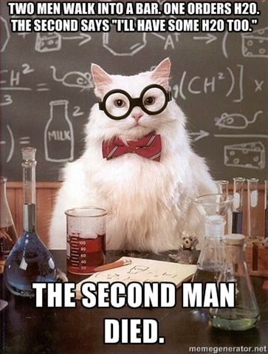

Slide 4
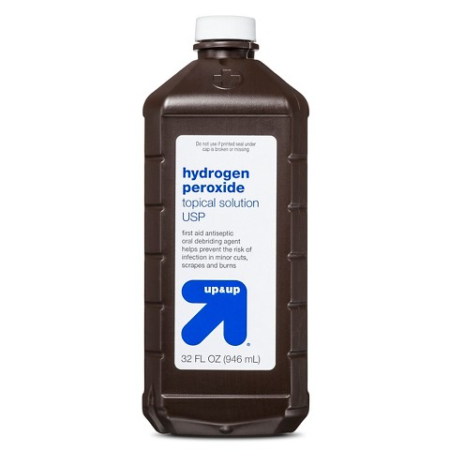
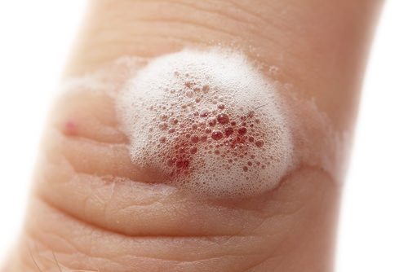
What do we use it for?

Slide 5
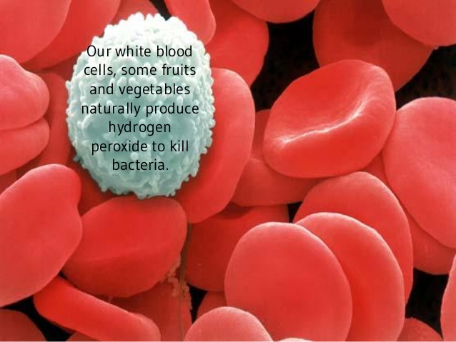

Slide 6
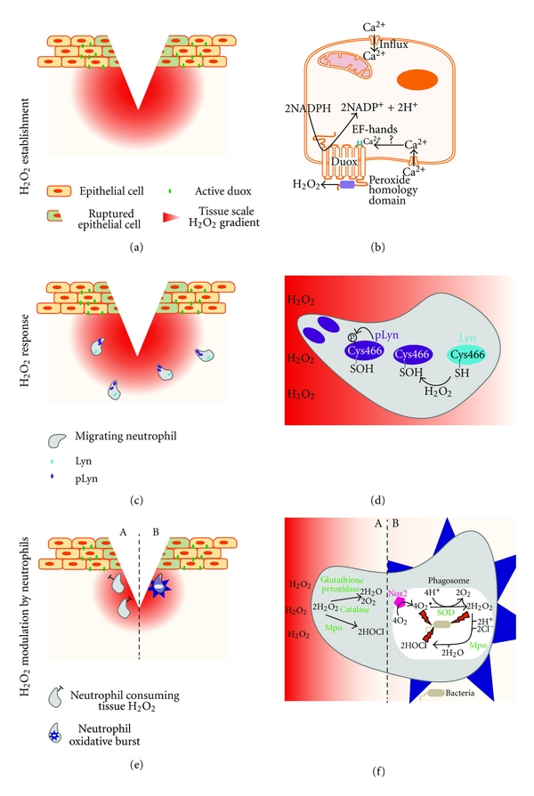

Slide 7
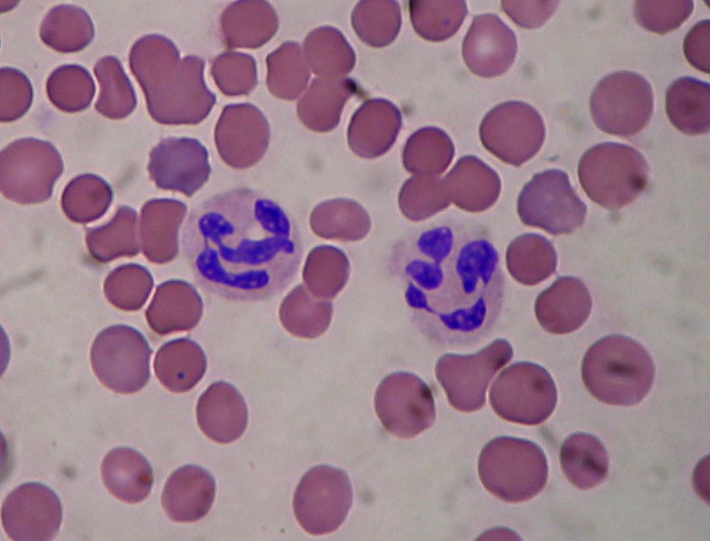
Catalase
Neutrophils use catalase to kill bacteria.

Slide 8
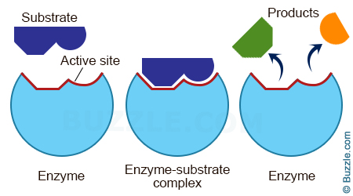
H2O2
+
H2O
O2
CATALASE
CATALASE

Slide 10
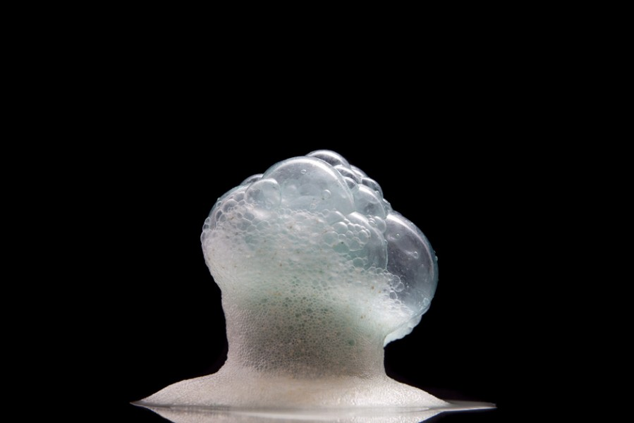
Will this reaction occur on its own?
BUT?

Slide 11
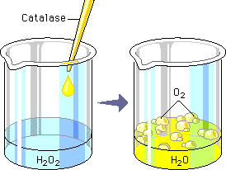
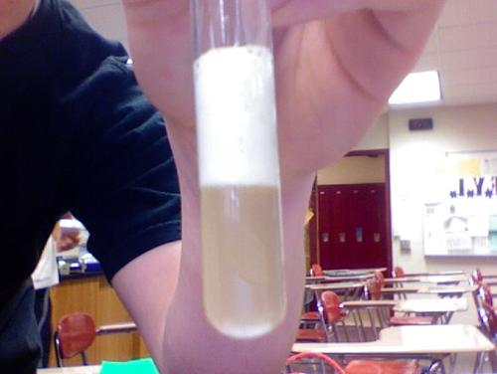
Demonstration Time!

Slide 12
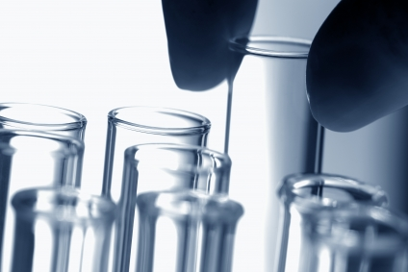
Time to design an experiment!
Q: What factors affect the rate of reaction?
DV: rate of reaction
IV: temperature of enzyme
pH of enzyme
concentration of enzyme concentration of substrate
surface area

Slide 13
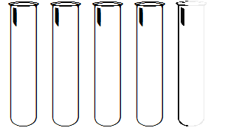
H2O2
H2O2
H2O2
H2O2
H2O2
VARIABLES HELD CONSTANT
Amt. of yeast
Amt. of substrate
Felt soaking time

Slide 14
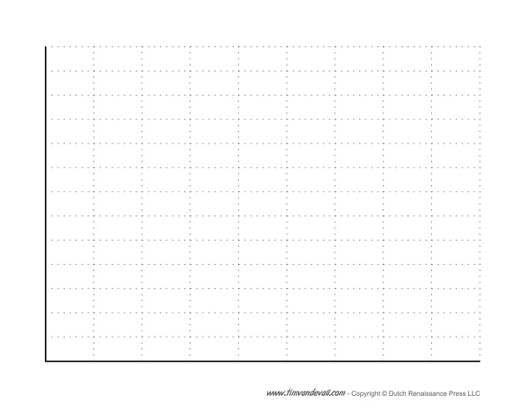
FAST (0-1 sec)
DV: Rate of Reaction
(time)
SLOW(20 sec)
IV: temp, pH, conc, SA

