Slide 1
BIOLOGY

Slide 3
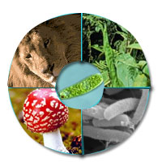
Kingdoms of Life

Slide 4
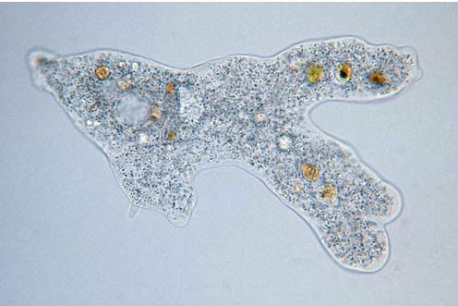
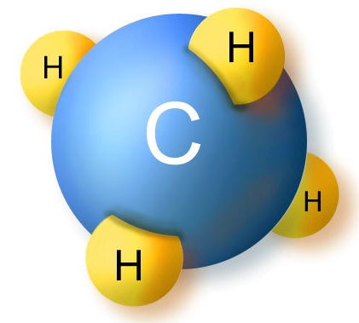
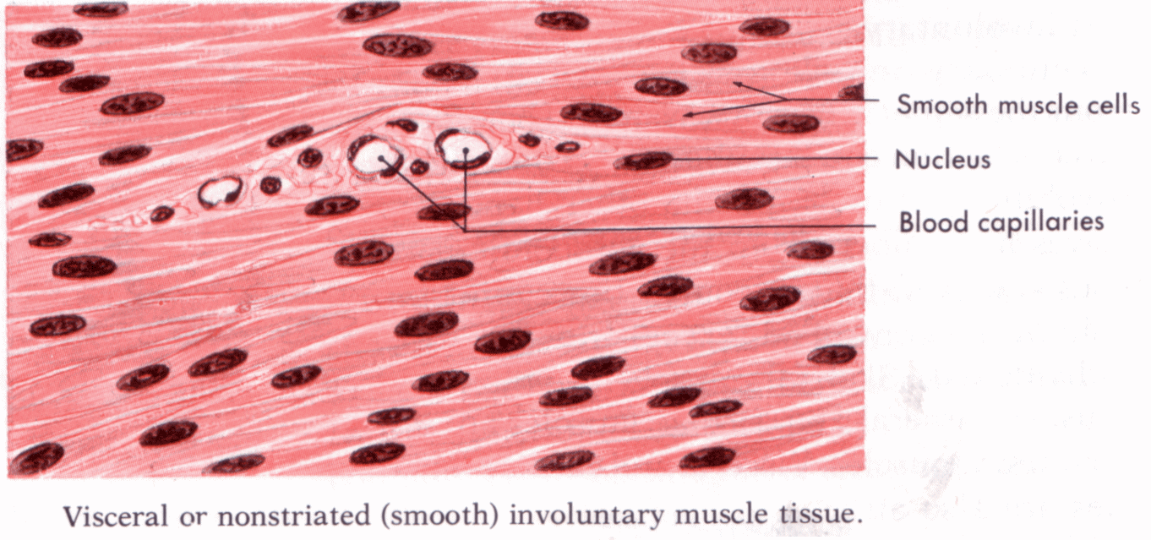
How is life organized?
CELL: smallest unit of life
ATOMS & MOLECULES
TISSUE: many cells working together

Slide 5
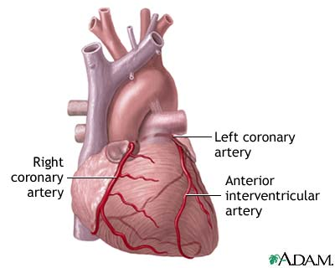
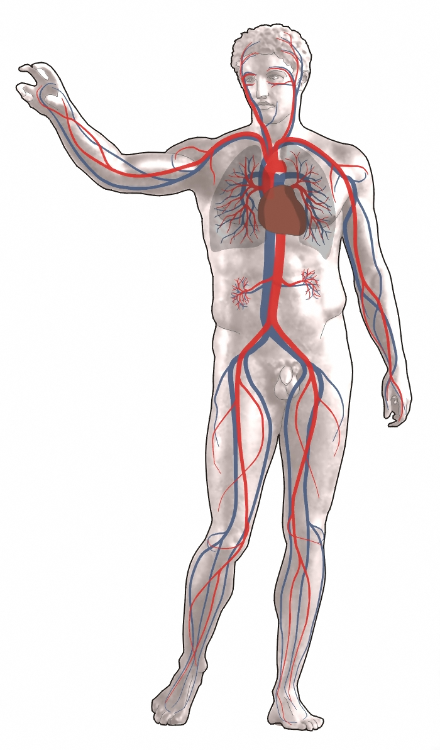
ORGAN SYSTEM
ORGAN
ORGANISM

Slide 6
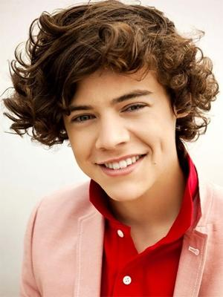
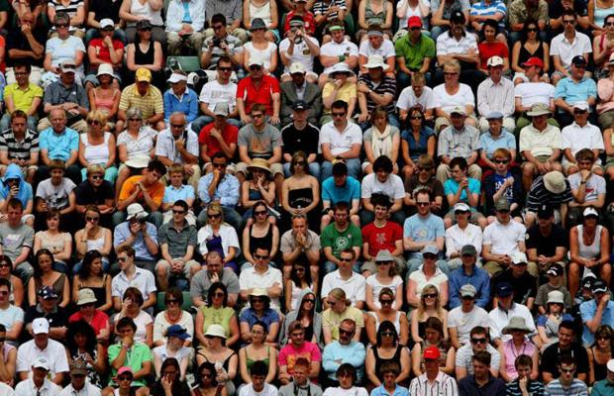
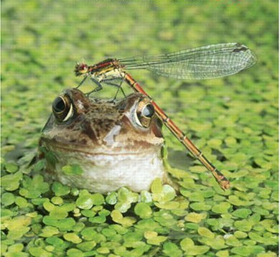
POPULATION: group of organisms in the same area
ORGANISM
COMMUNITY: All BIOTIC factors (living)

Slide 7
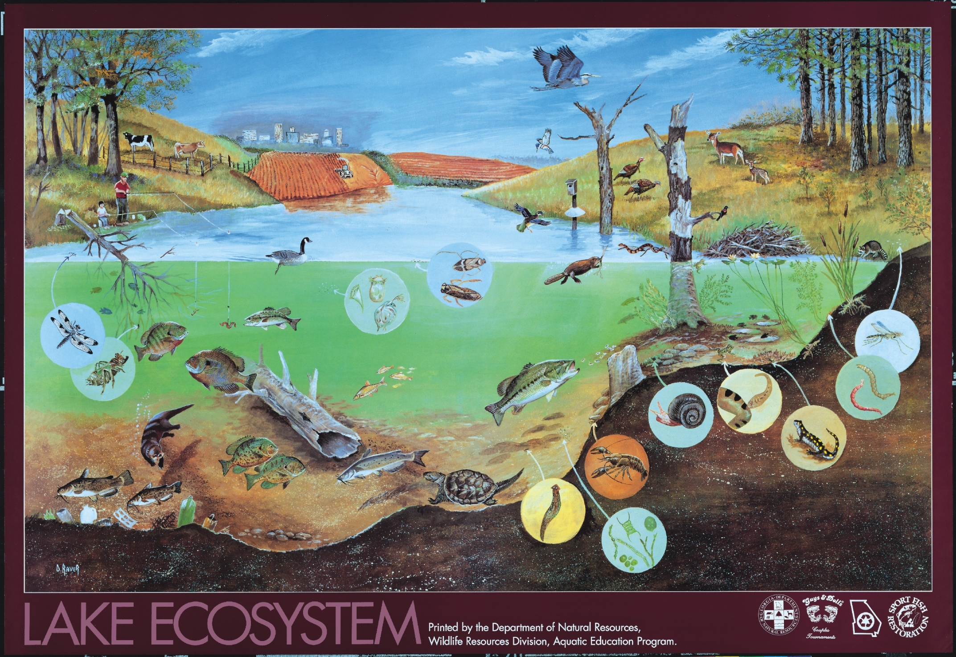
BIOSPHERE
ECOSYSTEM: All biotic and ABIOTIC FACTORS (non-living)

Slide 8
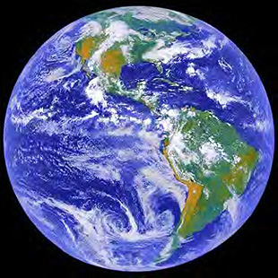

Slide 9
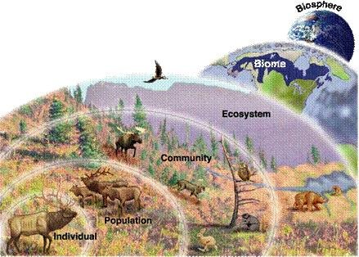
ORGANIZATION OF LIFE

Slide 10
STEPS TO THE SCIENTIFIC METHOD
IV
DV
VARIABLES HELD CONSTANT
CONTROL GROUP

