Slide 1
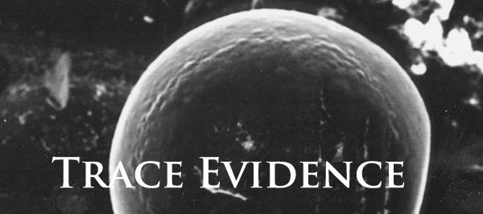
Physical evidence found in small amounts at a crime scene

Slide 2
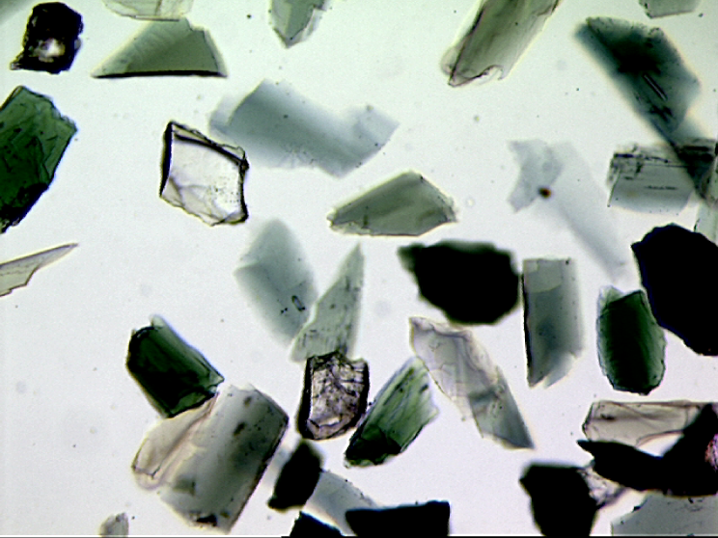
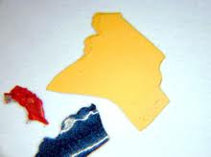
What are examples of trace evidence?
Hair
Fiber
Paint Chips
Body Fluids
Stains
Powders
Explosive residue
Glass Particles
Vegetative matter
Metal particles
Soil

Slide 3
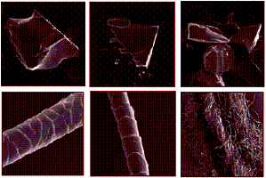
Are Hair and Fibers individualized or class evidence?
CLASS
Useful in backing up other circumstantial evidence by placing someone at the crime
Does not mean that the person committed the crime.
Use Probability of Circumstantial Evidence
http://www.youtube.com/watch?v=cQJpRLthtZc&feature=related
http://www.youtube.com/watch?v=yeAwJwuUQH8

Slide 4
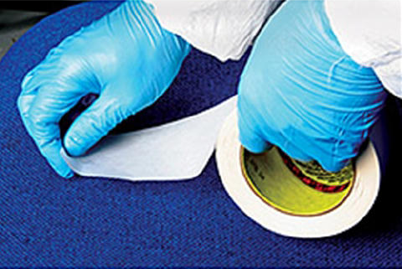
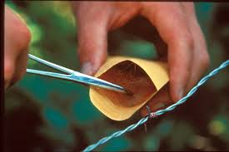
What techniques would you use to collect trace evidence?
Notes:
Use Tweezers first
Use extra light – flashlight or UV
Then tape to lift
Finally a vacuum with clean bag or filter – last resort because too much evidence to sift through
Put into druggist fold envelopes, labeled and separately packaged by areas

Slide 5
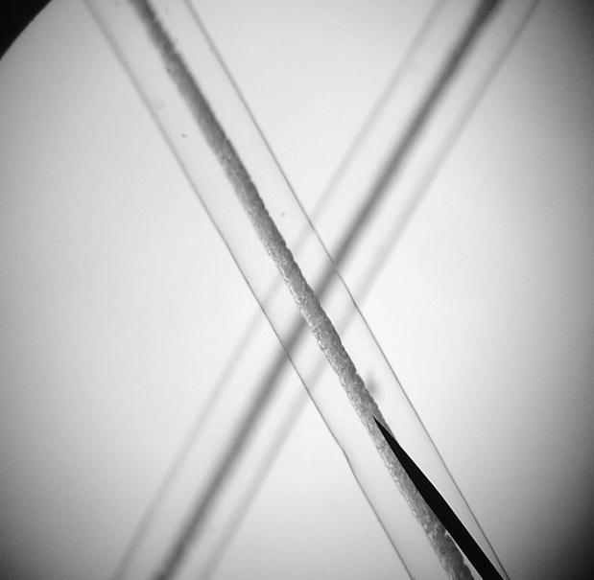
Chapter 5:Hair
“For three days after death, hair and fingernails continue to grow but
phone calls taper off.”
—Johnny Carson
Comedian and television host

Slide 6
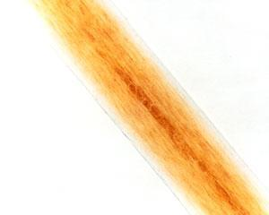
What can be determined with one hair?
If the source is human or animal
Race (sometimes)
Origin of the location on the source’s body
Whether the hair was forcibly removed
If the hair has been treated with chemicals
If drugs have been ingested
*

Slide 7
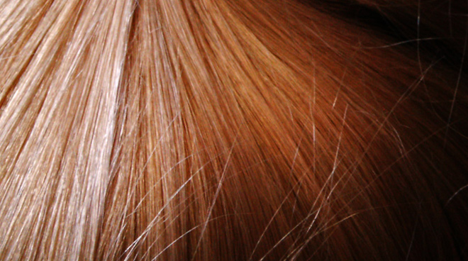
Degrades very slowly
Skin recedes and will eventually come off = hair mask.
Are all of your hairs on your head identical?
All hair on 1 person’s body is not identical – color and texture vary.
*

Slide 8
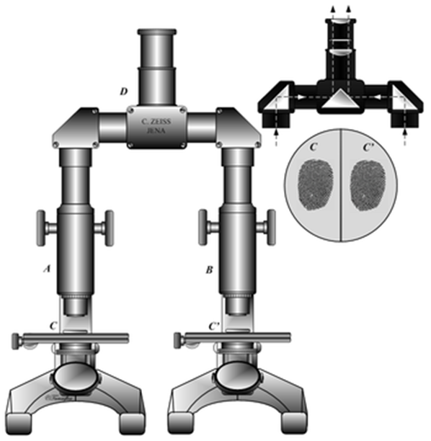
Collection of Hair
Questioned hairs must be accompanied by an adequate number of control samples.
from victim
from possible suspects
from others who may have deposited hair at the scene
Control Sample
50 full-length hairs from all areas of scalp
24 full-length pubic hairs
*
Notes:
fig4: Hair shaft samples under high powered light microscopy. (a) African-American control hair sample, demonstrating evenly distributed pigment in the hairshaft. (b) Hair sample of a previously published severely affected Chediak-Higashi syndrome patient [19], demonstrating an atypical granular distribution of “pigmented clumps” in the hair shaft. (c) Hair sample of our African-American patient with Chediak-Higashi syndrome, demonstrating a similar atypical granular pigmentation pattern as the CHS patient in (b). All images were taken at the same settings using a 40X/1.3 oil objective on an Axiovert200M light microscope.

Slide 9
http://www.youtube.com/watch?v=aWK6qJFvWoM

Slide 10
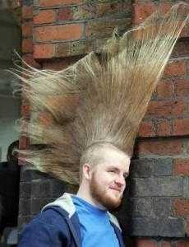
Humans:
Have approx. 5 million hairs. Most are down-like and cover body.
Head hair:
Blondes: approx. 120,000 hairs
Black/brown: approx. 100,000 hairs
Red: approx. 80,000 hairs
Shed approx. 100 hairs/day. Coarse hair grows more slowly and falls out less frequently.
*

Slide 11
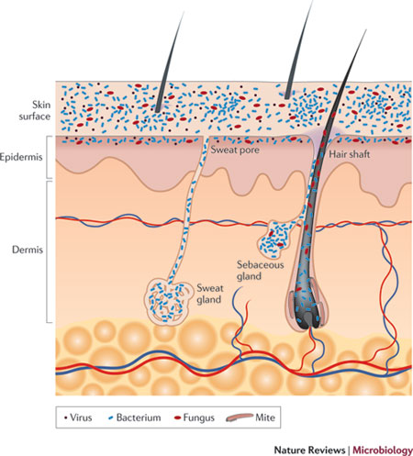
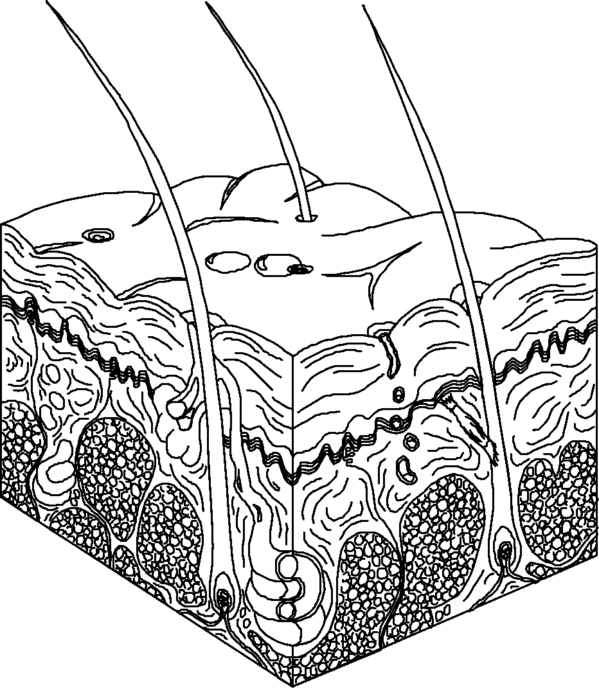
Hair Morphology
Shaft--part of the hair that sticks out of the skin
Root--lies below the epidermis
Follicle--structure from which the hair grows
*

Slide 12
HUMAN HAIR
https://www.youtube.com/watch?v=xqZ16iNPaac

Slide 13
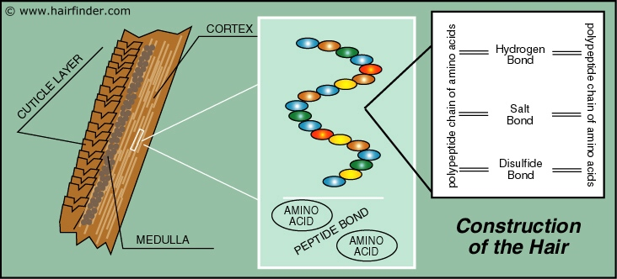
Morphology of Hair
Made of polymers – cross-linked proteins
Very resistant to break down
Grows from a tube-like organ under the skin (Dermis) called a hair follicle.
The follicle is linked to the body’s blood supply (important in analyzing hair for drugs and poisons)

Slide 14
Morphology of Hair

Slide 15
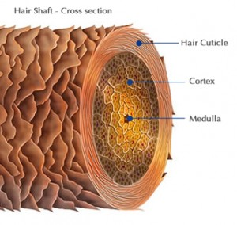
Hair Shaft
Cuticle—outside covering, made of overlapping scales
Cortex—inner layer made of keratin and imbedded with pigment; also contains air sacs called cortical fusi
Medulla—inside layer running down the center of the cortex
*

Slide 16
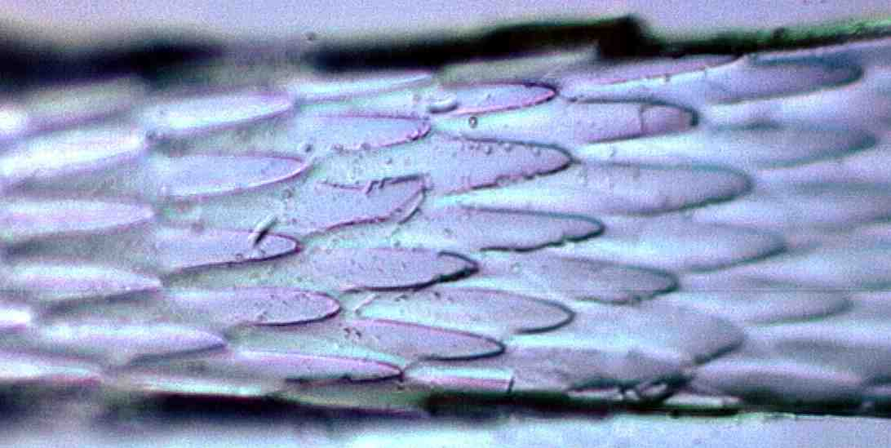
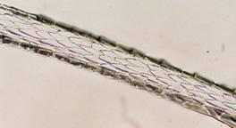
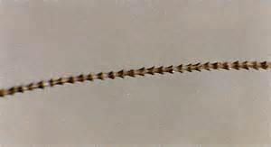
The CuticleScales
The scales point toward the tip of the hair.
Scales differ between species of animals.
The three basic patterns are:
Coronal
Spinous
Imbricate
mouse
cat
human
*

Slide 17
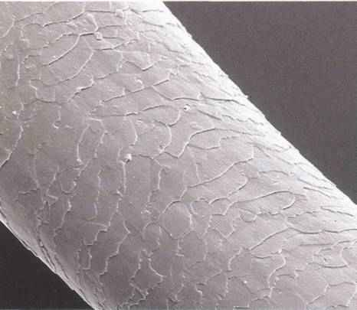
Human Scales
In order to visualize the
scales:
paint clear fingernail polish on a glass slide
when the polish begins to dry, place a hair on the polish
when almost dry, lift off the hair and observe the scale imprints
What pattern is seen in
this slide?
*

Slide 18
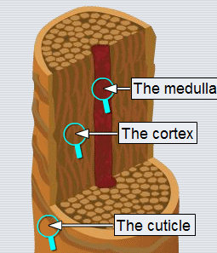
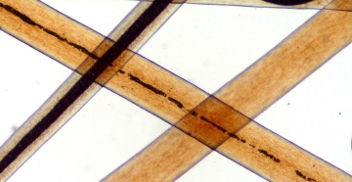
The Cortex
The color, shape and distribution of the granules provide points for forensic comparison
B
A
C

Slide 19
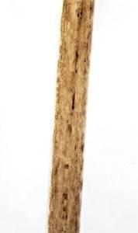
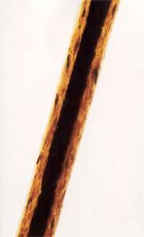
The Cortex
The cortex gives the hair its shape.
It has two major characteristics:
Melanin—pigment granules that give hair its color
Cortical fusi—air spaces, usually found near the root but may be found throughout the hair shaft
Images: Cow hair vs. human hair
*

Slide 20
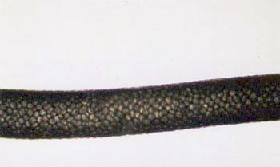
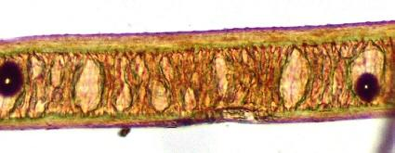
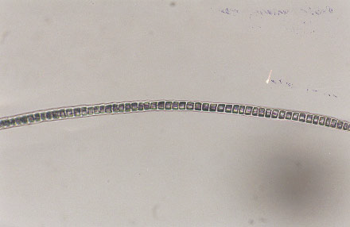
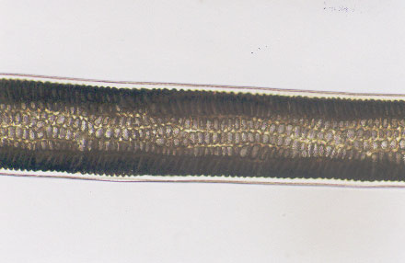
Vacuolated
Mountain Lion
Lattice
Human
Serial
Cat
Multiserial
Human

Slide 21
The Medulla
Canal like structure of cells that runs through the center of the cortex

Slide 22
The Medulla
Hair core that is not always visible.
Human hairs generally do not have a medulla (except for Native Americans and Asians –continuous)
Types:
Intermittent or interrupted
Fragmented
Continuous
Stacked
Absent—not present
*

Slide 23
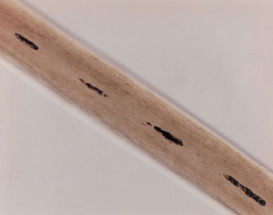
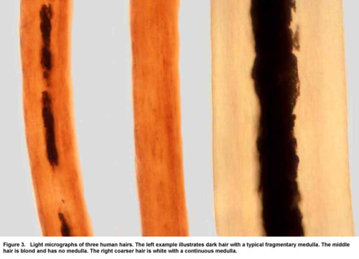
Identify each type.
Fragmented
Continuous
Intermittent
Absent
Continuous

Slide 24
Medulla Patterns
Rabbit
Rabbit
Dog, fox
deer
Human

Slide 25
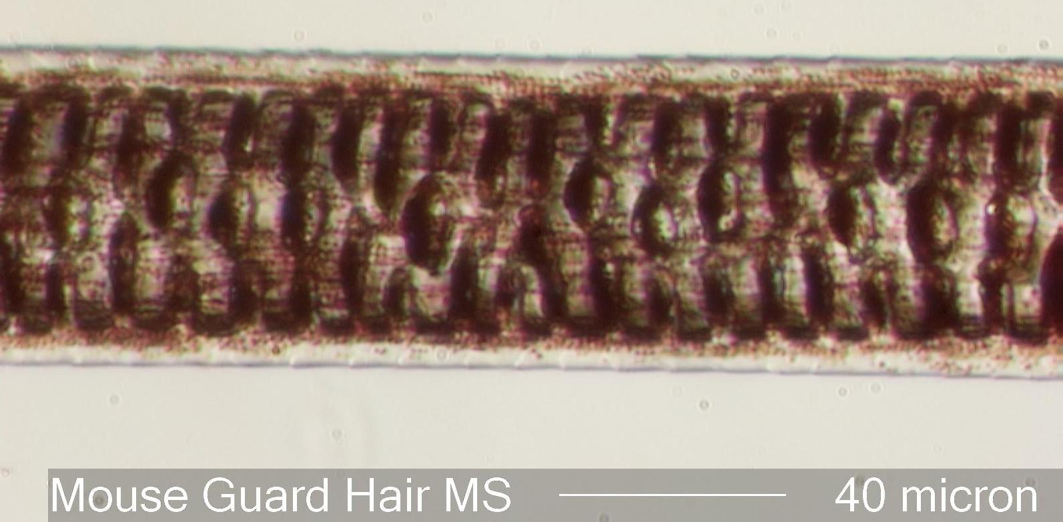
Medulla in different species

Slide 26
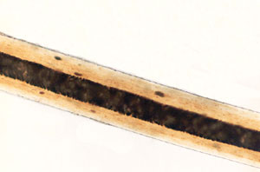
Medullary Index
Medullary Index for human hair is generally less than 1/3.
For animal hair, it is usually greater than 1/2.
Determined by measuring the diameter of the medulla and dividing it by the diameter of the hair.
D of hair
D of medulla

Slide 27
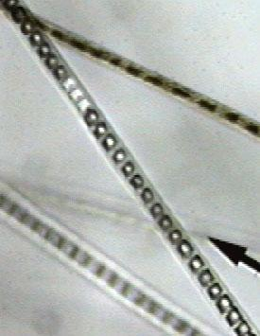
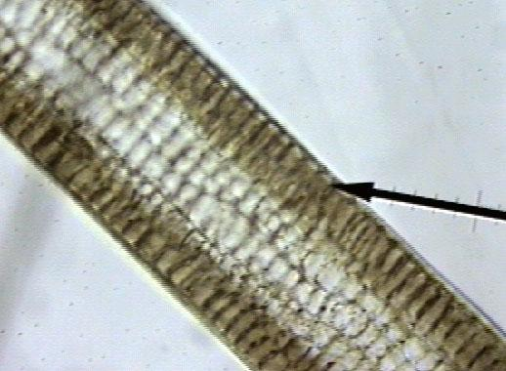
RABBIT MEDULLA
Rabbit medulla is different depending on the type (location on the rabbit) of hair.
The one to the left is multiserial.
The one to the right is a uniserial ladder and is found in guard hair.

Slide 28
http://www.microlabgallery.com/Hair.aspx - hair pictures
http://www.youtube.com/watch?v=3PBSQ3CqxUI - Casey Anthony Hair analysis

Slide 29
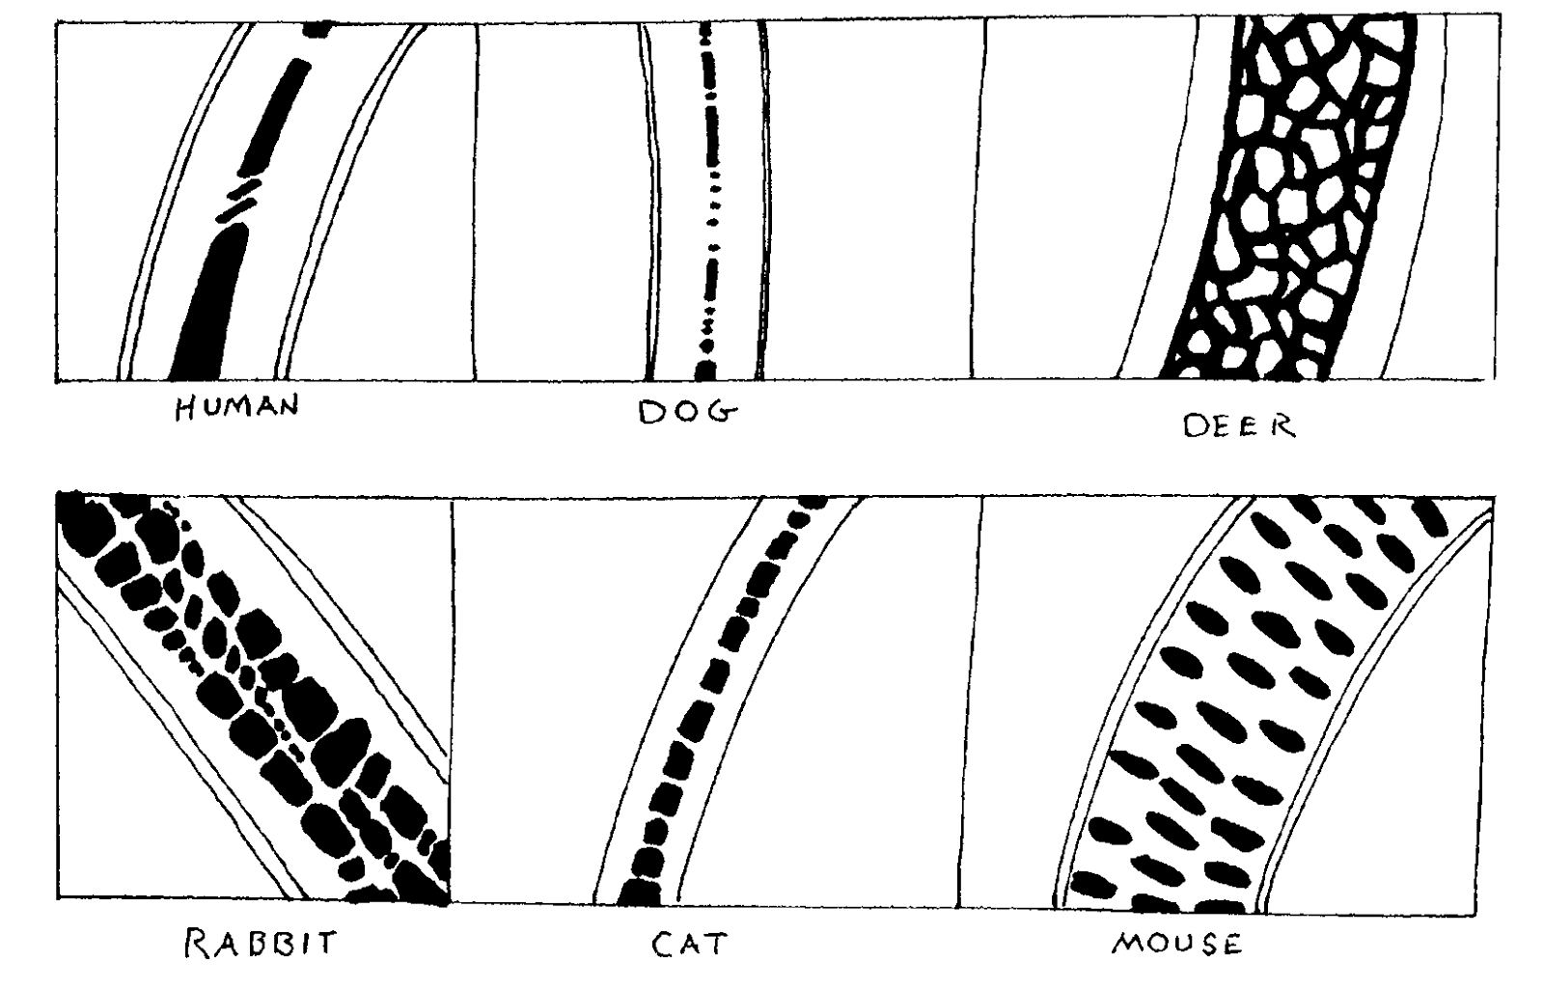
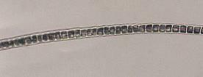
Medulla of different species
*

Slide 30
Hair Growth
Grows about 0.5 mm per day or 1.3 cm centimeter per month; approximately one half inch per month
Hair and nails do not continue to grow after death – looks like it because skin shrinks.

Slide 31
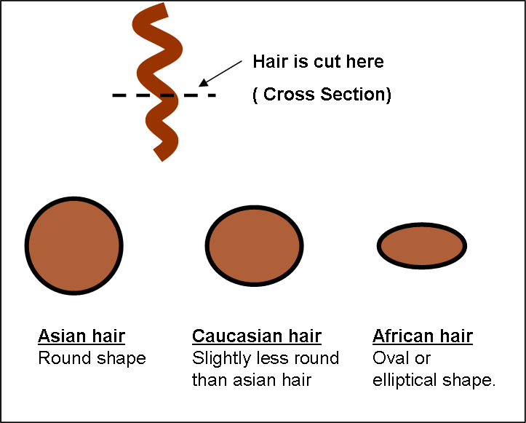
Can you tell race from hair sample?
Sometimes

Slide 32
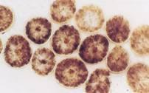
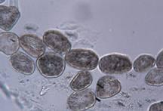
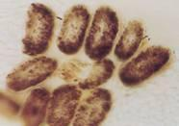
Hair Shape
Can be straight, curly or kinky depending on the cross-section, which may be round, oval or crescent-shaped.
Round
(Straight)
Oval
(Curly)
Crescent moon
(Kinky)
Often found in Asian and Native American hair.
Often found in whites, Mexicans and Middle Eastern hair.
Often found in African hair.
*

Slide 33
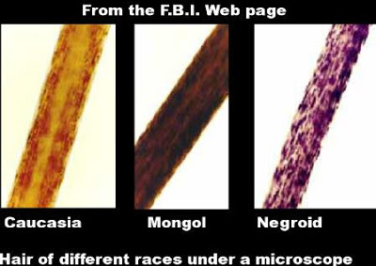
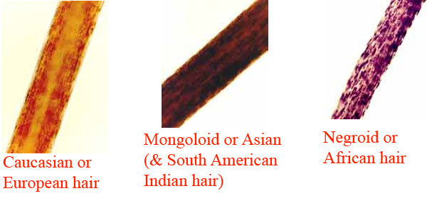

Slide 34
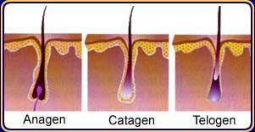
Hair Growth
Terminology
Anagen—hair that is actively growing; lasting up to 5 years. 80-90% of follicles at any given time.
Catagen—hair is not growing; a resting phase; lasts about 3 weeks.
Telogen—hair that is dying and ready to fall out; lasting two to six months. 8-10% follicles are in this stage. Root will look like a white bulb due to lack of pigment. (telogen effluvium – pregnant women)
Grows about 0.5 mm per day or 1 centimeter per month; approximately one half inch per month
*

Slide 35
The Root
Human roots look different based on whether they have been:
1. forcibly removed or are
2.telogen hairs and have fallen out.
Animal roots will vary, but in general have a spear shape.
Forcibly removed
Fallen out

Slide 36
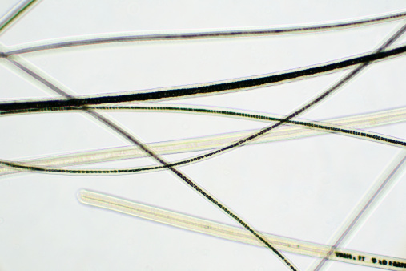
Different hairs from the same body region of a person exhibit variation in microscopic characteristics and features.
it is important to obtain a sufficient number of hairs in order to adequately represent the range of all characteristics present

Slide 37
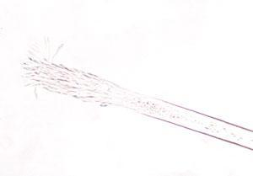
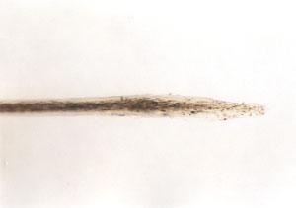
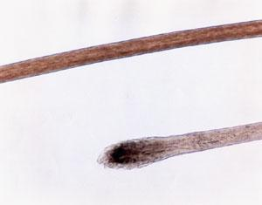
Species ID using the Root
Cat hair: elongated with frayed
ends
Dog hair: spade shaped
Human hair: spade shaped
*

Slide 38
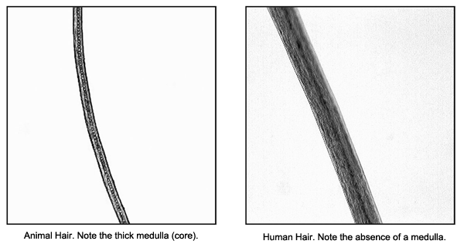
Hair Comparison
Color
Length
Diameter
Distribution, shape and color intensity of pigment granules
Dyed hair has color in cuticle and cortex
Bleaching removes pigment and gives a yellow tint
Scale types
Presence or absence of medulla
Medullary type
Medullary pattern
Medullary index
*

Slide 39
The hair shaft contains abundant mitochondrial DNA, inherited only from the mother.

Slide 40
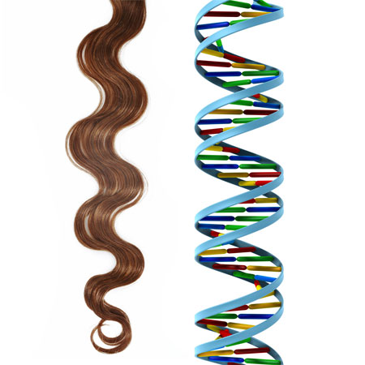
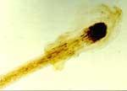
DNA from Hair
The root contains nuclear DNA.
If the hair has been forcibly removed, some folicular tissue may be attached containing DNA.
*

Slide 41
Hair Toxicology
Advantages:
Easy to collect and store
Is externally available
Can provide information on the individual’s history of drug use or of poisoning.
Collections must be taken from different locations on the body to get an accurate timeline.
*

Slide 42
Hair Toxicology
Drugs flow from bloodstream to follicle and then move with hair growth.
Darker, coarser hair retains drugs more.
Can provide information on the individual’s history of drug use or of poisoning.
Collections must be taken from different locations on the body to get an accurate timeline.

Slide 43
Hair Toxicology
Napoleon died in exile in 1821.
By analyzing his hair, some investigators suggest he was poisoned by the deliberate administration of arsenic;
others suggest that it was vapors from the dyes in the wallpaper that did him in.
*

Slide 44
Hairs found on a bloody knife at a homicide scene.

Slide 45
Photomicrograph of hair fragment with blood crust

Slide 46
Link to More Hair Info.
Microscopy of Hair Part II: A Practical Guide and Manual for Animal Hairs
http://www.fbi.gov/hq/lab/fsc/backissu/july2004/research/2004_03_research02.htm
*

Slide 47
http://www.cengagesites.com/academic/assets/sites/4827/chapter3_bertino.pdf
Hair chapter website

Slide 48
More about Hair
For additional information about hair and other trace evidence, check out Court TV’s Crime Library at:
www.crimelibrary.com/criminal_mind/forensics/trace/1.html

