Slide 1
Crime Labs & LAWS

Slide 2
Deductive vs. Inductive Reasoning
Deductive reasoning – ability to make a specific conclusion based upon known general premise. General to specific.
Ex: Footprints cross over one another so prints on bottom came 1st.
Inductive reasoning – ability to generalize based upon a specific observation. Specific to general
Ex: Find a stethoscope at a scene, therefore crime committed by a medical person.

Slide 3
Laws that Pertain to the U.S. Criminal Justice System
The U.S. Constitution – overarching laws for the whole country. Overrules the Constitutions of the individual states.
Statutory Law – written laws or codes declaring, commanding or prohibiting something and is created by the government. Based on the Constitution.
Common Law or Case Law – made by judges. Precedents are set in appellate court. Stare decisis –”to stand by a decision”. Makes for consistency in how law is applied.

Slide 4
Laws that Pertain to the U.S. Criminal Justice System
Civil Law – laws established to deal with relationships between individuals. Ex: property, marriage, contracts and businesses.
Criminal Law – laws meant to protect the rights of individuals.
Equity Law – laws for cases not covered by common law. Ex: injunctions, restraining orders.
Administrative Law – rules or laws established by agencies such as the IRS, Social Security Administration, or branches of the military

Slide 5
Miranda v Arizona
In 1963, Ernesto Miranda, a 23 year old mentally disturbed man, was accused of kidnapping and raping an 18-year-old woman in Phoenix, Arizona.
He was brought in for questioning, and confessed to the crime. He was not told that he did not have to speak or that he could have a lawyer present.
At trial, Miranda's lawyer tried to get the confession thrown out, but the motion was denied.
The case went to the Supreme Court in 1966. The Court ruled that the statements made to the police could not be used as evidence, since Mr. Miranda had not been advised of his rights.

Slide 6
Types of Crimes:
Violation = a broken law and can be a minor or major crime
Infraction - minor offense. Ex: jaywalking, traffic violations and littering. Penalty is generally a fine.
Misdemeanors – punishable by no more than 1 year in jail. Fines range from $250 to $2,500 and sometimes include community service. Ex: first offense of drunk driving, vandalism, assault, and prostitution. Cases heard by district court.
Felonies – more serious crimes. Generally transferred to circuit court. Ex: rape, homicide, arson, aggravated assault, burglary, robbery. Punishments range from five years up to life and may include the death penalty. Fines up to $100,000

Slide 7
Major Crime Laboratories
FBI
DEA
ATF
U.S. Postal Service
U.S. Fish and Wildlife Service
Target’s Crime Lab:
https://www.youtube.com/watch?v=NleXS2d53Is

Slide 8
https://www.youtube.com/watch?v=NleXS2d53Is

Slide 9
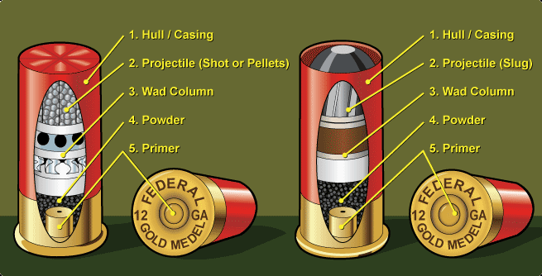
1784 Lancaster, England
John Toms Murder Conviction
Pistol wad

Slide 10
http://www.awarenesstest.co.uk/
http://www.theinvisiblegorilla.com/videos.html

