Slide 1
EVIDENCE
Anything that tends to prove or disprove an alleged fact.

Slide 2
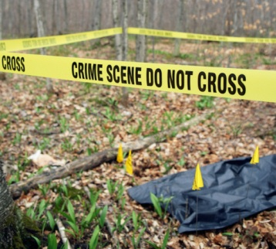
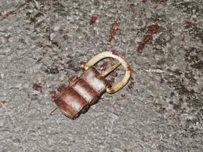
II. Physical Evidence
Types of Common Physical Evidence
drugs fibers paints soil, glass gunshot residue blood firearms body fluids impressions fingerprints hair tissues alcohols pollen bones feathers explosive residues serial numbers documents resins, plastics
any object or material that is relevant in a crime.

Slide 3
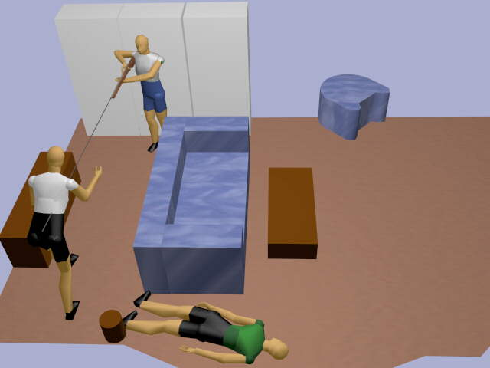
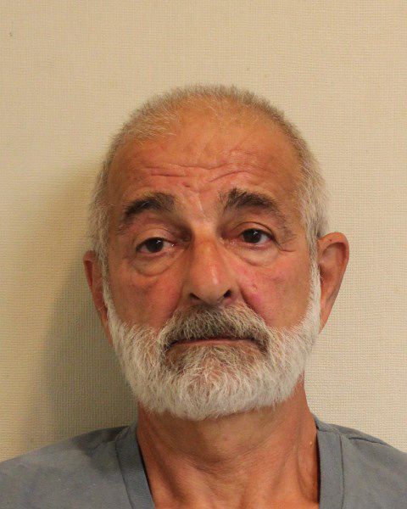
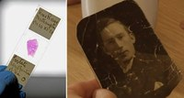
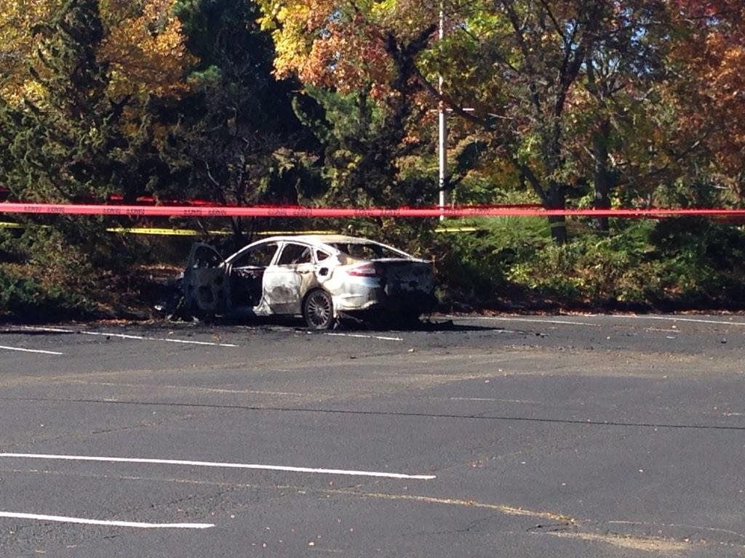
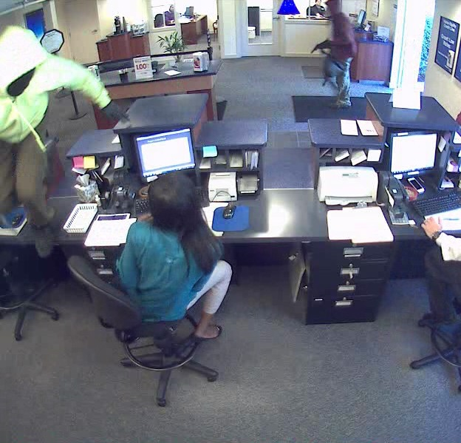
Physical Evidence Purpose
Proves that a crime has been committed
Links suspect with victim or crime scene
Provides new leads
Corroborates statements/testimony
Allows reconstruction of events of crime
Establishes identity of person associated with crime
A 65-year-old Monroe man, whose violent crimes have spanned three decades and as many states, was ordered Tuesday held in lieu of $1 million in connection with a Trumbull bank robbery and carjacking.
In his wallet police found more than $600 in 20-dollar bills that police said was part of the loot from the robbery.
Bratsenis served twenty years for attempted murder in 1984 out of Meriden and has bank robbery convictions in New York and Pennsylvania, according to the Connecticut Post.

Slide 4
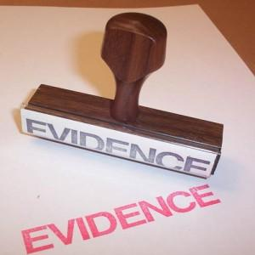
Federal Rules of Evidence
In order for evidence to be admissible, it must be:
Probative—actually prove something
Material—address an issue that is relevant to the particular crime

Slide 5
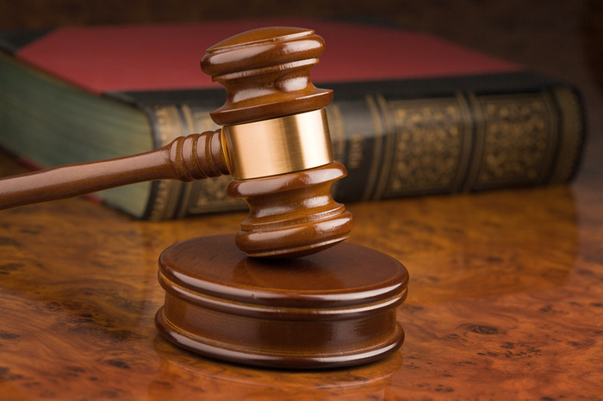
Is it Admissible?
Governed by two legal decisions

Slide 6
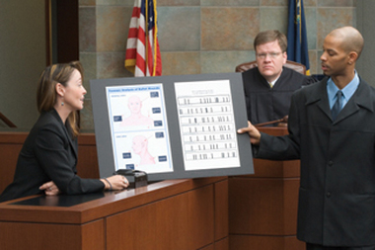
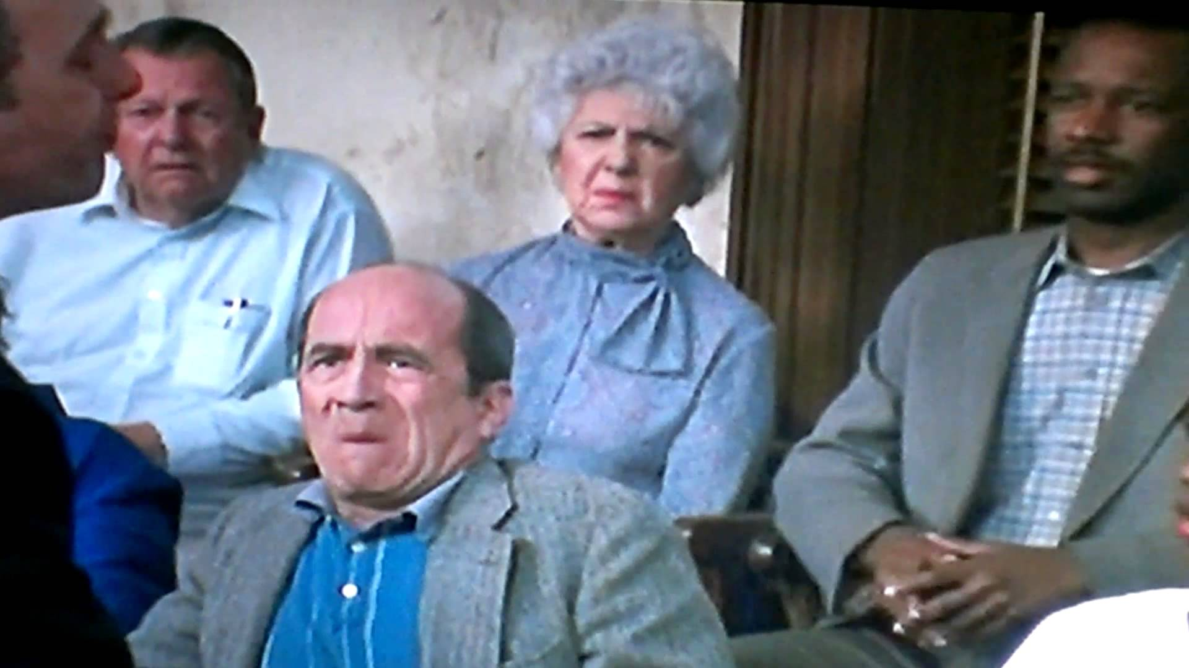
1923 Frye v. United States
Scientific evidence is allowed into the courtroom if it is:
generally accepted by the relevant scientific community.
NO guidance on reliability.
evidence is presented, jury decides if used

Slide 7
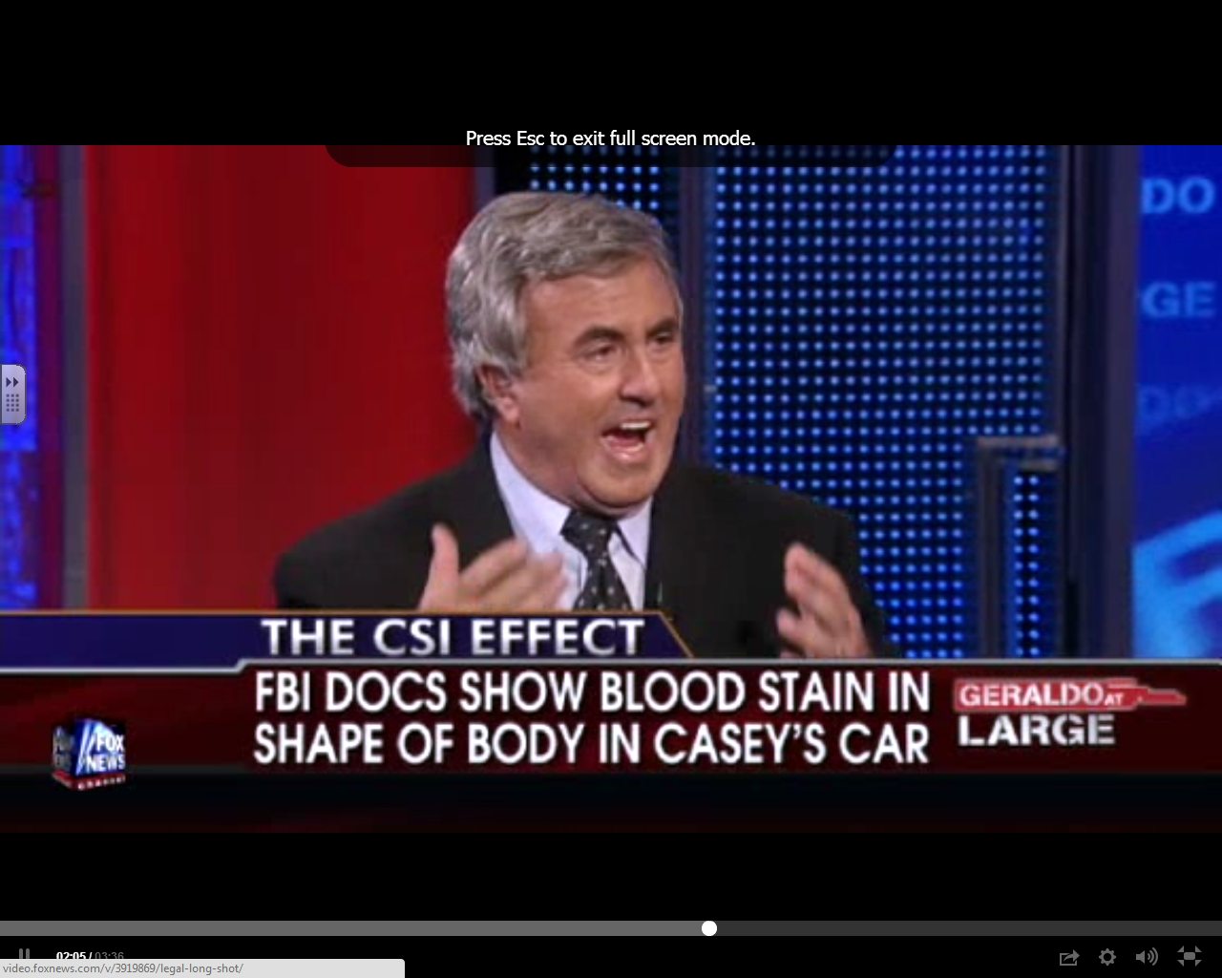
Frye Standard
Evidence must be given by an expert witness and has “general acceptance.”
http://www.foxnews.com/topics/casey-anthony.htm

Slide 8
Frye Standard
It must be accepted by a meaningful segment of the scientific community
http://www.cnn.com/2011/CRIME/07/15/casey.anthony.forensic.evidence/
http://en.wikipedia.org/wiki/Death_of_Caylee_Anthony#Evidence

Slide 9
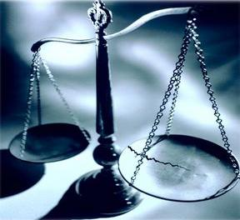
1993 Daubert v. Merrell Dow Pharmaceuticals
Jason Daubert and Eric Shuller were born with limb reduction defects. Their mothers had taken an anti-nausea drug, Bendectin, during pregnancy. They brought a product liability action against the drug's manufacturer, Merrell Dow.
Merrell Dow moved for summary judgment on the ground that plaintiffs had no admissible evidence to establish general causation.
http://homepages.law.asu.edu/~kayed/talks/se-bassv-98/soundness/daubert.htm

Slide 10
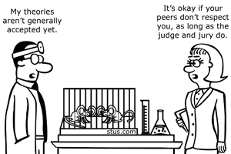
1993 Daubert v. Dow
Admissibility is determined by:
can it be tested?
offered for peer review?
rate of error is acceptable?
The method has widespread acceptance?
the opinion is relevant to the issue?
The judge decides if the evidence can be entered into the trial.

Slide 11
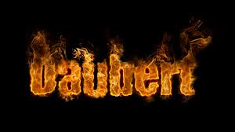
States Frye standard is not an absolute requirement for admissibility of scientific evidence
Only applies to Federal Court
Trial judge determines responsibility for admissibility of evidence

Slide 13
Guidelines for Judgment of Admissibility of Evidence of Daubert Ruling
The scientific theory or technique must be testable
The theory or technique must be subject to peer review and publication
Rate of error or potential errors must be stated
The technique must follow actual standards
The theories or techniques used must have widespread acceptance within a relevant scientific community

Slide 14
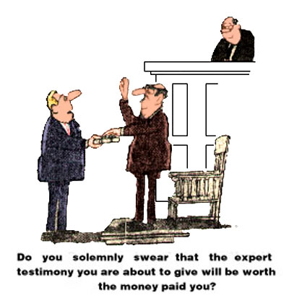

Slide 15
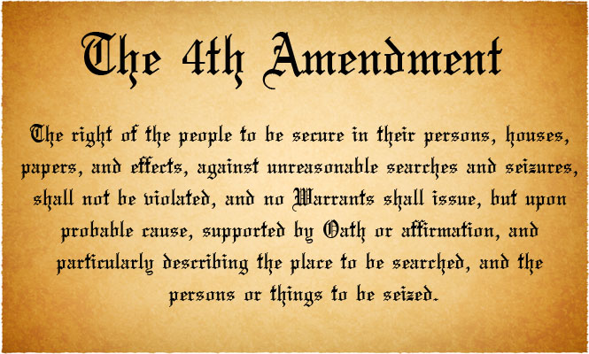
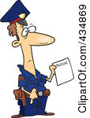
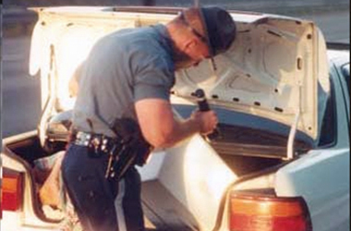
Search Warrants
“probable cause”
“affidavit”
judge approve the warrant
time limits on search warrants
When evidence is obtained without a search warrant: must show that the evidence was obtained under one of the “established and well delineated exceptions”

Slide 16
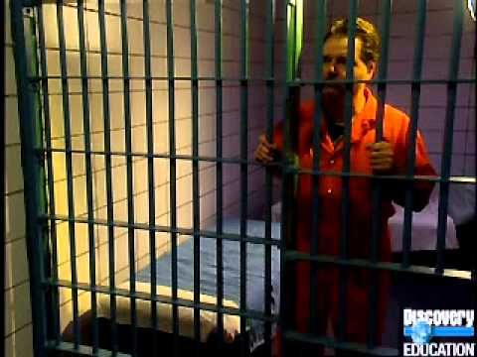
Value of Physical Evidence:
Generally more reliable than testimonial
Can prove that a crime has been committed
Can corroborate or refute testimony
Can link a suspect with a victim or with a crime scene
Can establish the identity of persons associated with a crime
Can allow reconstruction of events of a crime

Slide 17
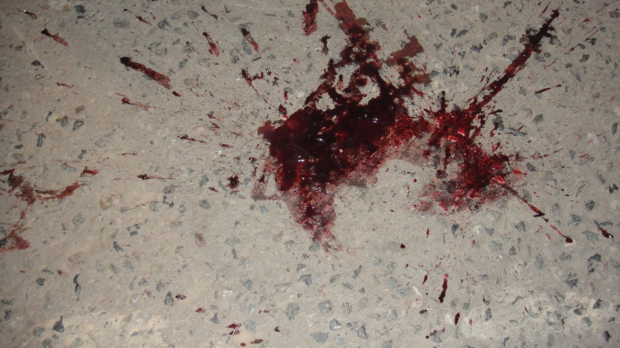
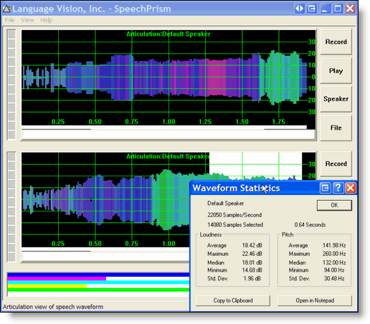
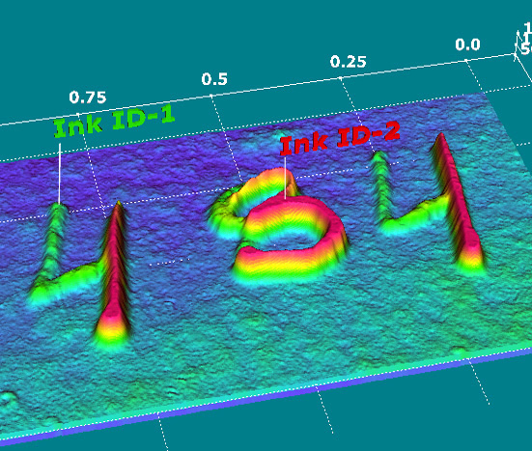
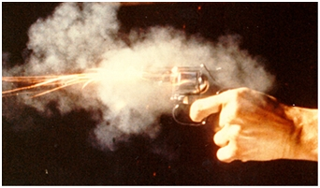
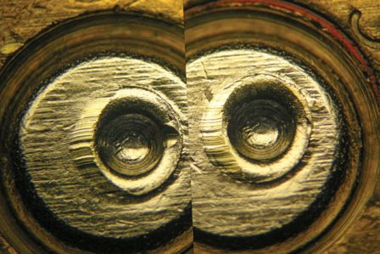
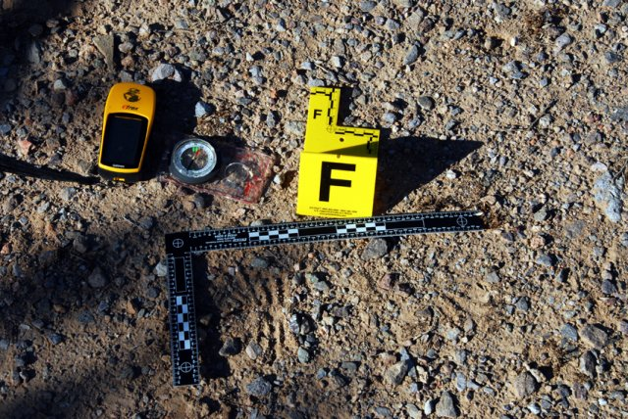
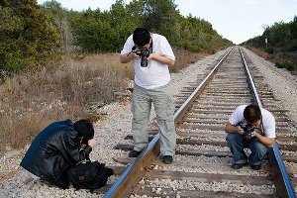
Classification of Evidence by Nature
Biological—blood, semen, saliva, sweat, tears, hair, bone, tissues, urine, feces, animal material, insects, bacterial, fungal, botanical
Chemical—fibers, glass, soil, gunpowder, metal, mineral, narcotics, drugs, paper, ink, cosmetics, paint, plastic, lubricants, fertilizer
Physical science—fingerprints, footprints, shoe prints, handwriting, firearms, tire marks, tool marks, typewriting
Miscellaneous—laundry marks, voice analysis, polygraph, photography, stress evaluation, psycholinguistic analysis, vehicle identification

Slide 19
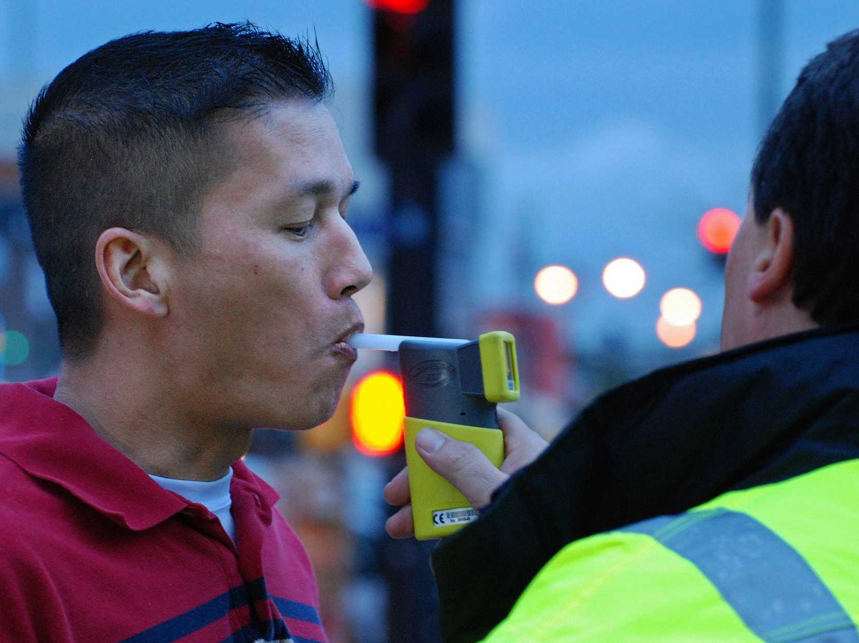
II. Physical Evidence
Most evidence does not prove a fact = indirect evidence
Some physical evidence may be considered proof of fact.
Ex: possessing drugs or driver’s blood-alcohol
greater than 0.10%

Slide 20
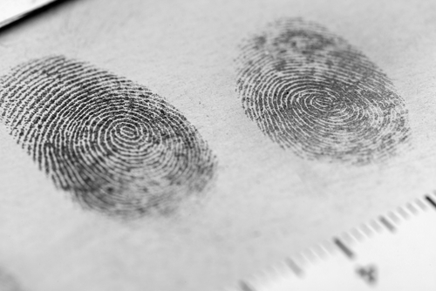
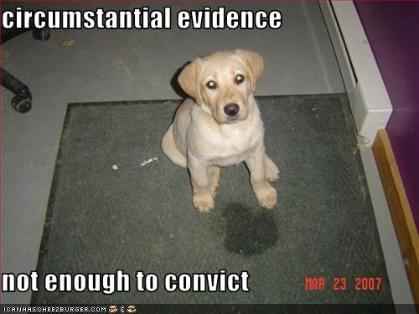
II. Physical Evidence
Circumstantial evidence implies a fact or event.
The greater the volume of circumstantial evidence there is, the greater the weight it carries.
Probability and statistics come into play here.

Slide 21
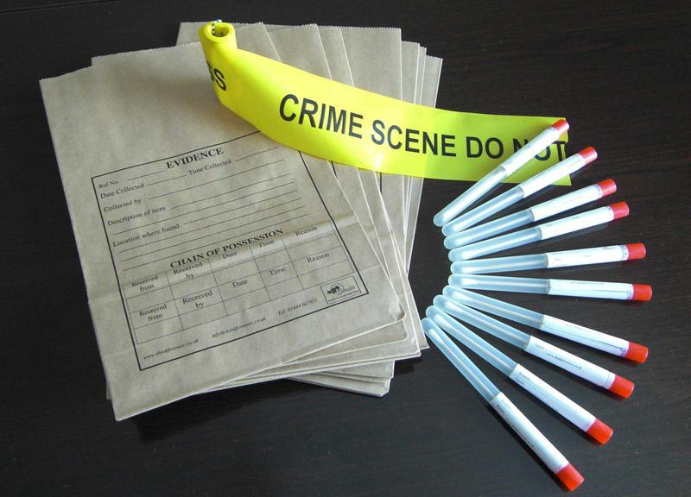
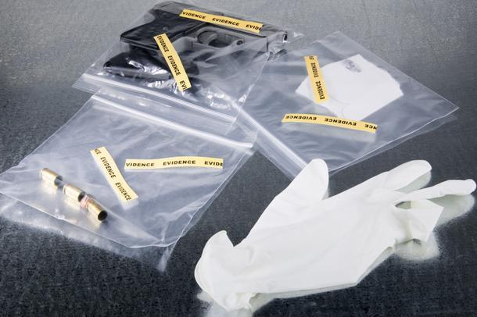
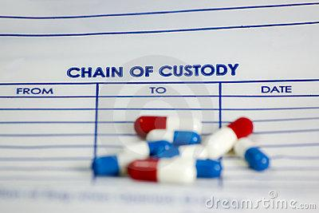
VALUE OF EVIDENCE
DEPENDS ON WHAT HAPPENS TO IT AFTER ITS FOUND.
INTEGRITY OF EVIDENCE – must be the same as when it was found when used in court
CHAIN OF CUSTODY (Evidence) – documentation of what has happened to the evidence from the time it was discovered until it is needed in court.

Slide 22
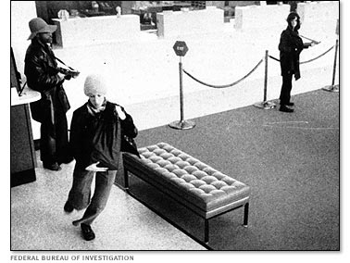
EVIDENCE CLASSIFICATION
DIRECT EVIDENCE –
establishes proof without any other evidence – through an eyewitness or record of a criminal act.
Example - if a witness testifies that the defendant was seen actually stabbing the victim, that is direct evidence.

Slide 23
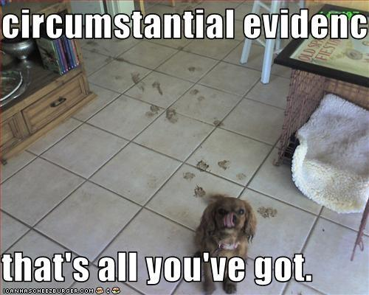
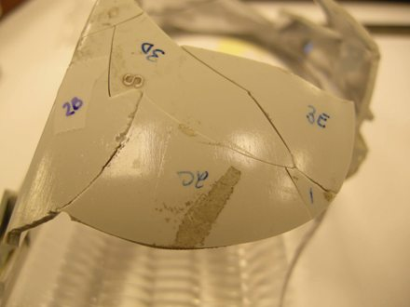
EVIDENCE CLASSIFICATION
INDIRECT EVIDENCE –
Based on one fact being inferred from another fact. (class or individualized)
ex. CIRCUMSTANTIAL EVIDENCE – (an – indirectly establishes the existence of a fact – uses probability

Slide 24
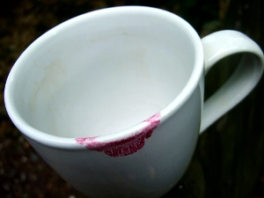
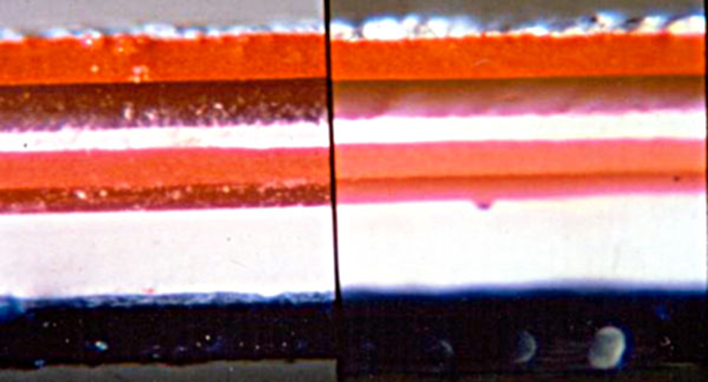
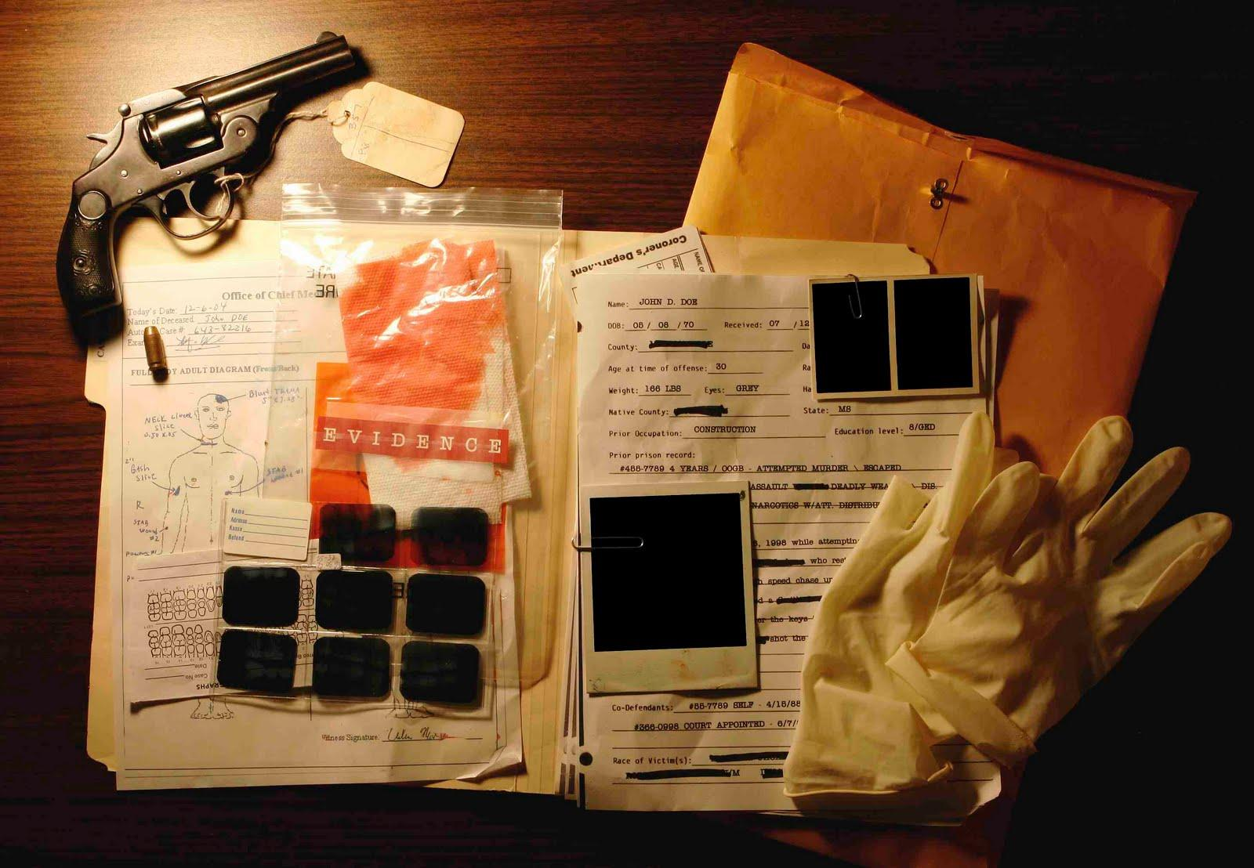
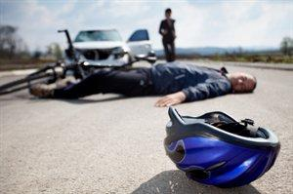
TRACE EVIDENCE – small items
MATERIAL EVIDENCE - evidence that is relevant to the specific case and has an influence on the decision of the case.
PRIMA FACIE EVIDENCE – “at first sight” evidence without proof or reasoning
PROBATIVE EVIDENCE – evidence vital to investigate or prosecute a case - evidence that proves something
EXCULPATORY EVIDENCE – physical evidence that clears a person of blame.
EVIDENCE MUST BE LEGALLY SEIZED AND PROPERLY PROCESSED

Slide 25
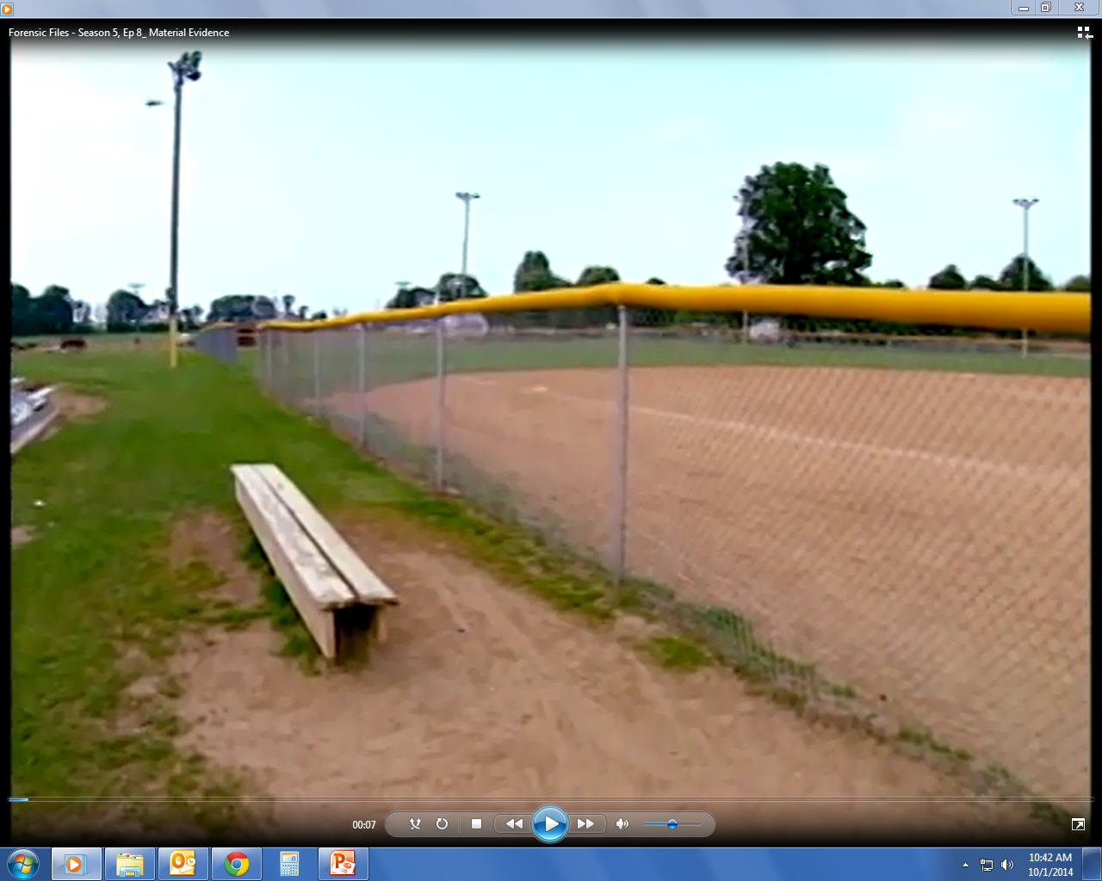
Forensic Files - Season 5, Ep 8_ Material Evidence.mp4

Slide 26
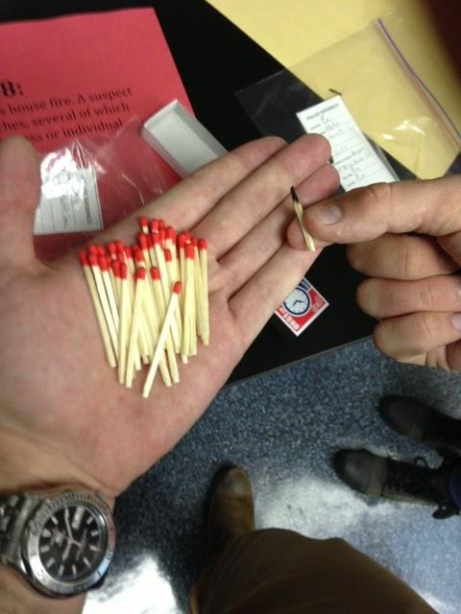
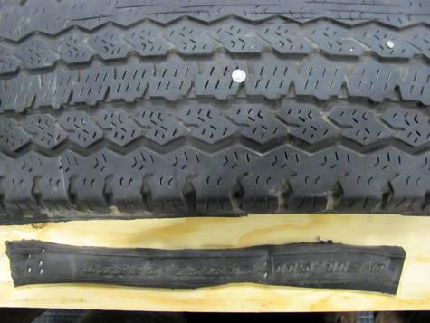
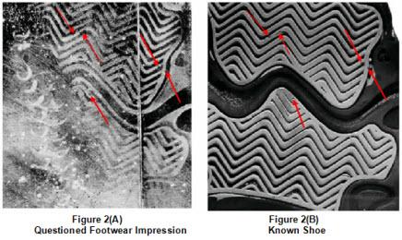
Evidence Characteristics
Class—common to a group of objects or persons. Ex: Hair, fibers, soil, glass fragments

Slide 27
Evidence Characteristics
Individual—can be identified with a particular person or a single source. Involves comparison and can be linked with a high degree of probability
Ex: fingerprints, handwriting, DNA patterns, physical matches, such as a piece of broken glass that fits like a jigsaw puzzle to its mate.
Fingerprints
Blood DNA Typing

Slide 28
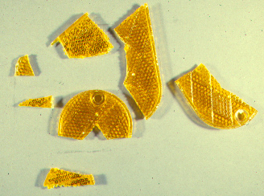
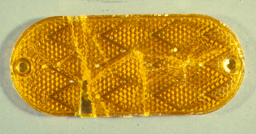
Individualized
This type specifically confirms a link pertaining to Locard’s Principle. Involves comparison.
EXAMPLE – torn fabric to a shirt matches up
_______________________________________

Slide 29
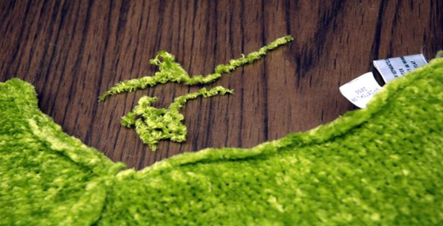
Class
Alone it may not be that powerful but if a lot is admissible it can be convincing.
EXAMPLES – hair, fibers, soil, glass fragments

Slide 30
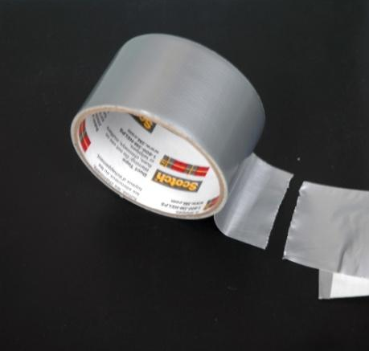
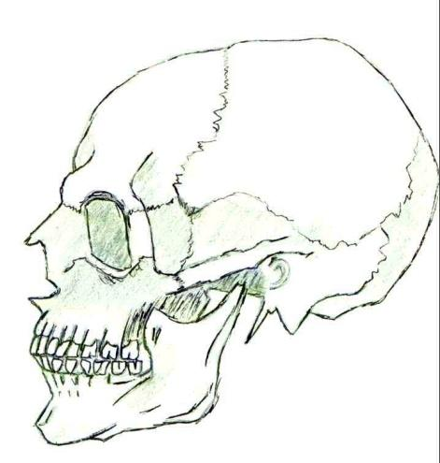
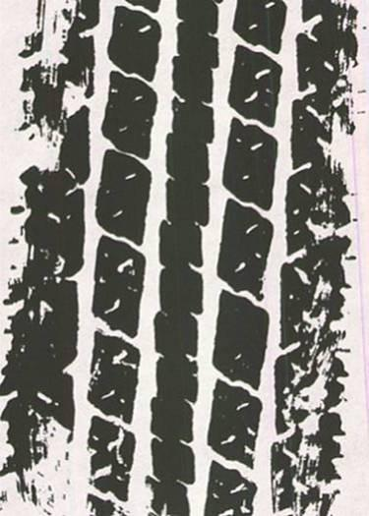
Class or Individual Evidence?
Which examples do you think could be individual evidence?

Slide 31
USES FOR EVIDENCE
PROVIDES PROBABLITIES (fingerprints and DNA)
SOME HAVE IDENTIFICATION MARKS
(tire impressions, bullet marks, torn clothing)
USED FOR COMPARISON (ex. Fingerprints)
HOW EVIDENCE FITS WITH SURROUNDINGS
(man’s handkerchief found in women’s locker room)

Slide 32
PROPER PACKAGING (label and take notes)
AVOID CROSS-CONTAMINATION Of EVIDENCE
PRESERVING OF EVIDENCE – avoid plastic
(Brown paper bags are best)
UV light are useful in finding small evidence
(makes evidence easier to see)
Thermal imaging – detect heat emitted from
substance scientists are looking for.

Slide 33
EQUIPMENT
HAVING CORRECT EQUIPMENT IS IMPORTANT.
IT IS USUALLY CARRIED IN:
POLICE VEHICLE
INVESTIGATOR’S VEHICLE
CRIME VAN – (MOBILE CRIME LAB)
SHOULD HAVE RADIO COMMUNICATION

Slide 34
Forensic Investigations
Include some or all of these seven major activities
1. Recognition—ability to distinguish important evidence from unrelated material
Pattern recognition
Physical property observation
Information analysis
Field testing
2. Preservation—collection and proper preservation of evidence

Slide 35
Investigations
3. Identification—use of scientific testing
Physical properties
Chemical properties
Morphological (structural) properties
Biological properties
Immunological properties
4. Comparison—class characteristics are measured against those of known standards or controls; if all measurements are equal, then the two samples may be considered to have come from the same source or origin.

Slide 36
Investigations
5. Individualization—demonstrating that the sample is unique, even among members of the same class
6. Interpretation—gives meaning to all the information
7. Reconstruction—reconstructs the events of the case
Inductive and deductive logic
Statistical data
Pattern analysis
Results of laboratory analysis
—Lee, Dr. Henry. Famous Crimes, 2001

Slide 37
People in the News
Dr. Henry Lee—Chief Emeritus for Scientific Services and the former Commissioner of Public Safety for the state of Connecticut. He served as that state’s Chief Criminality from 1979 to 2000. Lee was the driving force in establishing the modern forensic lab in Connecticut. He has worked with many high profile cases including O.J. Simpson, Jon Benet Ramsey, and the “wood chipper” case. He is also seen on many of the true crime shows, including his own, “Trace Evidence: The Case Files of Dr. Henry Lee”. Learn more at his website:
www.drhenrylee.com/review.shtml

